Slide 1
XGBoost: A Scalable Tree Boosting System
Tianqi Chen Carlos Guestrin
University of Washington
闫晓芳 10.20

Slide 2


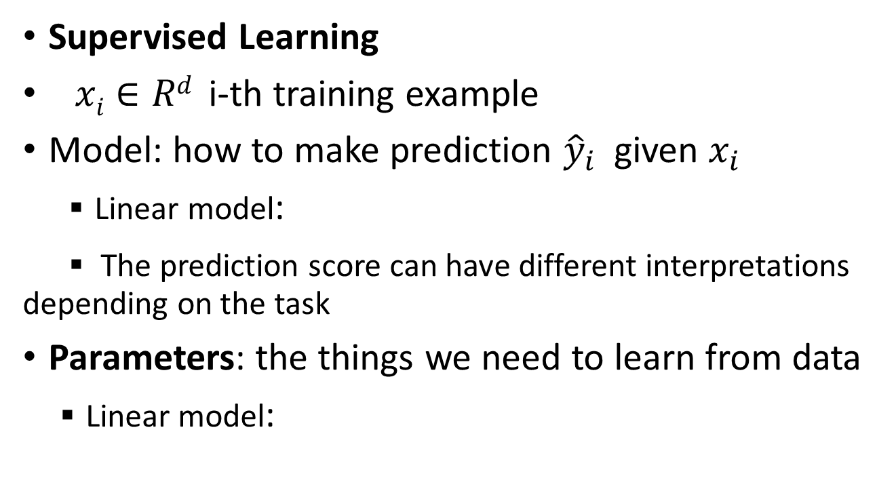
Background
Supervised Learning
$xi∈Rd$ i-th training example
Model: how to make prediction ${\hat{y}}_{i}$ given $x_{i}$
▪ Linear model:
▪ The prediction score can have different interpretations depending on the task
Parameters: the things we need to learn from data
▪ Linear model:

Slide 3




Objective Function
Objective function that is everywhere
Loss on training data:
▪ Square loss:
▪ Logistic loss:
Regularization: how complicated the model is?
▪ L2 norm:
▪ L1 norm (lasso):

Slide 4
Objective and Bias Variance Trade-off
Why do we want to contain two component in the objective?
Optimizing training loss encourages predictive models
▪ Fitting well in training data at least get you close to training data which is hopefully close to the underlying distribution
Optimizing regularization encourages simple models
▪Simpler models tends to have smaller variance in future predictions, making prediction stable

Slide 5
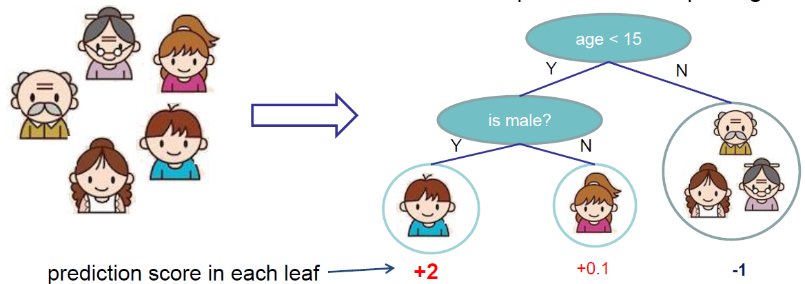
Regression Tree (CART)
Regression tree
▪ Decision rules same as in decision tree
▪ Contains one score in each leaf value
Input: age, gender, occupation, …Does the person like computer games

Slide 6
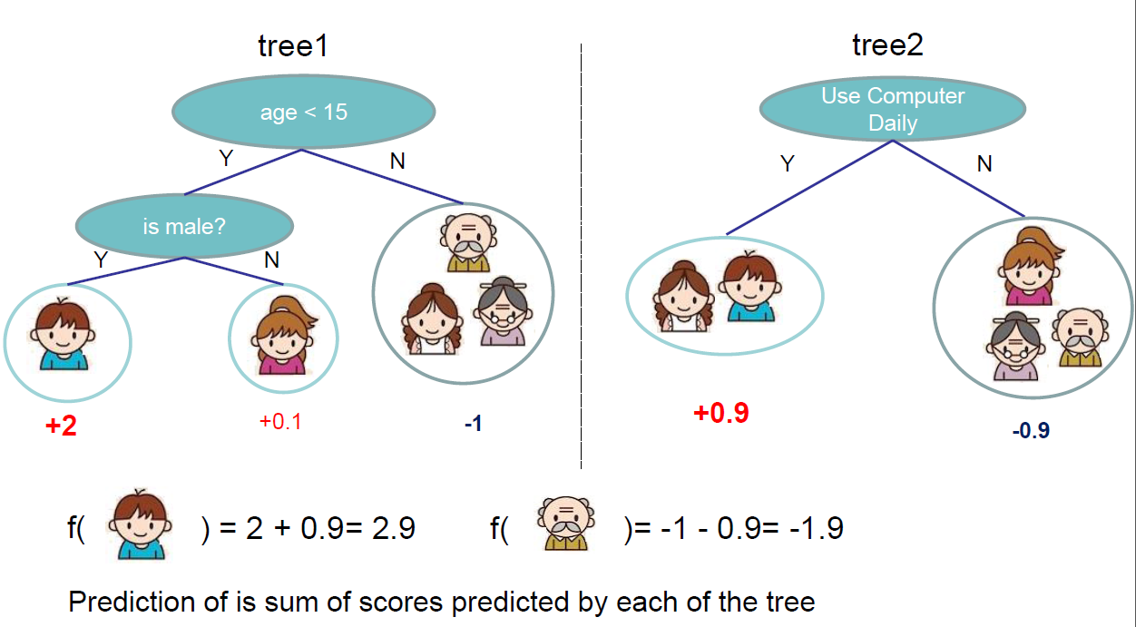
Regression Tree Ensemble

Slide 7
Tree Ensemble methods
Very widely used, look for GB,GBDT, random forest…
▪Almost half of data mining competition are won by using some variants of tree ensemble methods
Invariant to scaling of inputs, so you do not need to do careful features normalization.
Learn higher order interaction between features.
Can be scalable, and are used in Industry

Slide 8
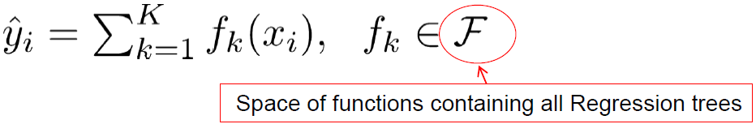


Model and Parameters
Model: assuming we have K trees
Parameters
▪Including structure of each tree, and the score in the leaf
▪ Or simply use function as parameters
▪Instead learning weights in , we are learning functions(trees)

Slide 9

Objective for Tree Ensemble
Objective
Possible ways to define ?
▪Number of nodes in the tree, depth
▪L2 norm of the leaf weights

Slide 10
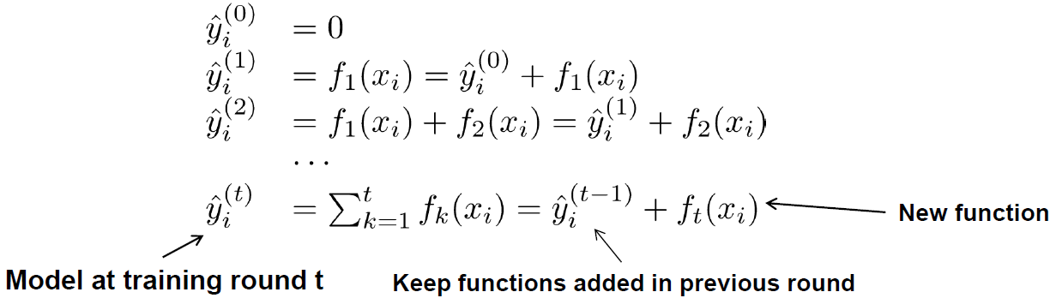
So How do we Learn?
Objective:
We can not use methods such as SGD, to find f (since they are trees, instead of just numerical vectors)
Solution: Additive Training (Boosting)
▪Start from constant prediction, add a new function each time

Slide 11

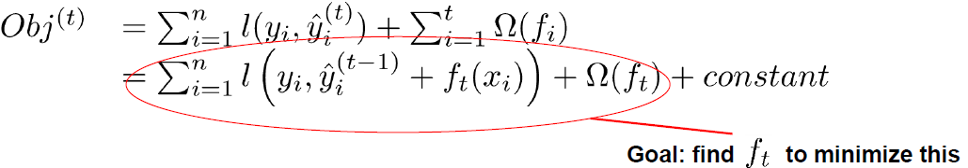
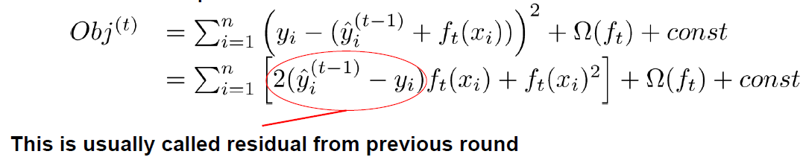
Additive Training
How do we decide which f to add?
▪Optimize the objective!!
The prediction at round t is
Consider square loss

Slide 12

Taylor Expansion Approximation of Loss
Goal
Take Taylor expansion of the objective
▪ Recall
▪Define

Slide 13
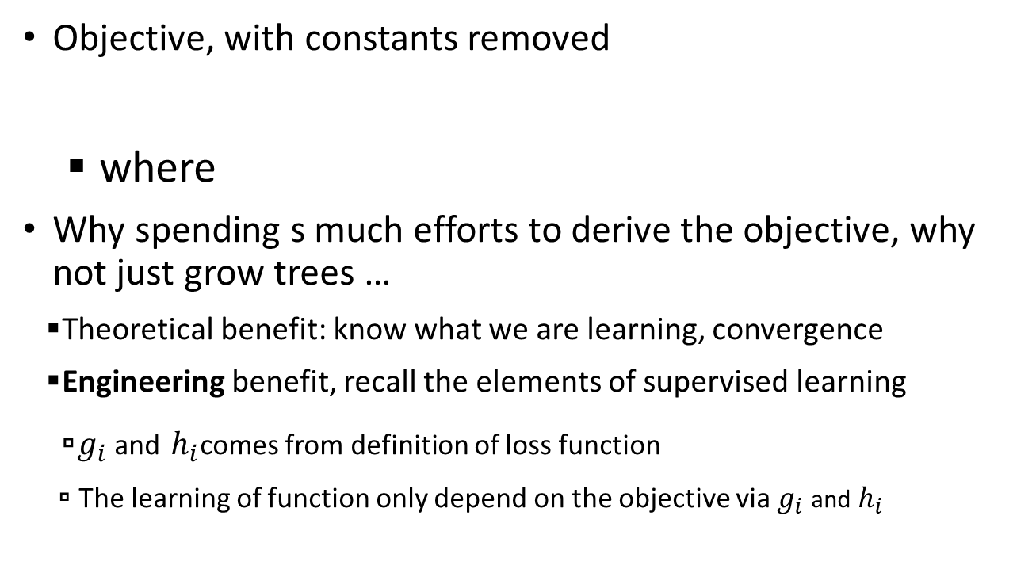
New Goal
Objective, with constants removed
▪ where
Why spending s much efforts to derive the objective, why not just grow trees …
▪Theoretical benefit: know what we are learning, convergence
▪Engineering benefit, recall the elements of supervised learning
▫$g_{i}$ and $h_{i}$comes from definition of loss function
▫ The learning of function only depend on the objective via $g_{i}$ and $h_{i}$

Slide 14
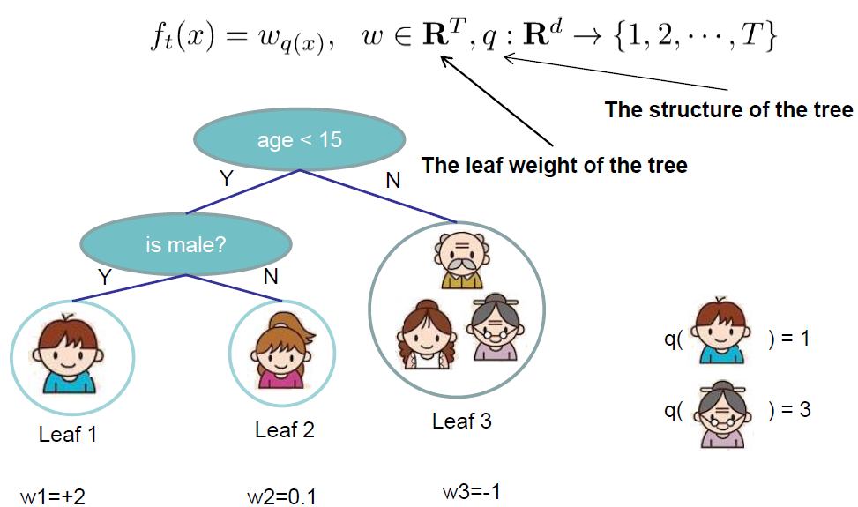
Refine the definition of tree
We define tree by a vector of scores in leafs, and a leaf index mapping function that maps an instance to a leaf

Slide 15
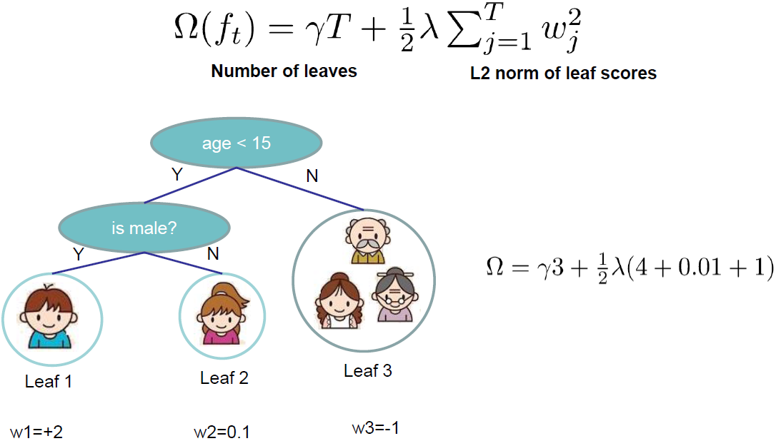
Define Complexity of a Tree
Define complexity as

Slide 16

Revisit the Objectives
Define the instance set in leaf j as
Regroup the objective by each leaf
This is sum of T independent quadratic functions
Notes:
I是样本的集合

Slide 17


The Structure Score
Two facts about single variable quadratic function
Let us define

Slide 18
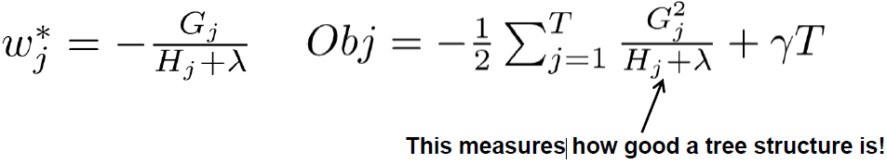
Continue
Assume the structure of tree ( q(x) ) is fixed, the optimal weight in each leaf, and the resulting objective value are

Slide 19

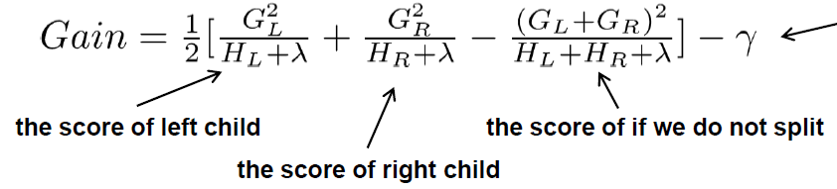
Greedy Learning of the Tree
In practice, we grow the tree greedily
▪ Start from tree with depth 0
▪For each leaf node of the tree, try to add a split. The change of objective after adding the split is

Slide 20
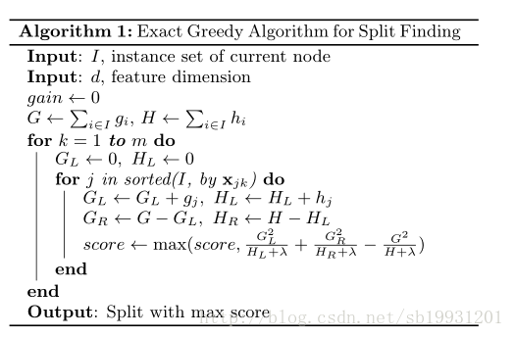
Exact Split Finding
Sort the data according to feature values and visit the data in sorted

Slide 21
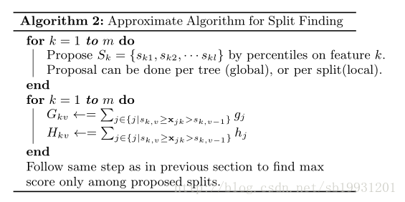
Approximate Split Finding
Candidate splitting points according to percentiles of feature distribution

Slide 22


Candidate split
multi-set:
Rank function:
candidate split points

Slide 23
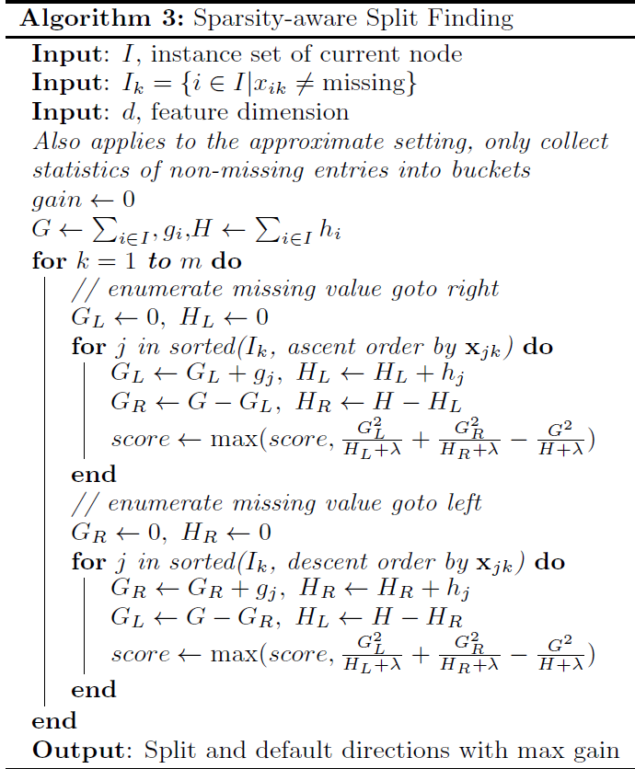
Sparsity-aware Split Finding
Method : add a default direction in each tree node

Slide 24

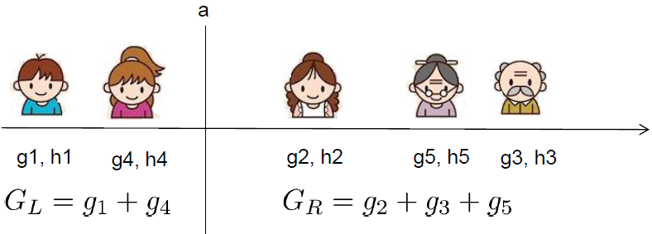

Efficient Finding of the Best Split
What is the gain of a split rule ? Say $x_{i}$is age
All we need is sum of g and h in each side, and calculate
Left to right linear scan over sorted instance is enough to decide the best split along the feature

Slide 25
Summary
The separation between model, objective, parameters can be helpful for us to understand and customize learning models
The bias-variance trade-off applies everywhere, including learning in functional space

Slide 26
Reference
Greedy function approximation a gradient boosting machine. J.H. Friedman
Stochastic Gradient Boosting. J.H. Friedman
Elements of Statistical Learning. T. Hastie, R. Tibshirani and J.H. Friedman
Additive logistic regression a statistical view of boosting. J.H. Friedman T. Hastie R. Tibshirani
Learning Nonlinear Functions Using Regularized Greedy Forest. R. Johnson and T. Zhang
Introduction to Boosted Trees, Tianqi Chen

