Slide 1
An extremely simple introduction to ggplot2
Zhen Cao

Slide 2
Why ggplot2 ?
ggplot2 is based on grammar of graphics, which is quite simple and elegant.
So using ggplot2, it is easy to turn your idea in to a real-world plot within just several seconds.
ggplot2 has well-tuned default parameters, which enables you to make plots of publishable level within several minutes.
Nowadays ggplot2 has a very large community!
Notes:
为什么讲画图？很多学生都是新来的，在没有真正发表一篇文章之前，都不容易理解plot for publish的真正要求
为啥ggplot2?如上

Slide 3
ggplot2 is based on grammar of graphics

Slide 4
Key components of a layered graph

Slide 5
What is the dataset for ggplot2 ? —mpg data
Rows: samples Columns: descriptions

Slide 6
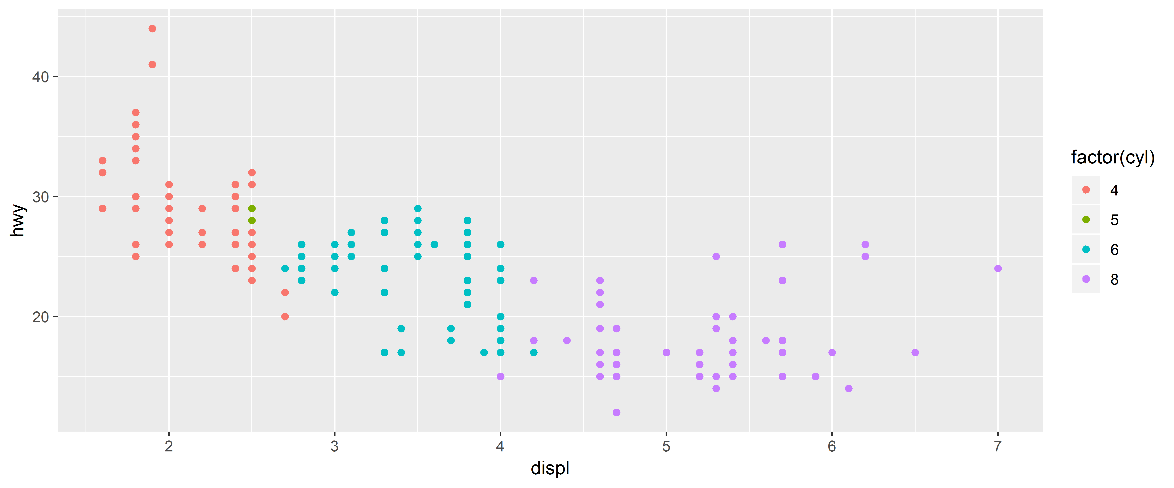
Building a scatterplot
ggplot(mpg, aes(x = displ, y = hwy, color = factor(cyl))) + geom_point()

Slide 7
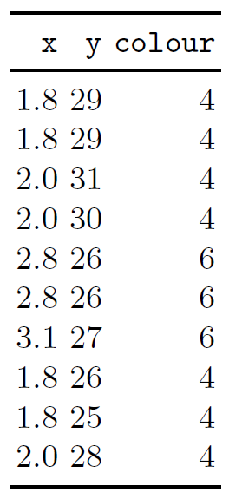
Mapping aesthetics to data
As well as a horizontal and vertical position, each point also has a size, a colour and a shape.
These attributes are called aesthetics, and are the properties that can be perceived on the graphic.
ggplot(mpg, aes(x = displ, y = hwy, color = factor(cyl))) + geom_point()

Slide 8
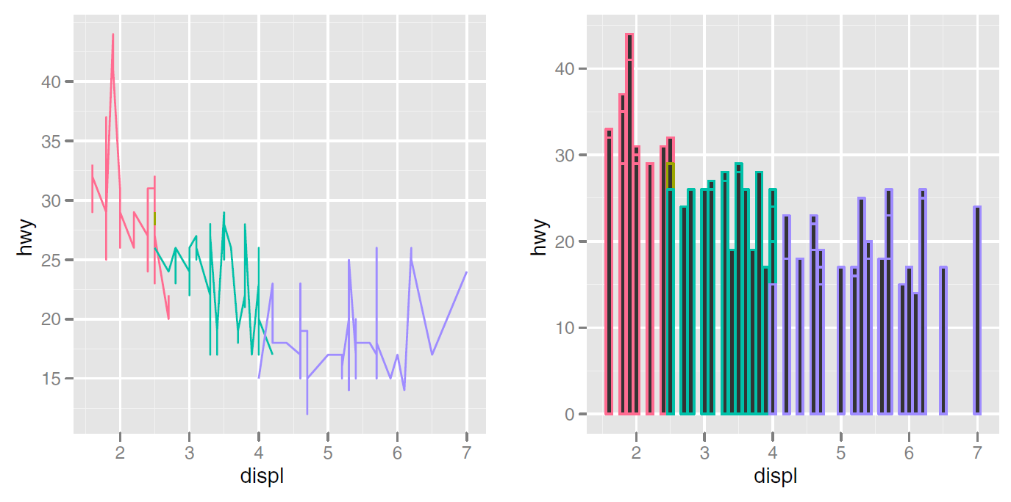
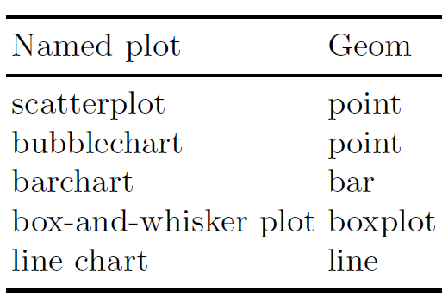
geom—type of the plots
Non-sense, grammatically valid pictures

Slide 9
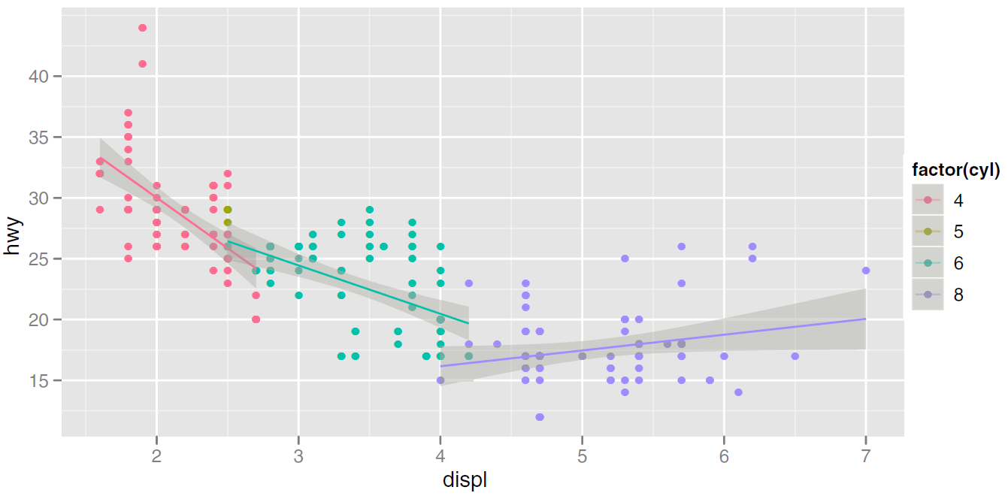
A more complicated picture

Slide 10
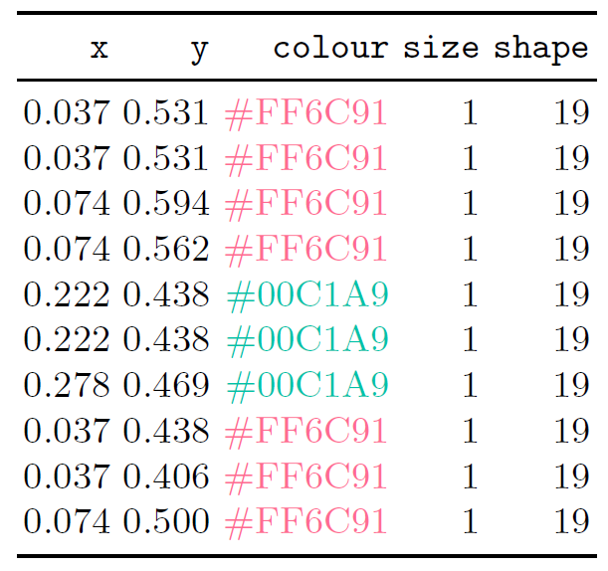
Scaling
The values in previous table have no meaning to the computer.
We need to convert them from data units (e.g., litres, miles per gallon and number of cylinders) to physical units (e.g., pixels and colours) that the computer can display.
Notes:
假定坐标系就是笛卡尔坐标系

Slide 11
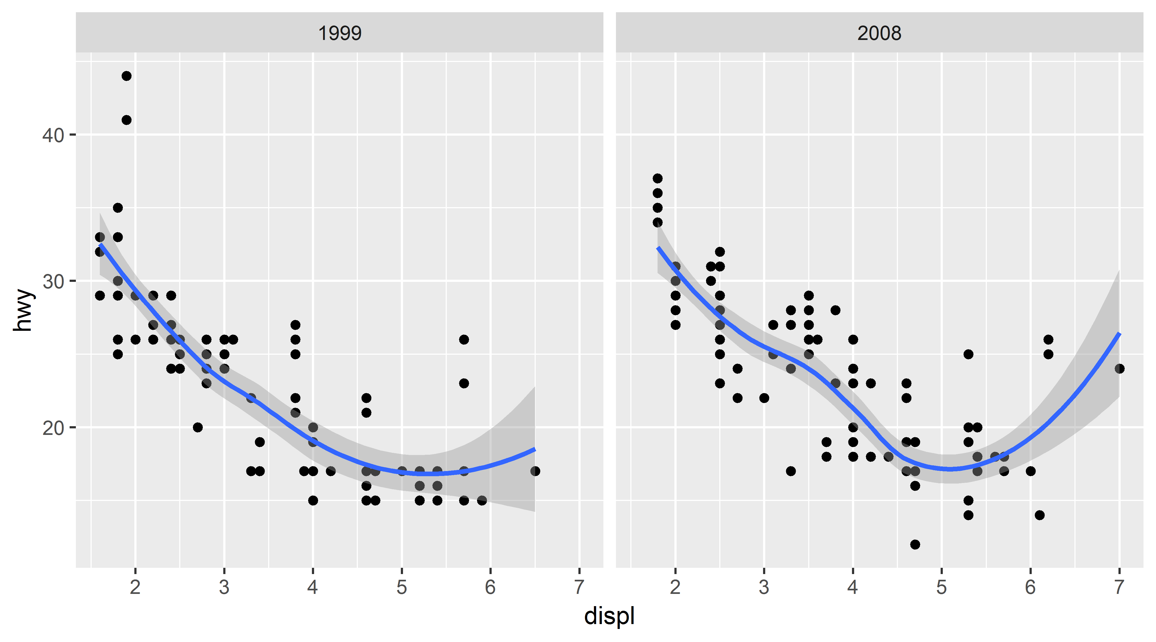
A more complex plot—stat + facet
How is geom_smooth plotted ?
ggplot(mpg, aes(x = displ, y = hwy)) +
geom_point() +
geom_smooth() +
facet_wrap(. ~ year)
Scaling actually occurs in three parts: transforming, training and mapping.

Slide 12
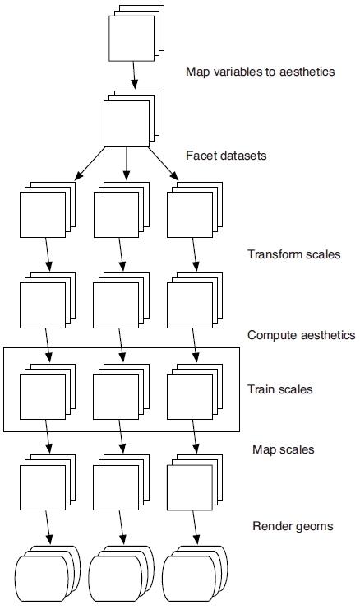
Schematic description of the plot generation process

Slide 13
Components of the layered grammar
Layers
data and aesthetic mapping
a statistical transformation (stat)
a geometric object (geom)
and a position adjustment
Scales
Coordinate system
Faceting
Notes:
请尽量不要用layer函数，新手多用geom_XXX,老手可以用用stat_XXX

Slide 14
Layers: build a plot layer by layer
A standard model
A simple example
ggplot(mpg, aes(x = displ, y = hwy)) +
geom_point(stat = “identity”,
position = “identity”)
ggplot(mpg, aes(x = displ, y = hwy)) +
geom_point() +
geom_line()

Slide 15
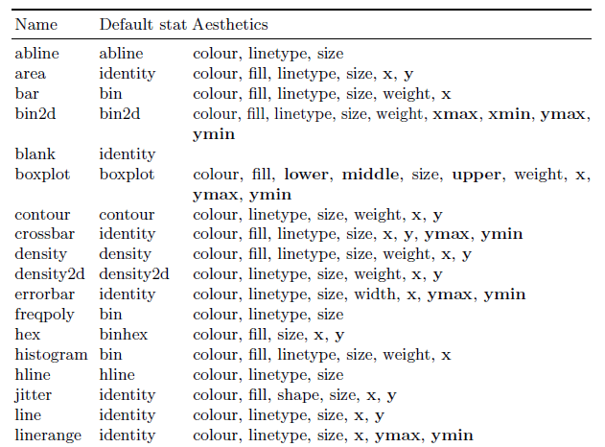
geom with default stat (some examples)

Slide 16
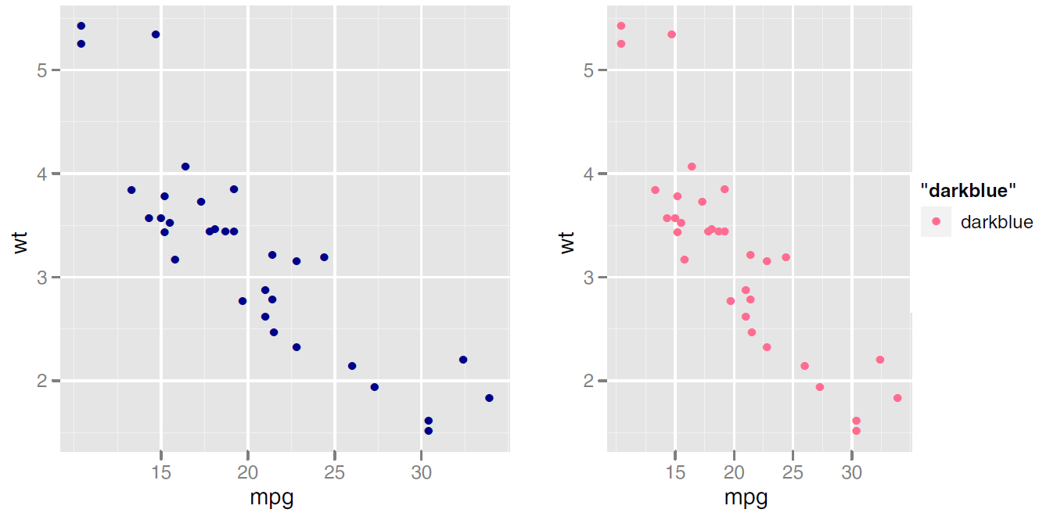
Aesthetic mappings: setting v.s. mapping
p <- ggplot(mtcars, aes(mpg, wt))
p + geom_point(colour = "darkblue")
p + geom_point(aes(colour = "darkblue"))

Slide 17
Position adjustments
stack
fill
dodge

Slide 18
Scales, axes and legends
Usage: scale_xxx_yyy
xxx: x, y, color, fill, linetype
yyy: see the table
Notes:
Scale_xx_manual: 走向高手进阶之路

Slide 19
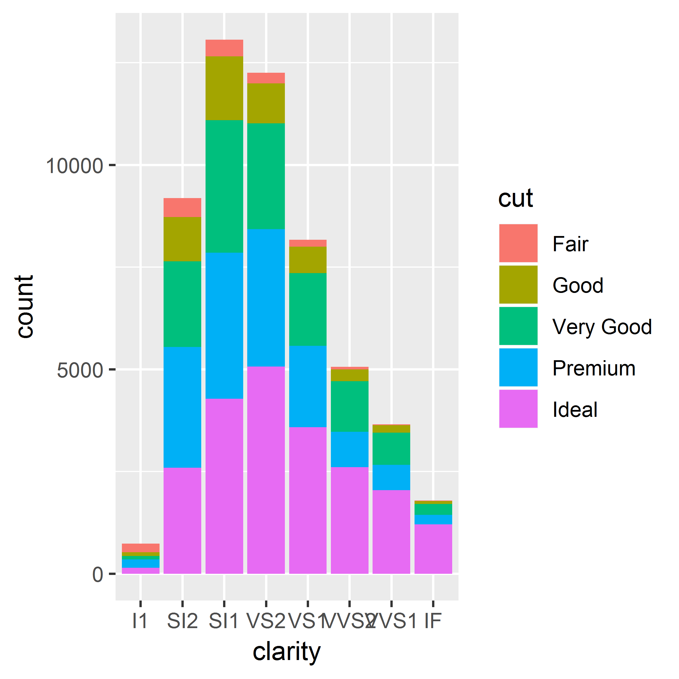
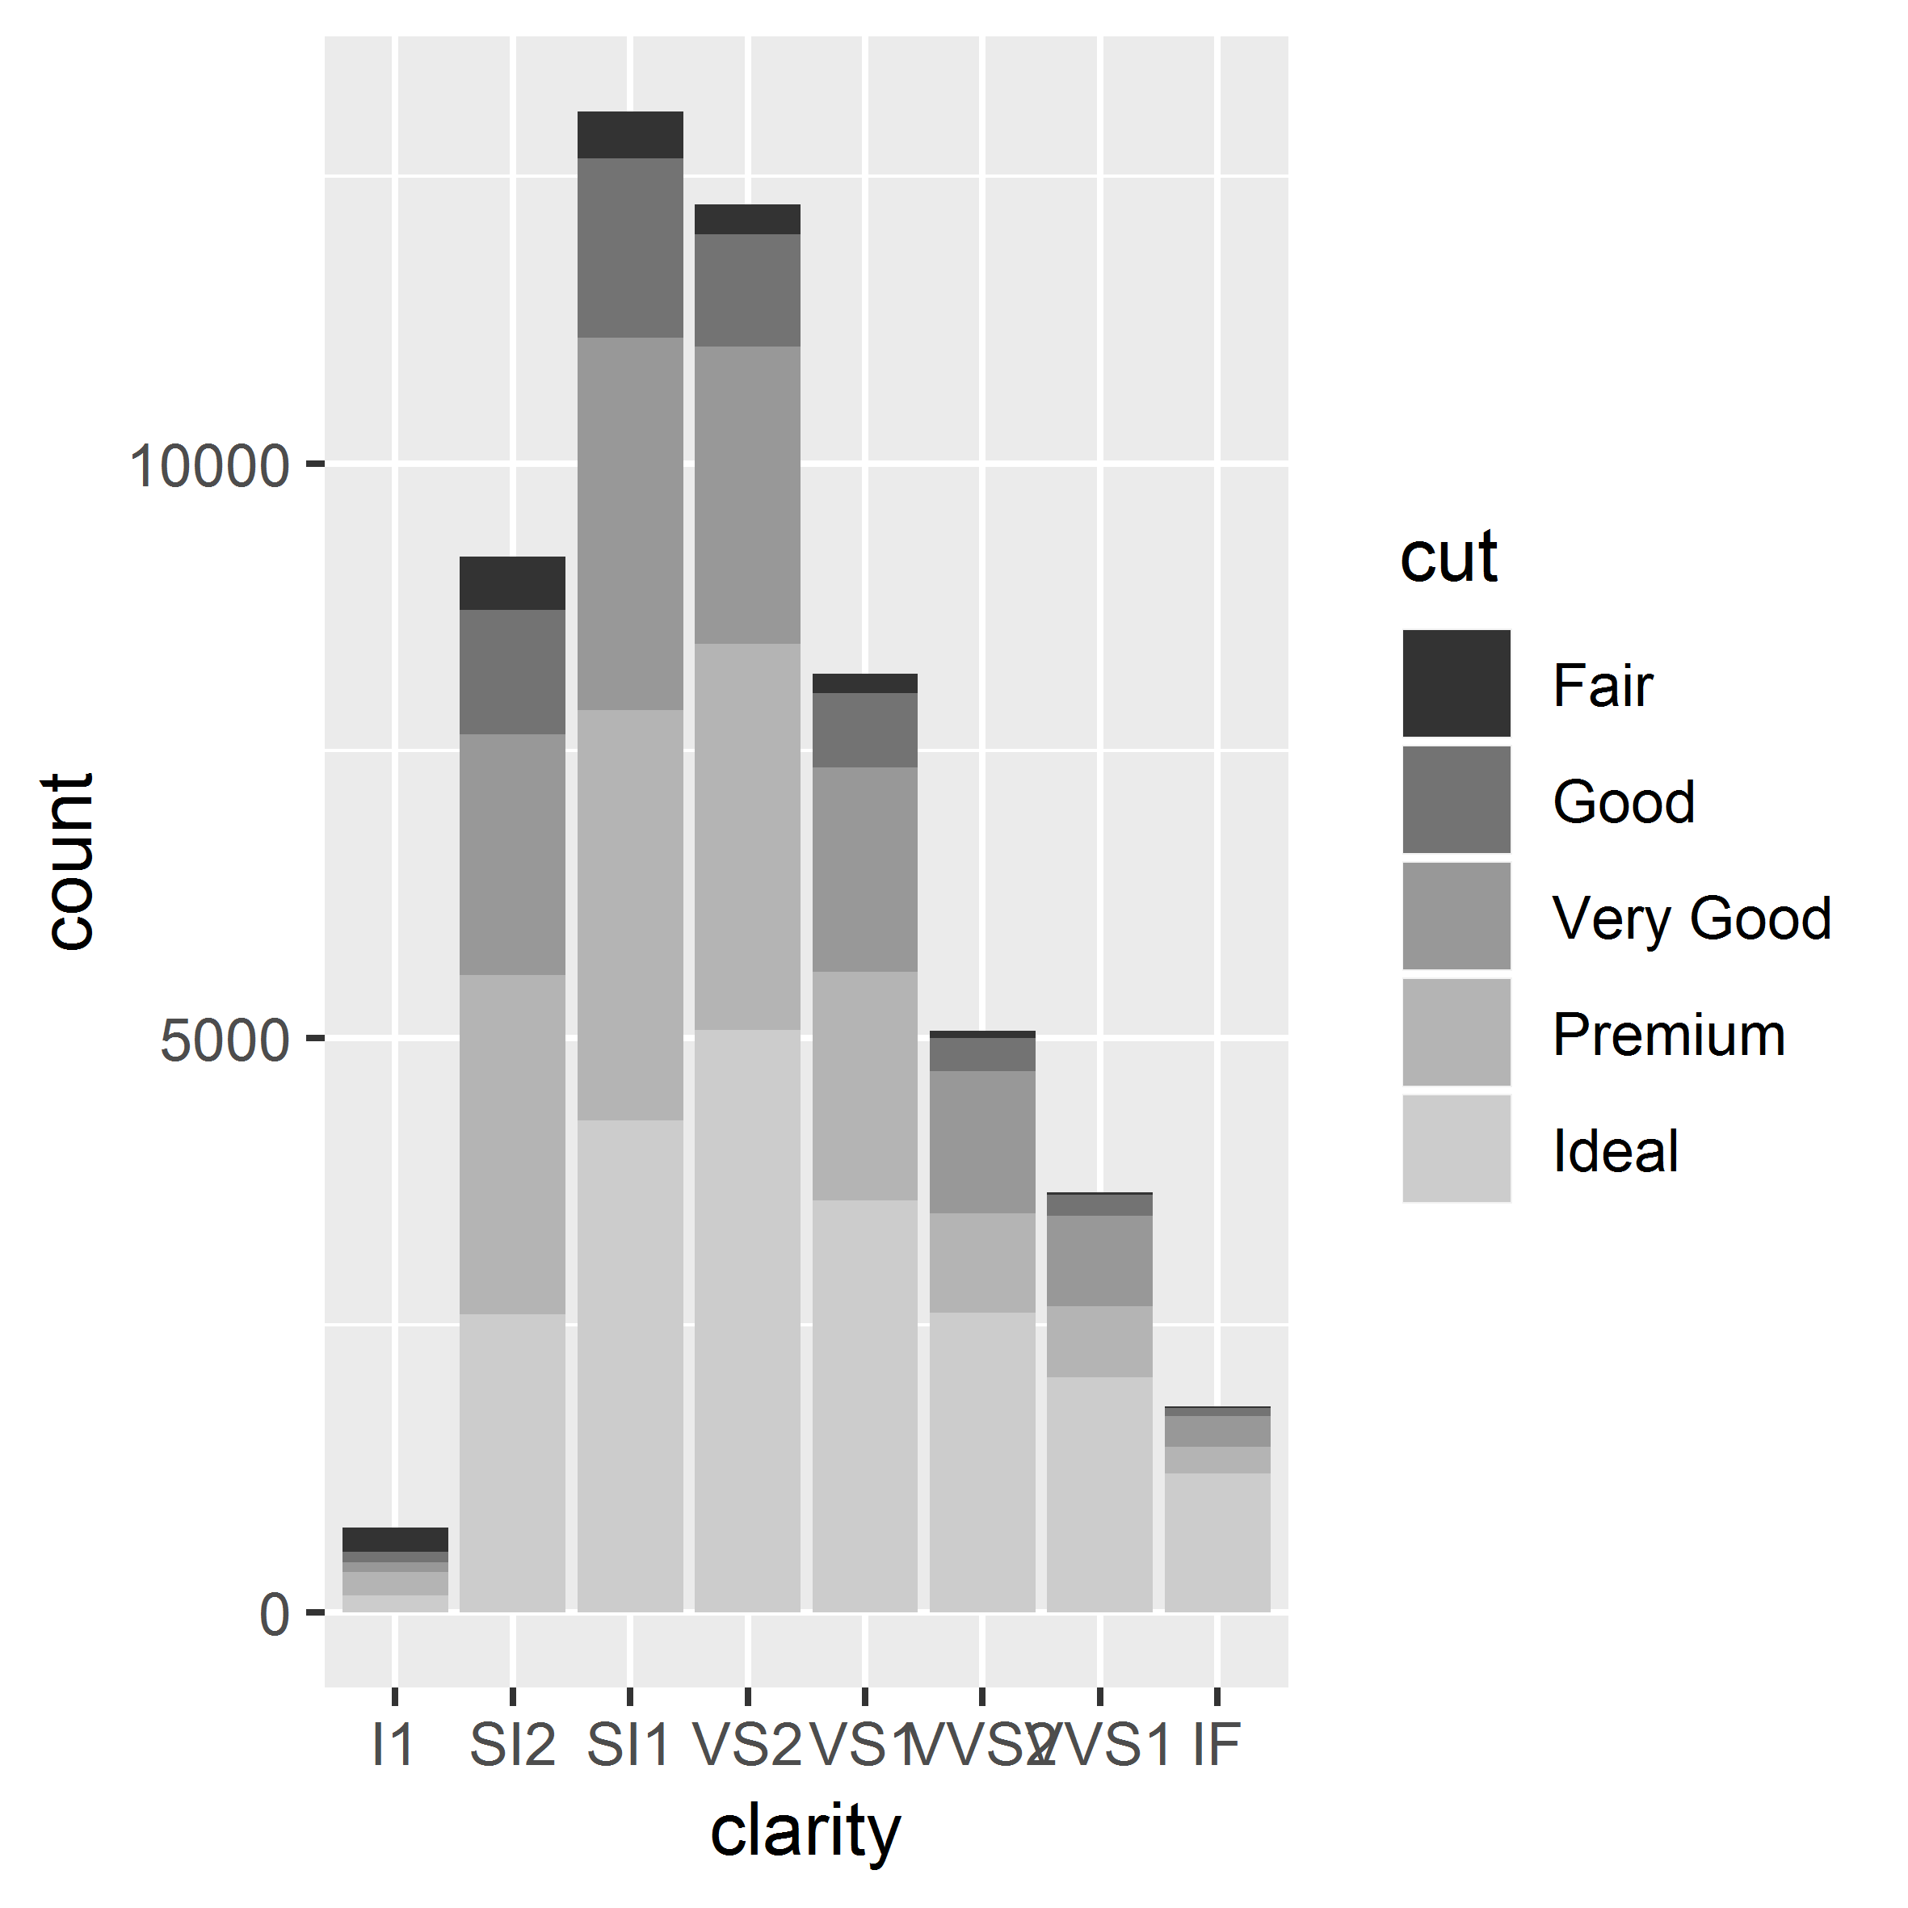
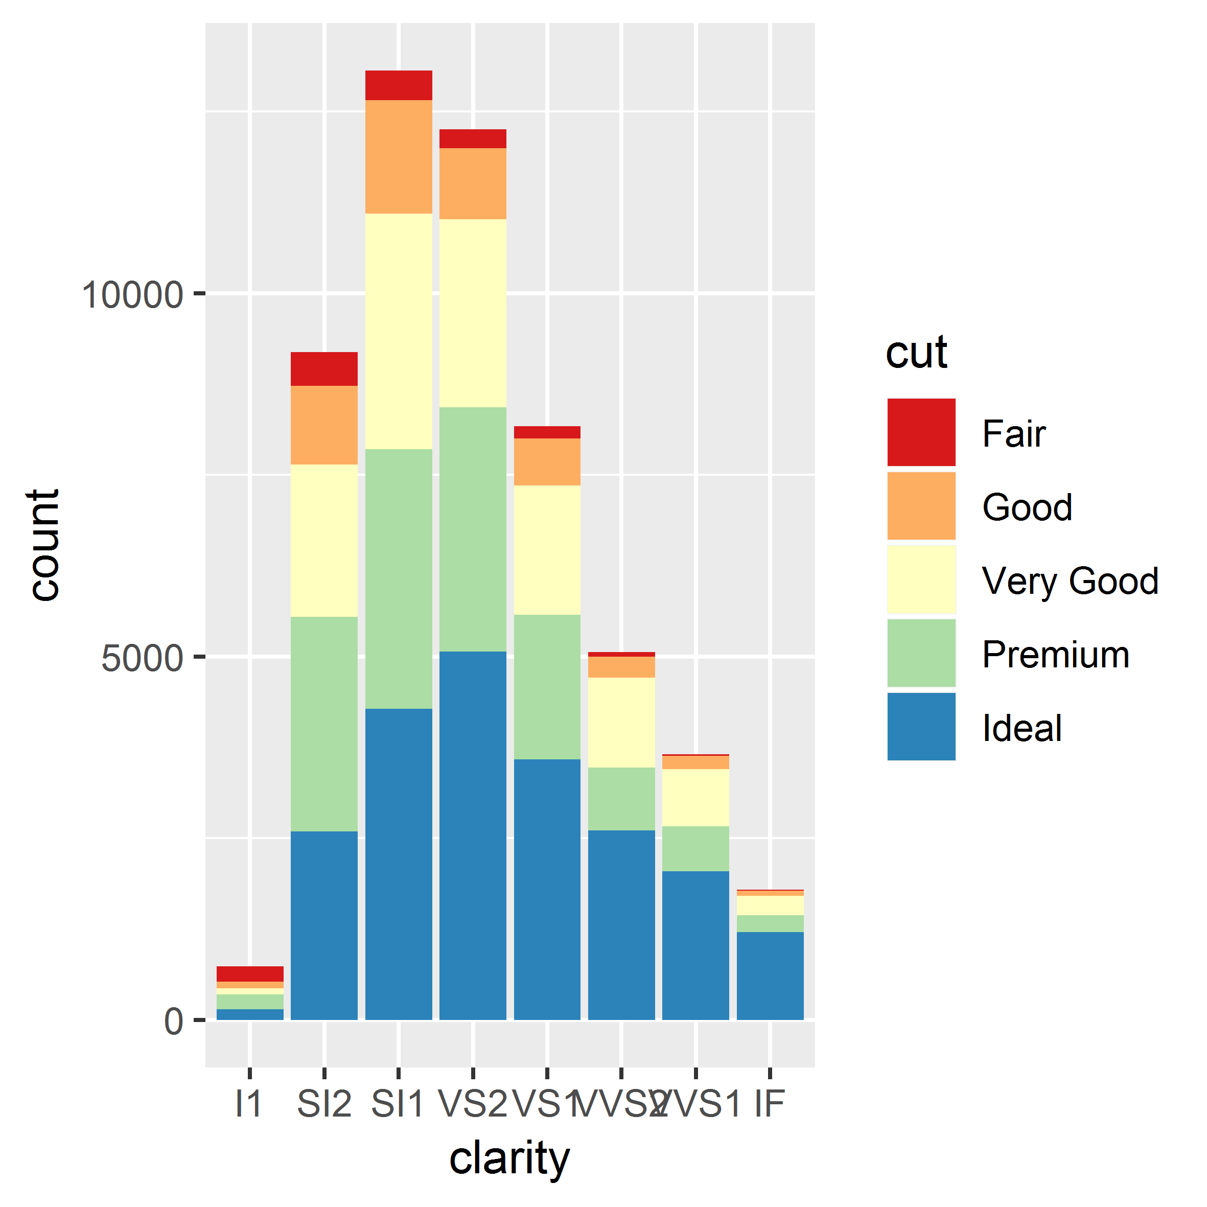
A simple example for discrete color scale
scale_color_hue()
scale_color_grey()
scale_fill_brewer(palette = "Spectral")

Slide 20
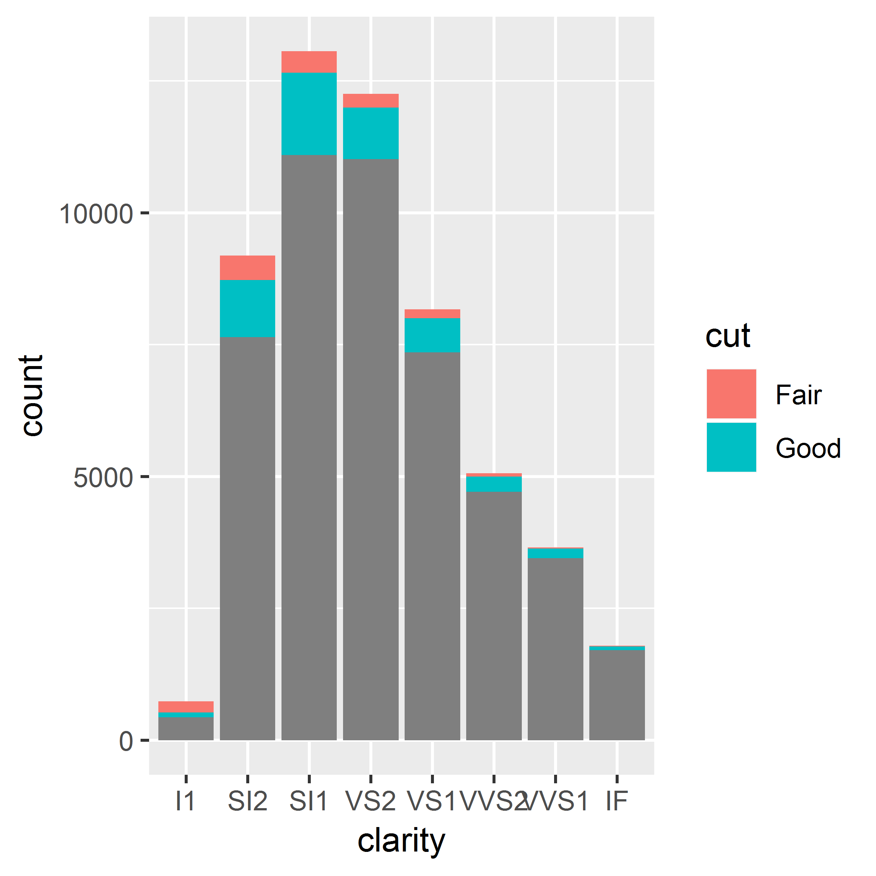
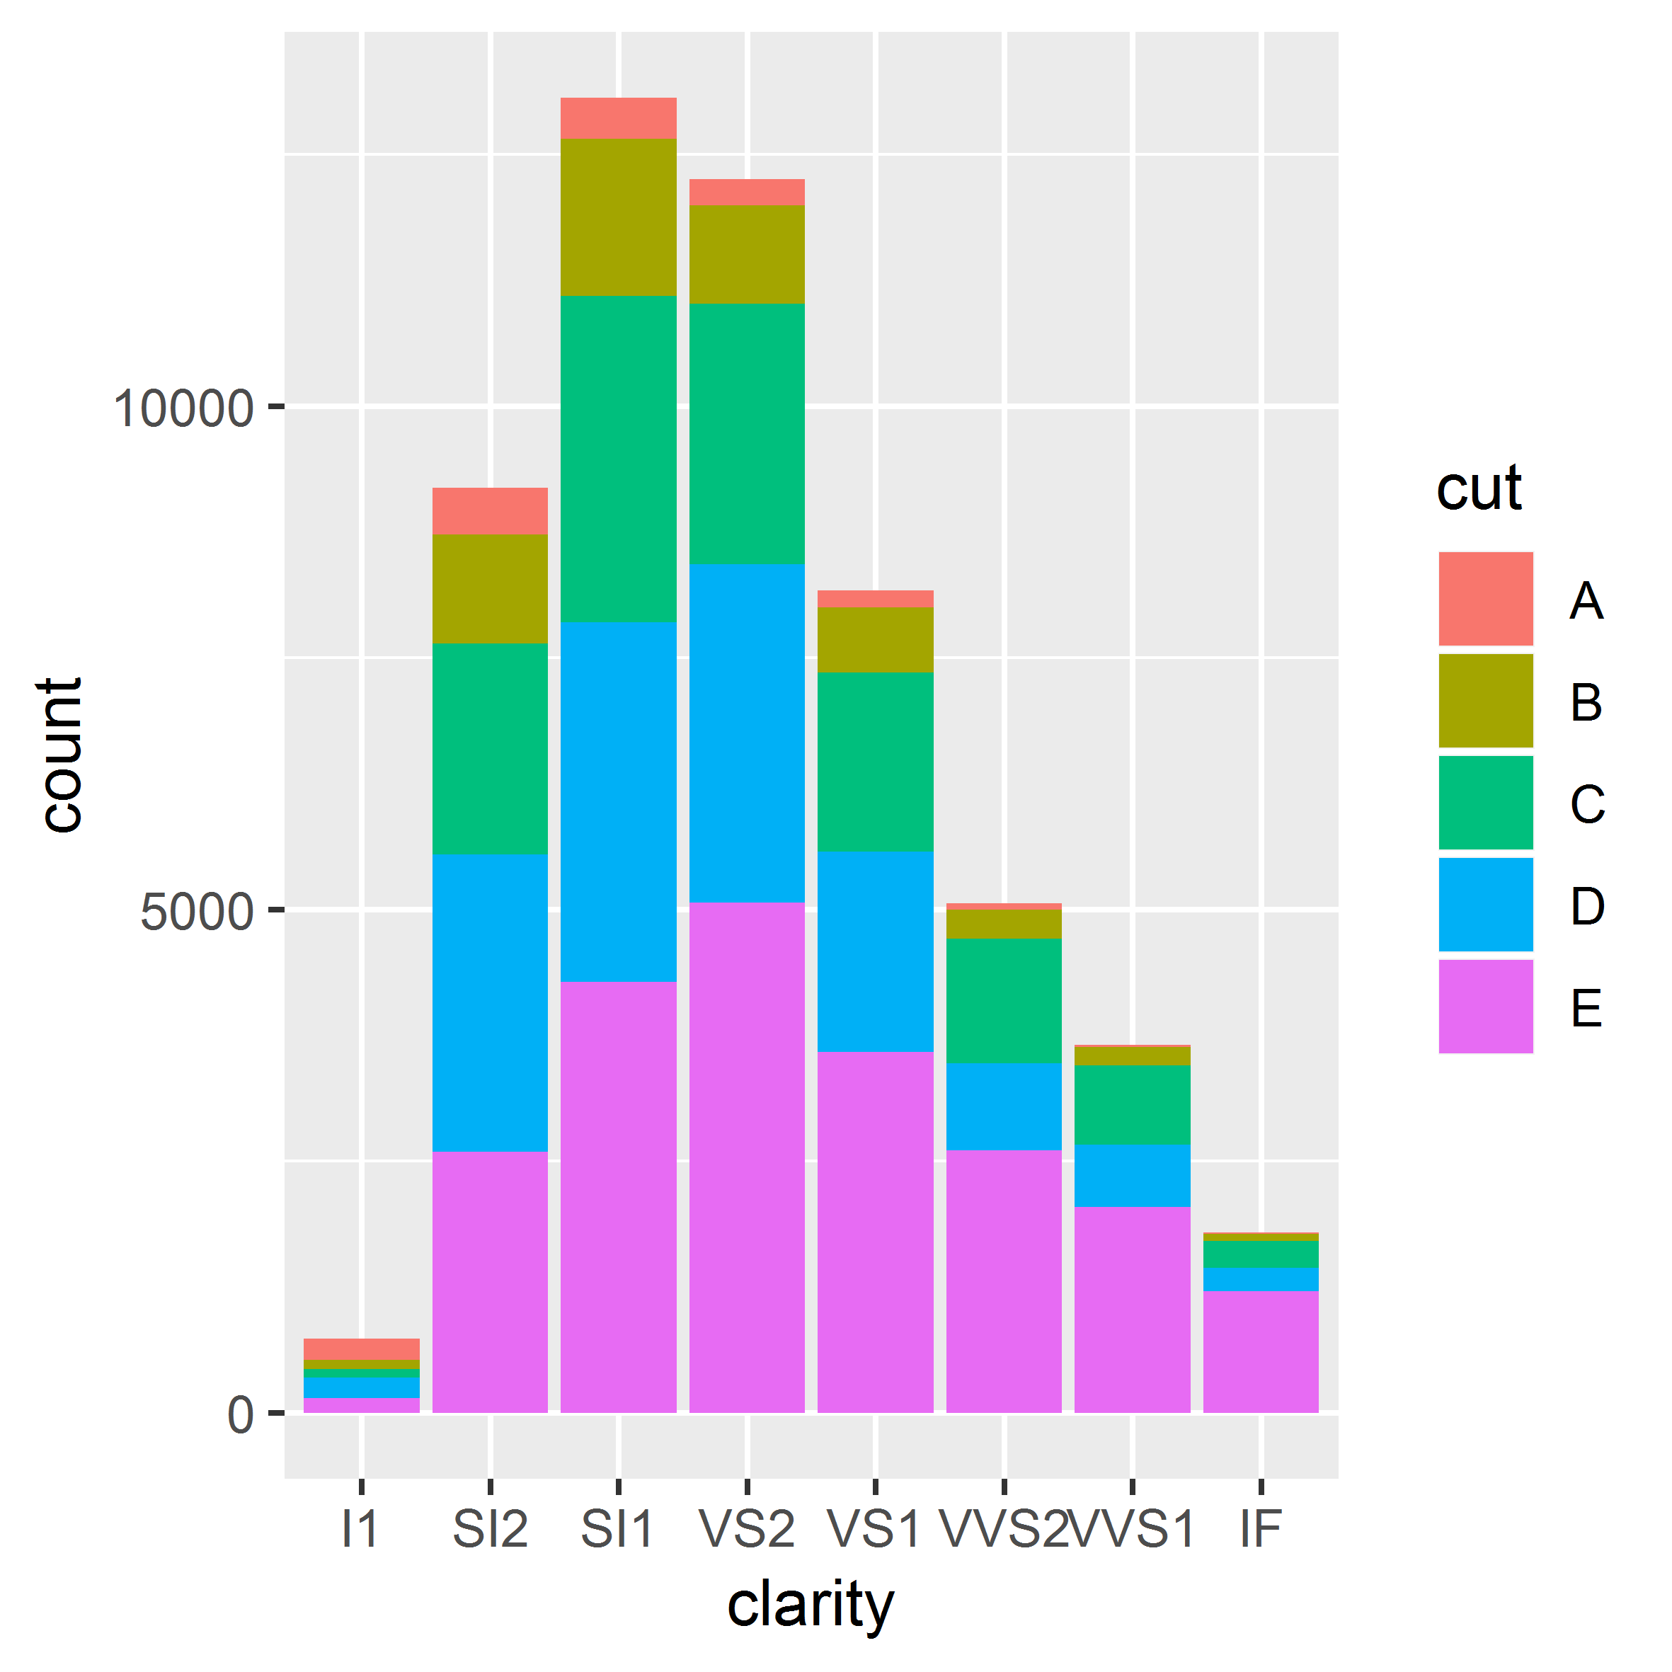
Some details: common argument
name, limits, breaks + labels
scale_fill_hue(breaks = c("Fair", "Good", "Very Good", "Premium", "Ideal"), labels = c("A", "B", "C", "D", "E"))
scale_color_hue(name = “Jack”)
scale_color_hue(limits = c("Fair", "Good"))

Slide 21
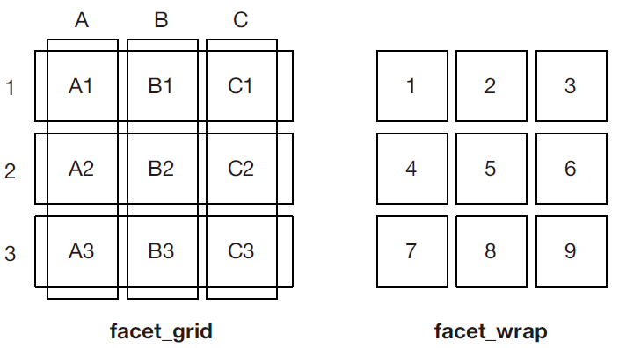
Positioning—Faceting

Slide 22
A simple example for facet_wrap
Please be caution when using facet. The picture will be extremely big.
ggplot(mpg, aes(x = displ, y = hwy)) +
geom_point() +
geom_smooth() +
facet_wrap(. ~ year)

Slide 23
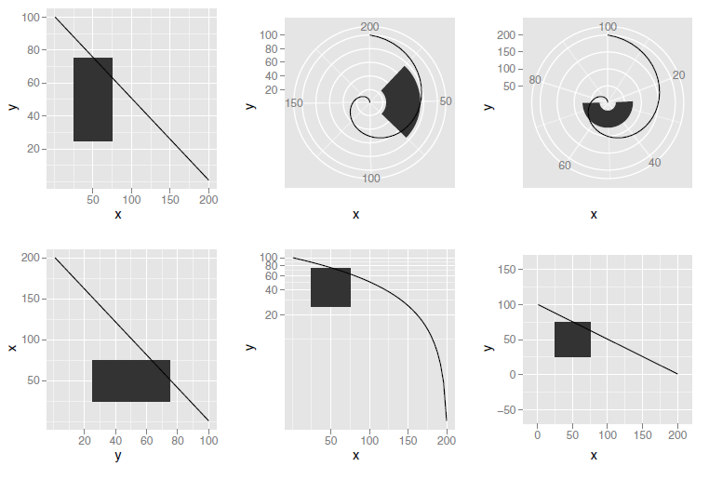
Coordinate systems
polar with x position mapped to angle
Cartesian
polar with y position mapped to angle
flipped
equal scale
Usage: coordinate_XXX
transformed with log in y direction

Slide 24
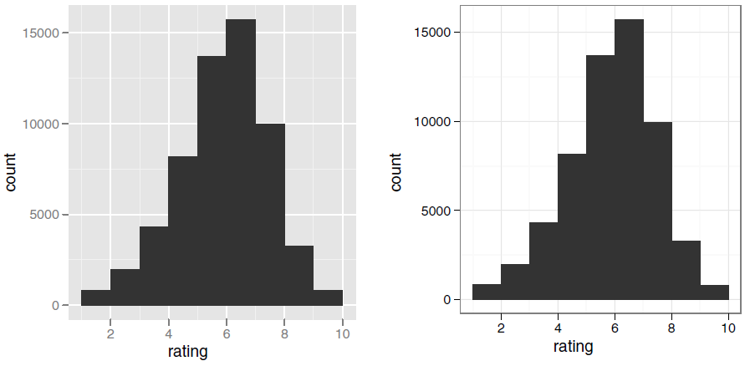
Polishing your plots for publication —Theme
Usage: theme(), theme_XXX()
A simple example
theme_grey()
theme_bw()

Slide 25
A selection of the most important elements

Slide 26
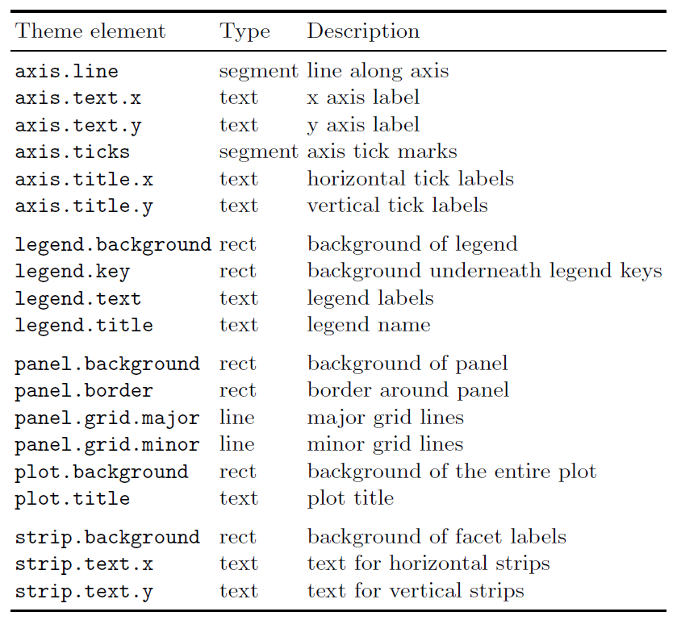
Theme elements and element functions

Slide 27
Summary—only four steps
Prepare your data
plot your geom
Adjust your theme
Save the plots out

Slide 28
Some examples using diamond dataset

Slide 29
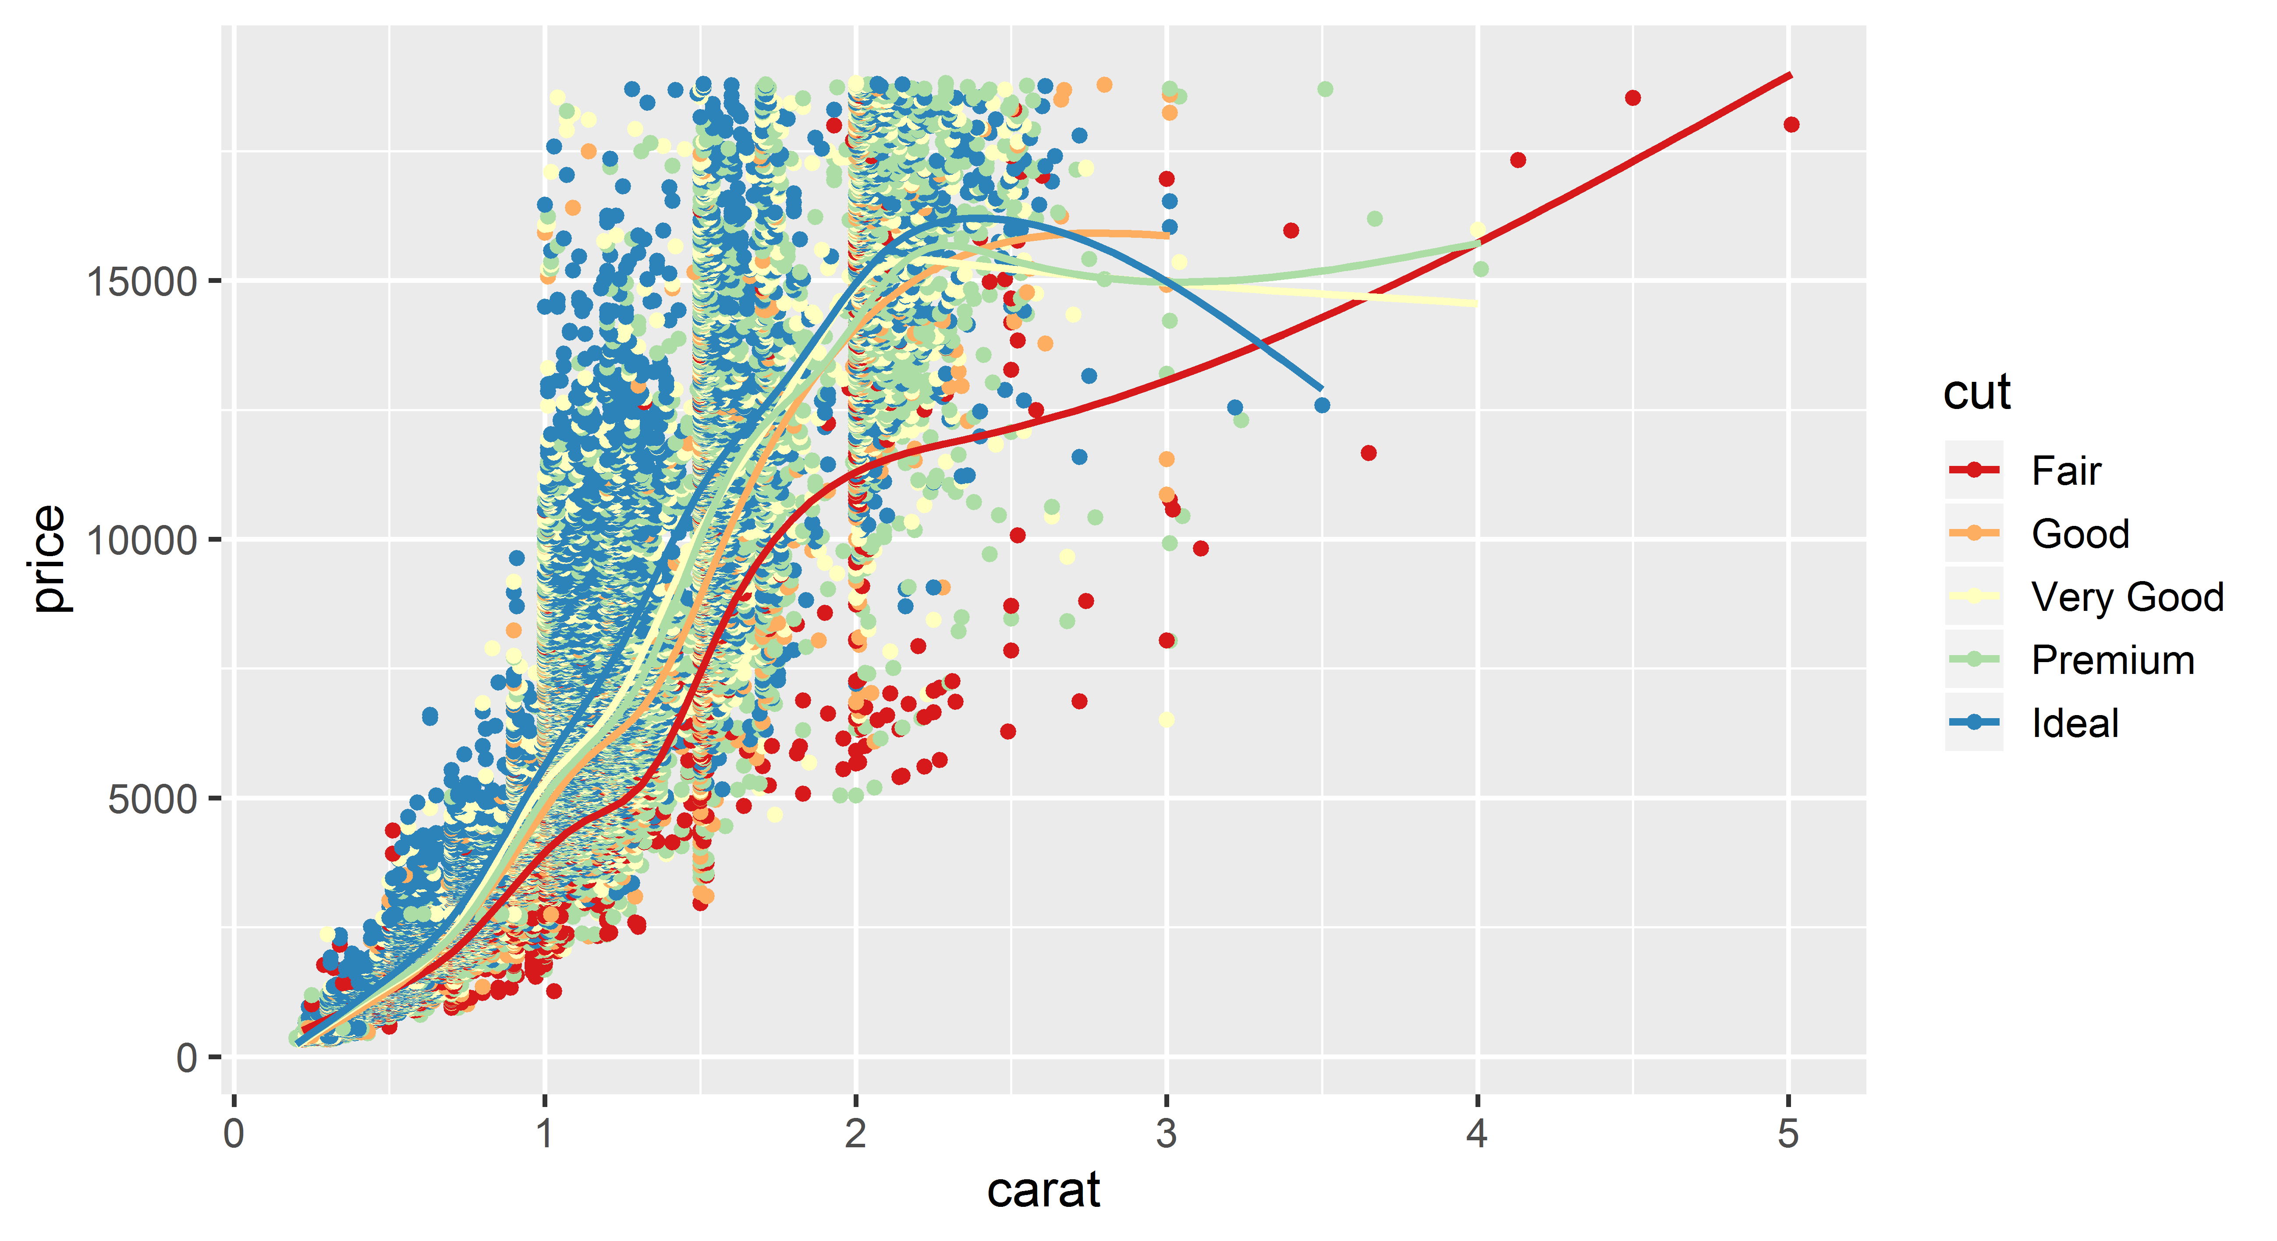
Point and smooth
ggplot(diamonds,aes(carat, price, color = cut)) +
geom_point() +
geom_smooth(se = 0) +
scale_color_brewer(palette = "Spectral") +
theme_grey(14)

Slide 30
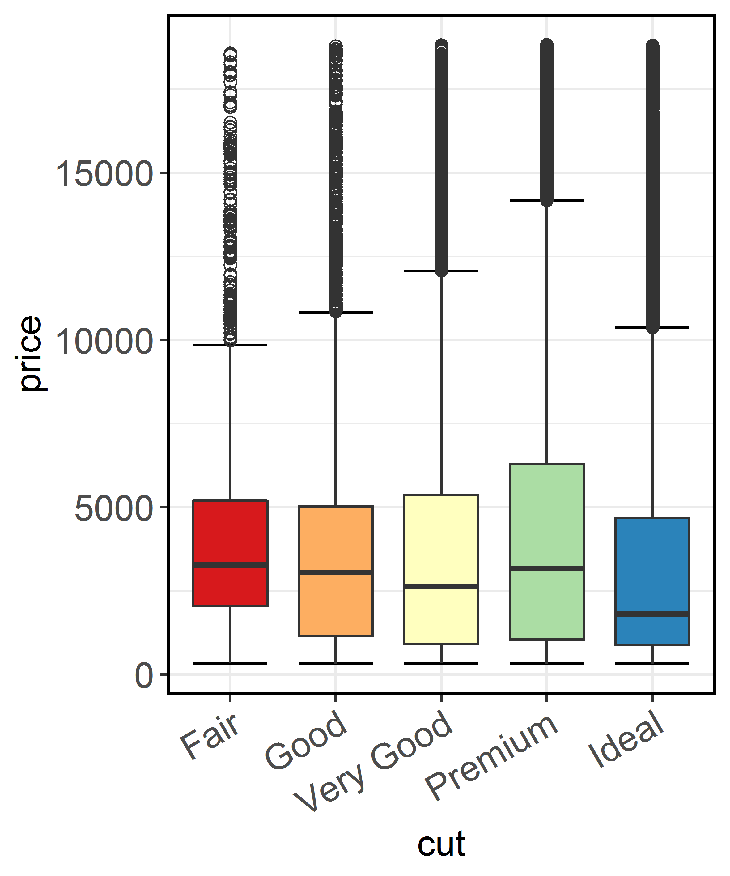
Standard boxplot
ggplot(diamonds, aes(cut, price, fill = cut)) +
stat_boxplot(geom = "errorbar", width = 0.7) +
geom_boxplot(width = 0.7, outlier.size = 2, outlier.shape = 1) +
scale_fill_brewer(palette = "Spectral") +
theme_bw(14) + theme(
axis.text.x = element_text(angle = 30, hjust = 1, vjust = 1),
legend.position = "none")

Slide 31
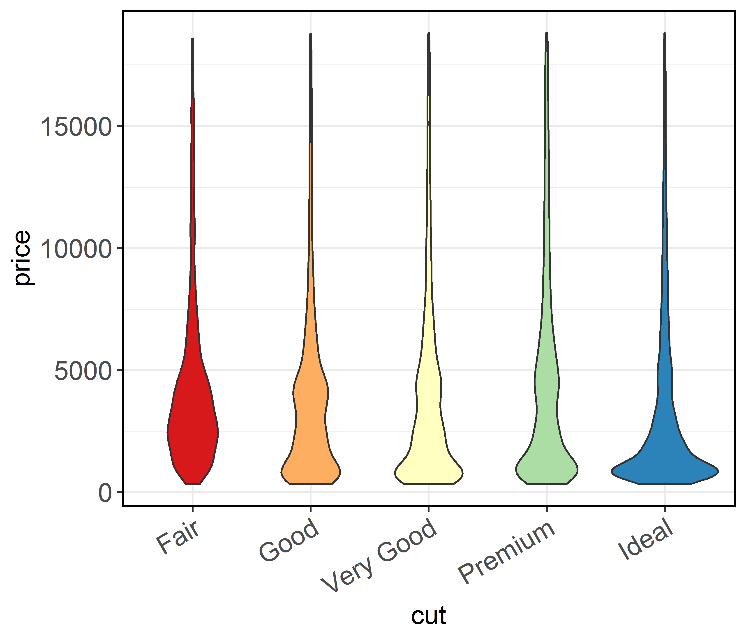
Violin
ggplot(diamonds, aes(cut, price, fill = cut)) +
geom_violin(width = 0.7) +
scale_fill_brewer(palette = "Spectral") +
theme_bw(14) + theme(
axis.text.x = element_text(angle = 30, hjust = 1, vjust = 1),
legend.position = "none")

Slide 32
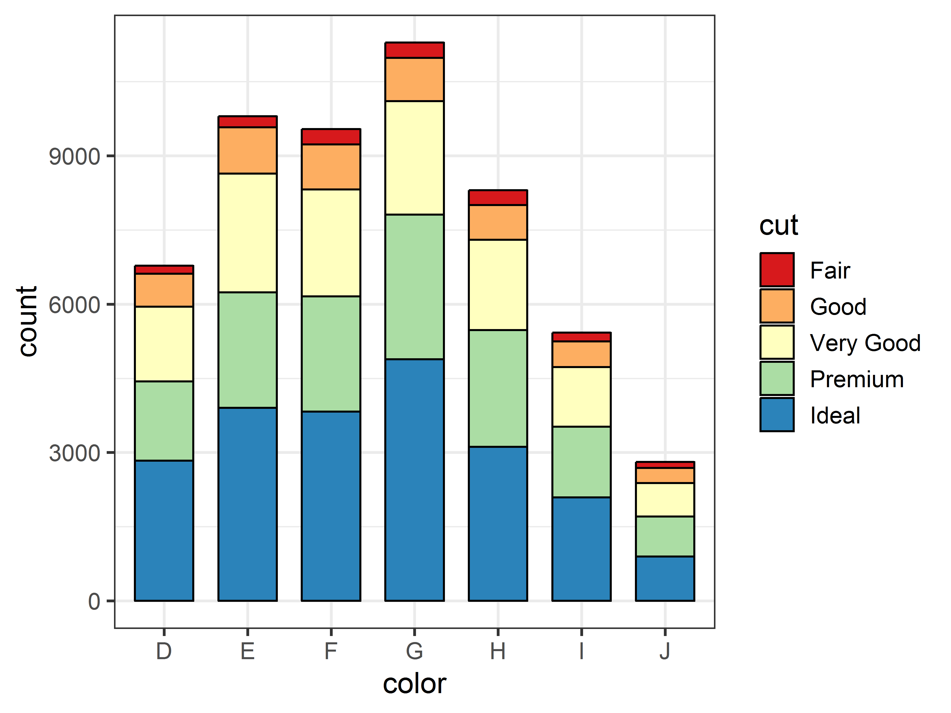
Bar
ggplot(diamonds, aes(color, fill = cut)) +
geom_bar(width = 0.7, color = "black") +
scale_fill_brewer(palette = "Spectral") +
theme_bw(14)

Slide 33
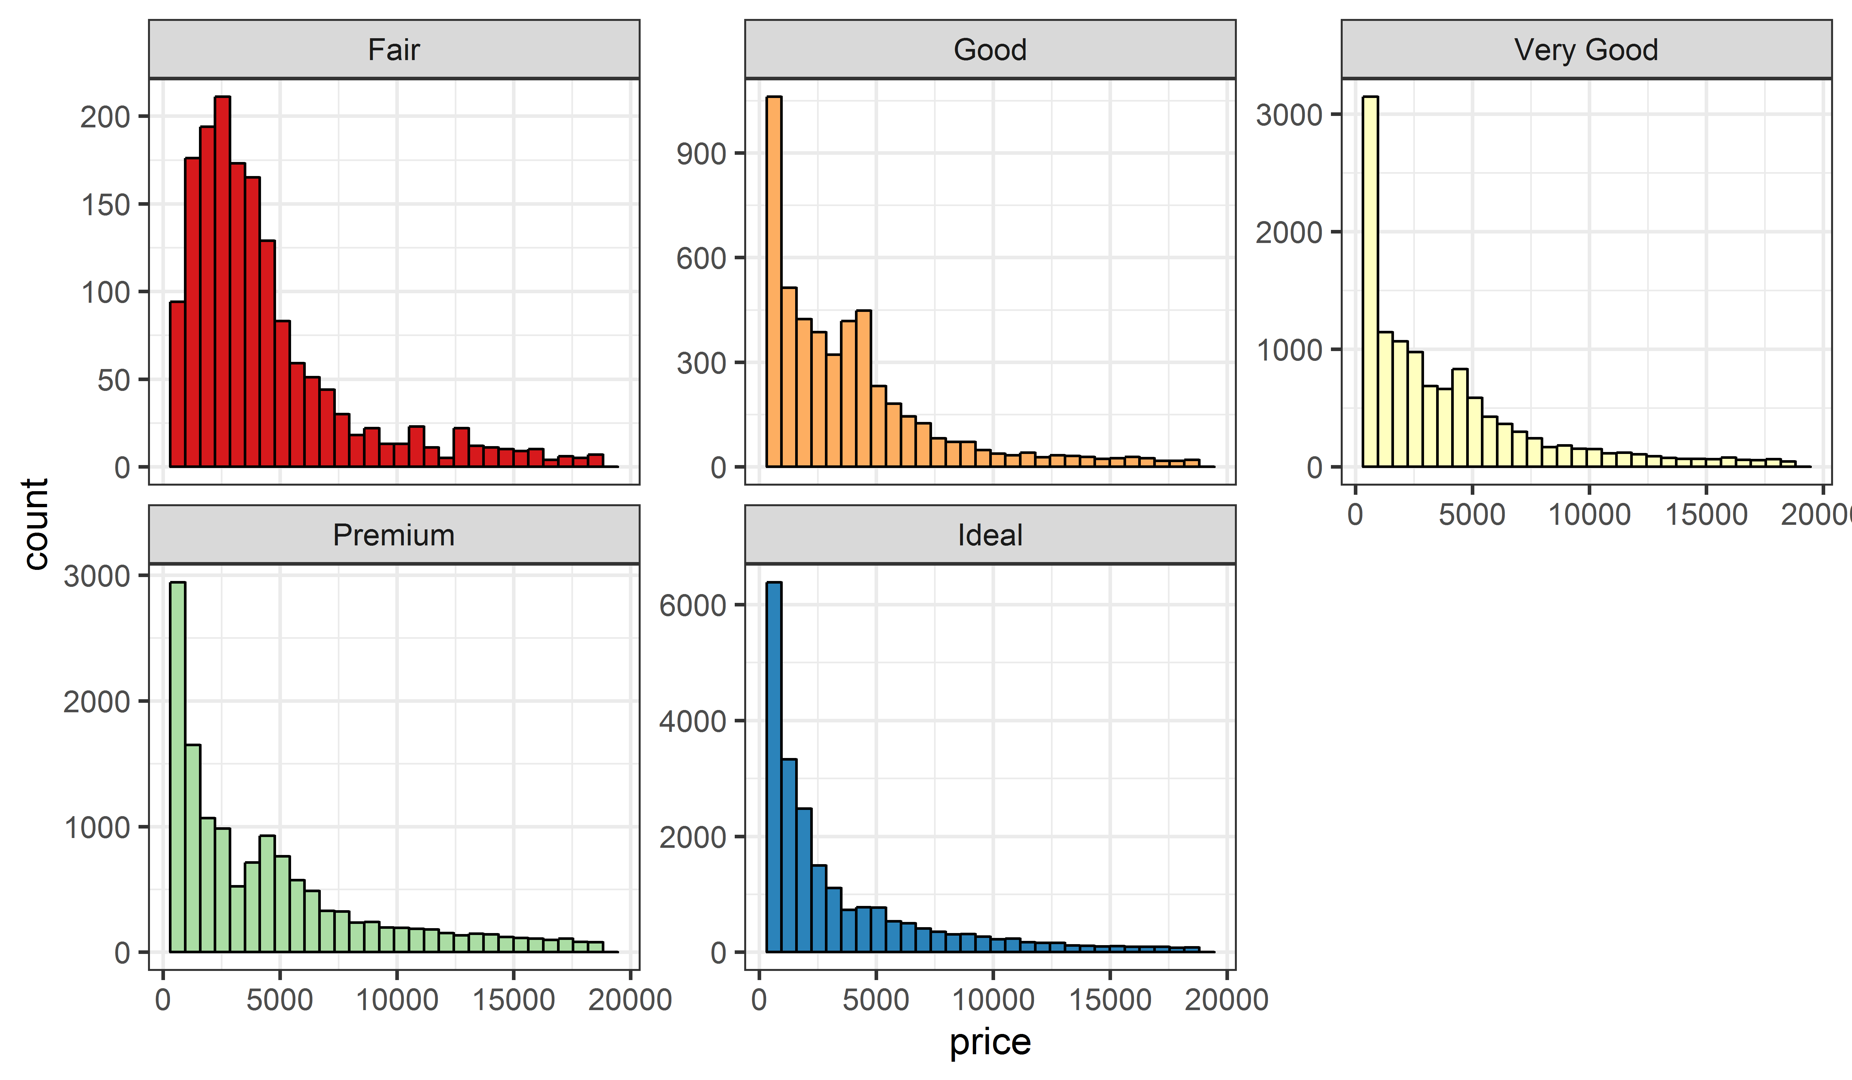
Histogram
ggplot(diamonds, aes(price, fill = cut)) +
geom_histogram(color = "black") +
scale_fill_brewer(palette = "Spectral") +
facet_wrap(. ~ cut, scales = "free_y") +
theme_bw(14) + theme(legend.position = "none")

Slide 34
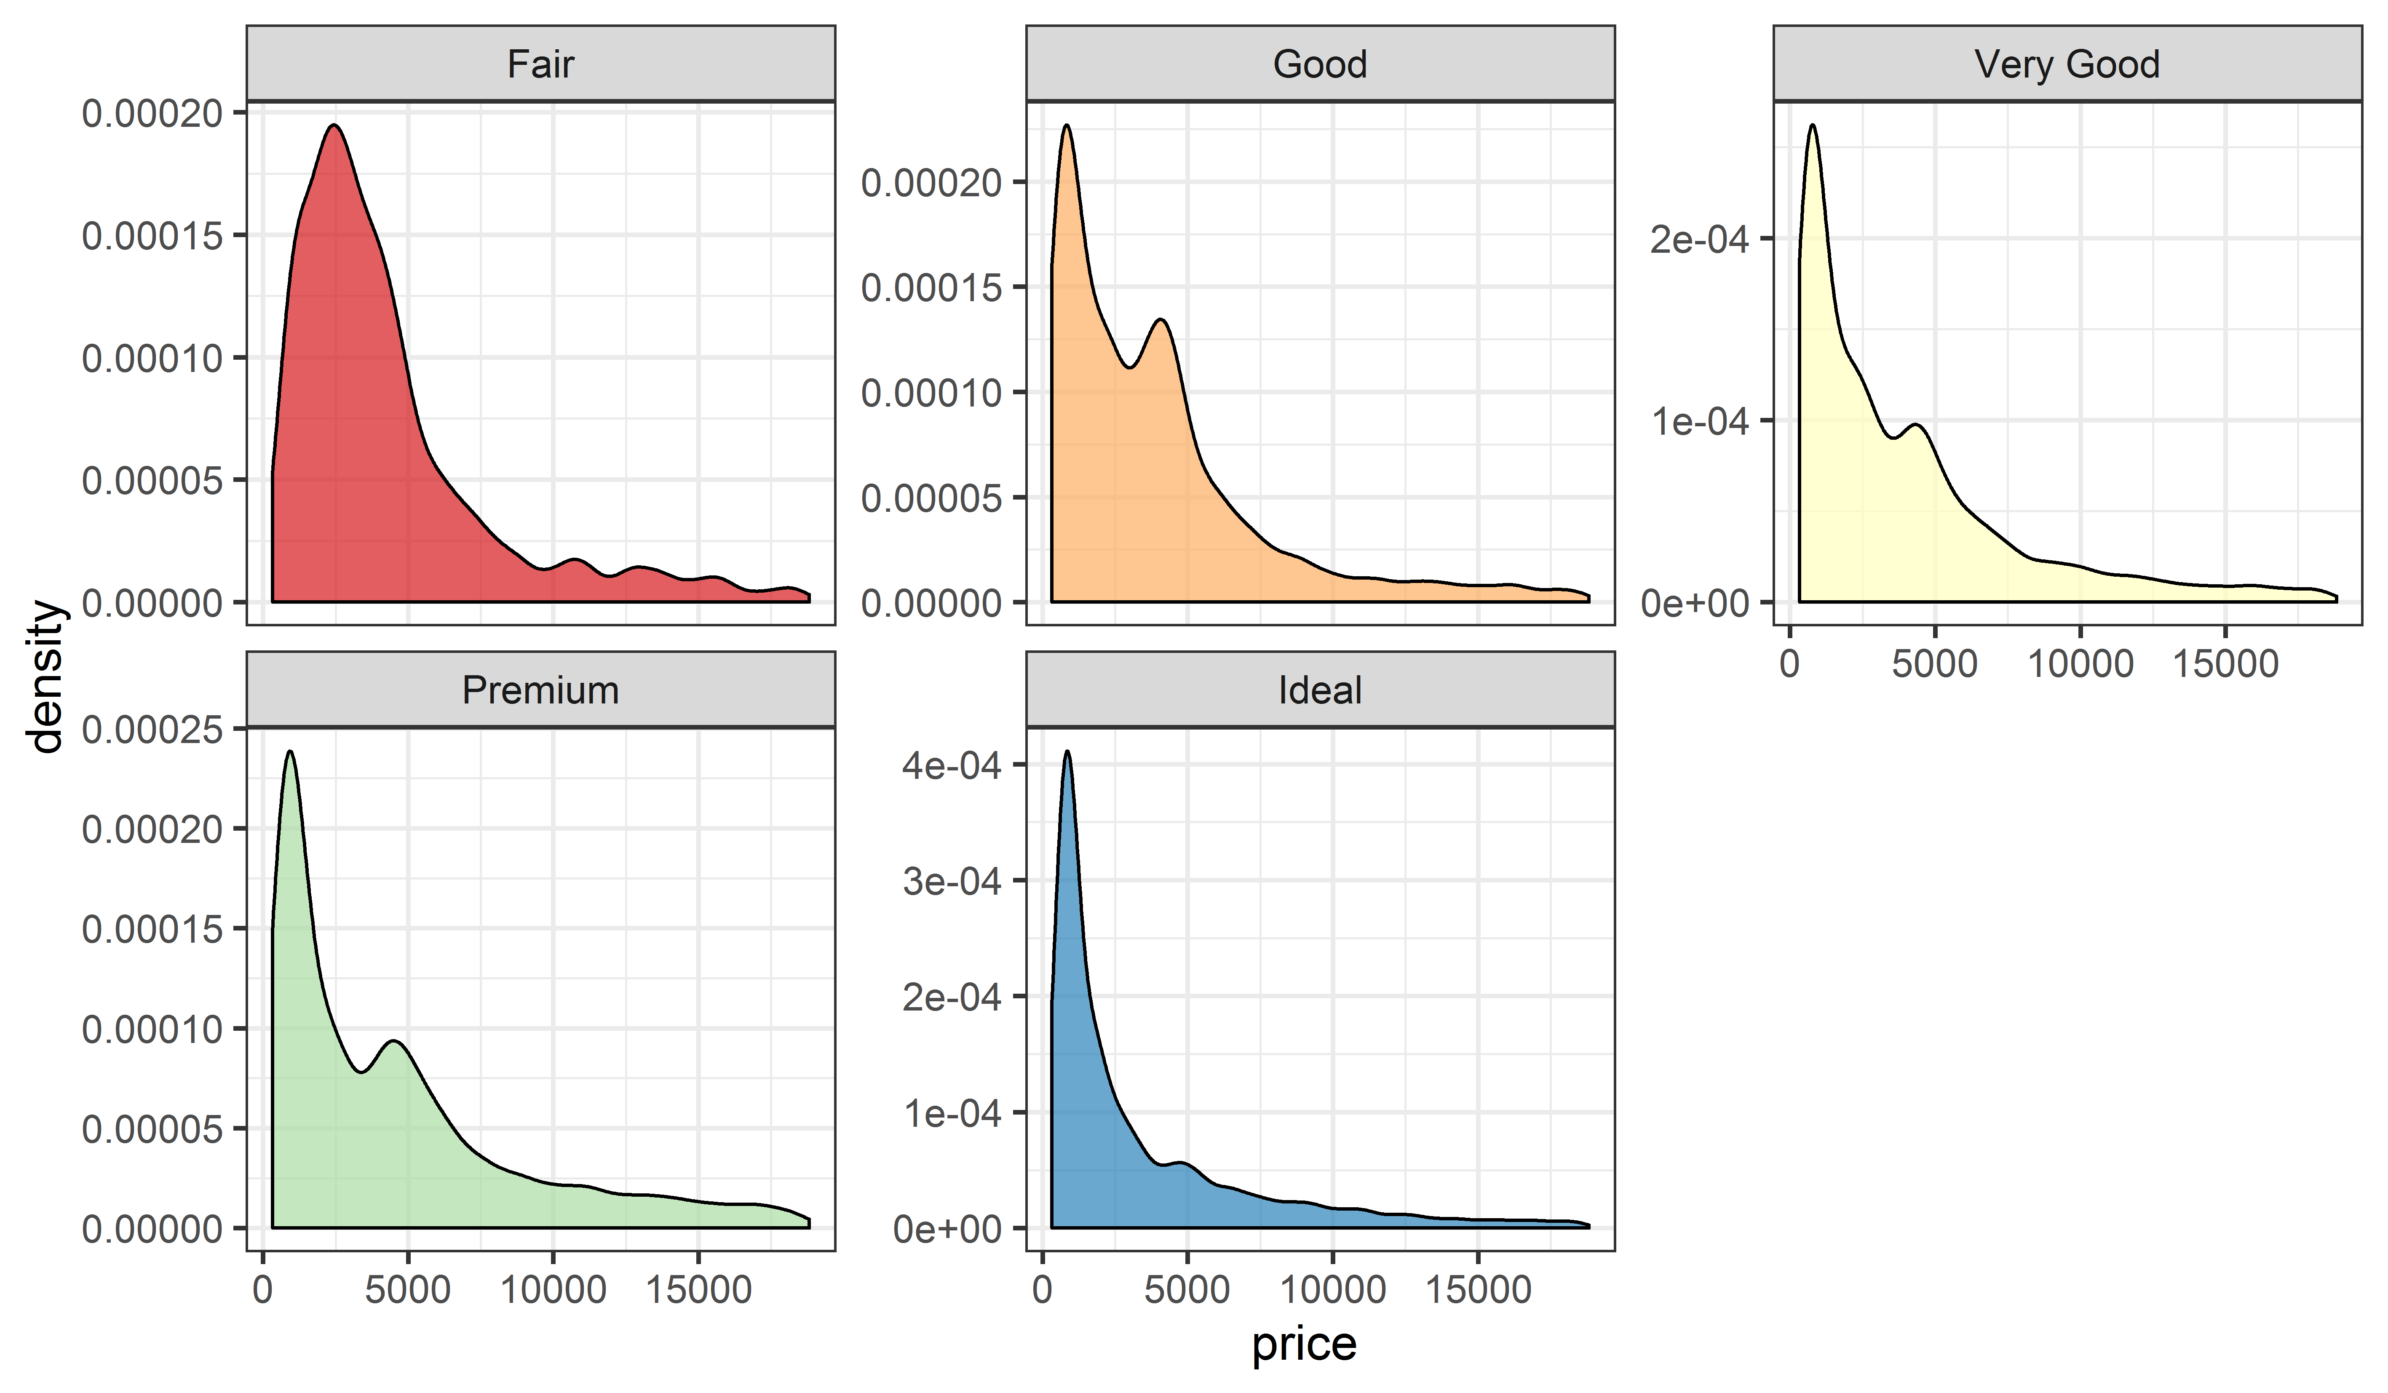
Density
ggplot(diamonds, aes(price, fill = cut)) +
geom_density(color = "black", alpha = 0.7) +
scale_fill_brewer(palette = "Spectral") +
facet_wrap(. ~ cut, scales = "free_y") +
theme_bw(14) + theme(legend.position = "none")

Slide 35
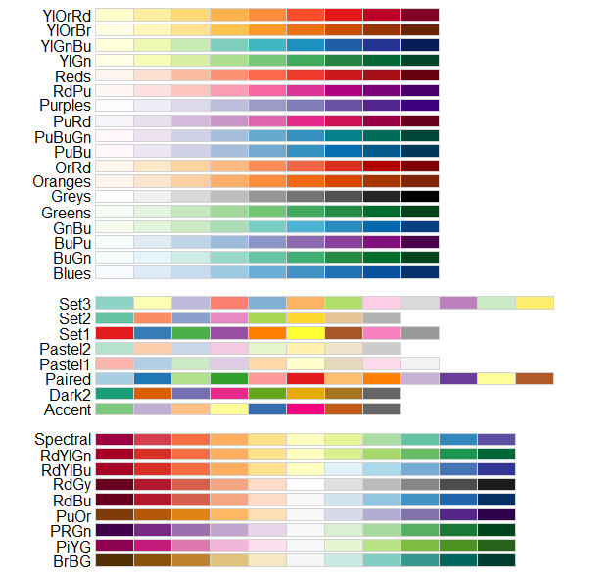
Discrete color sets from ColorBrewer

Slide 36
THANKS!

