Slide 1
TRB ABE30: TRANSPORTATION ISSUES IN MAJOR CITIES MID-YEAR MEETING
Committee Chair: Deputy Mayor Rina Cutler

Slide 2
Agenda
Welcome and Introductions – 10min
Sub Committee Reports – 20min
Review of Minutes and Survey Results from Annual Meeting Committee Meeting (Ema Yamamoto)
Research (Wes Marshall)
Annual Meeting Organizing Group (Aimee )
Communication (Stephanie Dock)
Paper Review (Eric Sundquist, Christine Yager)
TRB Liaison Report (Monica Starnes) – 5min
NACTO Update (Linda Bailey) – 5min
Strategic Plan Discussion (Steve Buckley) – 60min
Member and Friend Presentations – 10min
Open Floor for Announcements – 10min

Slide 3
Welcome & Introductions
Executive Committee
Chair: Rina Cutler
TRB Liaison: Monica Starnes
Committee Coordinator: Ema Yamamoto
Communications Coordinator: Stephanie Dock
Research Coordinator: Wes Marshall
Paper Review Coordinators: Eric Sundquist, Christine Yager
Annual Meeting Organizers: Fred Dock, Aimee Jefferson, Jamie Parks
Strategic Plan/Vision Coordinators: Steve Buckley, Andrea d’Amato, Julia Salinas, Karina Ricks

Slide 4
Agenda
Welcome and Introductions – 10min
Sub Committee Reports – 20min
Review of Minutes and Survey Results from Annual Meeting Committee Meeting (Ema Yamamoto)
Research (Wes Marshall)
Annual Meeting Organizing Group (Aimee )
Communication (Stephanie Dock)
Paper Review (Eric Sundquist, Christine Yager)
TRB Liaison Report (Monica Starnes) – 5min
NACTO Update (Linda Bailey) – 5min
Strategic Plan Discussion (Steve Buckley) – 60min
Member and Friend Presentations – 10min
Open Floor for Announcements – 10min

Slide 5
Review of Minutes & Survey Results from Annual Meeting
Annual Meeting
We sponsored 5 sessions
James Corless, Director of Transportation for America, spoke at the Committee Meeting
5 committee members and friends gave pecha kucha presentations
Survey Results
Over 60 people filled out the survey
Incorporated survey results into strategic plan

Slide 6
Research
Selected four calls for papers:
Urban Transportation Data and Performance Metrics
Livable Arterials: An Oxymoron or Urban Elixir?
Confirmed Co-Sponsors:
ANF10: Pedestrians
ANF20: Bicycles
ANB20: Safety Data, Analysis and Evaluation
Goods Movement in Active Urban Environments
Confirmed Co-Sponsors:
ANF10: Pedestrians
ANF20: Bicycles
AT025: Urban Freight Transportation
Gender Gap in Urban Biking
Confirmed Co-Sponsors:
ANF20: Bicycles
ABE70: Women’s Issues in Transportation

Slide 7
Annual Meeting Organizing
Received 4 workshop proposals
Selected the following workshop proposal:
Performance Metrics for Urban Streets
Co-Sponsors:
ANB20: Safety Data, Analysis and Evaluation
ANF10: Pedestrians
ANF20: Bicycles
Possible podium sessions for Annual Meeting
First Year on the Job: City Transportation Officials Session
Climate Resiliency: The Science and Design and Operational Solutions
State DOT Projects in Urban Areas
Is there another session you want to see? Submit your ideas by Friday, May 16, to Ema at Ema.Yamamoto@phila.gov
Notes:
NOTES FROM MID-YEAR MEETING:
We received 4 workshop proposals and did select a single proposal
TRB this year has limited the number of workshops to 0.5 per committee, it will be a competetive process but we are optimistic that ours will be selected.
The workshop we selected is on Performance Metrics for Urban Streets. It will highlight best practices by local, regional, and state agencies in using non-traditional performance metrics to (1) ensure multimodal street design outcomes and (2) convey the impacts of urban street improvements to the public and decision-makers.
We have sent out emails soliciting co-sponsors and have received positive responses and interest from the following committees --
ANB20: Safety Data, Analysis and Evaluation
ANF10: Pedestrians
ANF20: Bicycles
The workshop proposal is due June 16th, we are well on our way to submitting it ahead of schedule
Now we are in the process of thinking about podium sessions for the Annual Meeting. As you may know, the Committee receives 2.3 credits to sponsor sessions at the Annual Meeting. Each session we sponsor is 1.0 credits, but if we find a co-sponsor, the session is then 0.5 credits. If we find 2 co-sponsors, a session becomes 0.3 credits, etc. With that in mind, we are planning to save 1.0 credits for paper related sessions (depending on the number of papers submitted to the committee). This means we currently have 1.3 credits to begin planning sessions right now. We have brainstormed among ourselves and come up with the following topics:
First Year on the Job: City Transportation Officials -- with so much change in administrations and heads of transportation at the municipal level, we thought it would be interesting to have a panel of city transportation officials discussing their first year.
Climate Resiliency: The Science and Design and Operational Solutions -- this was actually a session submitted as a workshop from Andrea d'Amato that we felt was better suited as a podium session. It could look at a variety of aspects including scientific findings, climate impacts, and current approaches/best practices in adaptive design solutions and operational changes to create climate change resiliency/adaptation through transportation in urban areas.
State DOT Projects in Urban Areas -- this session would be a follow-up to last years session. This year we would like to bring in individuals from a variety of perspectives, including transit, state, city, and private practitioners that have worked on a State DOT project in an urban area.
Are there sessions that you would like to see at the 2015 Annual Meeting that you don't see listed here? If so, please email your ideas to Ema Yamamoto by Friday, May 16th.

Slide 8
Communications
Blog/newsletter coming
Setting up a blog to have regular postings on urban transportation research issues/topics
Monthly update that points you to “best of” the blog
Website updates overall
Logo Contest
Some examples from other committees:
Committee on Transportation-Related Noise and Vibration

Slide 9
Paper Process 101
Timeline of Paper Review Process:
SPRING
Committee members submit possible calls for papers, due 3/15
Research coordinator selects calls for papers and works to find co-sponsors by 4/15
Research coordinator submits calls for papers to TRB by 5/1
SUMMER
Authors can submit papers 6/1– 8/1
TRB assigns papers to committees by 8/12
Paper review coordinators assign papers to committee members by 8/15
FALL
Committee members review papers 8/17 - 9/15
Paper review coordinators work with Annual Meeting Organizers to assign select papers to Annual Meeting sessions by 10/1
Paper review coordinators send paper decisions to authors by 10/15
Authors resubmit papers by 11/15
WINTER
TRB Annual Meeting – 1/11 – 1/15
Paper review coordinators submit final publication decisions by 2/1
Notes:
NOTES FROM MID-YEAR MEETING:
Upcoming items to keep in mind:
We will be sending out the calls for papers and the location on our website and TRB’s website. We are hoping to advertise/broadcast these to a larger group of people than last year – please help!
We will be sending out a survey during the summer asking about the specific paper calls you would like to review papers for. Please respond so that we can assign papers in the best manner. We expect all current members to review at least one paper. Paper review process is not required for friends but we appreciate all the help we can get!

Slide 10
Agenda
Welcome and Introductions – 10min
Sub Committee Reports – 20min
Review of Minutes and Survey Results from Annual Meeting Committee Meeting (Ema Yamamoto)
Research (Wes Marshall)
Annual Meeting Organizing Group (Aimee )
Communication (Stephanie Dock)
Paper Review (Eric Sundquist, Christine Yager)
TRB Liaison Report (Monica Starnes) – 5min
NACTO Update (Linda Bailey) – 5min
Strategic Plan Discussion (Steve Buckley) – 60min
Member and Friend Presentations – 10min
Open Floor for Announcements – 10min
Notes:
NOTES FROM MID-YEAR MEETING:
TRB Announcements:
- The Technical Activities Council has selected a number of critical issues – Stephanie, did you catch all of these?
Webinars are due to TRB at the end of May. If you would like to see a webinar by ABE30 this coming year, please submit your ideas to Ema by Monday, May 16th, EOB
Theme for the Annual Meeting is Corridors to the Future
NACTO/Linda Announcements
NACTO put out the Street Design Guide and is actively soliciting endorsements through May 2nd and is working with FHWA and AASHTO to make it a more formalized design standard
FHWA is doing a study of cycle tracks
Working on TripGen with Stephanie
10/22-25 is the Designing Cities Conference

Slide 11
Agenda
Welcome and Introductions – 10min
Sub Committee Reports – 20min
Review of Minutes and Survey Results from Annual Meeting Committee Meeting (Ema Yamamoto)
Research (Wes Marshall)
Annual Meeting Organizing Group (Aimee )
Communication (Stephanie Dock)
Paper Review (Eric Sundquist, Christine Yager)
TRB Liaison Report (Monica Starnes) – 5min
NACTO Update (Linda Bailey) – 5min
Strategic Plan Discussion (Steve Buckley) – 60min
Member and Friend Presentations – 10min
Open Floor for Announcements – 10min

Slide 12
Strategic Plan Discussion
Vision
Committee Scope
Future Outlook (Critical Issues)
Key Research Focus Areas
Committee Plan
Membership
Sub-Committees
Communications

Slide 13
Vision
Cities are where diverse populations, businesses, health and academic institutions and agencies converge, creating a nexus where competing transportation modes and interests must operate in a confined spatial location. Because of this, major cities are on the forefront of managing change and provide unique leadership in designing and operating intermodal connections, energy efficient and sustainable solutions, and the safe movement of people and goods in the larger region. This committee strives to take advantage of its cross-cutting nature and its ability to collaborate with a variety of practitioners and researchers to provide a forum to share research and exchange lessons learned from those challenges and opportunities.

Slide 14
Committee Scope
Urban environments present distinct and complex policy, planning, and operating challenges to meet the needs of large volumes of pedestrians, bicycles, transit trips, private vehicles, and freight movements across a variety of surface transportation assets. In order to examine and explore transportation issues in major cities and merging cities and urban environments in the United States and other countries and how these issues affect the other urban policies and the larger urban environment. The work of the committee will focus on issues of significant interest to organizations who are planning, constructing, and operating in urban environments.
Notes:
NOTES FROM MID-YEAR MEETING:
Perhaps include engagement of senior levels of government – looking for interagency cooperation

Slide 15
Future Outlook (Critical Issues)
Changing cities - Renewed growth in most urban cores, aging “baby boomers”, increased interest in active urban living, decreasing importance of automobiles for the Millenial generation, influence of technology on how we travel
Rapidly improving technology and wealth of “big data” will have a profound impact on the planning, operating, maintaining and understanding of multi-modal travel in cities. Systems are emerging capable of collecting, analyzing data and predicting issues so that we can properly respond, monitor and evaluate actions, and communicate information. including transit fare, autonomous vehicle, and communications including social media/ crowd based and smart system technology.
Greater openness to grass-roots innovation and experimentation to advance new design standards, techniques and practices, particularly in urban centers. Pilots, parklets and “pop ups” are increasingly used for rapid implementation and/or to test concepts.
Uncertainty about the future of the Highway Trust Fund and Federal Transportation bill(s) means that responsibility for visionary planning and funding will increasingly fall to states and regions making it more important than ever that cities, regions, stations and transit authorities work collaboratively and productively.
Increase conversation between Federal DOT, State DOT’s, Local DOT’s, and MPO’s in order to create collaborative, unified, and place specific urban transportation agendas.
Curbspace and ROW Management – manage the increasingly competitive desire for curbspace and space in our rights of way.
Notes:
NOTES FROM MID-YEAR MEETING:
Incorporate social equity (means to access)/immigration/curbspace/ROW management into the changing cities
Can we incorporate data capture and integration for suburban cores
We need include the need to explore better ways of data communication
Rename number 4 to be “Taking Control of Your City’s Fiscal Future”

Slide 16
Key Research Focus Areas
Designing cities for changing population
Multimodal safety
Urban congestion and reliability
Opportunities through technology
Urban performance measures
Improving relationships partners, including MPOs, State DOTs, and federal agencies
Balancing competing demands on the streets, including parking & freight
Finance and economic development
Climate adaptation and mitigation
Equity: equal access to mobility for all users
Innovative Sustainable Design: Partially housed under climate adaptation/ mitigation. Also includes water resource management and urban habitat.
Agency and stakeholder collaboration
Major event management
Notes:
NOTES FROM MID-YEAR MEETING:
Want more specific statements
Perhaps tie into TRB’s critical issues

Slide 17
Committee Plan
Develop a high-quality Annual Meeting program: Deliver high-quality technical information through Sunday/Thursday workshops, podium presentations, poster presentations, and a committee meeting. Expand to cities, not just large cities, and incorporate more international practices.
Strengthen partnering opportunities with other Committees (Improve connections): Cities have always been the forum for synthesis and integration. They are the place where pedestrians, parking, transit and technology converge and aggregate. The Large Cities Committee will expand collaboration with a broad array of topically focused Committees to expand their research and thinking to incorporate the practical daily applications and interactions of our large urbanized centers.
Increased publishing of case studies in practice and peer exchanges: Cities across North America are facing similar issues in real time with one another. Cities are frequently so busy focusing on the issue of the moment that it is easy to miss that a peer city has already devised solutions worth noting. Because of the increasing pace of change, peer information sharing is vital. While deep academic research and analysis is vital, empirical data and practical examples are equally valuable to cities. The Large Cities Committee will seek out more practical examples and reporting, with the goal of bringing more technical work for presentation at the Annual Meeting and subsequent publication in the Transportation Research Record.
Continue to monitor and maintain research needs statements Research problem statements will be prioritized on a periodic basis using researcher, practitioner, and public agency input. The top 5-10 research statements will be the focus of efforts to identify and market to likely funding agencies. This should include a list of potential funders.
Create formalized relationship with NACTO in the form of a liaison and possible conference activities
Notes:
NOTES FROM MID-YEAR MEETING:
Instead of “relationship” with NACTO, use “partnership”
Introduce what this partnership looks like – dissemination of information

Slide 18
Membership
Criteria for membership will include, but not limited to:
Active participation in meetings and/or conference calls
Contributions of individuals by submitting:
Calls for papers
Reviewing papers
Submitting research needs statements
Participation in a Sub-Committee

Slide 19
Sub-Committees
Annual Meeting Session Organizing Sub-Committee: Organize the Major Cities Committees presence at the Annual Meeting.
Research Needs Sub-Committee: Identify major city research needs/topics and develop research needs statements; locate organizations to fund and conduct urban research; and track previous, ongoing, and upcoming research.
Paper Review Sub-Committee: Lead the paper review process. Identify papers worthy of special recognition at the Committee level and at the Group level. Identify Practice Ready papers.
Communications/Website Sub-Committee : Communicate committee business to members and friends in regular intervals.
Strategic Plan/Vision Sub-Committee: Write and update the Major Cities Committee’s triennial plan. Participate in committee meetings to ensure the implementation of the strategic plan and vision.
Subject based sub-committees?
Notes:
STEVE BUCKLEY

Slide 20
Agenda
Welcome and Introductions – 10min
Sub Committee Reports – 20min
Review of Minutes and Survey Results from Annual Meeting Committee Meeting (Ema Yamamoto)
Research (Wes Marshall)
Annual Meeting Organizing Group (Aimee )
Communication (Stephanie Dock)
Paper Review (Eric Sundquist, Christine Yager)
TRB Liaison Report (Monica Starnes) – 5min
NACTO Update (Linda Bailey) – 5min
Strategic Plan Discussion (Steve Buckley) – 60min
Member and Friend Presentations – 10min
Open Floor for Announcements – 10min

Slide 21
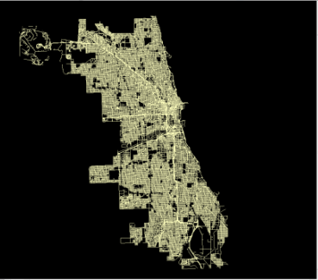
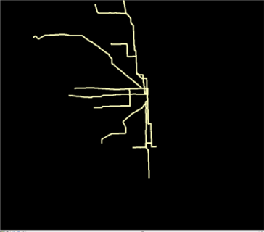
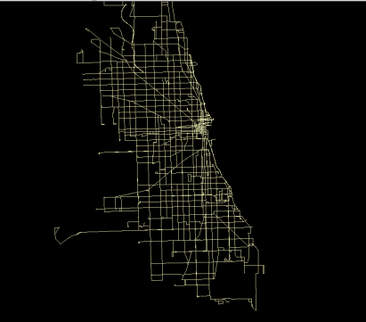
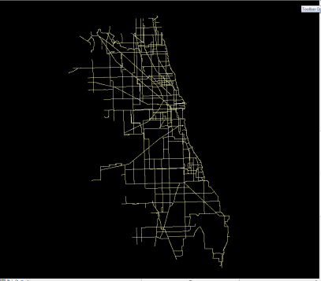
Access To Multimodal Transportation And Traffic Safety: Data From Chicago
Ivana Tasic, Utah Traffic Lab
Safety
Spatial Features
Socio Economic
Transport Access
Traffic Conditions
Land Use
Objective: Trade-offs between traffic safety and multimodal accessibility in major cities
Methods: Negative binomial regression, Seemingly unrelated regression, Generalized estimating equations
Findings: Crashes significantly impacted by population, socio-economic characteristics, education levels, land use diversity, road and intersection density, transit stops, biking facilities
Road network
Rail network
Bus network
Bike network
Traffic crashes
❸
◆
❖
❶

 | Ivana Tasic ivanat@trafficlab.utah.edu
Notes:
IVANA TASIC

Slide 22
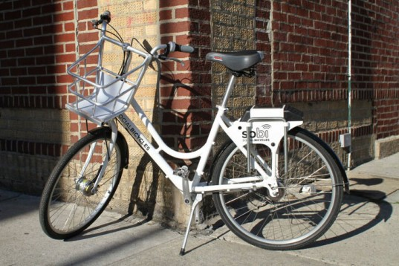
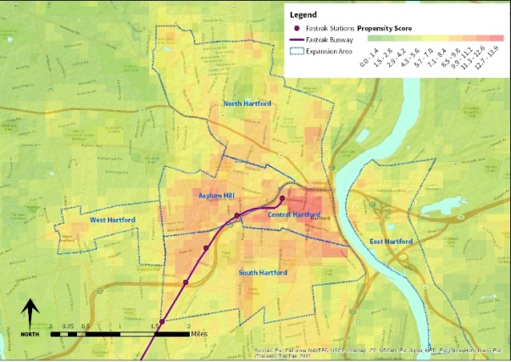
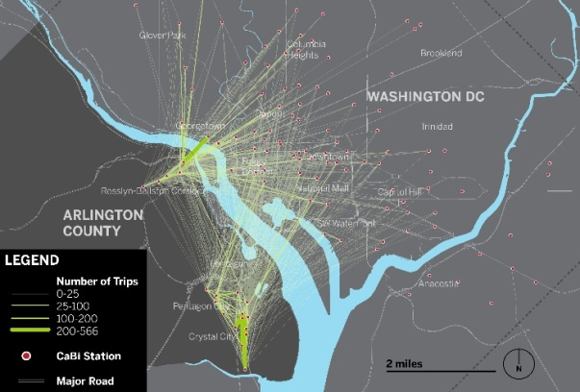
Bikeshare: Rapidly Evolving Field
Andrew Zalewski, Foursquare ITP
Involved in development of feasibility studies and business planning for bike share
Exciting field – Things are changing quickly
Need for greater data transparency
Research Needs
Better ways to model demand and understand what drives the bike share market
Research on bike share and equity – attracting a wider user base
Pricing – understand price elasticity better
Bike share outside urban settings
Notes:
ANDREW ZALEWSKI

Slide 23
Urban Multimodal Trip Generation
Stephanie Dock, District Department of Transportation
DDOT and NACTO project to build a database of multimodal trip generation rates with contextual variables
Seeking support for building the database
Funding – federal or pooled fund
Partners – review, collect data, contribute funds
Review underway of the proposed data collection methodology – please let Stephanie.Dock@dc.gov know if you want to participate. More reviewers welcome!
Notes:
STEPHANIE DOCK

Slide 24
Agenda
Welcome and Introductions – 10min
Sub Committee Reports – 20min
Review of Minutes and Survey Results from Annual Meeting Committee Meeting (Ema Yamamoto)
Research (Wes Marshall)
Annual Meeting Organizing Group (Aimee )
Communication (Stephanie Dock)
Paper Review (Eric Sundquist, Christine Yager)
TRB Liaison Report (Monica Starnes) – 5min
NACTO Update (Linda Bailey) – 5min
Strategic Plan Discussion (Steve Buckley) – 60min
Member and Friend Presentations – 10min
Open Floor for Announcements – 10min

