Slide 1
Tufts Divestment Proposal
1/24/13
Board of Trustees Investment Committee Meeting

Slide 2
Student Power why we are here (Dan)
Urgency of Climate Change - one anecdote (Anna)
Political Need for Divestment - lobbying #s (Nate)
Precedent for Divestment - hydro-quebec, mandela story, talloire declaration, vision statement, green initiatives (Emily)
Divestment Financially Feasible - mulkey quotes (Dan)
Conclusion - next date to meet, clear response by March 1 (Nate)
Notes:
we should delete this. See agenda.

Slide 3
Tufts Alumni Support Divestment
"I pledge to withhold donations to Tufts until the University divests, and I’m sure there are other alumni like me who are not willing to support Tufts financially as long as it fails to make its investments transparent or ignore important ethical, social, and ecological issues with its endowment. ... Alumni want Tufts to be a true “Light on the Hill” and not exploit people or the planet to fund its important mission of educating students. " -Michael Kramer (A'88) Managing Partner and Director of Social Research, Natural Investments.
1,100 Tufts student signatures
200 Tufts alumni signatures
200+ Universities nationwide
Seattle, Hampshire College, Unity College, and several Foundations have divested
largest divestment movement since Apartheid
Notes:
We know people come to you often making demands of the endowment. And so we are grateful to be able to present to you today, and are honored to present. We want to stress that this campaign is national, strong, and growing. This is not like any previous divestment request. This campaign has gotten incredibly big very fast, and pressure will only continue to grow, both at the national level and on campus.
climate disruption is different than any other past or foreseen issue because it threatens to undercut the habitability of the planet for a thriving civilization. What higher education exists for will not likely be possible if we continue on the current path.

Slide 4
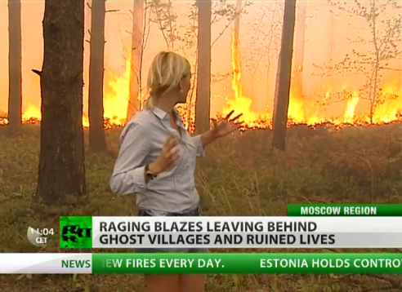
"The greatest humanitarian crisis of our time"

Slide 5
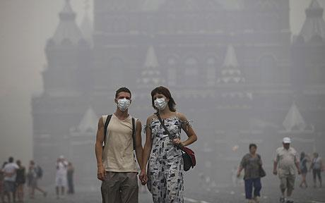
M
Moscow heat wave, summer 2010

Slide 6
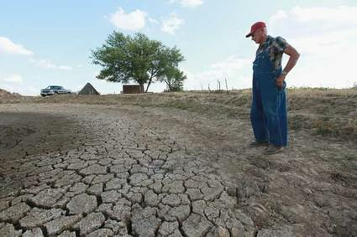
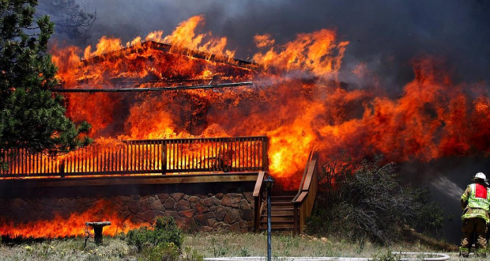
Drought in U.S. affected corn yield, 2012
Hotel scorched by Colorado wildfires, June 2012
Notes:
-

Slide 7
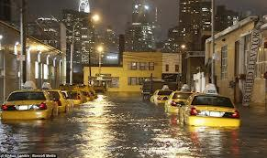
Queens, New York City after Hurricane Sandy, October 2012

Slide 8
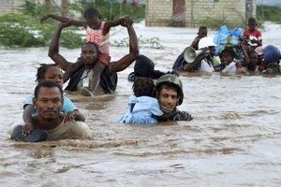
"The greatest humanitarian crisis of our time"

Slide 9
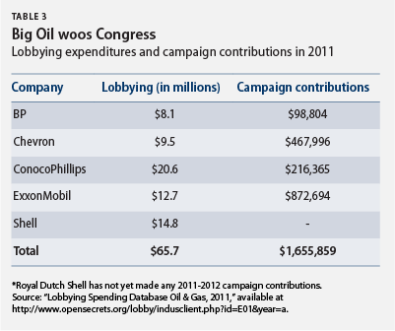
Ineffectiveness of Political Action

Slide 10
Divestment: An Effective Strategy for Social Change
“Divestment from select fossil fuel producers would send a powerful message to the energy industry and the nation. It would signal that America’s universities take the climate-energy challenge seriously.”
-2012 study by the Harvard Institute of Politics
Both the South African Apartheid and Darfur Divestment movements led to legislation in Congress
-1986: The Comprehensive Anti-Apartheid Act
-2007: The Sudan Accountability and Divestment Act

Slide 11
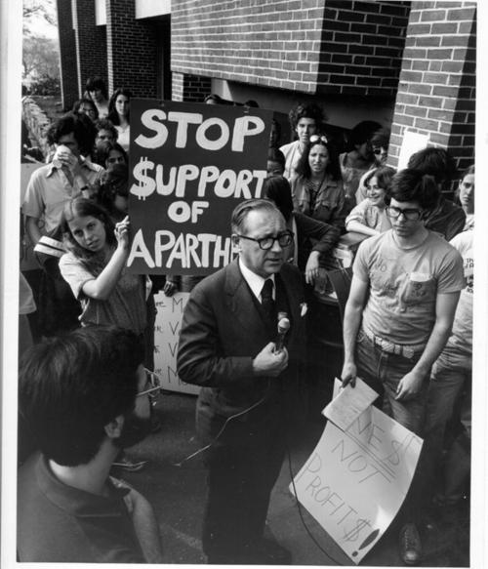
Precedent for Divestment at Tufts
"This is a symbolic act in many ways...it nevertheless is an important statement about what we believe about equality and civil rights"
William Meserve, 1988, on Apartheid Divestment, Head of Tufts Board of Trustees Financial Committee

Slide 12
Aligning Tufts Core Values with its Investments
“We are deeply concerned about the unprecedented scale and speed of environmental degradation, the integrity of the earth and its biodiversity, the security of nations, and the heritage of future generations...University heads must provide the leadership and support to mobilize internal and external resources so that their institutions respond to this urgent challenge.”
-Talloires Declaration
Notes:
If Tufts is reluctant to act unless other schools do we are acting like followers, not leaders. We were leaders with Apartheid and with the Talloires Declaration we should be out front on this issues. This is a way for Tufts to distinguish itself from our competitor schools – giving us good publicity and a giving us a leg up on students and faculty. It could also spur new individual and institutional investments in Tufts.

Slide 13
Divestment is Financially Feasible
"With respect to fiscal responsibility for the College...our estimates show that divesting is consistent with maintaining a return that will continue to beat the market averages under current prices. Thus, we feel this is a win- win approach for the College and for the planet. When fossil fuel prices rise, which they will, we should then loudly reject the notion that a divested portfolio is ‘underperforming.'" Stephen Mulkey, President of Unity College
Carbon Tracker - strong risk of stranded assets in the fossil fuel industry, since only 20% of the world’s fossil fuel reserves can be burned. We are living in an age of a carbon bubble, where fossil fuel markets are overcapitalized.
Divestment is feasible, as demonstrated by the divestiture of Seattle, Hampshire College, and Unity College, and other Foundation Endowments.
Divestment does not contradict legal fiduciary duty. Fiduciary duty does not require any institution to hold stock in a company with a broken business model.
Notes:
To begin, And no matter how much money they may be making today, fossil fuel companies are bad bets.
· When and if the government decides to create an actual price for carbon pollution, the companies will face a severe financial reckoning for the damage that they are causing to the planet.

Slide 14
Conclusion
-reiterate moral argument
-official ask
-set date for next meeting
Notes:
higher education teaches us to think in rational, synthetic and ethical ways that have led to modern life. For Tufts not to base its decision-making on the overwhelming evidence produced by the world's finest scientists (who primarily come from higher education) is to repudiate the entire model for learning and good citizenship that it purports to impress upon its graduates for the sake of a thriving civilized society.

Slide 15
Citations
http://www.theblaze.com/stories/2012/06/24/thousands-evacuated-as-colorado-wildfires-close-in-on-tourist-destinations/
http://www.yellowcabnyc.com/blog/hurricane-sandy-alert-stay-safe
http://eternian.wordpress.com/2010/08/12/russian-heat-wave-2010/
http://www.telegraph.co.uk/news/worldnews/europe/russia/7931206/Russian-heatwave-kills-5000-as-fires-rage-out-of-control.html
http://www.usnews.com/news/articles/2012/07/19/us-drought-a-boon-for-foreign-farmers

