Slide 1
A Complexity Primer for Systems Engineers July 2015
Dr. Jimmie McEver, JHU APL
Dr. Michael Watson, NASA-Marshall
Complex Systems Working Group
1

Slide 2
Agenda
Brief overview of Complex Systems WG
Complexity Primer for Systems Engineers

Slide 3
Complex Systems (CxS) WG Overview
Organized in 2006 from Systems Science WG
Co-chairs: Dr. Jimmie McEver, JHU/APL Mr. Michael Watson, NASA/MSFC
46 INCOSE members participated in discussions at IW 2015
https://connect.incose.org/WorkingGroups/ComplexSystems/

Slide 4
Purpose and Objectives
The purpose of the Complex Systems Working Group is to enhance the ability of the systems engineering community to deal with complexity.
The CxS Working Group works at the intersection of complex systems sciences and SE, focusing on systems beyond those for which traditional systems engineering approaches and methods were developed.
Complex Systems Working Group objectives
Communicate the complexity characteristics to systems engineering practitioners
Provide knowledge and expertise on complex systems in support of other INCOSE working groups working in their systems engineering areas
Facilitate the identification of tools and techniques to apply in the engineering of complex systems
Provide a map of the current, diverse literature on complex systems to those interested in gaining an understanding of complexity.
Although analysis is important, the goal is to make a difference in synthesis (creation of new systems).

Slide 5
Candidate Activities
Expand on Mat French MBSE in Complexity Contexts work begun in 2014
Expand on selected Primer topics; evolve into wiki to facilitate evolution and access; develop annotated complexity bibliography
Work with US Government partners to identify WG initiatives to help address current systems challenges (digital engineering, engineering resilient systems, open architecture based approaches for engineering complex systems)
Identify relationships and strengthen interactions with other INCOSE WGs (and with complexity groups in other organizations)
Workshop or other joint meeting with AIAA Complex Aerospace Systems Exchange organizers
Maturity Model for the Complex SE capability of an organization or endeavor
Organize webinars to discuss WG initiatives and topics of interest

Slide 6
A Primer on Complexity for Systems Engineers
The INCOSE Complex Systems Working Group has drafted a primer to introduce complexity concepts and approaches to practicing systems engineers
Members of the primer development team
Sarah Sheard
Eric Honour
Jimmie McEver
Dorothy McKinney
Alex Ryan
Stephen Cook
Duane Hybertson
Joseph Krupa
Paul Ondrus
Robert Scheurer
Janet Singer
Joshua Sparber
Brian White
6

Slide 7
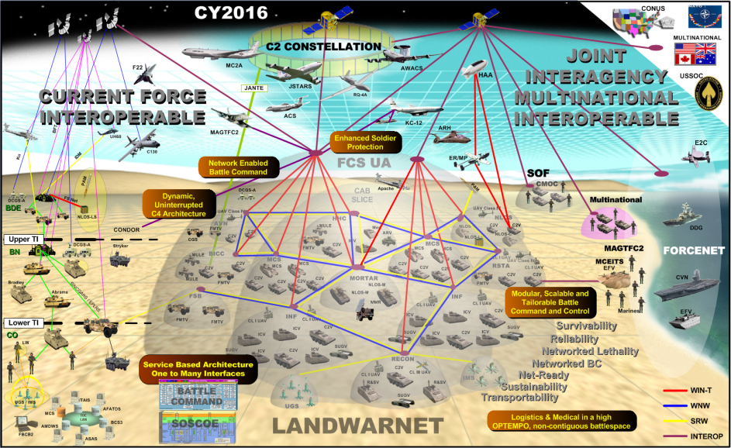
Motivation: The Implications of Complexity
Systems engineering has evolved to improve our ability to deal with scale and interdependency though the life cycle of engineered systems
Systems are becoming increasingly dynamic and interdependent, with growing emphasis on adaptiveness
BUT, complexity places new demands on systems engineers that require more than extensions of “classical” SE practice
Source: Sarah Sheard, Complexity and Systems Engineering, 2011
Source: Monica Farah-Stapleton, IEEE SOS conference, 2006
7

Slide 8
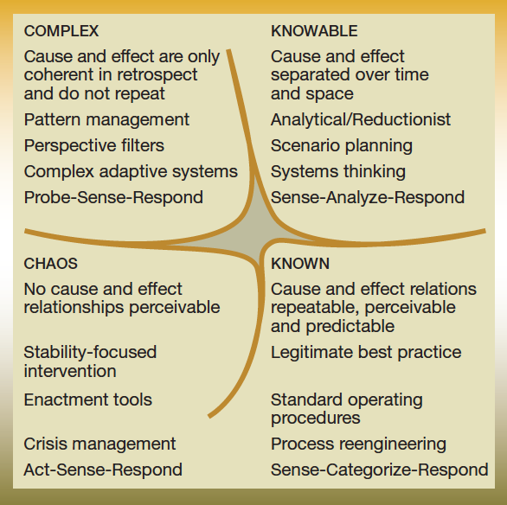
Classes of Systems Problems: Kurtz and Snowden’s Cynefin Framework
Cynefin domains
Complex systems, characterized by interdependence, self-organization, and emergence – new tools and approaches are needed
Massively- complicated systems present challenges of scale and interface accounting – extensions of traditional methods/tools can help
Chaotic systems can only be reacted to; can attempt to transform into another domain
Simple and complicated systems are straightforward to deal with using traditional systems engineering / mgmt approaches
Source: Kurtz and Snowden, “The new dynamics of strategy: Sensemaking in a complex and complicated world,” IBM Systems Journal, 42 (3), 2003.
8

Slide 9
What do we mean by complexity?
No easy, agreed-upon definition
We often call something complex when we cannot fully understand its structure or behavior: it is uncertain, unpredictable, complicated, or just plain difficult (see Sillitto (2009): Subjective Complexity)
Concepts that seem essential
Emergence: Features/behavior associated with the holistic system that are more than aggregations of component properties
Multi-scale behavior: System not describable by a single rule, structure exists on many scales, characteristics are not reducible to only one level of description.
A system with self-organization, analogous to natural systems, that grows without explicit control, and is driven by multiple locally operating, socio-technical processes, usually involving adaptation
9
Notes:
Opposite of complex is not “simple”; opposite of complex is decomposeable

Slide 10
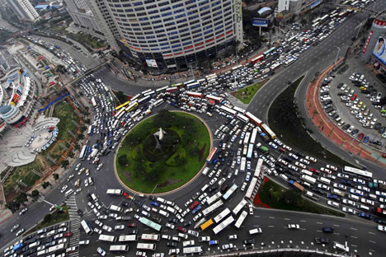
Complex vs Complicated
Complex system
Complicated system
Traffic jams exhibit:
Self-organization and Emergence – local actors and decisions interact to create larger patterns
Memory – even after an obstacle is removed the jam can persist for hours
Counter-intuitive outcomes – e.g., Braess’ Paradox – adding capacity to the network can degrade network performance
Modern transit vehicles exhibit:
Large numbers of interacting systems – fuel, electrical, engine, transmission, safety, etc.
Aggregate properties, but not emergence – e.g., range, top speed…
Unexpected outcomes still possible, but origin is different
Transit systems may be complex
The opposite of “complex” is “decomposable”, not “simple”
10
Source: Alex Ryan

Slide 11
Hallmarks and Implications of Complexity
How complexity makes it difficult
Hallmarks of complexity | Impact on Decision Maker
Interdependence | Cannot treat by decomposition
Nonlinearities | Extrapolation of current conditions → error
Open boundaries | Cannot focus only on processes inside boundary
Multi-scalarity | Have to address all relevant scales
Causal & influence networks | Challenge: develop ‘requisite’ conceptual model within time and information resource constraints
Emergence | Unknown risks and unrecognised opportunities
Complex goals | Goals may change, be unrealistic, vague
Adaptation & innovation | ‘Rules’ change, interventions stimulate adaptation
Opaqueness | Many possible hypotheses about causal paths, insufficient evidence to discriminate
Adapted from Grisogono, Anne-Marie and Vanja Radenovic, The Adaptive Stance –Steps towards Teaching more Effective Complex Decision-Making, International Conference on Complex Systems, June 2011.
11

Slide 12
Sources of Complexity
System
Large number of components, many intricate interdependencies
Adaptive components, interactions
Interfaces with human users or other complex entities
Evolving technology
Environment
Operational environment
Problem you’re trying to solve changes
Conditions under which you’re trying to solve a problem change
Way that you elect to solve the problem changes
System environment
Changes to elements of the larger SoS
Design/management
Large number of people and organizations involved

Slide 13
System Complexity as SE Challenges
Sarah Sheard, Complexity and Systems Engineering, 2011. Used with permission
System Characteristics
(Objective Complexity)
Cognitive Characteristics (Subjective Complexity)
Many pieces
Uncertain
Emergent
Complexity
Difficult to understand
Nonlinear
Adaptive
Unclear cause and effect
Chaotic
Unpredictable
Tightly coupled
Self-Organized
Unstable
Uncontrollable
Decentralized
Unrepairable, unmaintainable
Political
Takes too long to build
Open
Multi-Scale
Costly
13
Notes:
"Essentially, the left are system properties that contribute to complexity, and on the right are the results of complexity on the human.“
(Hillary Sillitto and Scott Jackson of INCOSE have referred to "objective" and "subjective" complexity. They are both interested in what is "objectively complex" about our systems. John Warfield and Heydari seem to be interested in the "subjectively complex." Warfield was exclusively and passionately interested in the subjectively complex.)

Slide 14
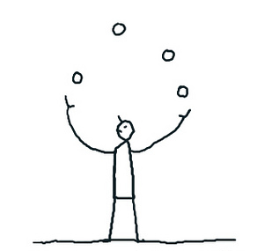
Complexity and Systems Development
You need complexity to respond to complexity
Provides degrees of freedom to needed to deal with/work in complex, volatile and uncertain environments
But developing and using complex systems have their own challenges
Less ability to plan and predict
Problems/systems not neatly decomposable – interdependencies between subsystems grow beyond ability to deal with them in traditional ways
Uncomfortable phenomena arise, such as normal accidents, black swans, catastrophic fragility
Ashby’s Law of Requisite Variety
A model system or controller can only model or control something to the extent that it has sufficient internal variety to represent it.
14

Slide 15
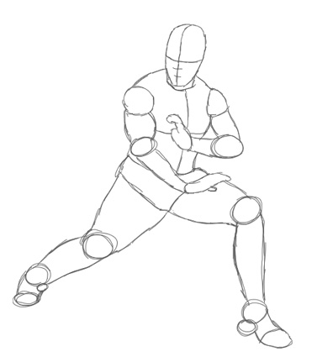
Candidate approaches: Selected Guiding Principles
v
Think like a gardener, not a watchmaker
Take an adaptive stance
Grow, don’t build
Focus on the ecosystem
Extensible substrate
Rules and feedback for adaptation
Influence and intervene vice design and control
Enable and improve adaptation capabilities
Observe system behavior
ID and create variation
Selecting the best versions
Amplify the fit of the selected versions
15

Slide 16
Candidate approaches: Selected Guiding Principles
Think at multiple levels and from multiple perspectives
System behavior may be fundamentally different at different levels
The decomposed problem is a different problem
Systems may create different value at different levels and from different perspectives
Need to look at systems and requirement from diverse perspectives
16

Slide 17
Candidate approaches: Selected Guiding Principles
Combine courage with humility
Use free order
Identify and use patterns
See through new eyes
Collaborate
Achieve balance
Learn from problems
Meta-cognition
Focus on desired regions of the outcome space rather than specifying detailed outcomes
Understand what motivates autonomous agents
Maintain adaptive feedback loops
Integrate problems
17
Notes:
Call out:
Meta cognition
Learn from problems
Focus on desired regions rather than specific outcomes

Slide 18
Candidate approaches: SE Methods Environmental Complexity
 | Requirements Elicitation and Derivation | Trade Studies | Solution Architecture and Design | Development Process
Environment susceptible to unpredictable but high-consequence events and/or recursive complexity | Use power laws to characterize relevant phenomena Focus elicitation on agility vice optimizing to particular assumptions | Make dimensions of agility key trade-space attributes Use trades to ID aspects of the problem space that will drive the system architecture | Design for resilience to “beyond-design-envelope” events to provide robustness and timely recovery to a minimally functional state. | Resilience analysis Enterprise development: study how enterprises or societies survive catastrophes.
18

Slide 19
Candidate approaches: SE Methods System/Solution Complexity
 | Requirements Elicitation and Derivation | Trade Studies | Solution Architecture and Design | Development Process
Complexity in System Design & Development (General) | Use multi-scale modeling (linking macro- and micro-level models), including exploratory analysis and agent-based modeling, and experimentation: To generate insight into the implications of derived requirements As the basis for trade studies and to inform trade-off decisions |  | Emphasize selection of robust and adaptive elements and structures over optimizing to meet current requirements | Use Systems-of-Systems methodologies to synchronize constituent systems; incentivize collaboration. Ensure prototyping and experimentation are used.
19

Slide 20
Applicability of Generalized Analytic Methods: The Cook Matrix
Lists and briefly describes modeling and analysis methods from a wide range of disciplines
Candidate approaches to consider in modeling complex systems problems
Analyze | Diagnose | Model | Synthesize
Data Mining | Algorithmic Complexity | Uncertainty Modeling | Design Structure Matrix
Splines | Monte Carlo Methods | Virtual Immersive Modeling | Architectural Frameworks
Fuzzy Logic | Thermodynamic Depth | Functional / Behavioral Models | Simulated Annealing
Neural Networks | Fractal Dimension | Feedback Control Models | Artificial Immune System
Classification & Regression Trees | Information Theory | Dissipative Systems | Particle Swarm Optimization
Kernel Machines | Statistical Complexity | Game Theory | Genetic Algorithms
Nonlinear Time Series Analysis | Graph Theory | Cellular Automata | Multi-Agent Systems
Markov Chains | Functional Information | System Dynamics | Adaptive Networks
Power Law Statistics | Multi-scale Complexity | Dynamical Systems
Social Network Analysis |  | Network Models
 |  | Agent Based Models
 |  | Multi-Scale Models

Slide 21
Candidate approaches: Analytic tools for the Complex SE Toolkit?
Some are emerging for “massively complicated” SE
MBSE tools and methods
Emerging thinking on T&E in large test spaces
For complex SE, some exist – but are not designed for or aligned with SE community
Complex SE (or CxSE) requires more than just tools
Not a “run the tool, get the answer” problem
Requires understanding of the nature of complexity and how to deal with volatility and deep uncertainty
Mindset, experience (and education)
Tools needed are those that will enable this understanding
A key role of the systems engineer is to facilitate this understanding across his/her stakeholder communities
21

Slide 22
Next Steps (for the Primer and the WG)
Present Primer for INCOSE technical review
Continue to socialize primer as a resource for INCOSE members
Expand on selected Primer topics; evolve into wiki to facilitate evolution and access; develop annotated complexity bibliography
Construct Concept Map for complex systems knowledge
Leverage primer (and other) approaches to address (or at least generate new insight into) community “hard problems”
Cybersecurity
Evolutionary Acquisition
Systems of systems
Engage with other working groups to identify intersection topics we can work together

