Slide 1
Genneva Gold Savings Plan

Slide 2
Genneva Malaysia Sdn Bhd in a nutshell:
GENNEVA MALAYSIA SDN BHD (592576-A), (formerly known as Dimensi Sentosa Sdn Bhd was incorporated in Malaysia under the companies Act 1965 to conduct gold bullion trading business in Malaysia using GENNEVA's unique concept.
GENNEVA MALAYSIA has complied with section 21(1) of BAFIA 1989 (Banking and Financial Institution Act), relating to factoring and leasing business and has acquired the status of a scheduled business.
GENNEVA MALAYSIA is also a reporting institution under AMLA 2011 (Anti Money Laundering Act).
GENNEVA MALAYSIA's business model is based on the Syariah principle of "Ai-Bai" (Sale and Purchase). To make the transaction more attractive, GENNEVA rewards its customers with discretionary payments pursuant to the Syariah principle of "Hibah."
GENNEVA's Story
From its humble beginnings in 2007, Genneva has evolved to become one of the leading and most innovative gold traders in Malaysia, Singapore, Hong Kong, China and The Philippines, with a future plan to expand to all neighboring Asian countries.
GENNEVA has enriched tens of thousands of individuals from all walks of life from

Slide 3
Genneva Gold Savings Plan
Save with Genneva Gold Bullion. Through Genneva’s unique wealth sharing platform, you are not only the owner of the gold bullion in hand, you get 1.5% Hibah (gift) every month under Genneva’s Syariah principle-based product plan.
It is similar to placing your savings in Fixed Deposit. Whether the price of gold goes up or down, your capital is protected 100% with 1.5% Hibah every month (i.e. 18% per year); compared to FD which gives you only 3% return PER YEAR.
In addition, at the end of each tenure you can return the Gold Bullion at the same price you bought the gold at. This means a 100% capital protection.

Slide 5
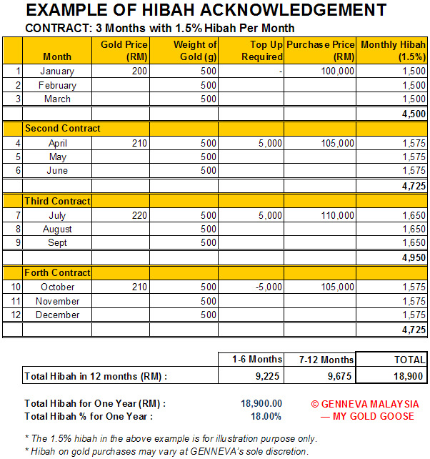
Beat this: For the same amount of your savings in Genneva Gold, you receive a total of RM15,750 compared RM2,700 at current FD rate at 3% return for a whole year!

Slide 6
LATEST NEWS: Deepavali Gold Promotion for new and existing clients valid till 14 October 2011. Tenure: Four months for the following packages:
50g-95g – Hibah 1.8% monthly
100g-995g – Hibah 2.1% monthly
1kg & above – Hibah 2.5% monthly

