Slide 1
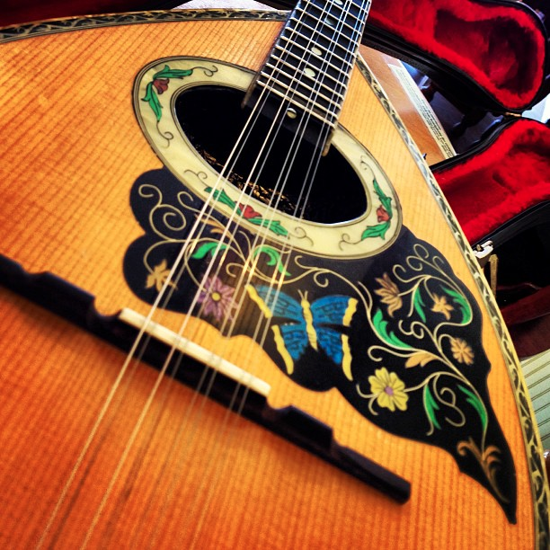
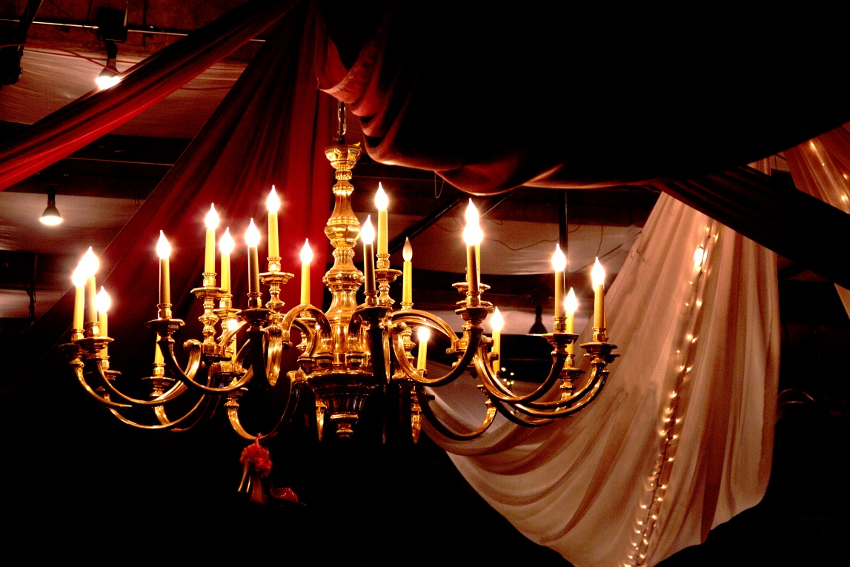
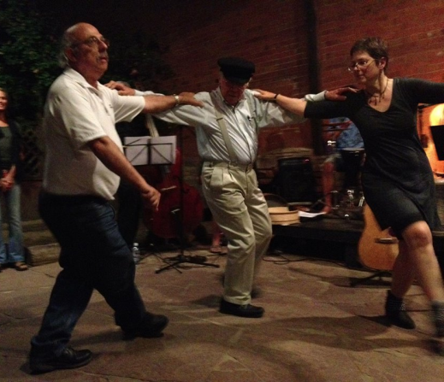
Glendi
at the
Potluck,
Greek
Music
&
Dance
Avalon
Vaccination REQUIRED
Masks may be required
Saturday March 26, 6 – 9 pm. Avalon Ballroom, 6185 Arapahoe Rd, Boulder, CO 80303
Neighbors, folkdancers, musicians, locals and visitors, families, friends and singles; all are welcome. Potluck at 6 (feed the musicians) then till 9:30 pm traditional folk dance music from around the world, usually Greek plus other Balkan flavors. Free dance lessons for beginners.
The Glendi Band will feature James Hoskins, Julie Lancaster, Dexter Payne, Jesse Manno and Brett Bowen.
Free! Don’t let the $10 donation request stop you. Donate if you can, all proceeds benefit the musicians. Thanks to BIFD for sponsoring the space! Questions? Biz@bizhertzberg.com

