Slide 1
H8-Z5-4 TAPE BACKUP CONTROLER CALIBRATION PROCEDURE
By: Norberto Collado V1.0
2/4/2023

Slide 2
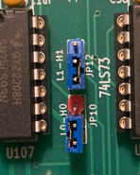
Jumpers Settings:
Jumper on JP1 – 1-2 (TP1-TL)
Jumper on JP12 – 2-3
Jumper on JP10 – 1-2
Jumper on JP703 – 3-4
Jumper on JP15 to calibrate the board per Heath H8-5 documentation
Jumper on JP13 – 2-3 (500mV setup.)
Jumper on JP702 to use single recorder and player
Jumper on JP701 to use single recorder and player
Warning:
If using P8251 or INS8251: do not insert jumpers on JP4 (motor on) and on JP6 (Motor On/Off)
If using 82C51 or others type: insert jumper on JP4 and JP6.
NOTE: You can use the Heathkit H8-5 manual to calibrate this new board as it is using same jumper
and adjustable resistors values.

Slide 3
H8T Console baud rate: P12
Default 1200bps (insert jumper on 3-4) or 9600bps (insert jumper on 1-2)
8251A Console Baud rate: P13
1. Insert jumper on 7-8 (default 1200bps) you can select max baud of 9600bps

Slide 4
Calibration Procedure using the TEST LED: (Refer to slide 7 for details.)
Turn H8 off
Insert jumper on JP2 (TP3/TP4)
Insert jumper on JP1 (TP1/TL) (1-2)
Turn PLL ADJ control and SPACE DET ADJ fully clockwise (RV119 – 200K ) and (RV113 – 5K)
Turn on H8 computer and D107 (TEST LED) should light.
Adjust the SPACE DET ADJ control until LED D107 just goes out
Turn off H8 Computer
Remove jumper on JP1. On JP1 Insert jumper from TL to TP2 (2-3)
Turn on H8 computer
Slowly adjust the PLL ADJ control fully counterclockwise. As you turn the control, notice the point or points where the
TEST LED flickers.
Set the PLL ADJ control to the point where the LED flickers or where it flickers most predominantly if there is more than one point.
Slowly adjust the control through this point of flickering once or twice and then set the “NULL” point. The “NULL” point is where the TEST LED slows down and virtually stops between the two points where it was flickering.
Turn off H8 computer
Remove jumper on JP2 (TP3/TP4)
Remove jumper on JP1. On JP1 Insert jumper from TP1 to TL (1-2)
Turn on H8 computer
Adjust Volume on cassette player until to get the H8 LED display to count properly.

Slide 5
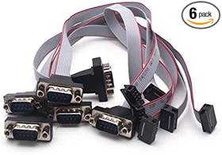
Please use 10 PIN CONNECTOR TO DB9 MALE CONNECTOR on P14, P15, and P7. 10-pin to DB9 female connector won’t work.

Slide 6
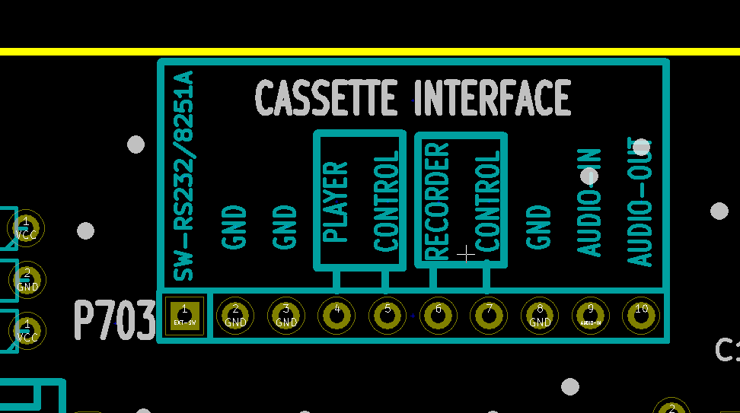
Cassette Interface:
The cassette interface P703 connector is fully compatible with the H89-5 cable.
Pin 1 & Pin 2 – goes to an external switch to select Cassette mode or H8T mode.
- When H8T mode is selected, LED D10 – H8T-ON will turn on, otherwise Cassette mode is selected.
Pin 3 – Ground
Pin 4 and Pin 5 is for Player Control
Pin 6 and Pin 7 is for Recorder Control
Pin 8 – Ground
Pin 9 – Audio in coaxial cable
Pin 10 – Audio out coaxial cable
NOTE: Refer to Heathkit H8/H89-5 manuals
on how to connect Player and Recorder Controls

Slide 7
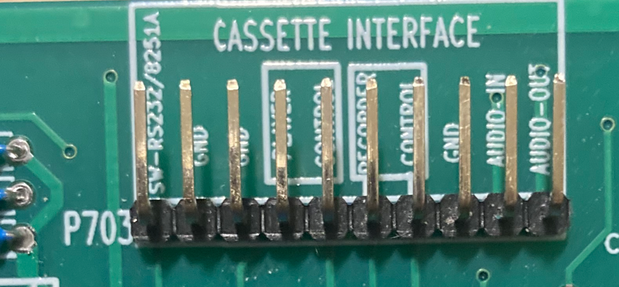
Cassette Interface (cont):

Slide 8
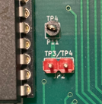
H8-Z5-4 Board Calibration with pictures.
Turn H8 off
Insert jumper on JP2 (TP3/TP4)
Insert jumper on JP1 (TP1/TL) (1-2)

Slide 9
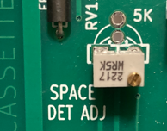
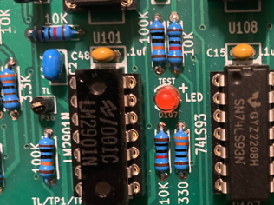
H8-Z5-4 Board Calibration with pictures (cont).
Turn PLL ADJ control and SPACE DET ADJ fully clockwise (RV119 – 200K ) and (RV113 – 5K)
Turn on H8 computer and D107 (TEST LED) should light.
Adjust the SPACE DET ADJ control until LED D107 just goes out (TEST LED).
NOTE: If you want a more accurate adjustment, after LED D107 goes out, keep adjusting slowly the SPACE DET
until the I/O LED stops blinking (D701).

Slide 10
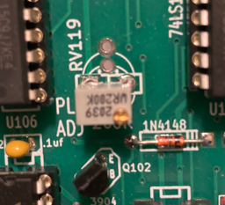
H8-Z5-4 Board Calibration with pictures (cont).
Turn off H8 Computer
Remove jumper on JP1. On JP1 Insert jumper from TL to TP2 (2-3)
Turn on H8 computer
Slowly adjust the PLL ADJ control fully counterclockwise. As you turn the control, notice the point or points where the
TEST LED flickers.
Set the PLL ADJ control to the point where the LED flickers or where it flickers most predominantly if there is more than one point.
Slowly adjust the control through this point of flickering once or twice and then set the “NULL” point. The “NULL” point is where the TEST LED slows down and virtually stops between the two points where it was flickering.
Turn off H8 computer
TEST LED

Slide 11
H8-Z5-4 Board Calibration with pictures (cont).
Turn off H8 computer
Remove jumper on JP2 (TP3/TP4)
Remove jumper on JP1. On JP1 Insert jumper from TP1 to TL (1-2)
Turn on H8 computer
Adjust Volume on cassette player until to get the H8 LED display to count properly.

Slide 12
H8-Z5-4 TAPE BACKUP CONTROLER CALIBRATION
END OF PROCEDURE
By: Norberto Collado V1.0
2/4/2023

