Slide 1
Ruben’s
Causal Layered Synthesis
The diagrams show the fours causal layers and the relationship among them found in any human consciousness/culture at any given time in history and in any given place.
Note that the relationships are bi-directional –
Both from surfaces to depths and form depths to surfaces.
Note also that any functional culture requires a fundamental coherence among the content of the four layers. As incoherence increases:
Things start going awry.
The possibility of personal/cultural evolution increases.
The classrooms and the buildings are simply illustrative of the way things at the surface of life (the “bloody obvious”) embody/exemplify deeper layers of thought, imagination and reality.

Slide 2
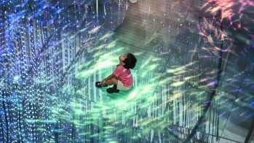
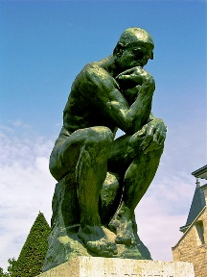
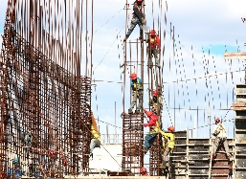
Layers of Our Humanity (At Every Scale)
The Ways We
Know and are Known by Reality
Sensing/Imagining/Seeing
that which Makes Sense
Unconscious
Socialization
Intentional & Reflexive
Embodiment
Coherent Line of Sight Required
Thinking Things Through
Doing Things

Slide 3
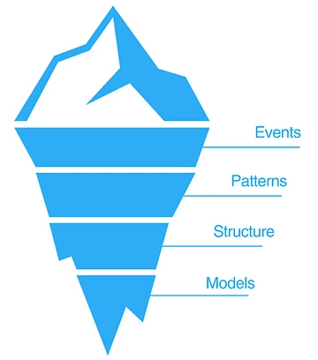
Layers of Our Humanity (At Every Scale)
DO it
DOING PHYSICAL THINGS
Presupposes adequacy of & coherence with all other functions.
THINK it
THNINKING THINGS THROUGH
Presupposes adequacy of & coherence with all other functions.
Intentional & Reflexive
Embodiment
Unconscious
Socialization
SEE it
“SEEING”/IMAGINING
Presupposes adequacy of & coherence with
all other functions.
KNOW it
KNOWING
Presupposes the adequacy of our grasp on reality and its grasp on us.

Slide 4
Layers of Our Humanity (At Every Scale)
KNOW &
BE KNOWN
KNOWING
Presupposes the adequacy of our grasp on reality and its grasp on us.
SEE it
“SEEING”/IMAGINING/SENSE MAKING
Presupposes adequacy of & coherence of our ways of knowing.
Intentional & Reflexive
Embodiment
Unconscious
Socialization
THINK it
THNINKING THINGS THROUGH
Presupposes adequacy of & coherence of our Imagining and Knowing.
DO it
DOING PHYSICAL THINGS
Presupposes adequacy of & coherence of all other functions.

Slide 5
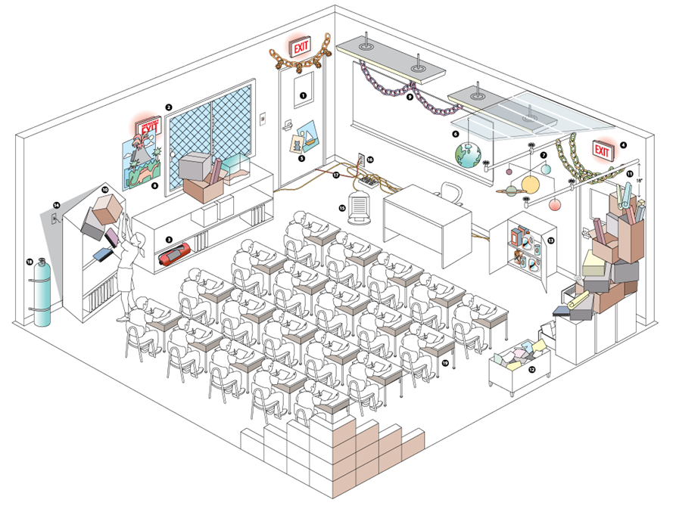
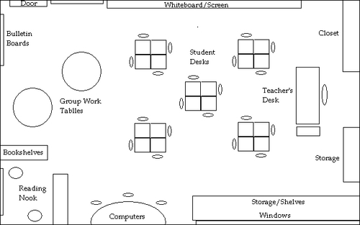
Consciousness Matters: Stuff as Embodied Consciousness

Slide 6
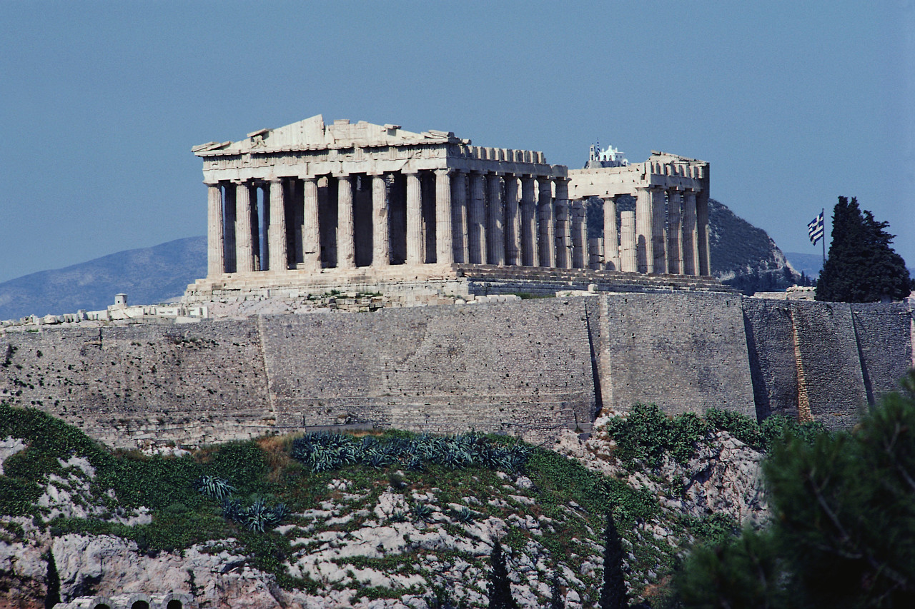
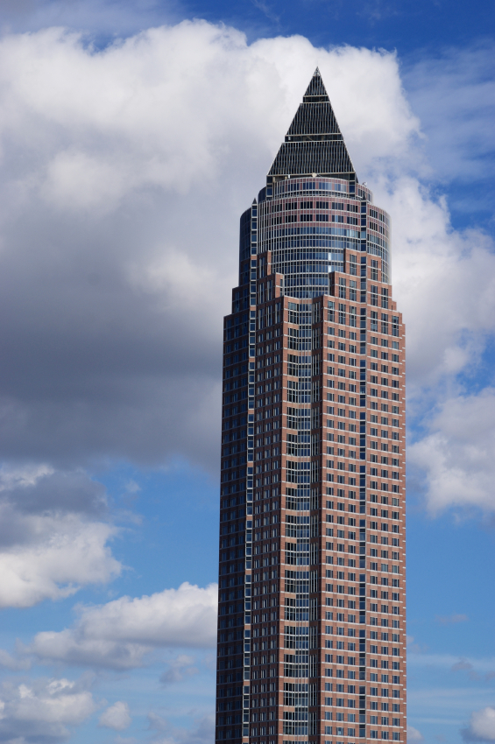
Bill’s Message

