Slide 1
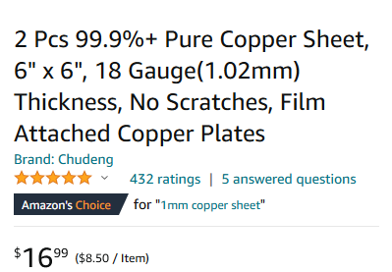
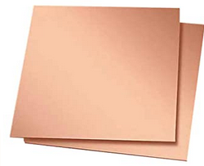
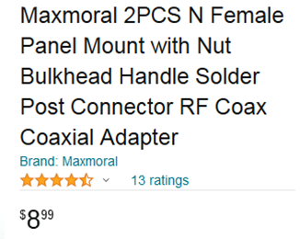
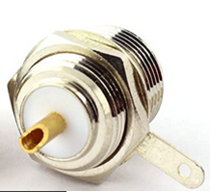
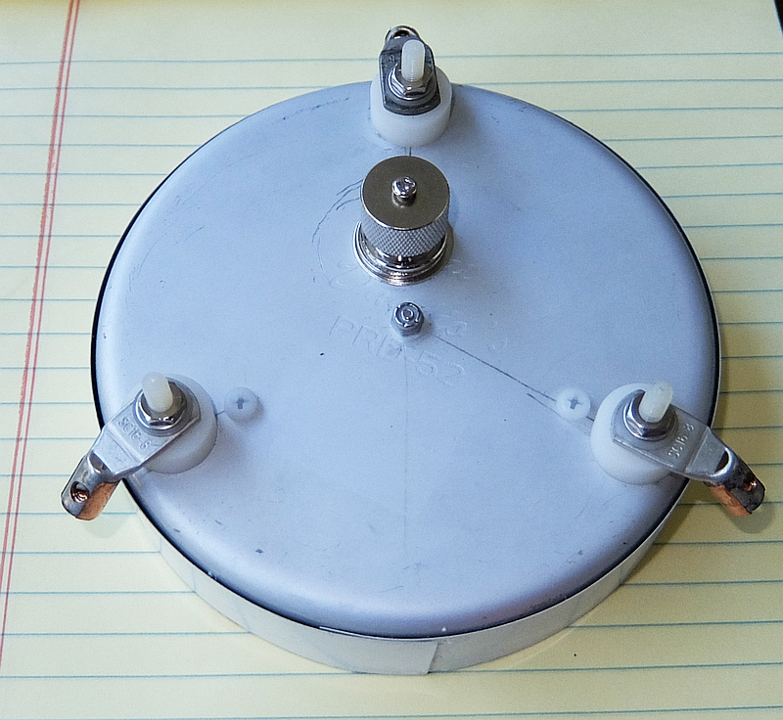
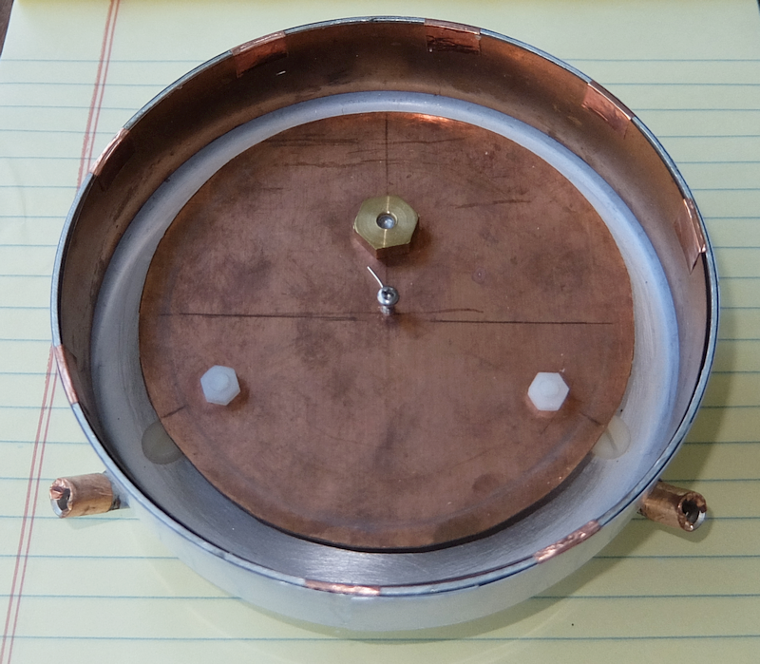
1.42 GHz Patch Feed Antenna
Patch Dia 103mm 1mm copper sheet
Feed_Point 19mm from Center
Reflector <> Patch 8mm
Reflector : 5" cake pan 18 mm deep

Slide 2
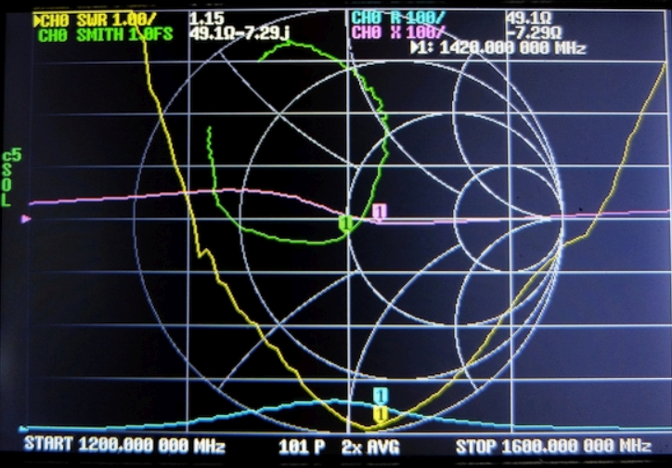
Data obtained With the Feed Mounted on the 1m dish.
( VNA calibrated @ the feed connector )
Z = 49.10 - j7.29 @ 1420 MHz

Slide 3
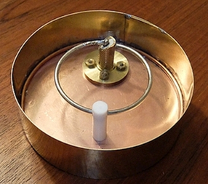
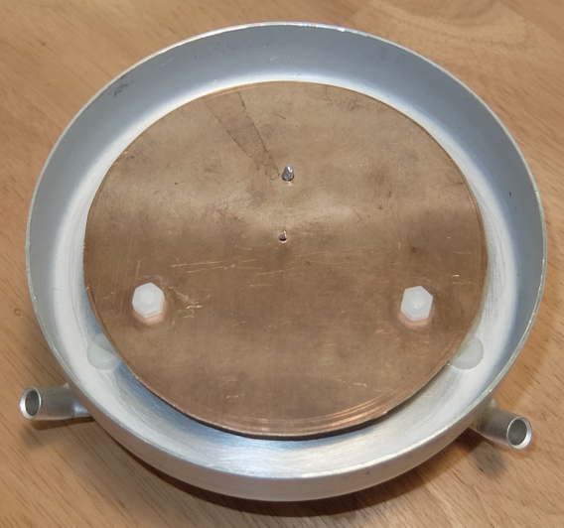
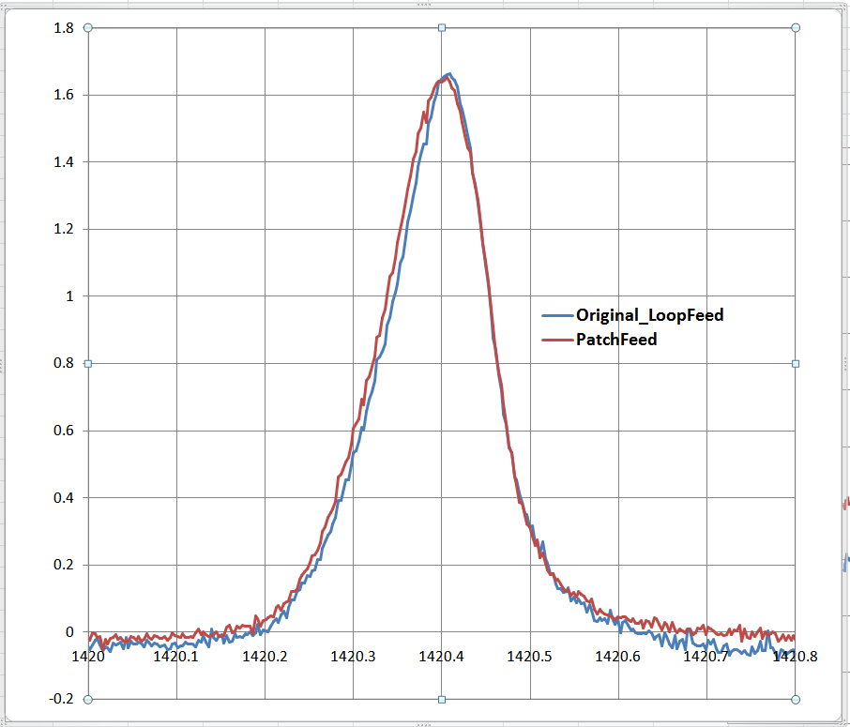
1.42 GHz Loop vs Patch Feed Antenna

