Slide 1
Bus Route Information Management System
A design / requirements document
Author: Nikhil VJ, nikhil.js@gmail.com
Volunteer, PMPML Pravasi Manch
Pune, India

Slide 2
Introduction
This is a working draft+proposal for a design contest that we hope would be hosted by PMPML (Pune and Pimpri Chinchwad’s public bus transit authority) where interested teams would compete to create a robust state-of-the-art user-friendly bus stops and routes information management system that PMPML will thereupon use to maintain their data.
The specifics of the contest are yet to be discussed and the whole project is still in-the-air and subject to change.
This document aims to capture the technical design requirements which the contesting teams would have to follow.
This document is released under a Creative Commons Attribution-NonCommercial 4.0 International license.

Slide 3
Basic Requirements
Stops Management system.
Routes Management system.
Each route has an Up and Down route, in many cases they differ where there are one-ways etc, so need to be defined as two separate lists.
In a few cases Down route is a simple inversion of Up route and so doesn’t need to be defined separately. (this might go away completely if we define stops on opposite sides of the street separately.)
There are some circular routes
Timings are in either of two forms:
First trip, frequency (in mins), last trip
List of times (eg: 0700 0730 0800..)
All data processed and input must be in multilingual form, English and Marathi minimum.

Slide 4
Data Organisation
Core data is Bus Stops, each having a unique StopCode.
Routes are ordered lists of bus stops, storing the StopCode and looking up the rest of stop-related information.
One route can have two lists (Up/Down), or just one (Down is same route in reverse, or Circular route).
Additionally, it can have two sets of timings (Up / Down) or just one (Circular).
Each name/title has English and Marathi version.

Slide 5
Management Interface Requirements
Please see the illustrations in the next few slides; they ought to explain what all we’re looking for.
The look-and-feel used in the following slides is only for representation of ideas, and are not binding. The participating teams are free to create their own look and feel while staying committed to user-friendly design principles.
Contact us for further discussions and clarifications, if you’re a participating team.

Slide 6
Main Screen
View Bus Stops
View Bus Routes
“Manage sections” must be accessible only through login by admins
“View” sections can be accessed without login; they can have the same interfaces as the management secions but without the edit / add / delete features.
Ability to give different kinds of access to different logins.
So some can change only stops, some only routes of one depot, etc
Preferences section would have language selection, and any other customizations. It could also have system-wide customization, eg: to go with only one timings format, or to change the tile layer of the maps, etc.
Manage Bus Stops
Manage Bus Routes
Statistics, Analysis
Preferences

Slide 7
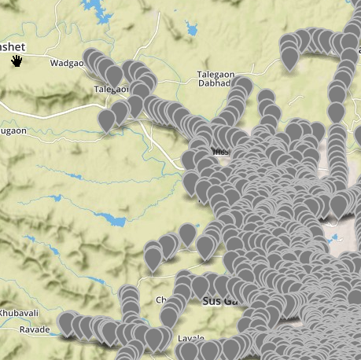
Manage Bus Stops
(adv. search: by stop name, stopcode, route number or name, area, list, bounding lat-long co-ords, date etc)
Add Stop
Remove Stop
Search
StopCode | StopEN | StopMR
□ 10001 | 10 Number colony | 10 नंबर कॉलनी
□ 10002 | 15 August Lodge (Somwar Peth) | 15 ऑगस्ट लॉज (सोमवार पेठ)
□ 10003 | 15 number / Manjari Gaon Phata | 15 नबर / मांजरी गांव फाटा
□ 10004 | 16 Number | 16 नंबर
□ 10005 | 40 Aundh Road | 40 औंध रोड
□ 10006 | 512 Factory Gate | 512 फॅक्टरी गेट
□ 10007 | A B Chowk | अप्पा बळवंत चौक
□ 10008 | Aaimata Mandir | आईमाता मंदिर
□ 10010 | Aashirwad Park | आशीर्वाद पार्क
□ 10011 | Abhi Chemicals | अभि केमिकल
□ 10012 | Abhinav Kala Vidyalaya | अभिनव कला विद्यालय
□ 10013 | AD Camp Chowk | एडी कॅम्प चौक
Browse stops using map also
Click to open a stop’s profile page
See all routes having selected stop(s)
Jumps to Routes Management
Add to list
Import /Export
Stops removed in past are here, can be edited and restored
For bulk operations

Slide 8
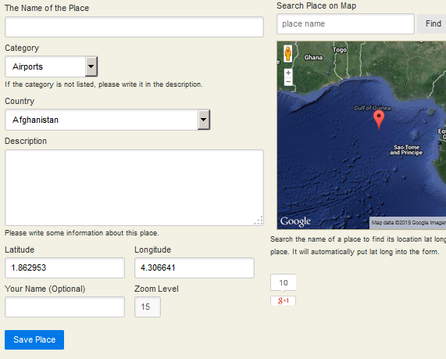
Add or Edit Bus stop
See http://www.latlong.net/add-place.html
We need something like that.
Fields:
English name (unique)
Marathi name (unique)
StopCode (option to let system auto-assign) (unique)
Address / nearby landmark
Lat-long : enter manually or pin on map (unique)
Area (dropdown list)
Date of commissioning (optional)
Work order / budget code details etc (optional paragraph)
Photo
+ Profile picture upload
Notes: - Form validation must not allow location to be beyond some set limits, like for Pune: Lat: 18.0 to 19.0, Lng: 73.4 to 74.4.
- Names, code, addr must be unique and should not match existing stops. For lat-long, show proximity warning if found within 50 meters of existing stop; list those stops and let user click to open their profiles in new tabs.
- Map should show other existing bus stops and allow user to click them and see their name/code, go to their profile etc.
- Have option to let system auto-assign StopCode , and this should become the key in the stop’s permalink (like slug in Wordpress)

Slide 9
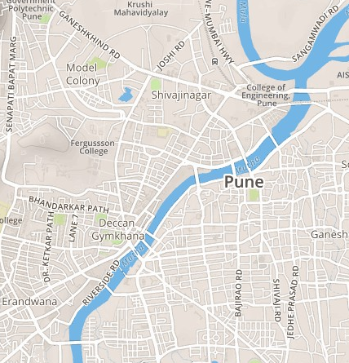
Manage Routes
Up and Down routes displayed
(adv. search: by route number, name, stop, depot, list)
Add Route
Remove Route
Search
Route | Name | No. of Stops | Trips/day | Kms
□ 5 | Route 1 | 25
□ 10 | Route 2 | 56
□ 15 | Route 3 | 32
□ 20 | Route 4 | 56
□ 25 | Route 5 | 43
□ 30 | Route 6 | 29
□ 35 | Route 7 | 12
□ 40 | Route 8 | 43
□ 45 | Route 9
□ 50 | Route 10
□ 50B | Route 11
Route: 21
Swargate to Sangvi
Mark circular routes, different up/down, etc
Edit this Route
Select to display Route on map>>
(multiple routes display also possbile)
See all stops in selected route(s)
Add to list
Import /Export
Jumps to Stops Management
For bulk operations incl. GTFS creation
Routes removed in past are here, can be edited and restored

Slide 10
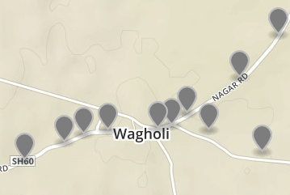
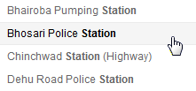
Edit / Add a Route
Mode:
Different Up / Down paths
Same Up / Down paths
Circular
Route:
24
Publish
(lower table disappears if 2nd or 3rd mode is chosen)
Route Name:
Depot↓
Up:
No | Name | StopCode | Distance from previous stop
1 | A | 4545 | --
2 | B | 3234 | 1.2
3 | C | 8658 | 2.1
4 | D | 23123 | 0.7
Up:
First trip
Frequency
Last Trip
Click and drag rows up/down to reorder
TIME
Or Times:
5
Add stop
Highlight stops that are in the route
Station
Wagholi
Code: 4655
Search as you type
Add to UP
Add to DOWN
Down:
Reverse Up sequence and copy
No | Name | StopCode | Distance from previous stop
1 | D | 23123 | --
2 | C | 8658 | 0.7
3 | B | 3234 | 2.1
4 | A | 4545 | 1.2
Stop can be added using map also : click on stop, and press button to add to either track
Down:
First trip
Frequency
Last Trip
TIME
Or Times:
5
Add stop

Slide 11
More Management Interface Requirements
If not Published, new/edited route is auto-saved in Draft mode at every edit.
“Custom playlist”-style list creation option to view and manage routes and stops in groups. Bulk imports should automatically make a new list with date/time stamp.
Update notification email to admins upon change of data, with basic details of the change described.
Rollback/versioning feature to revert changes made to a stop or route. Additions can be manually deleted. And Trash “folder” to preserve deleted stops and routes in case they need to be restored later.
Data import : Presently we are bringing the data together at this online google spreadsheet:
https://docs.google.com/spreadsheets/d/1ppFJeb7Dnj6-1yvniH2Q6exQFzK6fM0wsZNn4XZIvkI/edit?usp=sharing
So the system created should be able to import that data. Alternatively, you can create a program to convert data from that format to GTFS (must be included in the final submission and covered under the same license), and then have this system import the GTFS files.
Data Export: One format of data export is of course GTFS. But another form is needed that is more human-readable. Hence, the second export format has to be the same seen in the link shared above (a spreadsheet/excel format), OR some other equivalent format proposed by your team and approved by PMPML, that is able to accommodate the kind of data we are having.

Slide 12
Some possible customizations
While these aren’t critical to the functioning of the system, some features could be developed to accommodate these:
Each route is under control of a depot. But there are some routes operated by two depots, in which case either side decides the timing for the direction where they’re the origin.
Example: Route 5, station to swargate: Swargate decides timings from their side, Station decides from theirs.
There may be special routes on particular dates.
Timings for some routes might vary on Sundays and other official holidays.
Some routes might not be in operation on select dates.

Slide 13
Bonus features
Teams that accomplish any or all of these will get higher preference in the selection
Solution is in the form of a plugin/addon to popular open source CMS’s like wordpress, drupal, joomla etc.
Entire user interface is available in bilingual : English and Marathi (with language switching option in Preferences section. Bonus points for Hindi in addition to English and Marathi)
Solution can work on Apache+PHP+MySQL platform and can run on portable web servers like UWamp.
Different kinds of statistical information, output using graphical visualization, HTML5 / d3.js, printer-friendly output, etc
Automatic GTFS feed generation on a set URL (similar to posts feed) whenever updates happen

Slide 14
Licensing Requirements
The solution submitted must be released under Creative Commons Attribution-NonCommercial-ShareAlike 4.0 International license.
In addition to submitting all solution files, the team must also self-publish it on GitHub or similar repository under the same or similar license.
PMPML as well as any other public transport authority or group of citizens will be free to use, modify and re-share modified versions of the solution non-commercially.
While free to use, anyone using the solution or its derivatives must attribute the original creators, ie, the team that created this solution is to get complete credit for it wherever the solution goes.
We feel that going with open standards is necessary to break the deadlocks and empower not just Pune but all cities in India and elsewhere to have a robust state-of-the-art mass transit system.

Slide 15
Thanks!
Looking forward to getting something awesome together!
Regards,
Nikhil VJ, nikhil.js@gmail.com
Volunteer, PMPML Pravasi Manch
Pune, India

