Slide 1
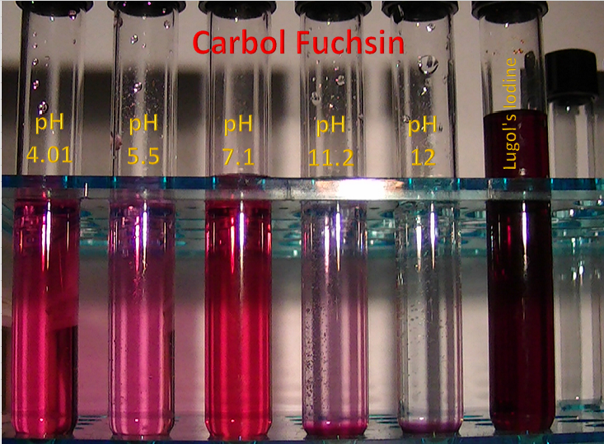
Carbol Fuchsin (Basic Fuchsin/Phenol) Doped with Lugol's Iodine
August 14, 2016
David H Haffner Sr.
Determination of 2 compounds contained in 1 mixture using the DH 4.0 v4 Spectrometer

Slide 2
Overview
Project description
Objective
Results
Project methodology
Key findings / results
Results / Carbol Fuchsin
Results / Lugol’s Iodine
Conclusion

Slide 3
Project Description
Objective
Results
The determination of 2 separate chemical compounds using absorption spectroscopy and the DH 4.0 v4 spectrometer.
Using pH adjustments for color changes in relation to absorption.
Preliminary findings are positive for the identification of carbol fuchsin and Lugol’s iodine solution (potassium iodine/Iodine) in distilled water at varying pH levels.
Notes:
Lugol's Iodine, also known as Lugol's Solution, first made in 1829, is a solution of elemental iodine and potassium iodide in water, named after the French physician J.G.A. Lugol.

Slide 4
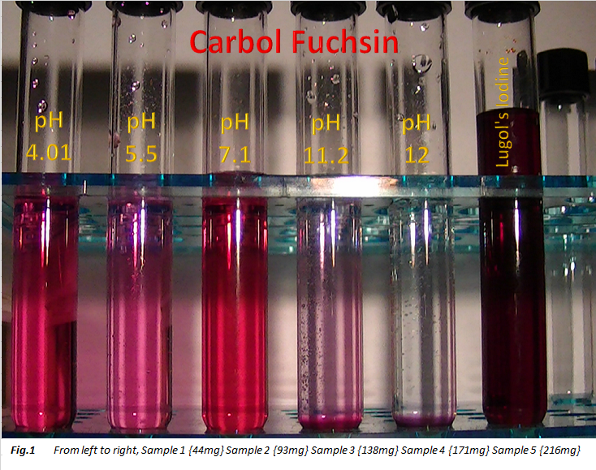

Slide 5
Procedure / Methodology
Using 7 13X100mm glass test tubes with screw tops, from Karter scientific (402D2,) each test tube was labeled as AB01- FI [1] thru [5] Batch#02. Using a 1000micro liter pipette tip, inserted into a glass eye dropper, each drop of Carbol Fuchsin and Lugol’s Iodine were weighed on a lab quality digital scale from 1 to 5 drops for volume weight per drop, then the appropriate sample quantity was transferred to each test tube.
2 Control sample test tubes were also prepared, using the above procedures. 1 for carbol fuchsin and 1 for Lugol’s Iodine solution.
Key assumptions
1) Since adjusting pH of a solution determines the extent to which any chemical group is protonated or deprotonated, (positively or negatively charged,) this effect should in fact, alter the color of each sample.
Using 2 separate controls (basic fuchsin and Lugol’s iodine) I should be able to utilize these as my references for comparison against my other 5 samples.

Slide 6
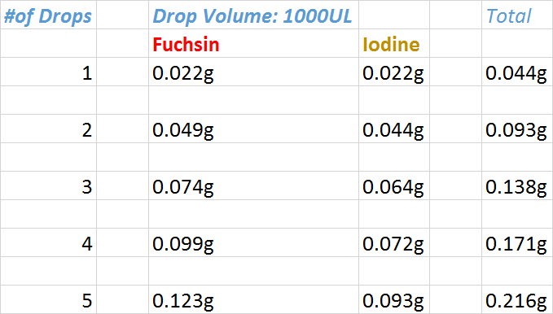
Determining Drop Volume
Using a high precision GEM50 smart scale, each individual drop was weighed using a 1000UL pipette tip attached to a glass eye dropper

Slide 8
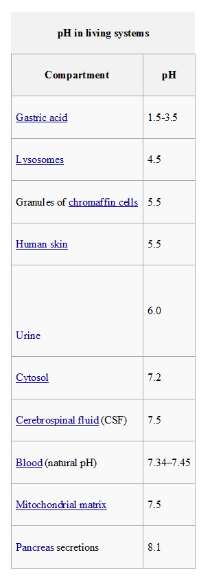
pH CHART for Living Organisms
I included this chart because I am using a biological staining dye and a few of the pH levels I used are on this chart.

Slide 9
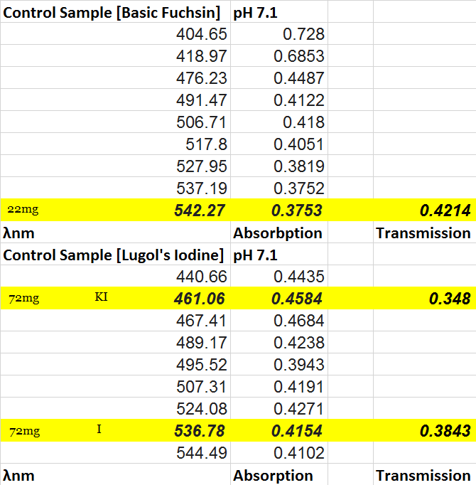
Methodology: Control Samples
These are my 2 controls that I used as my reference samples, one for basic fuchsin and the other for lugol’s iodine.
I used the 22mg fuchsin sample as my least concentrated sample so as to reduce any inner filter effect that might interfere with the Beer+Lambert Law.
The same was done with the iodine sample, although it is at a slightly higher concentration, I found that at this fair rate that, I got a better spectral reading from previous experiments.

Slide 10
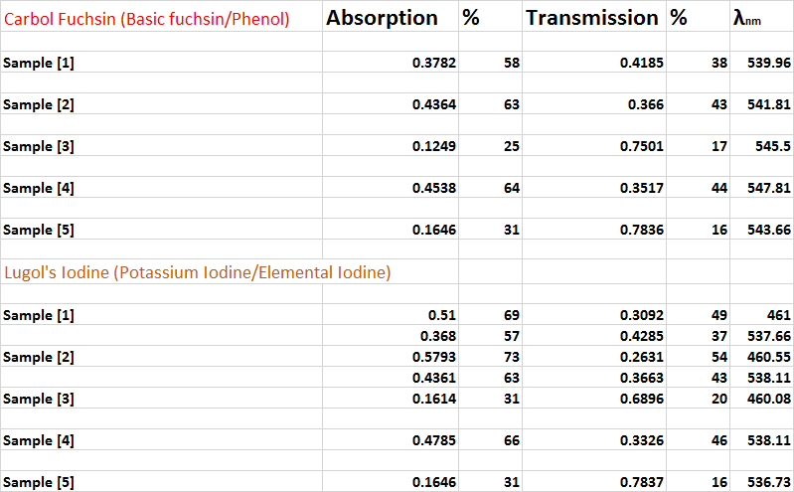
Data acquisition for all 5 samples:
Now my data is organized in a useful manner.
Here I can compare my results to those of my control samples and that of the results from the literature.

Slide 11
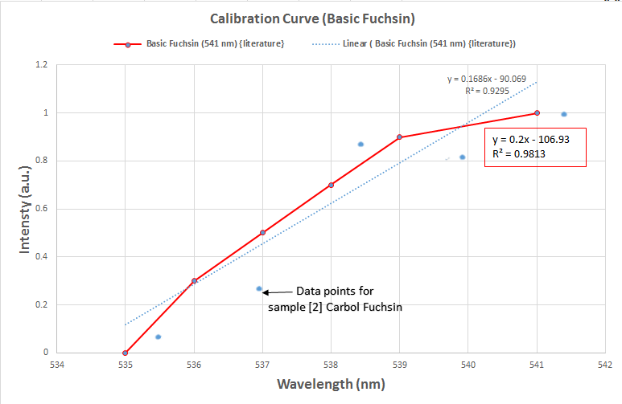
Key Findings / Results 1
This is my calibration curve for my reference, which is basic fuchsin from the literature spectrum at 541nm maximum absorption.
I chose sample # 2 because both the spectra for the fuchsin and iodine were the closest match. The trendline in RED is the reference spectrum and the blue is sample # 2.
Sample # 2’s maximum absorption is at 541.81 nm. I did not acquire a reference spectrum for iodine as it’s maximum absorption varies too widely and I did not have a high confidence level when the values range from 460 – 464nm for potassium iodine and 536, 538 and 541 nm for elemental iodine.

Slide 12
Sample [2] Calibration Curve
Sample #2 is at a pH of 5.5 (human skin) and has the closest “fit” to the reference curve of 541nm.
Y axis is scaled at mol/l for concentration level and the X axis is scaled at The Molar Absorption Coefficient [l/{mol*cm}]

Slide 13
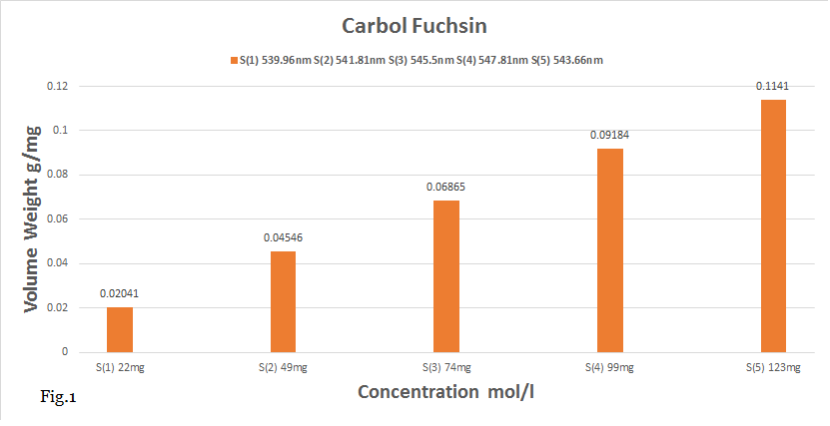
Key Findings / Results 2
Here is the individual molar concentration break down of carbol fuchsin samples 1 thru 5
And their respective wavelengths per mg.

Slide 14
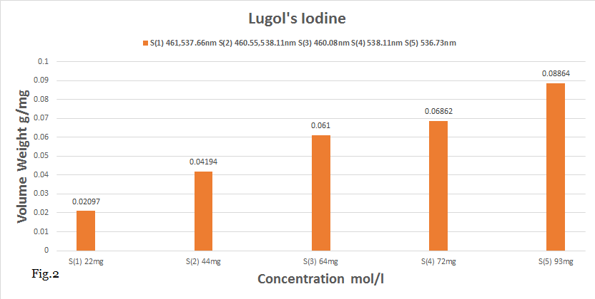
Key Findings / Results 3
Run number | Description | Result A | Result B
1 | Condition A | True | True
2 | Condition B | True | False
3 | Condition C | False | False
Here is the individual molar concentration break down of potassium iodine and elemental iodine samples 1 thru 5
And their respective wavelengths per mg.

Slide 15
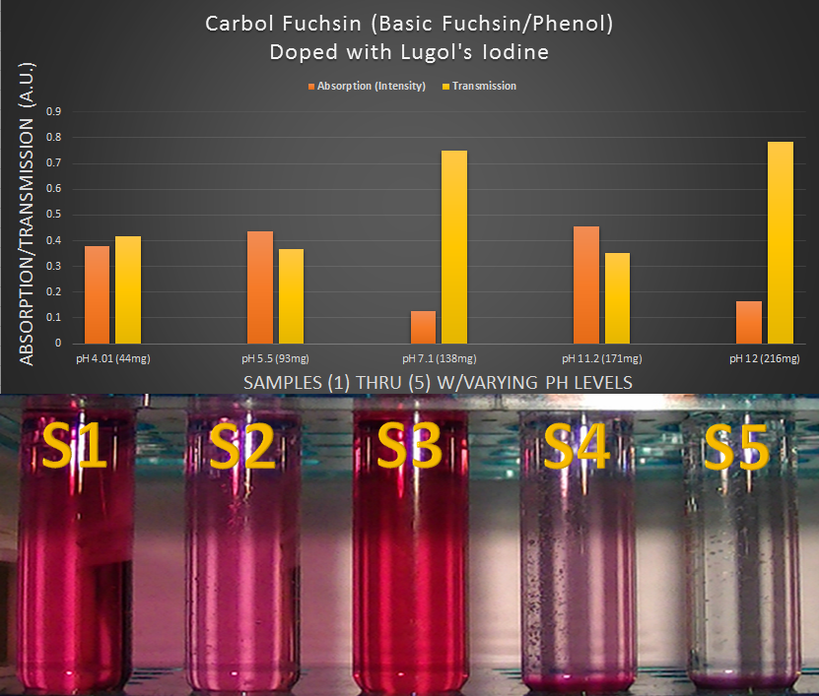
This is the main illustration representing the absorption and transmission properties of both substances, what I observed that was quite interesting were several things, starting with sample 3, notice its concentration at 138mg but its absorption factor was only 25% with a transmission of 17%, what would be going on here since our molar concentration value is in line with slide #14?
Also, notice in the picture that sample #3 has the darker red color, because of the neutral pH level. You would conclude that the color alone would constitute a higher absorption, not so, take note that there is 64mg of lugol’s iodine mixed in, which absorbed at an additional rate of 31% (only the potassium iodine absorption was recorded.)
Samples 4 and 5 will be discussed later

Slide 16
Conclusion
Samples 4 and 5, are the most interesting because they appear to ignore the Beer-Lambert Law, but in fact directly support it. In order for absorption spectroscopy to work, light must be absorbed by molecules and then that excitement is transmitted in a form of percentage per photon absorbed.
Sample 5 is almost clear, the high pH of 12 renders the molecules of fuchsin invisable at the visible light spectrum but the fuchsin molecule is still there at the concentration level of 123mg and the iodine at 93mg. Which is supported by the data (0.1141 mol/l for fuchsin and 0.08864 mol/l for lugols iodine [sample 5 ].
So, the Molar Absorptivity Constant is specific for every single solution, and at every wavelength. When you are taking an absorbance spectrum, and measuring the absorbance at different wavelengths, this is the only factor that is changing, as the concentration of the solution remains the same, and so does the path length. The path length of each vial is the same, and the concentration of each of these solutions is the same, yet the solutions are all different colors and will therefore absorb very differently. The only difference to change the absorbance, is the Molar Absorptivity Constant.
Conclusion # 2, using these strict guidelines throughout this study, for identifying multiple substances within a single compound, I have successfully identified both substances (carbol fuchsin and Lugol’s Iodine,) within acceptable values of the references, both the control samples and that of the literature absorption spectra’s.

Slide 17
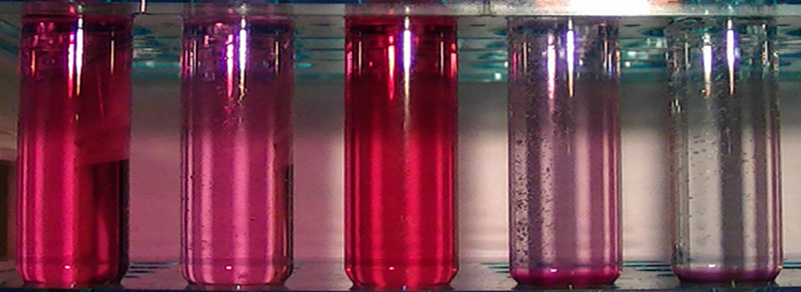
Questions & Discussion
One question is how the carbolic acid in the fuchsin might have played a part in some of the chemical reactions at the higher pH levels, since the literature states that carbolic acid (Phenol,)and how it accentuates staining is still not completely clear. The explanations tend to be speculative, and are not particularly convincing.
Future studies will be done to answer some of these questions about the interaction of carbolic acid
with and without the presence of high pH levels or iodine doping.

