Slide 1
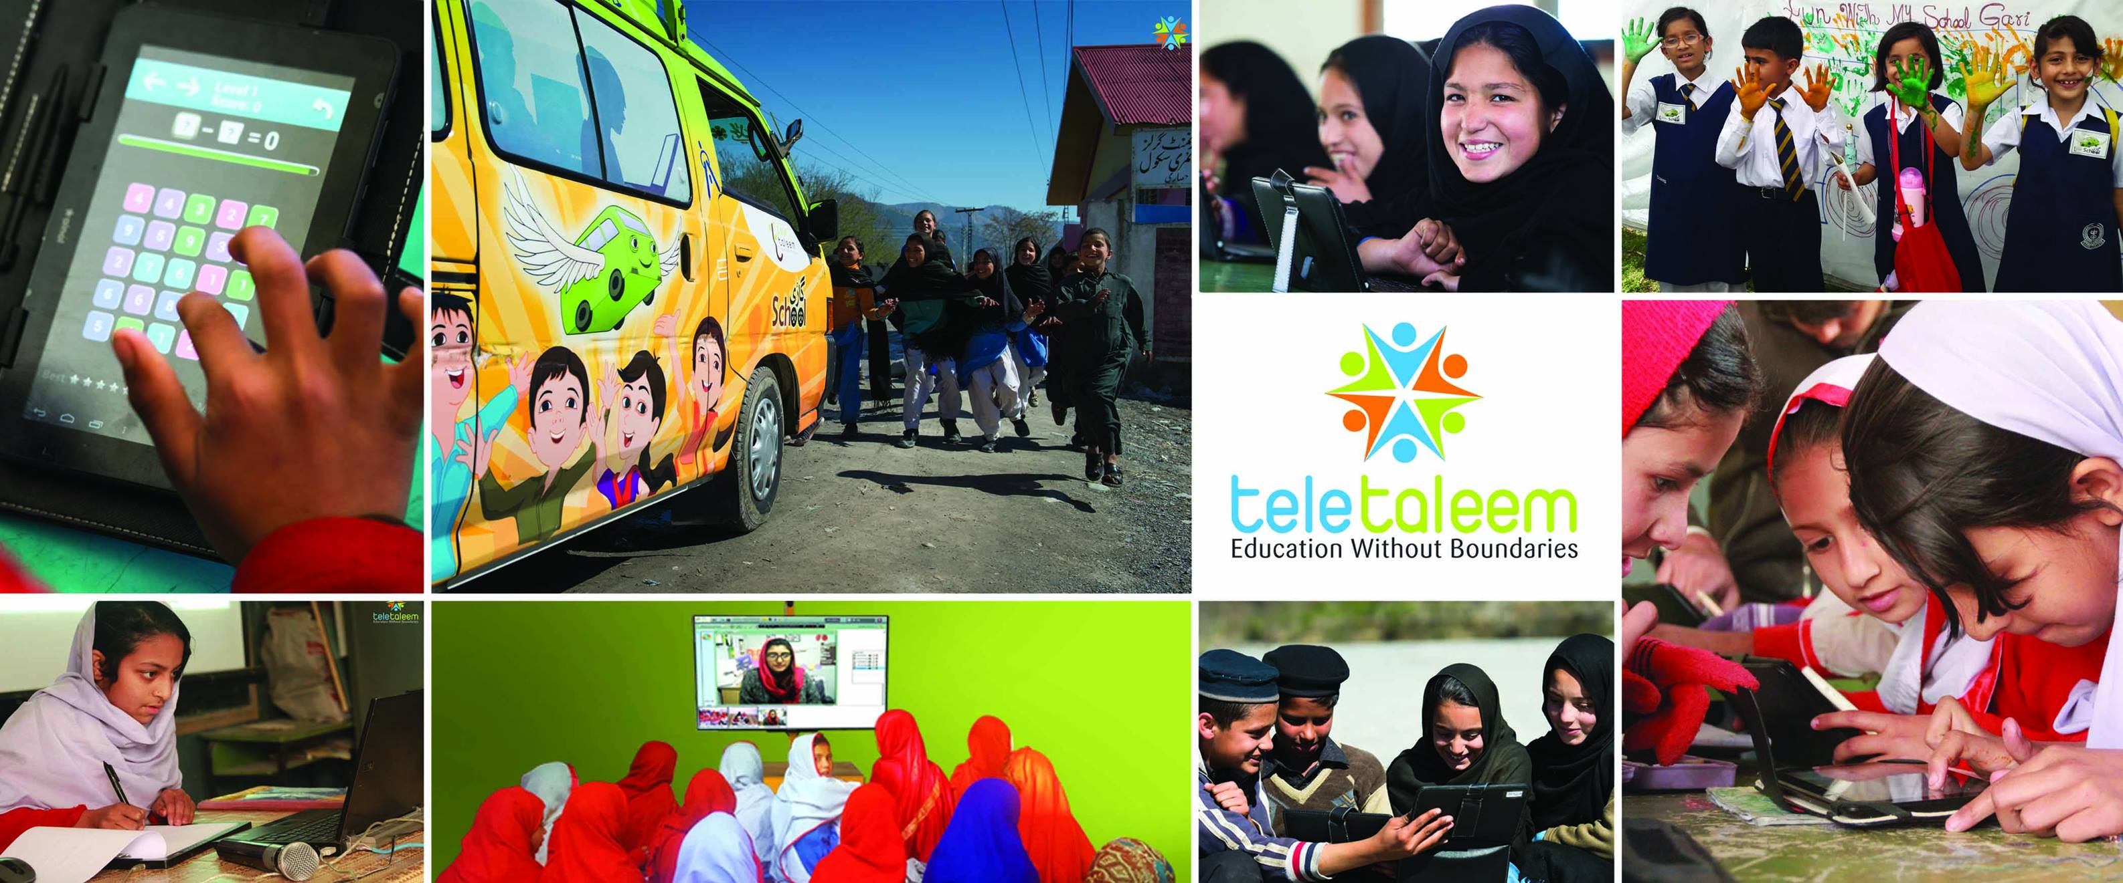
TeleTaleem Profile

Slide 2
Introduction
TeleTaleem is a social enterprise focused on enhancing quality of education services at the grassroots level, through innovative use of technology.
Specialists in the design & delivery of e-learning systems and services, using a variety of delivery mechanisms and platforms.
Over 8 years of local experience in delivering technology enabled teaching, training and assessment services.

Slide 3
The Learning Challenge
To achieve improved learning outcomes for primary school children in Pakistan.
Lack of qualified and well trained teachers in public and private schools in Pakistan, especially in rural settings.
Weak teacher competencies, specially in early to primary grade content knowledge.
Weak monitoring and assessment of in-class teaching process and student performance

Slide 4
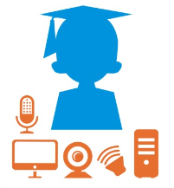
TeleTaleem’s Innovation
Online quality teaching, augmented with student assessment, feedback and monitoring.
Online access to quality teachers based in metros, backed by continuous training and quality assurance.
Rigorous observation and feedback of teaching practices and classroom processes to achieve improved learning
Continuous assessments of students with feedback to teachers to guide formative learning

Slide 5
Education Services
Online Teaching Services (OTS)
Online interactive teaching to students in remote schools
Grades 4-8 covering English, Math and Science
Fully managed service
Learning Boost
Teacher Professional Development
Early Grade Literacy & Numeracy
Rapid Assessment Service
3rd party assessment service
Benchmarking of learning outcomes
Independent diagnosis and recommendations
Online Teachers Training Services (OTTS)
Online interactive training of teachers from remote schools
Fixed and Mobile delivery models
Tech enablement OR Fully managed service models

Slide 6
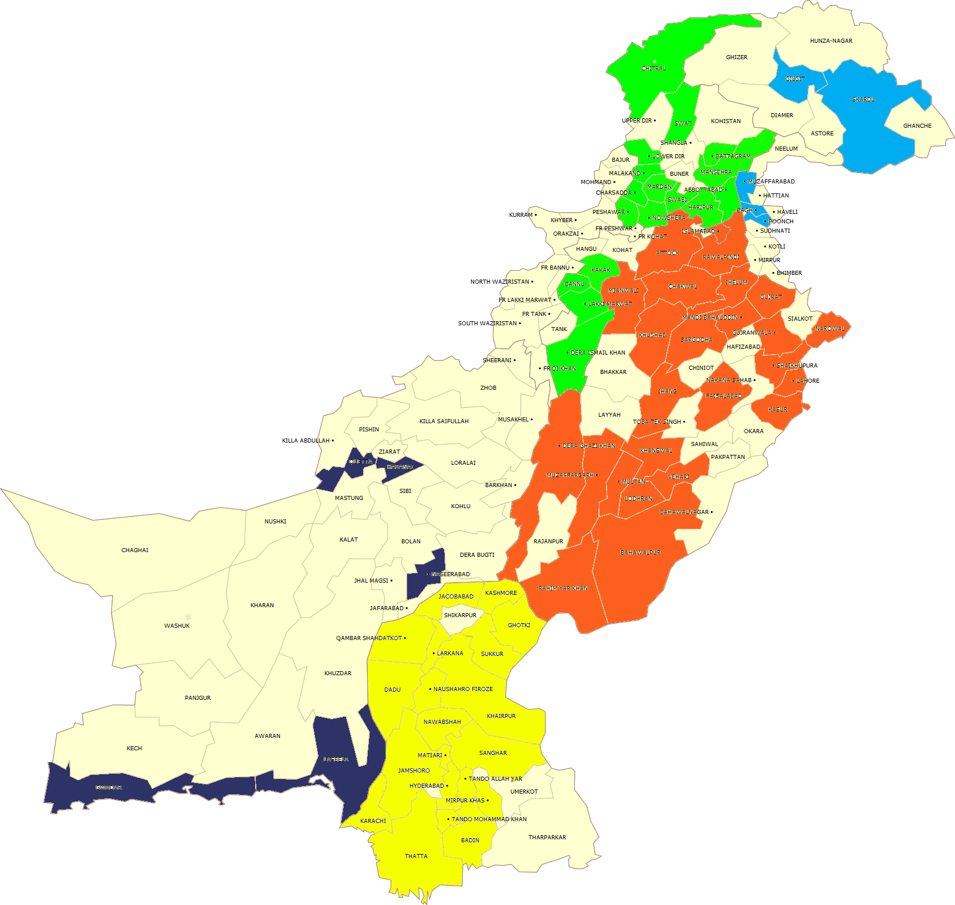
Geographical Coverage
Nationwide Reach – All provinces incl. AJK
4,000+ Schools
60+ Districts
6,000+ Teachers
300,000+ Children

Slide 7
Projects Implemented
Ilm-on-Wheels, Early Grade Literacy and Numeracy program implemented under an MoU with KP E&SE in 55 schools in Mansehra.
Teachers Training, Teaching Services in 300 public primary schools in Punjab and Khyber Pakhtunkhwa
Online Teaching & Training Service (150 Schools) - Daily classes of English, Math and Science for Grades 4, 5 Girls Community Schools throughout Khyber Pakhtunkhwa
Online Teaching Service – Daily classes of English, Math and Science for Grades 6, 7 & 8 in Govt. Girls Higher Secondary School, Harnai, Balochistan – Scaling up to 22 High Schools in Balochistan
44 Govt schools adopted in Punjab from PEF/PEIMA in collaboration with University of Education Lahore. Online Teaching, Learning Boost and Rapid Assessment implemented on ongoing basis

Slide 8
Projects Implemented
3rd party Independent external assessments of children in grades 2, 5, 6, 8 in all 1300+ schools across Pakistan
Multiple rounds of Formative Assessments in Sindhi and English in 1,570 schools across 7 districts in Sindh.
Monthly assessment and reporting of 900+ public primary schools in Distt. Sheikupura, in collaboration with DSD.
Development of a Crowd Sourcing based Assessment System
Technical Assistance to design and develop strategies for adoption of ICT in basic/primary education

Slide 9
Large in-house team of professionals in software design, eLearning content integration, training, teaching and project implementations

Slide 10
Partners, Customers & Global Recognition
Partners & Customers
Globally Featured and Recognized

Slide 11
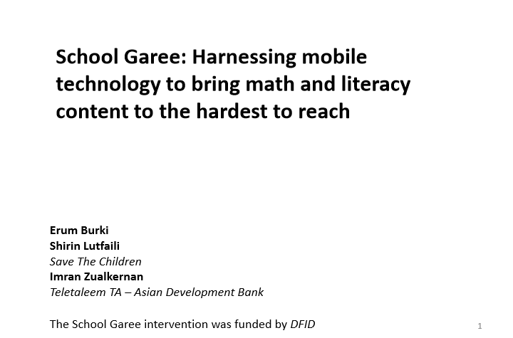
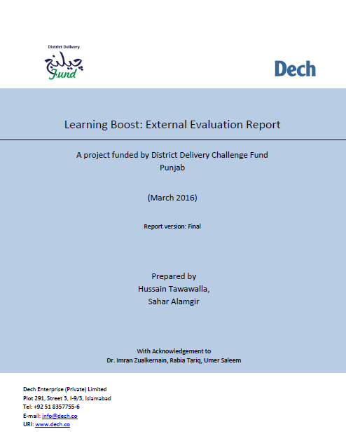
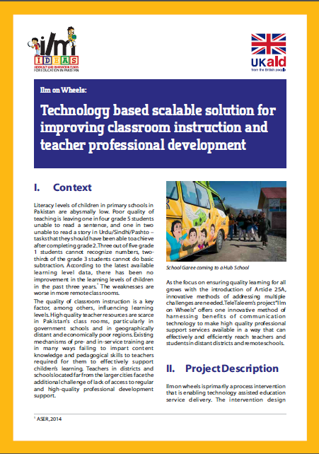
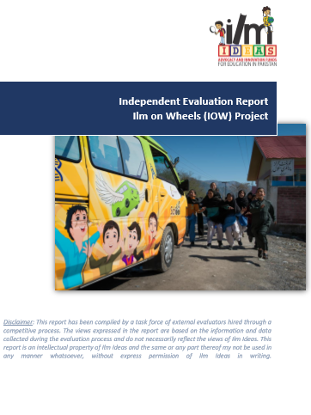
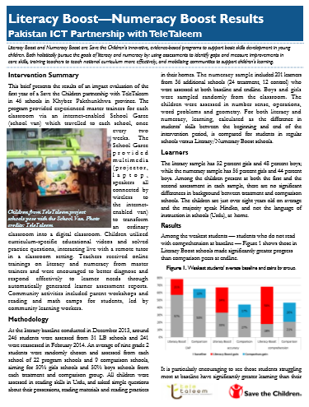
Evaluations

Slide 12
Thank You

