Slide 1
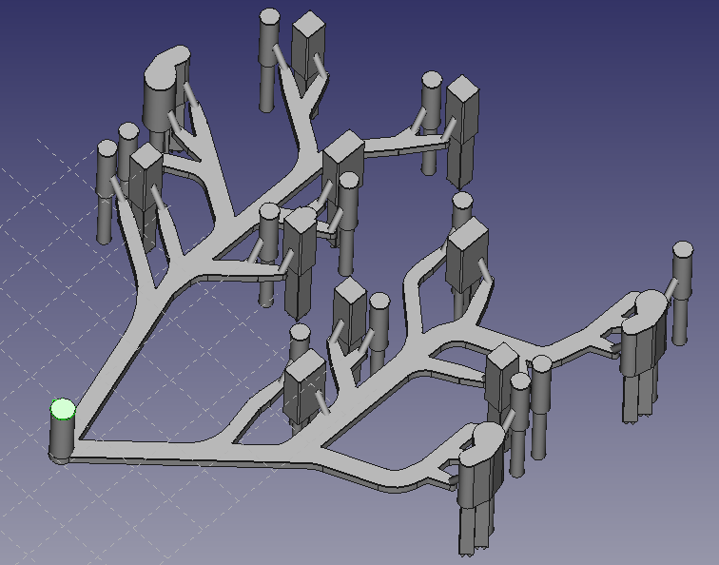
INLET

Slide 2
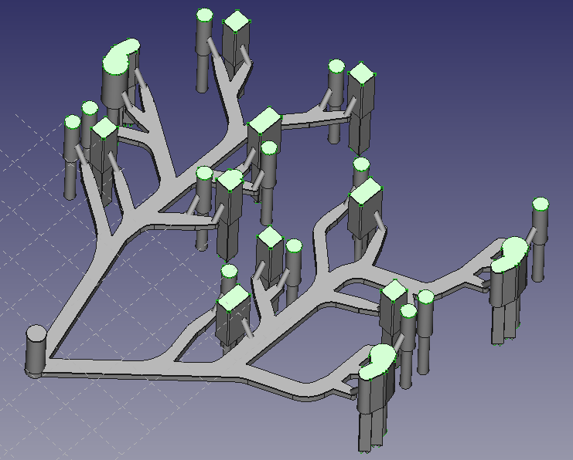
OUTLET

Slide 3
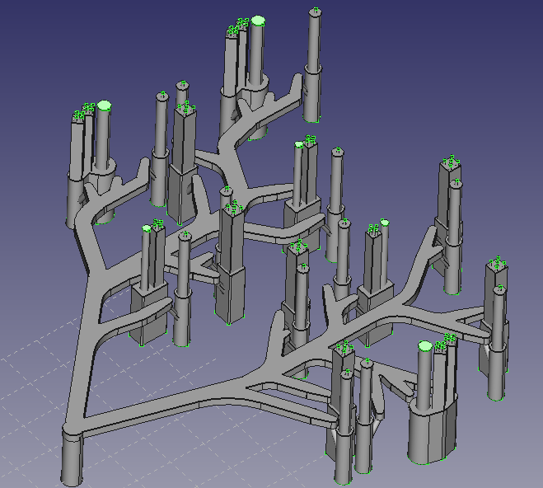
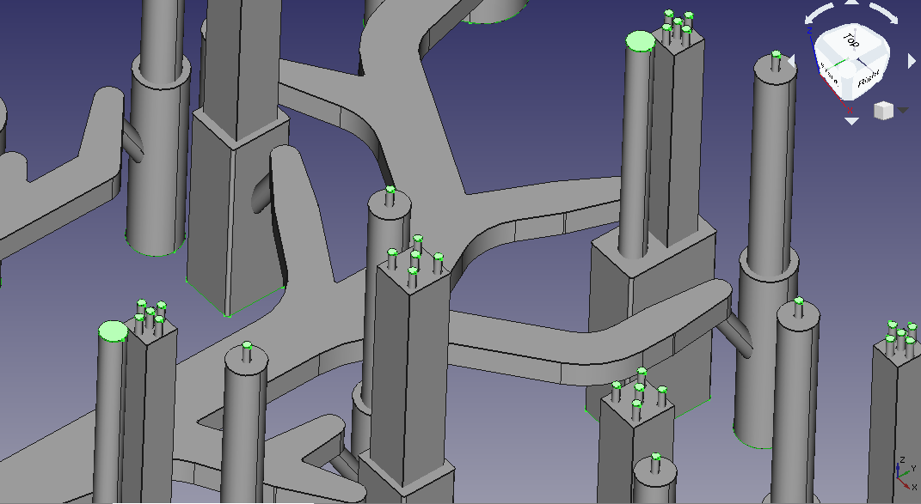
OUTLET

Slide 4
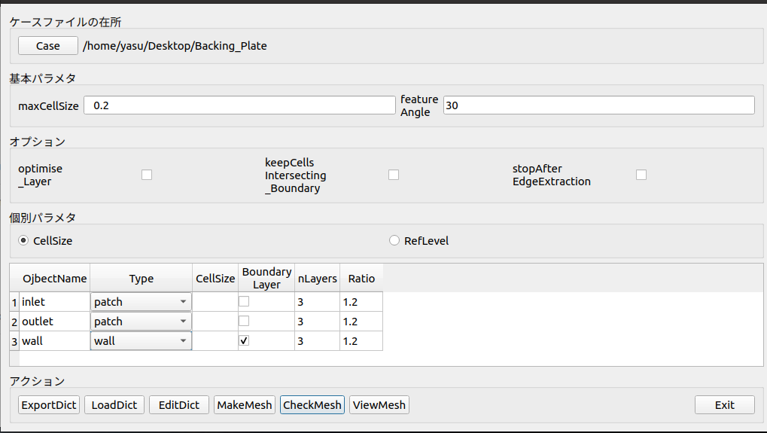

Slide 5
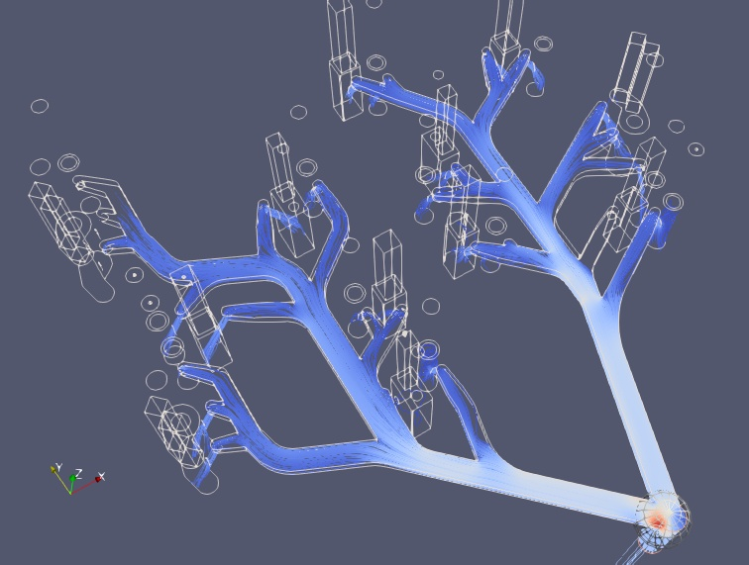
流速0.1m/S～0.5m/Sであればエラーは発生しないのですが、
速度を1m/S以上にすると、次のページのようなエラーが発生します。

Slide 6
Time = 86
smoothSolver: Solving for Ux, Initial residual = 1, Final residual = 0.0886587, No Iterations 3smoothSolver: Solving for Uy, Initial residual = 1, Final residual = 0.089842, No Iterations 3smoothSolver: Solving for Uz, Initial residual = 1, Final residual = 0.0879444, No Iterations 3
#0 Foam::error::printStack(Foam::Ostream&) at ??:?
#1 Foam::sigFpe::sigHandler(int) at ??:?
#2 ? in /lib/x86_64-linux-gnu/libpthread.so.0
#3 Foam::GAMGSolver::scale(Foam::Field<double>&, Foam::Field<double>&, Foam::lduMatrix const&, Foam::FieldField<Foam::Field, double> const&, Foam::UPtrList<Foam::lduInterfaceField const> const&, Foam::Field<double> const&, unsigned char) const at ??:?
#4 Foam::GAMGSolver::Vcycle(Foam::PtrList<Foam::lduMatrix::smoother> const&, Foam::Field<double>&, Foam::Field<double> const&, Foam::Field<double>&, Foam::Field<double>&, Foam::Field<double>&, Foam::Field<double>&, Foam::Field<double>&, Foam::PtrList<Foam::Field<double> >&, Foam::PtrList<Foam::Field<double> >&, unsigned char) const at ??:?
#5 Foam::GAMGSolver::solve(Foam::Field<double>&, Foam::Field<double> const&, unsigned char) const at ??:?
#6 Foam::fvMatrix<double>::solveSegregated(Foam::dictionary const&) at ??:?
#7 Foam::fvMatrix<double>::solveSegregatedOrCoupled(Foam::dictionary const&) at ??:?
#8 Foam::fvMesh::solve(Foam::fvMatrix<double>&, Foam::dictionary const&) const at ??:?
#9 ? in ~/OpenFOAM/OpenFOAM-v2006/platforms/linux64GccDPInt32Opt/bin/simpleFoam
#10 __libc_start_main in /lib/x86_64-linux-gnu/libc.so.6#11 ? in ~/OpenFOAM/OpenFOAM-v2006/platforms/linux64GccDPInt32Opt/bin/simpleFoam

