Slide 1
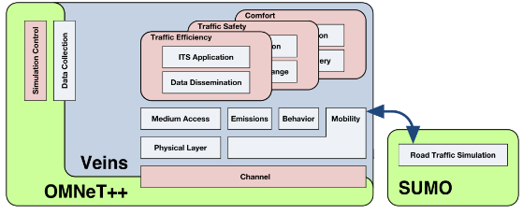
Simulate VANET systems though Veins
Simulate D2D LTE communications thorugh simuLTE
simuLTE
At the end, in order to reach my purpose, I will compare the results obtained through the two independent simulations.
No need to use both technologies jointly.

