Slide 1
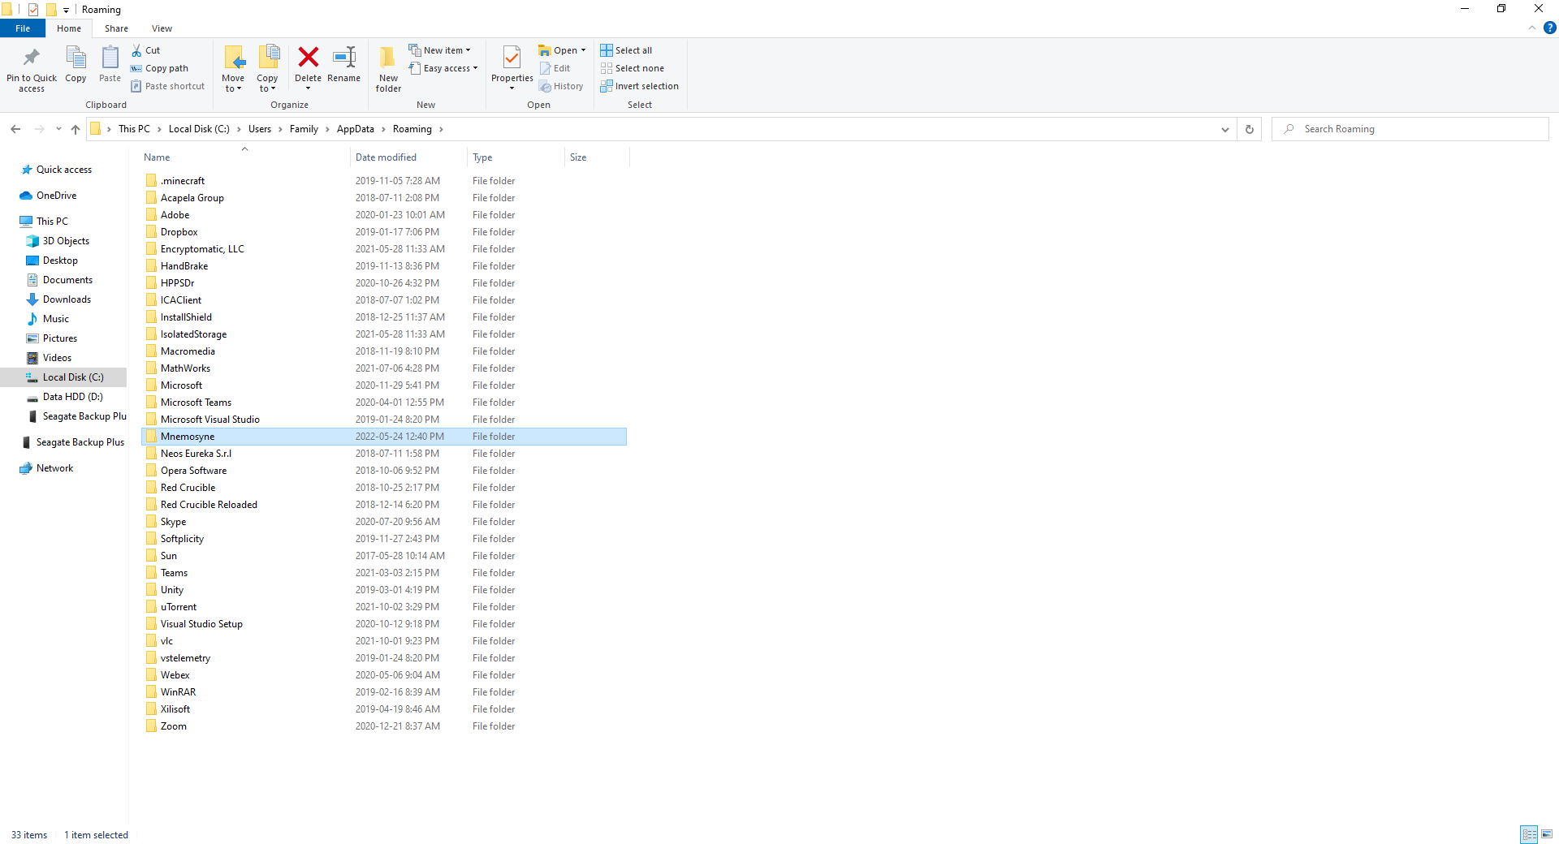
1) I delete the data directory on the new computer.

Slide 2
2) I copy the data directory on the old computer to the new computer.
Note: The date on the folder is now more recent.

Slide 3
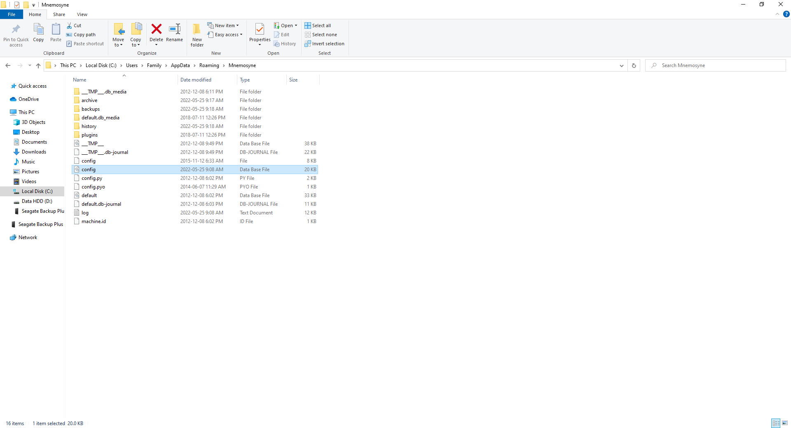
3) I delete config.db from the data directory.

Slide 4
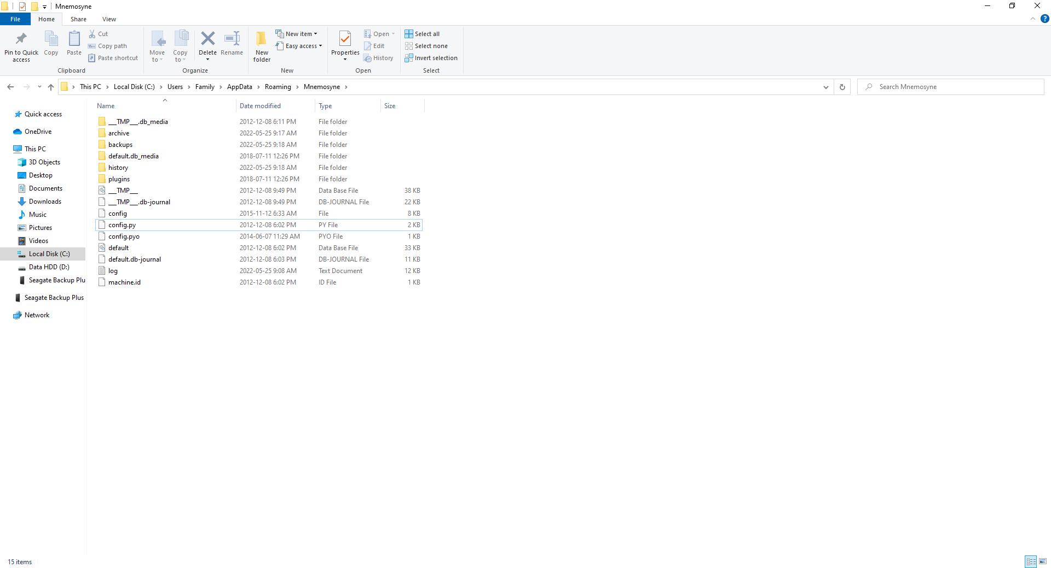
config.db is no longer in the data directory.

Slide 5
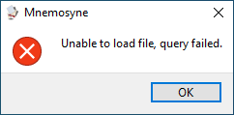
I open Mnemosyne and I get an error message.

Slide 6
I get the USB key error message.

Slide 7
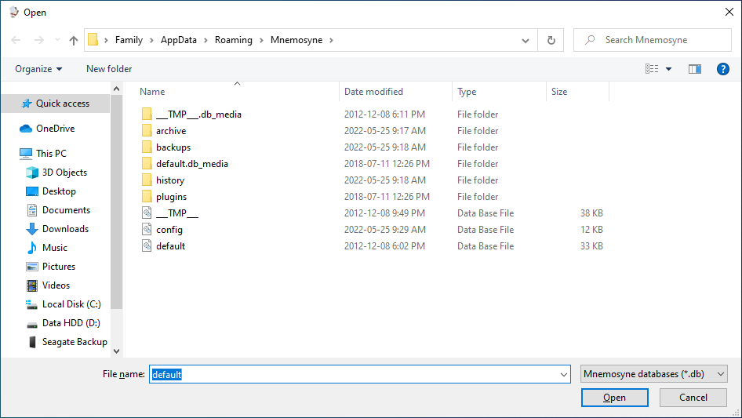
Mnemosyne wants me to open a database file.

Slide 8
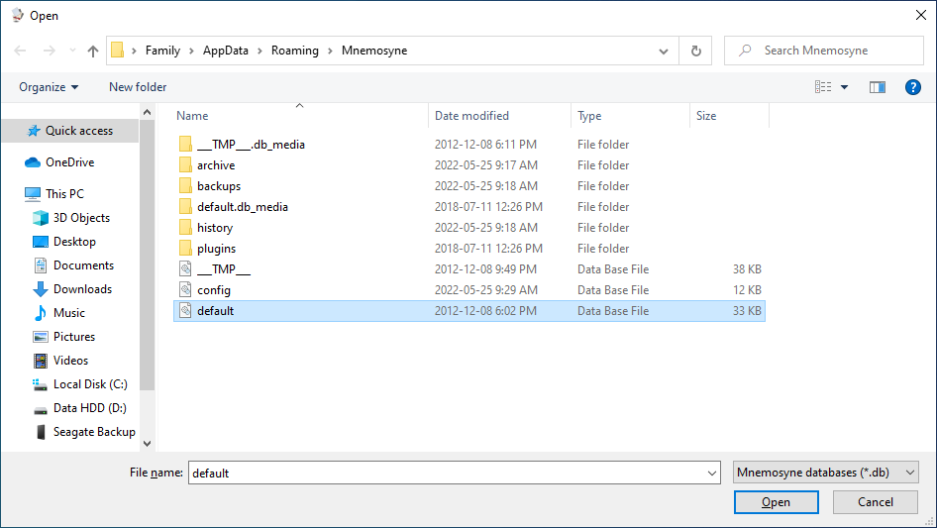
I open default.db

Slide 9
I get the same an error message as before.

Slide 10
I get the same an error message as before.

Slide 11
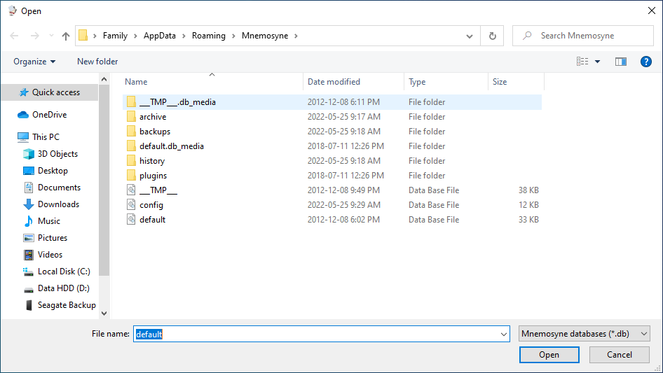
I am not sure what to do. If I open default.db then I will continue in a loop.

