Slide 1
Data Practices Update: FAQs, case law, and legislation
Data Practices Office
Taya Moxley-Goldsmith
Casey Carmody

Slide 2
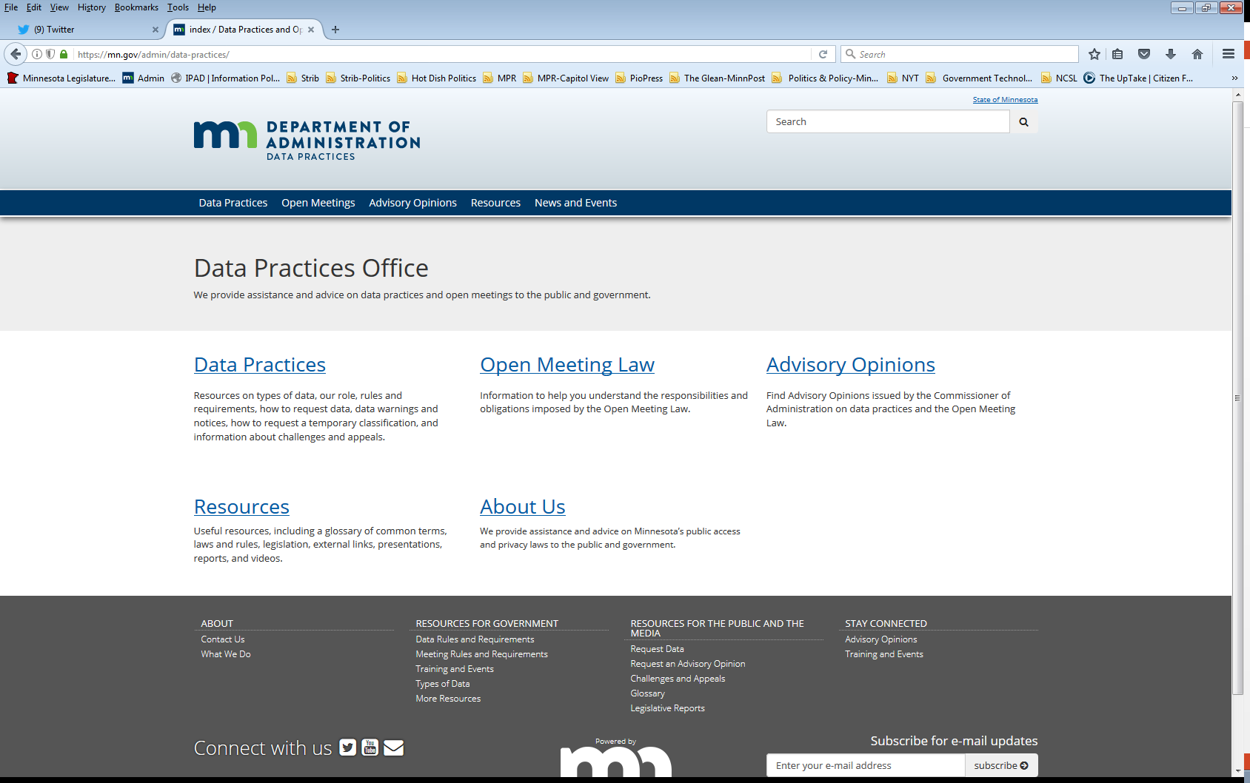
We are a statewide resource
Data Practices Office
Informal advice/technical assistance
Commissioner of Administration advisory opinions
Website and info pages: https://mn.gov/admin/data-practices/
Listserv and newsletters
Legislative assistance
Training

Slide 3
Part 1
FAQs about data practices and government records

Slide 4
What do you think? Archived, deleted, back up data
Your entity receives a request for all data about a program, including data that has been archived, recoverable deleted files, and back up data.
How should you respond?

Slide 5
Considerations
What does “archived” mean?
Is it deleted data that is temporarily stored?
Is it semi-permanent storage to free up space?
AO 00-019 and 00-067: data on “back up tapes” must be reviewed and provided
Opinions are over 20 years old
Deleted data is meant to be deleted (i.e., if you put something in the recycling bin, you don’t have to search through it)

Slide 6
What do you think? Collecting private data
Your department is running a voluntary program for employees to promote healthy eating and exercise; can you collect the participants’ social security numbers?

Slide 7
Collection of data limited Minn. Stat. § 13.05, subd. 3
No. See Minn. Stat. § 13.05, subd. 3:
Collection and storage of all data on individuals and
Use and dissemination of private and confidential,
Shall be limited to that necessary for the administration and management of programs specifically authorized by the legislature or local governing body or mandated by the federal government.
See also, Minn. Rules 1205.1300 – duties of the responsible authority in administering private/confidential data

Slide 8
Use and dissemination of not public data Minn. Stat. § 13.05, subd. 4
Private or confidential data shall not be collected, stored, used, or disseminated except as provided for in the Tennessen Warning notice, except:
Data treated as not public and collected before the MGDPA may be used in the same way with approval of the Commissioner of Administration
Private or confidential data may be used as specifically authorized by a law enacted after collection
Commissioner of Administration grants entity’s request for a new or different use or dissemination of the data
Private data may be used or shared with consent
Minn. Rules 1205.1400, subps. 3 and 4

Slide 9
What do you think? Personal devices/personal data
An employee uses a personal device to make a video of a virtual staff meeting and uploads it to your entity’s shared drive making it available to others at your entity.
Are the data in the recording government data? Should the data be accessible in response to a data request?

Slide 10
Government data on personal devices/ Personal data on government devices
Personal data is not government data
Employees can create government data on personal devices
Employers might consider:
Policy on compliance with records retention and data requests
Policy on usage
Incidental use policy

Slide 11
Photographs and videos of employees
Is the employee the subject of the data?
If yes, then it is personnel data – photos and videos are not in § 13.43, subd. 2 = private data
If no, then it is not personnel data
Presumptively public, or
Could be classified by another provision depending on circumstances

Slide 12
Advisory opinions
AO 01-075: “Personal data” are not government data.
AO 21-007: Based on its policies, City determined that a video an employee created data on a personal device was for work purposes and was government data.
AO 19-003: County had a policy that allowed employees to create government data on personal cellphones. Therefore, the County was obligated to obtain data to respond to a request.

Slide 13
What do you think? Data security
What are an entity’s obligations to keep data secure, particularly in a virtual/work-from-home environment?

Slide 14
Data security Minn. Stat. § 13.05, subd. 5
Procedures to ensure that all data on individuals are accurate, complete, and current for the purposes for which it was collected
Establish appropriate security safeguards for all records containing data on individuals:
Procedures for ensuring that data that are not public are only accessible to persons whose work assignment reasonably requires access to the data, and
Only accessed by those persons for purposes described in the procedure

Slide 15
Data security, continued
Policy incorporating procedures, which may include a model policy governing access to the data if sharing of the data with other government entities is authorized by law.
Destroy not public data in a way that prevents its contents from being determined.

Slide 16
Data security, practical considerations
Review and update current security processes and protocols.
Provide training to employees and team members
Reach out to employees and team members about records management/data destruction

Slide 17
What do you think? Large requests
A public data requester has asked for all of your program’s emails from the last two months. The estimated number of responsive emails is 80,000 emails.
Can you decline to respond due to the request’s overly burdensome nature?

Slide 18
Large requests
No burdensome or harassing exceptions to Ch. 13
Entities must have internal procedures to make sure requests are responded to in an appropriate and prompt manner and within a reasonable amount of time
Large requests may take a lot of time and that could be reasonable
Routine records management can help to alleviate some, though not all, of the burden

Slide 19
Large requests, practical considerations
Contact the requester to clarify the scope of the request
Give context to the length of time it may take to compile data and amount of responsive data
Ask whether certain responsive data should be prioritized
Consider providing data on a rolling basis

Slide 20
Webster v. Hennepin County 910 NW 2d 420 (Minn. 2018)
Large request for public data/email about use of biometric technology
Complaint at OAH, Court of Appeals unpublished case, appeal to Supreme Court
Supreme Court held:
County procedures did not ensure a prompt response
Records were maintained in a manner easily accessible for convenient use
No appellate jurisdiction to address overly burdensome question

Slide 21
Part 2
Case law

Slide 22
Case law
Smith v. City of Crosby, No. A21-0709 (Minn. Ct. App. Jan. 18, 2022)
Arbitrator ordered City to “expunge” references to employee’s termination.
Employee required to challenge the accuracy and completeness, per §13.04, subd. 4
Halva v. Minn. State Colls. & Univs., 953 N.W.2d 496 (Minn. 2021)
Official Records Act does not include private right of action.
Violations are remedied through Ch. 13

Slide 23
Case law, cont.
Energy Policy Advocates v. Ellison, A20-1344 (Minn. Ct. App., June 1, 2021), rev. granted
Private classification only applies to data on individuals
Under §13.393, attorney data:
Work product protects data without regard to status of litigation
General description that data are attorney-client privilege not sufficient
Ct of App declined to recognize the common-interest doctrine in MN
Advisory opinions 12-017, 01-079
There must be a basis upon which the government entity can justify removing data from the applicability of Ch. 13

Slide 24
Part 3
Legislation

Slide 25
2022 legislative session
Key dates:
Session started Jan. 31, 2022
First deadline March 25, 2022
Session ends, May 23, 2022
Legislative Commission on Data Practices
Education data
Facial recognition software

Slide 26
Bills under consideration
HF341/SF2307: Amends §13.32 to include provisions about technology providers.
HF2353/SF2459: Adds §13.463 classifying educational support services data.
HF2945/SF3214: Amends §299C.72 allowing local government to share criminal history data.

Slide 27
Bills under consideration
HF3249/SF3087: Amends §13.045 and other provisions around Safe-at-Home program and allows sharing.
HF3064/SF2979: Amends §13.41 to include licensing data of “local governmental units.”
HF3529: Amends §13.82 – classifying mental health data as private and allowing sharing.

Slide 28
DPO proposals
Remove $200 fee for OML opinions
Update provisions of §13.04 data challenge appeal process
Allows dismissal of appeal prior to informal resolution in specific circumstances
Pulls forward some requirements from the Rules
Included in the supplemental budget bill

Slide 29
What questions do you have for us?

Slide 30
Stay in touch
Data Practices Office
651-296-6733
info.dpo@state.mn.us
https://mn.gov/admin/data-practices/
Twitter: @mngovdata
YouTube training videos: https://www.youtube.com/user/INFOIPAD

