Slide 1
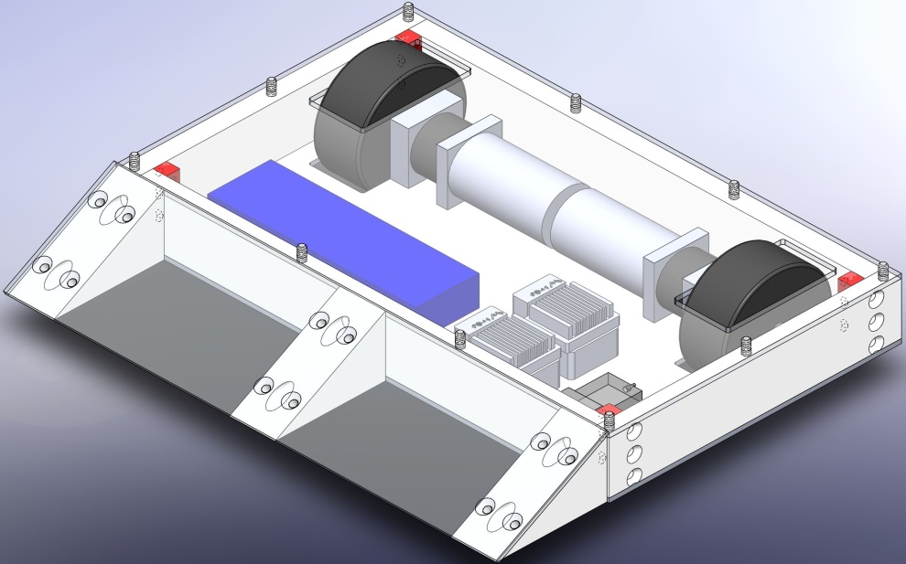
Armadillo Robotics
15 lb Robot Kit
Meets all requirements for National Robotics League Competition
Complete with all tools and detailed assembly instructions
20+ kits delivered to clients
NTMA Santa Fe Springs
National Robotics League
Providence High School
Kansas City Unified Schools
Collaboration of Mt. SAC Students, Faculty and MAGLab
For More information visit armadillorrobotics.com

