Slide 1
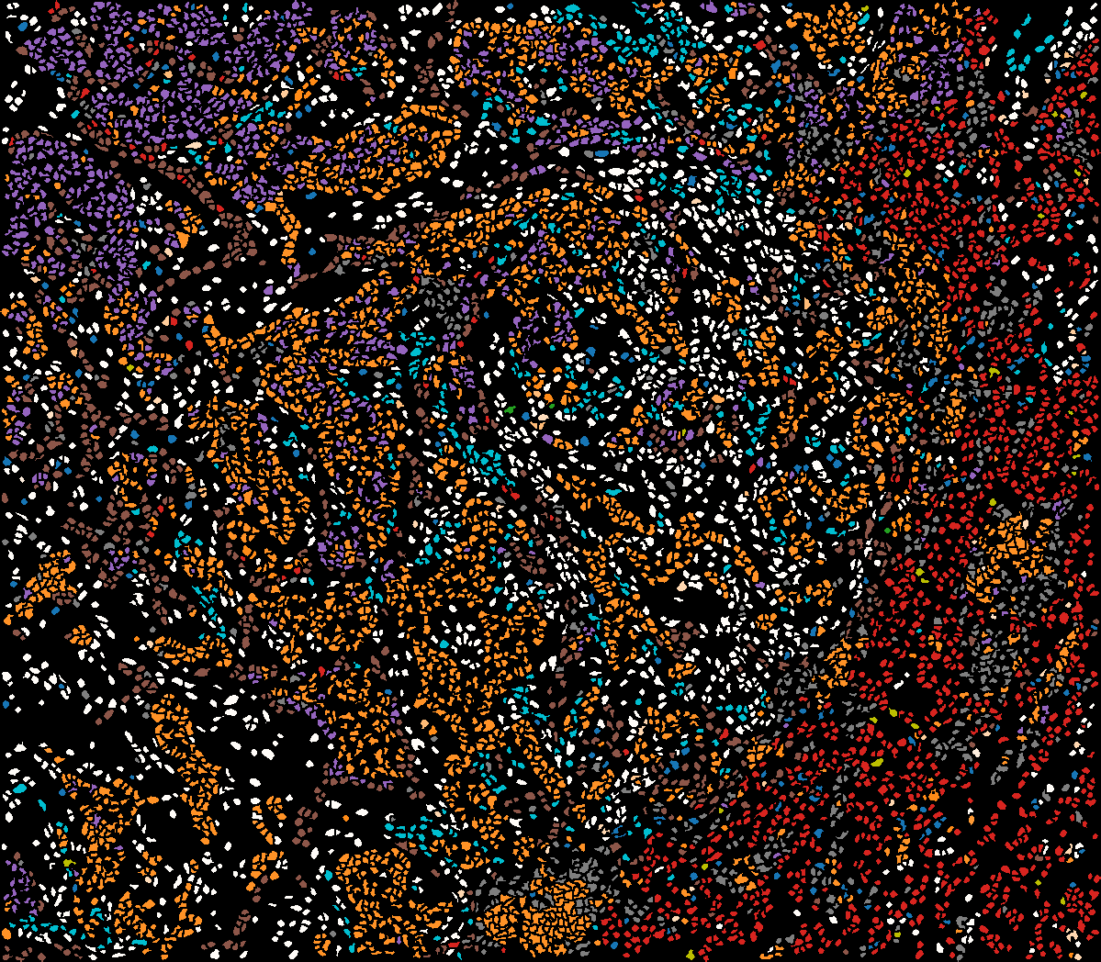
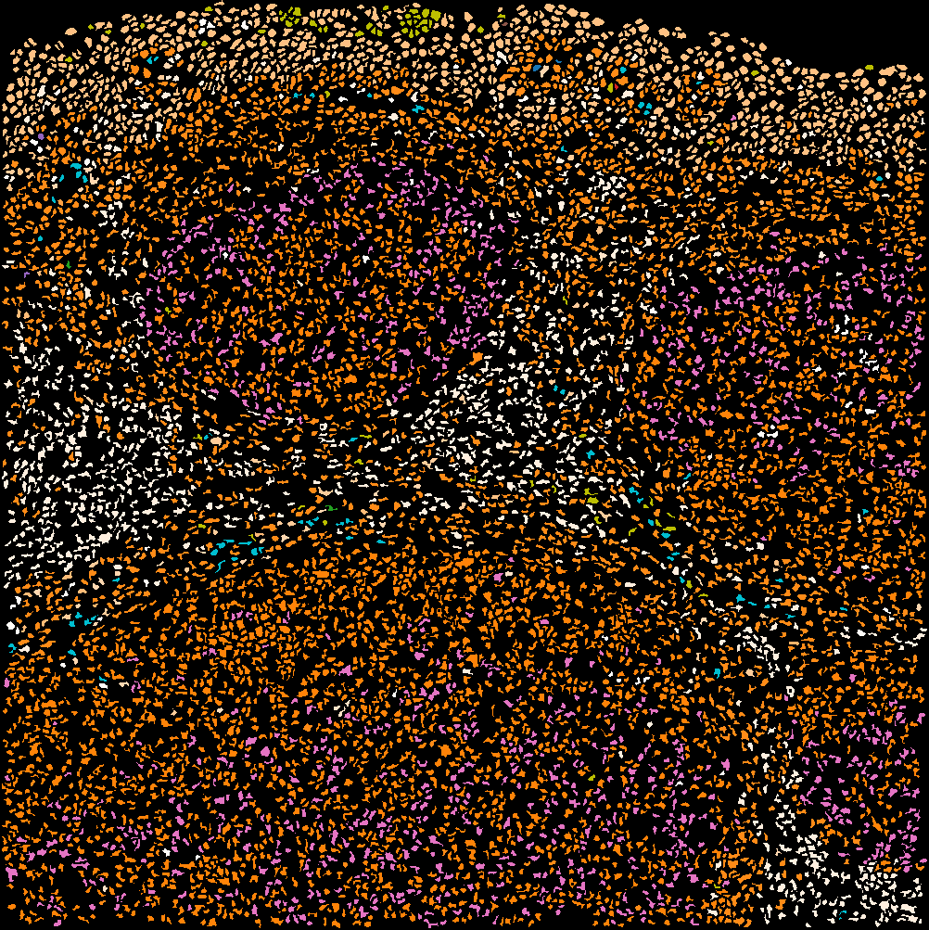
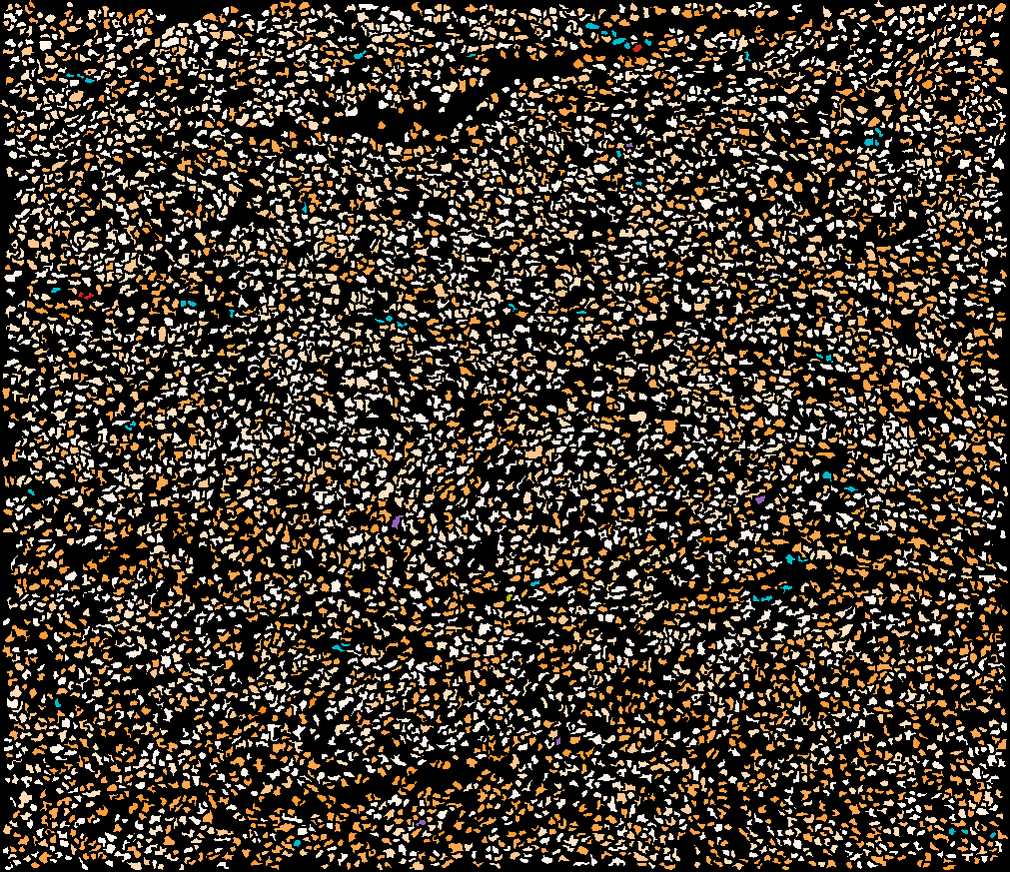
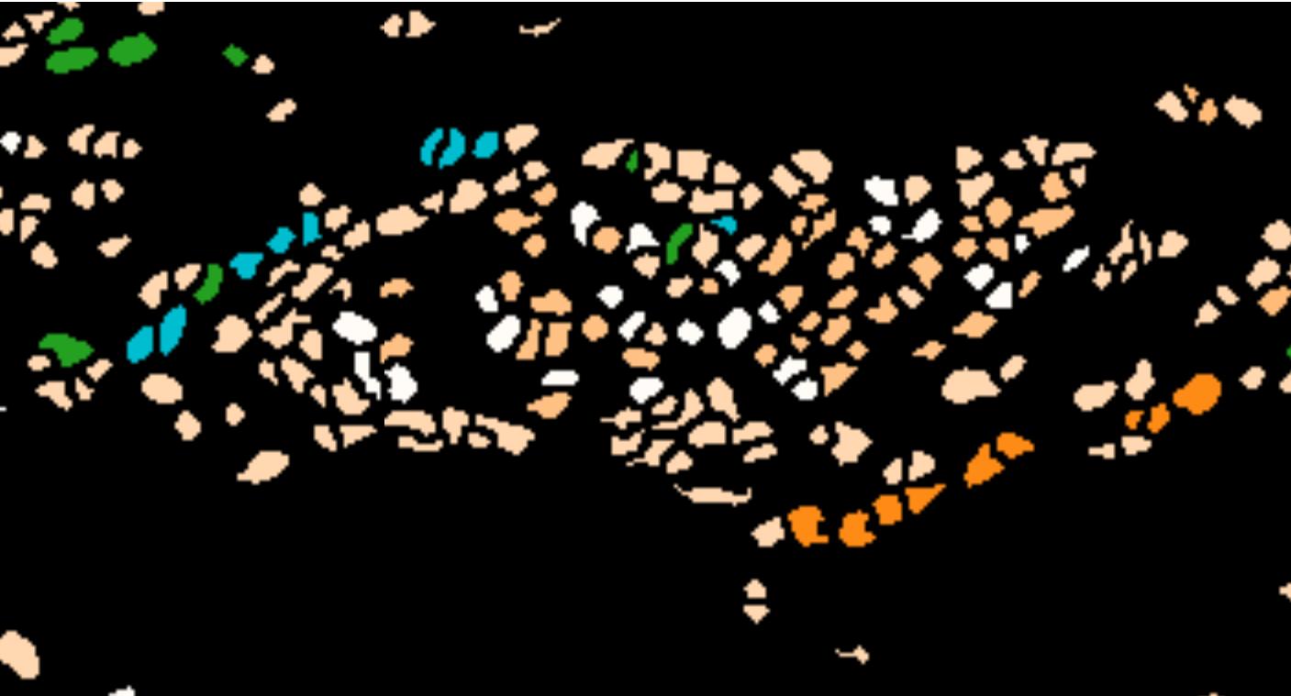
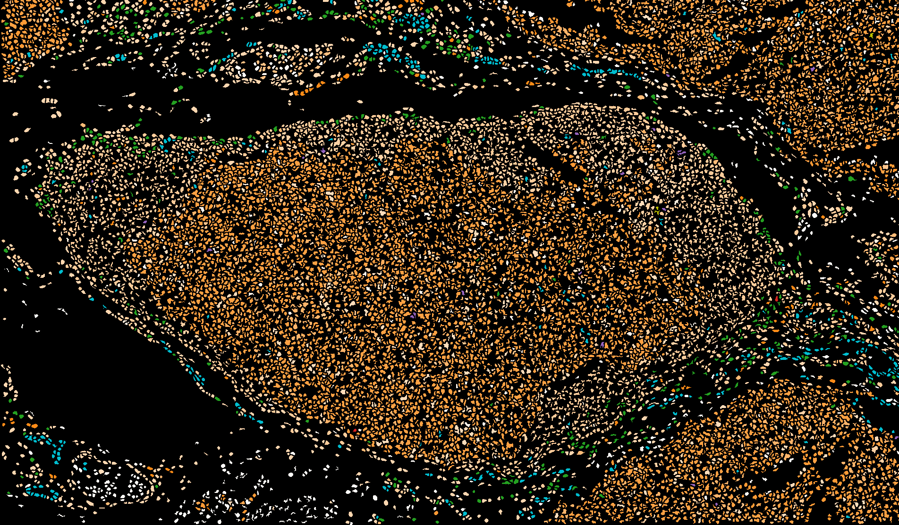
Research/Master project: Unsupervised clustering/ Classification of Multi-spectral images
Data/ Preprocessing Pipeline
Problem definiton:
>40 Proteins, Clinical Data, Unique Data in NL
Segmentation Mask
Different dimensions per image
Different amount of cells per image
Different cell types per image
Different patient
Healthy
Cancer, First stage
Cancer, Fatal stage
Cell Type identification (Each color represent a different cell type[2])
?
Requirements:
Basic knowledge in Deep Learning, Graph mining
Good programming skills:Python
[1] Hollt, Thomas, et al. "Visual analysis of mass cytometry data by hierarchical stochastic neighbour embedding reveals rare cell types." Nature communications 8.1 (2017): 1740. [2] Velickovic, Petar, et al. "Deep Graph Infomax." ICLR (Poster). 2019.
[3] Kipf, Thomas N., and Max Welling. "Variational graph auto-encoders." arXiv preprint arXiv:1611.07308 (2016).
Supervisor: Antonios Somarakis, Thomas Höllt, Boudewijn Lelieveldt , Contact: Antonios Somarakis, a.somarakis@lumc.nl

