Slide 1
Support Xen Hypervisor in KubeVirt
ARM - Jun Zhang & Michael Zhao

Slide 2
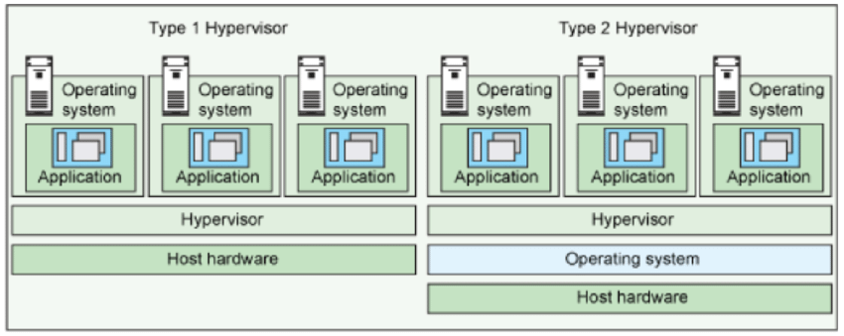
Type-1 vs type-2 Hypervisor
Type 1 Hypervisor runs directly on the host’s hardware
Type 2 Hypervisor runs on an operating system

Slide 3
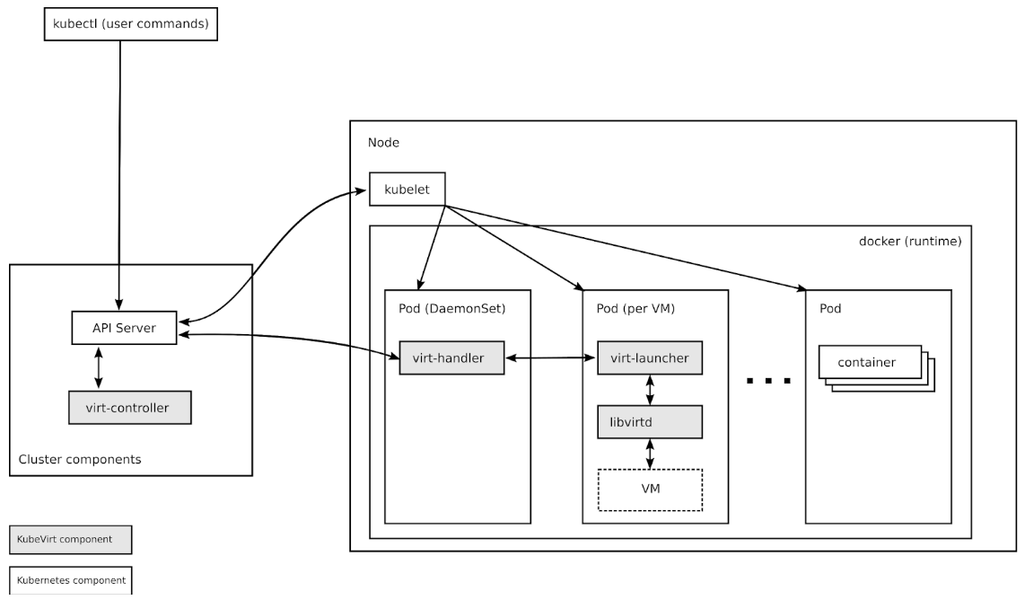
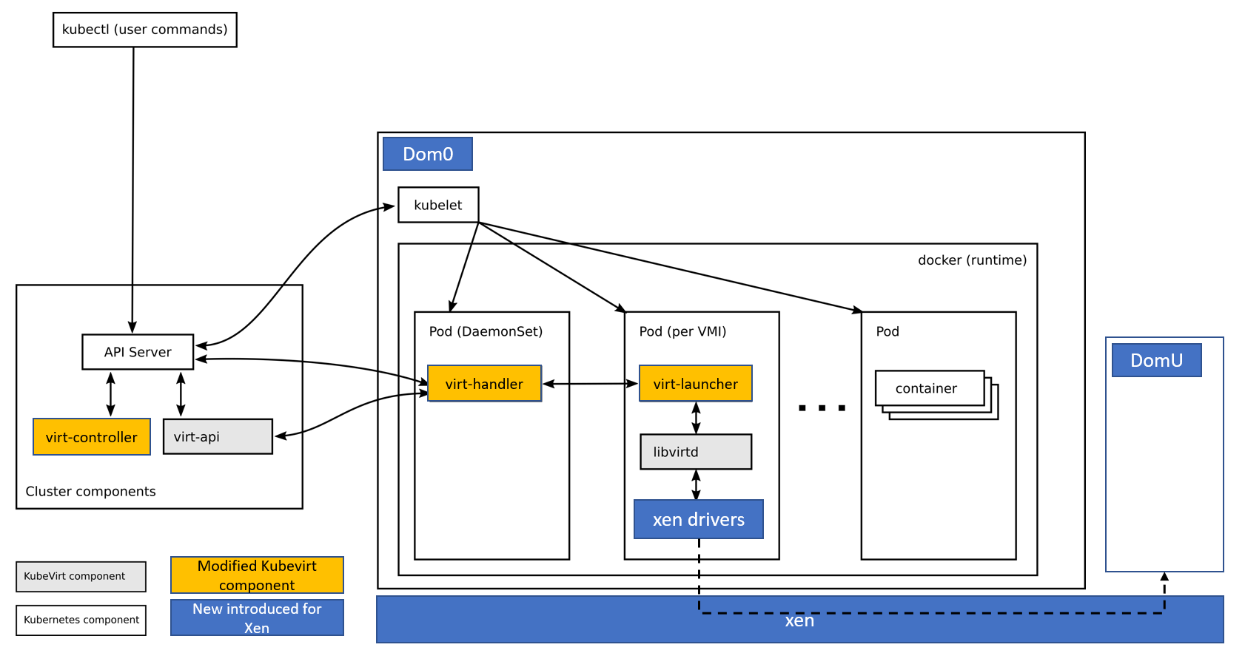
Deployment Change (KVM vs Xen)

Slide 4
Multi-hypervisor Support Challenges
Distinguish different hypervisor type in build time
Resolve different software dependencies for hypervisors
Host system resource isolation for different hypervisors
Xen version matching between Dom0(host) and libvirt
VM status monitoring
VM networking
……

Slide 5
Proof of Concept
What the PoC can do now
Schedule a xen VM on a kubernetes cluster
Launch a xen VM
Stop a xen VM
Pause/unpause a xen VM
Login a xen VM by virtctl console
What the PoC cannot yet
Configure VM networking

