Slide 1
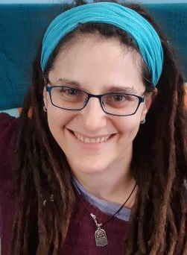
About the book Jewish Languages from A to Z provides an engaging and enjoyable overview of over 50 languages spoken and written by Jews over the past three thousand years. This comprehensive survey is designed to be accessible to all readers with an interest in languages or history, regardless of their background―no prior knowledge of linguistics or Jewish history is assumed. About the authors Aaron D. Rubin is Malvin E. and Lea P. Bank Professor of Classics and Ancient Mediterranean Studies, Jewish Studies, and Linguistics at Penn State University. Lily Kahn is Professor of Hebrew and Jewish Languages at University College London. You can learn more and purchase the book here.
Jewish Languages from A to Z: Celebrating a New Book
December 6, 10-11am Pacific / 1-2pm Eastern / 6-7pm GMT / 20:00-21:00 Israel
By Zoom: https://huc-edu.zoom.us/j/93274889026.
The HUC-JIR
Jewish Language Project
is pleased to present
a celebration of the new book by
Aaron D. Rubin and Lily Kahn,
Jewish Languages from A to Z (Routledge Press).
Sarah Bunin Benor will interview Rubin and Kahn,
and they will share excerpts and images from the book.

