Slide 1
Excerpts from the stories …..…

Slide 2
I completed my B.Sc. Hons. Forestry, though, my career took a positive turn as I delved into the world of Plant Systematics. I am now pursuing a Masters in Life Science (Plant Systematics by Research) thanks to the motivation, guidance and help I got from many members of our eFI group……………
Ashutosh Sharma
Celebrating 15 year journey

Slide 3
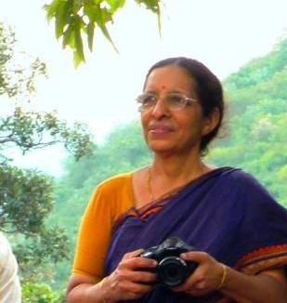
The mighty river of eFI began like a tiny stream…. It is Ever Flowing Independent Indian blood for good!
A. Lalithamba Ji
Celebrating 15 year journey

Slide 4
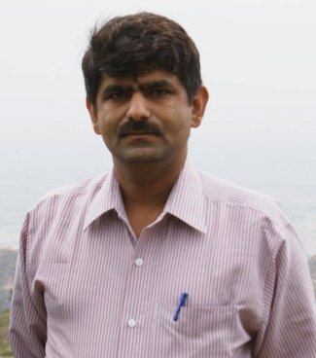
The real turning point came into life when during net surfing, I came to know about our beloved group efloraofindia. I sent a mail, requesting to join group…….and then the real journey of my life started………..
Dr Balkar Arya
Celebrating 15 year journey

Slide 5
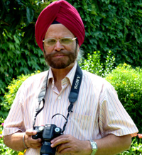
Two things changed my life style: a digital camera presented by my son, and my joining indiantreepix (now eFlora of India) in 2007……
Dr Gurcharan Singh
“Pitamah” of eFI
Celebrating 15 year journey

Slide 6
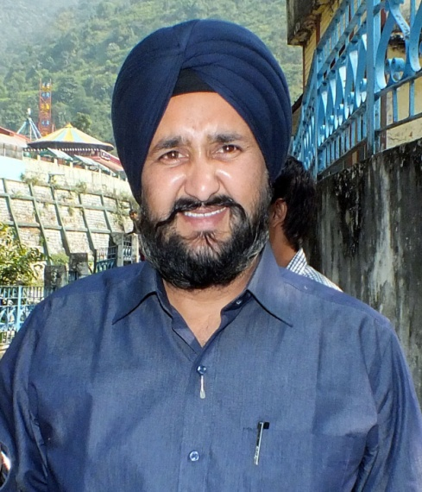
An intermittent flow of thoughts molded and carved into a gemstone, by a generation, for many generations, can be seen in efloraofindia…..
Dr Nidhan Singh
Celebrating 15 year journey

Slide 7
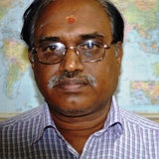
Being Taxonomist I need to collect information on valid botanical names, author citation and common name in different languages. I am able get this detail instantly from efloraofindia.com web site……
Dr P. Santhan
Celebrating 15 year journey

Slide 8
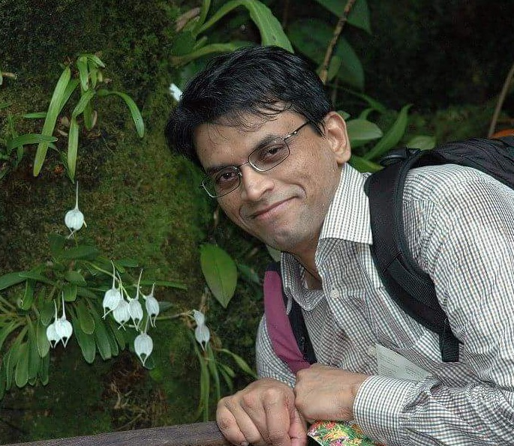
Sitting in Hong Kong, today with the help of this group I can know what plants including orchids are flowering in India and Nepal when they are shared………. this group is an inspiration about how even people who never studied botany can do botany …….
Dr Pankaj Kumar
Celebrating 15 year journey

Slide 9
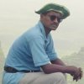
Our eFlora of India group is the perfect amalgamation of citizen scientists, Taxonomists, Nature lovers, trekker, engineers and what not….
Dr Prashant Awale
Celebrating 15 year journey

Slide 10
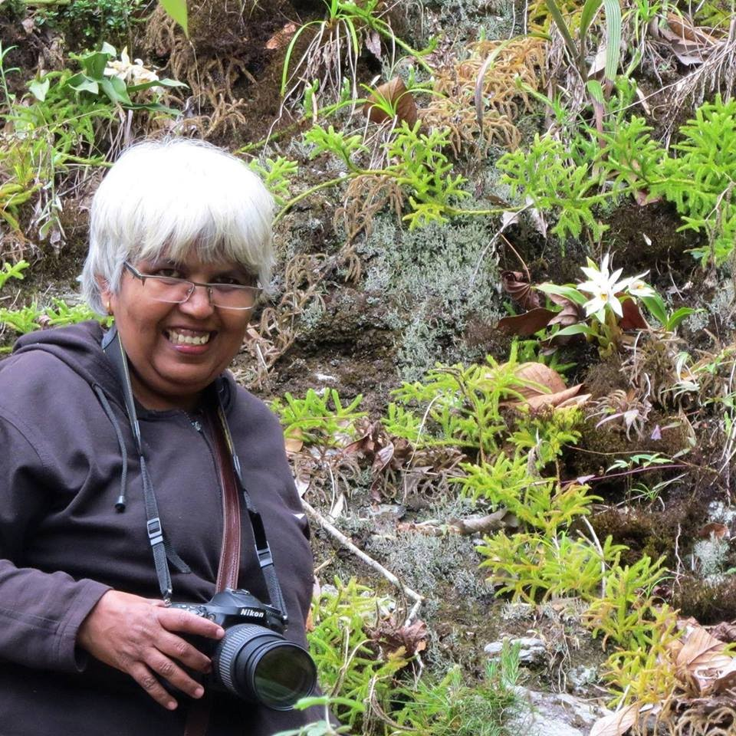
eflora of India to me is group of plant lover friends. It made me study more about plants & drawn me more towards fieldwork….
Ms Smita Raskar Ji
Celebrating 15 year journey

Slide 11
In 2021 I came to know about eflora of india. At first I found Google group of eflora india… there were thousands of plants……. I took a deep breath and it was a sign of relief for me to identify all those plants which were yet to be identified from me……
Mr Shakir Ahmed
Celebrating 15 year journey

Slide 12
efloraofindia is a symbol of big relief for me to identity plants. I used to send photographs of different plants for identification. It helped me a lot to identify plants which were difficult for other experts of Rajouri and Jammu region…..
Ms Seema Bin Jeenat
Celebrating 15 year journey

Slide 13
………AND WE selected
?

Slide 14
………. the best
A. Lalithamba Ji
Celebrating 15 year journey

