Slide 1
Photo entries for Best Flora Photograph to celebrate 15 years of completion of efloraofindia Jury: J. M. Garg, Saroj Kumar Kasaju & Dinesh Valke

Slide 2
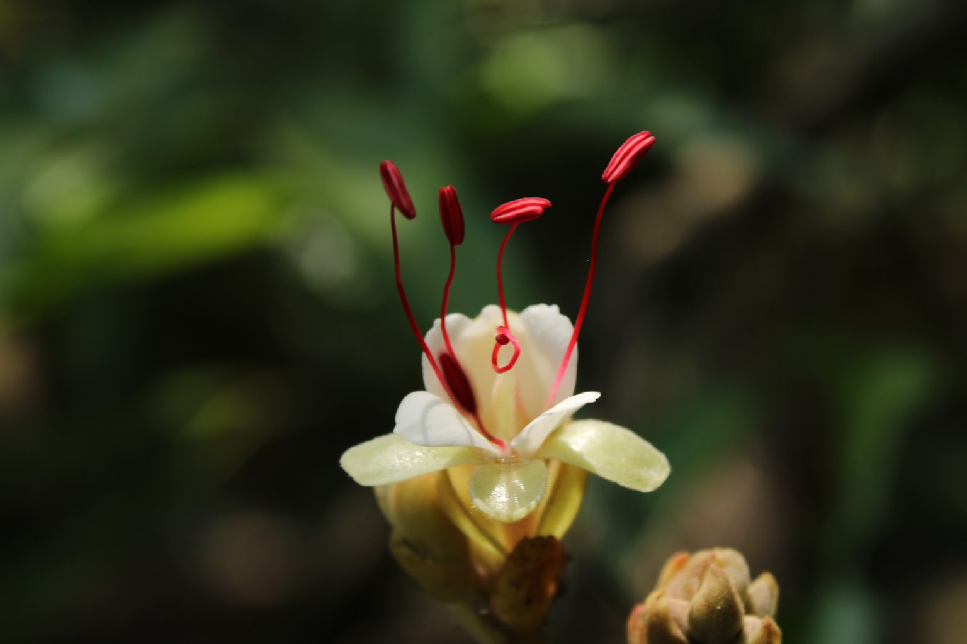
Sam Kuzhalanattu
The Hanging Rope
One February morning, my eyes were caught on a tree growing streamside with white flowers that I couldn’t see before and walked near to the tree for photography. But my way was blocked by sharp thorny branches of Senegalia torta creeping underneath of the tree, so it was needed to clear and results in time wasting there. When approaching to and capturing flowers, I found some disorder with style because it is not straight. While capturing images of opening flower, I saw an amazing figure of ‘knotted stigma’ through my lens. On further observation it was same as other opening flowers, and I decided it as absolutely natural and one of our green biodiversity wonders. Hence I considered this as my masterpiece image which gives much harmony in my photographic passion. My tree identification credits to Sheila ji and Saroj Kumar Kasaju ji, thanks a lot.
Humboldtia vahliana Fabaceae
Common name: Malabar Humboldtia
Local name: KAN: Neervaanche MAL: ആറ്റുവഞ്ചി Aattuvanchi കരപ്പൊങ്ങ് Karappongu കോരത്തി Korathi കൂറപ്പുന്ന Koorappunna SAN: Jelavedesa TAM: Attavanji
Location & Altitude: Ernakulam, Kerala, 1400 fsl
Flower date: 20th February, 2022, 12.54pm
Camera & Tech. details: Canon EOS1500D F8.0 1/160s 53.00mm ISO 100 White balance Manual No flash

Slide 3
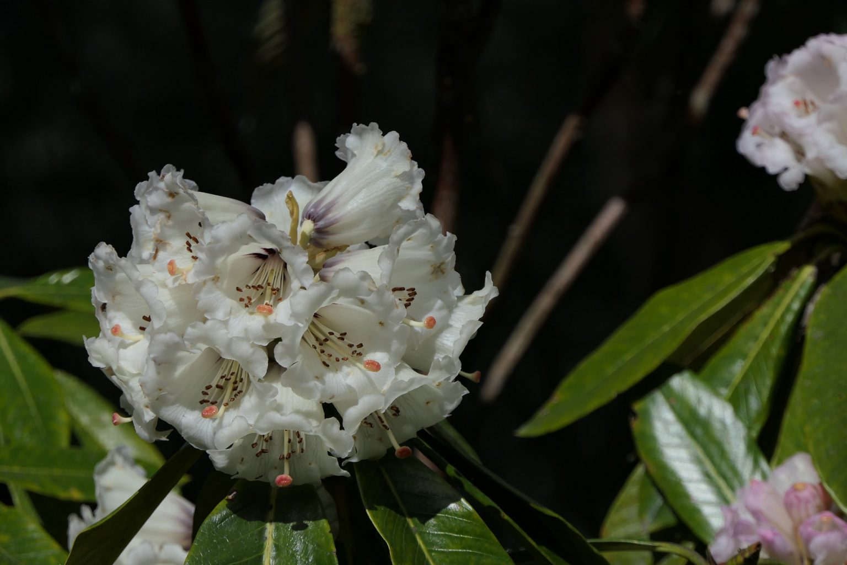
Dinesh Valke
Little is charming
Getting to explore flora during family vacation has always been rewarding to me. Whatever I get, however little, is charming. This March’22, I was in Sikkim. I was able to add around 40 new species to my collection. Sikkim is well-known for rhododendrons, I am posting a picture of rhododendrons.
March 7, 2022 … Plant Conservatory, Bulbuley, Gangtok, Sikkim Rhododendron grande Wight … many thanks to Shrikant Ingalhalikar ji for the ID.

Slide 4
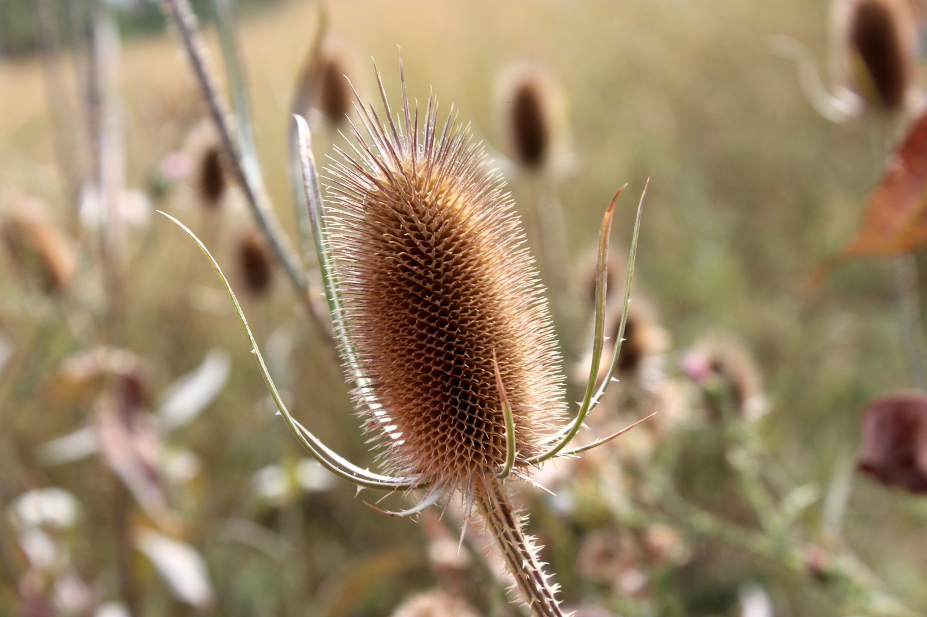
Dr. Gurcharan Singh
Beauty in death
Year 2019 was the most productive year for me because I was able to capture nearly 9000 images of plants between March and September. It was also the first time I was able to capture spring plants in California, on earlier visits we were able to capture summer and autumn plants only. We visited Toronto, Canada during August-September, when most of the plants had begun to complete their life cycle. I was able to capture a few plants of Wild Teasel, Dipsacus fullonum with lavender flowers in a head, but perhaps the almost dried fruiting head of an almost dead plant captured from Mississauga along roadsides on 28 August, 2019, looked more beautiful. I am sharing the same.

Slide 5
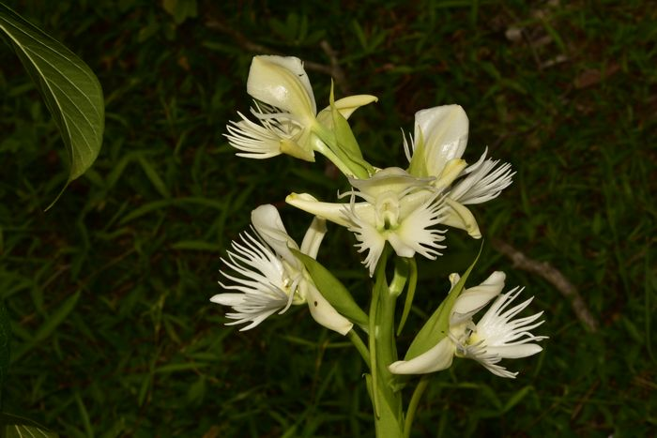
Smita Raskar
Best flora picture on completion of 15 years
What can be more beautiful than my most beloved fragrant orchid Pecteilis gigantea to celebrate 15th birthday of my favourite group.

Slide 6
Prashant Awale
Best flora picture on completion of 15 years
15 amazing years and counting.. It’s a great feeling to be associated with such a versatile and friendly group.
Sharing a photograph of Corynandra elegans as my flora picture.

Slide 7
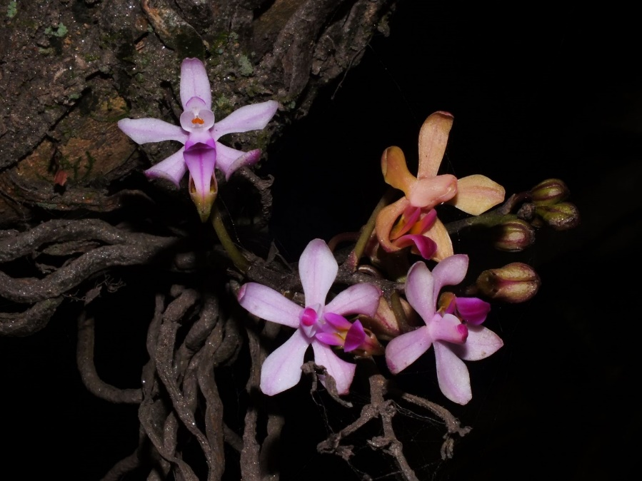
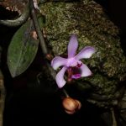
Dr. Nidhan Singh
Best flora picture on completion of 15 years
When I look back at my attempts to photograph flowering plants, it gives a sense of satisfaction that, out of interest, I could manage to visit a lot of places…especially in the Himalayas..!!
Every tour is deeply engraved in my memory and the feelings are unforgettable..!!
One of such tours was with Smita Ji, wherein we roamed around in Pelling (Sikkim), Darjeeling and Mirik lake …!!
The picture being presented here could be recorded with quite a lot of hard work, as both of us were really excited after seeing this … as usual with epiphytes, this was high up on a branch ... but we were determined to have some shots..
Result… some pics of Phalaenopsis taenialis ….!!
I could not resist sharing this pic also…

Slide 8
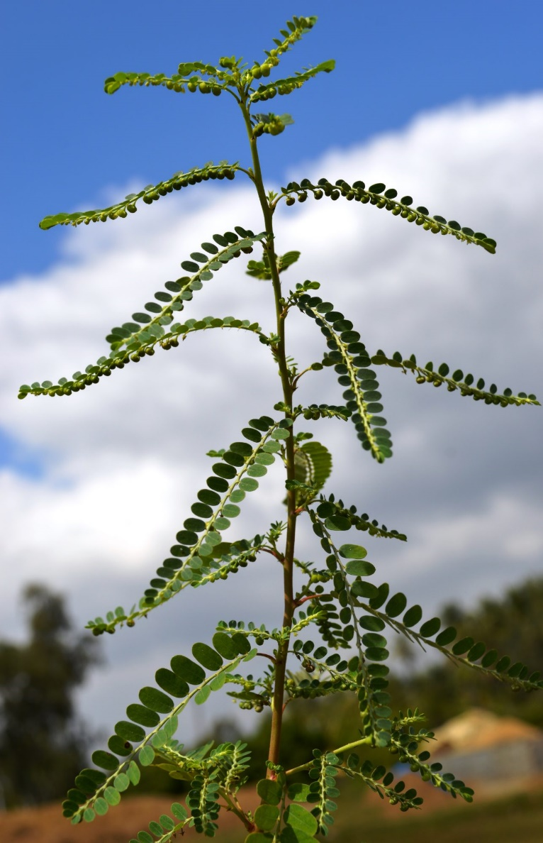
Dr. Santhan P
Best flora picture on completion of 15 years
It is very difficult to select the best from several thousands of pictures available in our folders. Still I am selecting this as my Best Picture because the information the image gives to us is related to identification and its background look. eg the number of leaves in a branchlet, leaf shape, apex shape, number and size, shape of calyx etc. Besides this plant comes throughout my life still today from the past 3 decades. Such an important medicinal plant in controlling Hepatitis B, anti viral, anti HIV, liver health, hair health etc. I worked on several projects related to this herb and developed products on par with allopathic drugs.
Phyllanthus amarus

Slide 9
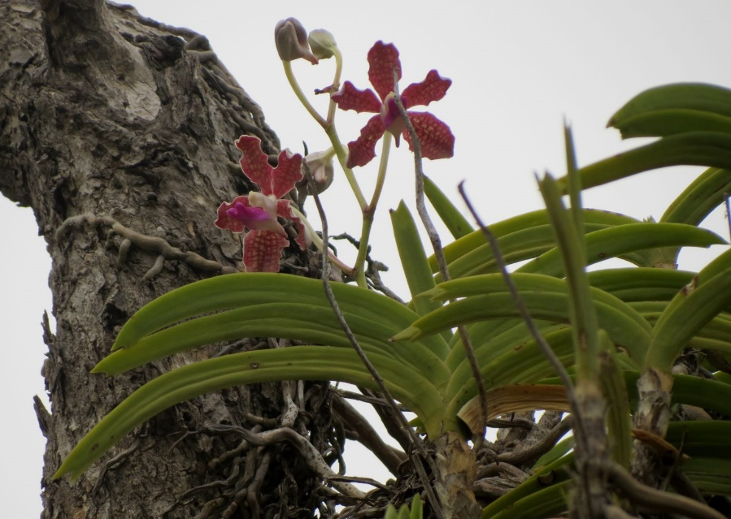
A. Lalithamba
Best flora picture on completion of 15 years
This is my entry for best picture; it is Vanda wightii; in Rapur-Chitvel ghat; on that day the sky is cloudy, though it is summer; I didn’t found any plant in flowering in the forest for few kilometers; suddenly I found it on a deciduous high Terminalia tree; but there is a deep pit which is difficult to cross; to take the view of entire plant with flowers I stood on a stone on the edge; first I thought it as Vanda tasellata, but on close scrutiny, it is V. wightii, I am happy for my adventure. It is considered as endemic to Kerala and Tamilnadu.

Slide 10
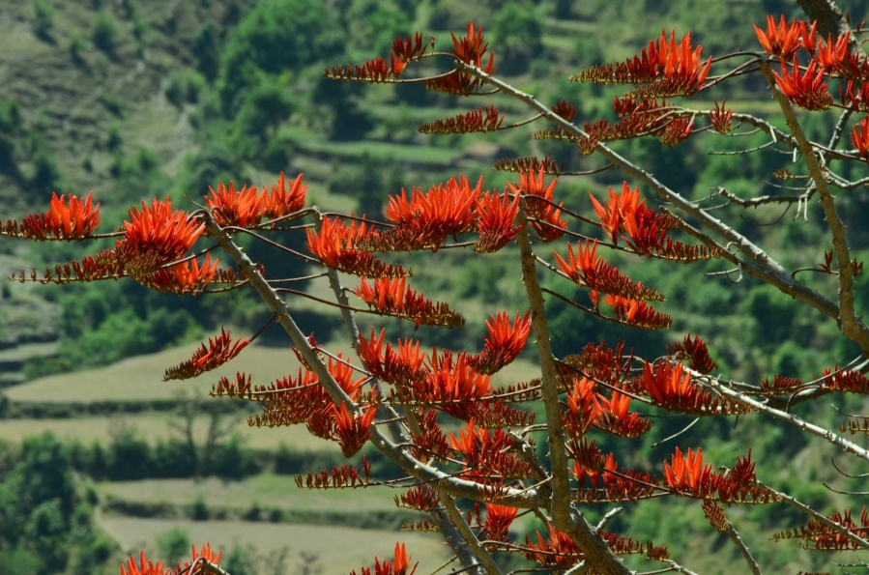
Dr. Balkar Singh
Best flora picture on completion of 15 years
Here is My best flora photograph. This was shot recently in April 2022 during our visit to Pratapnagar (Distt Tehri, Uttarakhand). We were on the way to Pratapnagar and the day was much hotter than usual. Flowers on the trees or shrubs were almost negligible but this Erythrina suberosa tree was standing with lush blooms, giving a treat to eyes. We stopped near this tree and took a lot of shots. From among them this one is shared here as Best Flora Photograph.

Slide 11
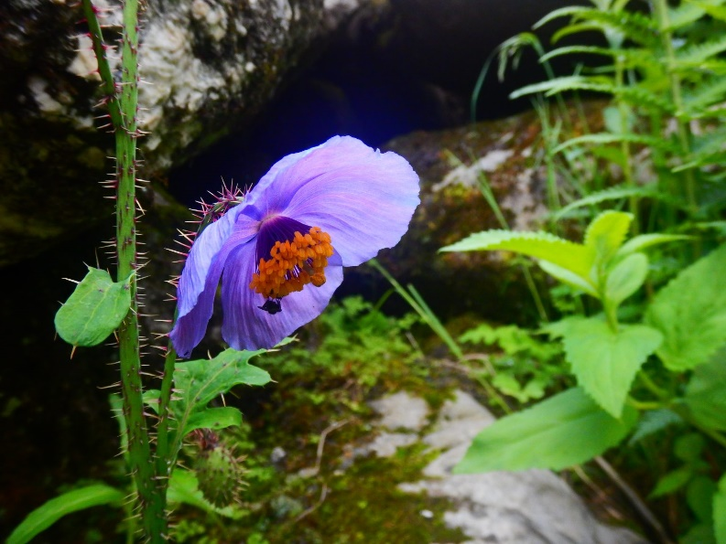
Dr. Satish Pardeshi
Best flora picture on completion of 15 years
Please find my entry for the Best Flora Photograph contest 2022. The details and story behind the photograph. Meconopsis horridula Hook. f. & Thomson, syn: Papaver horridulum (Hook.fil. & Thomson) Christenh. & Byng). also known as Prickly blue poppy found at altitudes of 3500-5500m from mid July to August end in Himalayas.
This photograph was clicked during my Hampta pass trek on a rainy day.
Probably the fly was taking refuge under that bright blue umbrella.

Slide 12
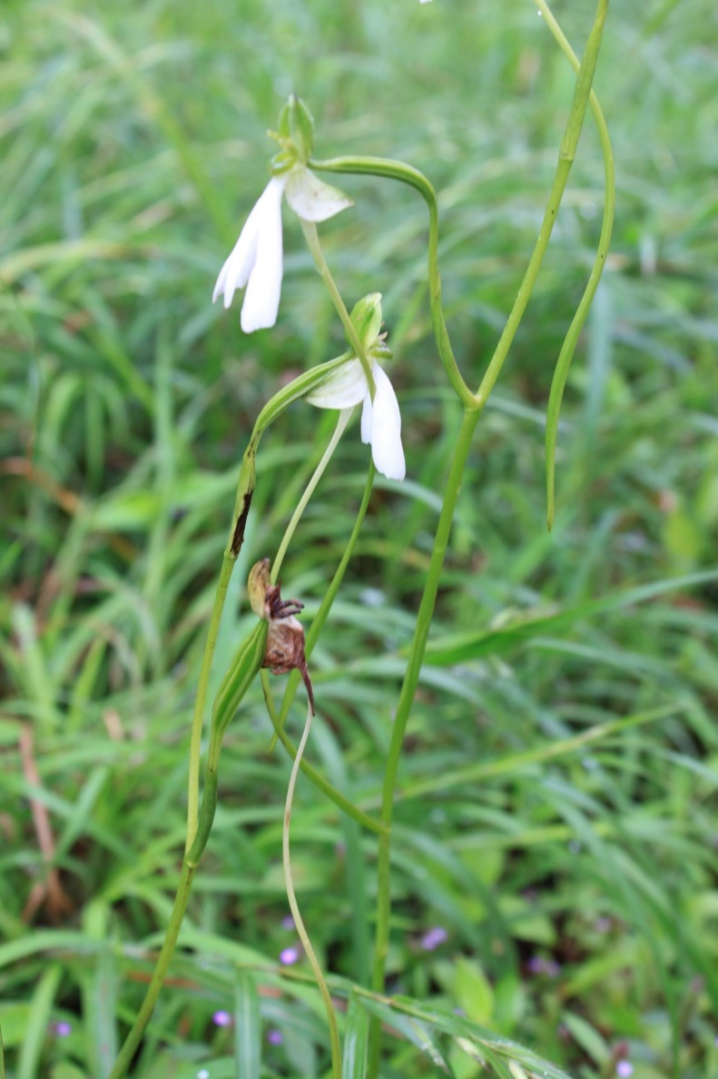
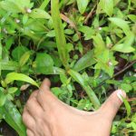
J. M. Garg
Best flora picture on completion of 15 years
This is my first upload after a long long time (mainly because of paucity of time due to different priorities). It is Habenaria longicorniculata as I knew it from the first glance while moving on a narrow road through Bhadra Wildlife Sanctuary on the way to Kemmanagundi from Chikmagalur in Oct ‘2013.
I requested the driver to stop the vehicle & hurriedly got down to click it. I didn’t bother with anything else. I also took the pictures of the basal leaves and many other pictures from many angles, a few while almost sitting. After the photo session with this & a few other flowering herbs was over, I returned back to the vehicle. As we moved a bit I could see blood on my pants. As I looked further, I saw many leeches on my legs, shirt & on the vehicle. It was, as if, it was a great attack of leeches. I quickly removed them by heavily shaking my hands & legs one by one. Finally all of them (around six) were gone but not without leaving their temporary scars. I knew they did no long term harm. One of them was later found to have left a mark on the toes of my daughter.
It certainly was a great encounter with Habenaria longicorniculata
I really miss such adventurous moments in the wild these days.

Slide 13
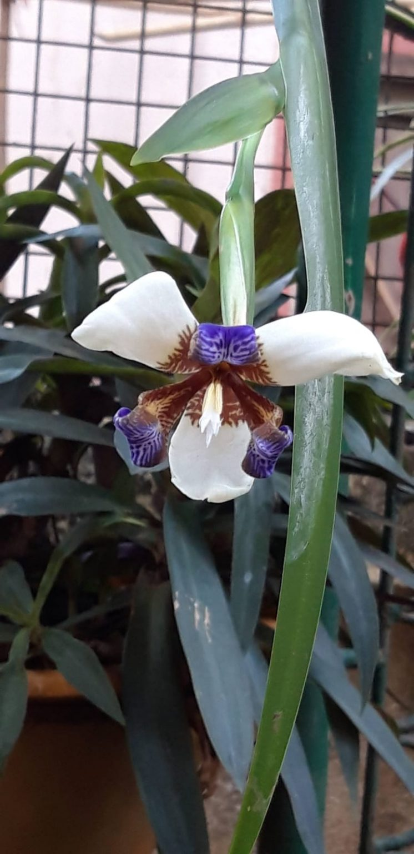
Shobha Halwe-Chavda
Best flora picture on completion of 15 years
Neomarica northiana
Lock down 1. April 2020.
Like everywhere, Mumbai too had come to a standstill. There was a frightening silence on the roads. Couldn’t move out anywhere. My regular morning walks had stopped. So gradually started making rounds in the building. Since I stay on ground floor, I have “encroached” the part of the building compound in front of my house 😄 and made a small garden. Suddenly my eyes fell on one neglected pot and I was speechless (still trying to recollect from where I got that plant). A beautiful flower was hanging like a pendulum. It had grown on one leaf. Three bright white petals with brownish tiger-striped patterns and three purplish blue curled petals. What a beauty it was ! efloraofindia as usual immediately did the id – Neomarica northiana. It’s common name is ‘Walking Iris’. The flower gets its common name Walking Iris from its unusual propagation habit. New plantlets grow at the tips of the flower stems, weighing them down until they bend to touch the ground and take root.
To sum it all, in those depressing days, this unique flower lifted my heart.

Slide 14
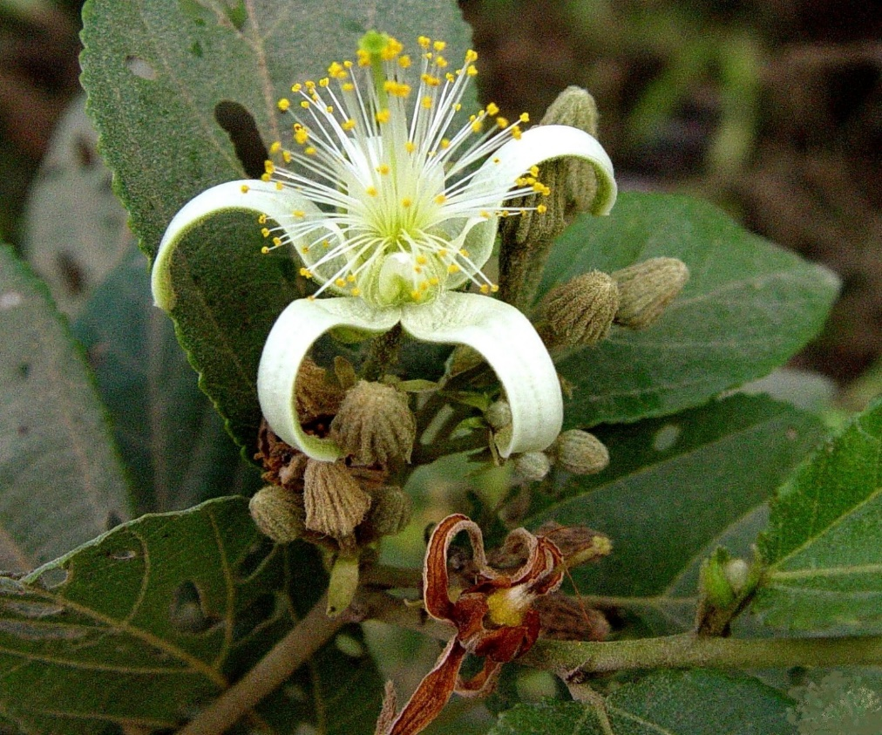
A. Sinha
Best flora picture on completion of 15 years
Grewia orientalis Syn. Grewia columnaris (Smith)
Growing wild in semi urban area near Chennai, photo ca 2012
———————————————————–
Plant exploration walks wherever possible are my top choice of leisure activity.
This photo re-captures for me the excitement of finding an unknown species, and the pleasurable hours looking through journals, illustrations, keys, in an attempt to identify.
Sometimes I succeeded, sometimes not.
But I was always confident of getting final verification from active and ever helpful eflora group.
Congratulations to all eflora mentors and members.
Jai Bharat, Jai eflora of India

Slide 15
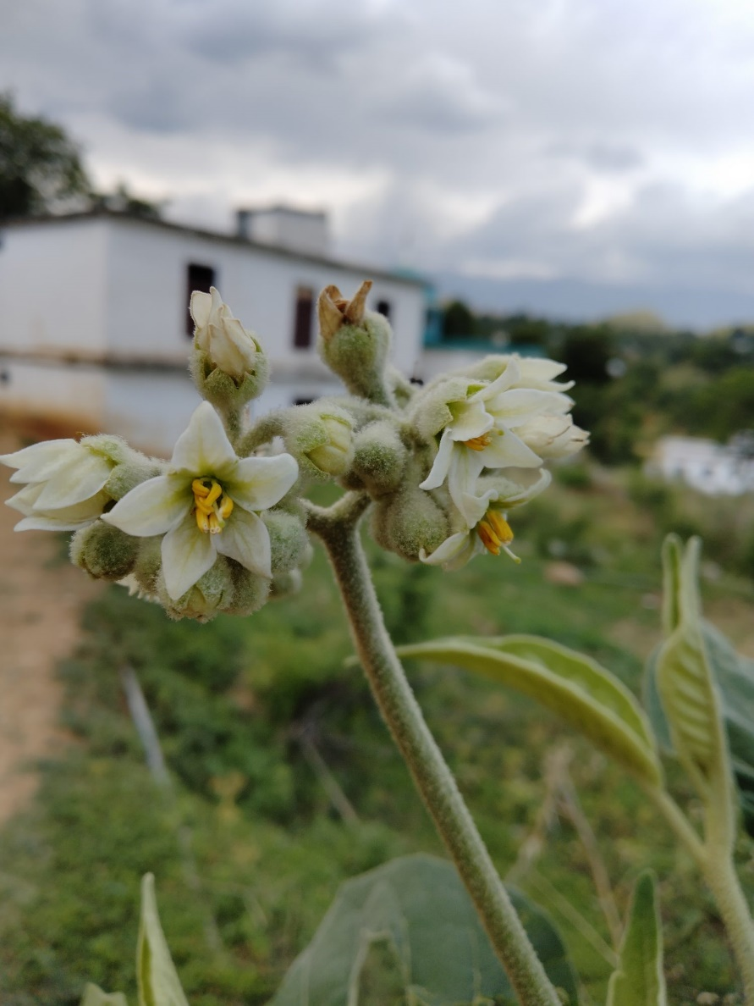
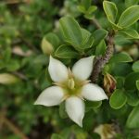
Seema Bin Zeenat
Best flora picture on completion of 15 years
Solanum erianthum
Himalrandia tetrasperma

Slide 16
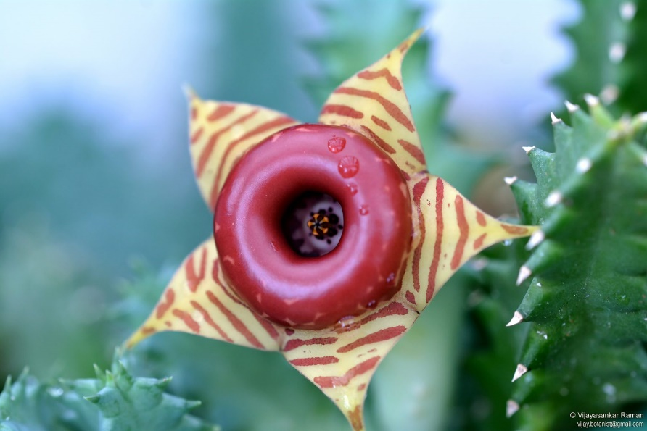
Dr. Vijayasankar Raman
Best flora picture on completion of 15 years
Huernia zebrina (Lifesaver plant, Doughnut flower) of Apocynaceae is my entry for the Best Flora Photograph contest to celebrate 15 years of efloraofindia.
I chose this picture because of the unique beauty of the flower. It has a prominent shiny central ring called the annulus, appearing like a doughnut, a popular delicacy in the USA and many other countries. This rare and interesting plant is native to Africa and is considered a famine food. Several hybrids are widely grown as ornamentals.
https://en.wikipedia.org/wiki/Huernia https://efloraofindia.com/2011/03/06/huernia-zebrina/ https://powo.science.kew.org/taxon/urn:lsid:ipni.org:names:98833-1

Slide 17
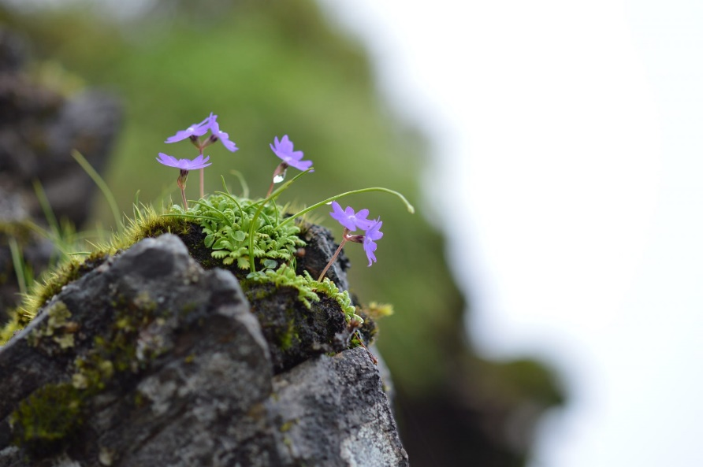
Saroj Kasaju
Best flora picture on completion of 15 years
Primula primulina (Spreng.) H. Hara
It was mid-monsoon and the dirt road leading to Kuri village was in a very bad state. We drove our jeep with much difficulty and we had to give up the ride at 8000 ft. Now the climb to Kuri village at 11000 ft. has started. It was raining all the way and I had to carry all the loads by myself. I started clicking all the way with much difficulty. Totally exhausted, I reached very close to Kuri village and I just missed the plant atop a cliff on the left side which I never saw before. Forgetting all my tiredness I tried to climb the cliff but could not get close enough to the flower. However, I could manage some shots from a distance and I was somewhat satisfied with the shots
Submitting for the Best flora photography contest

Slide 18
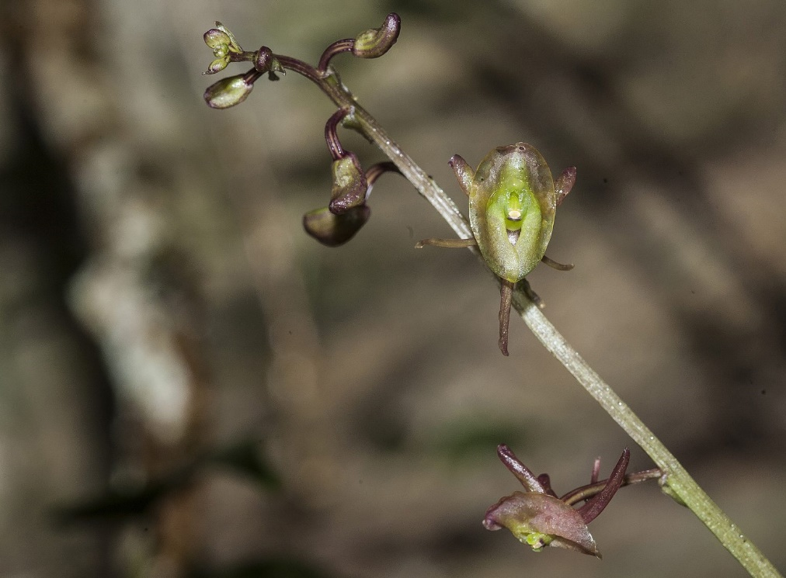
Dr. Pankaj Kumar
Best flora picture on completion of 15 years
In 2011, while going through the proof of one of the books, “The wild orchids of Hong Kong”, I realised there was a mistake. There was a species, Crepidium acuminatum included in the book and it had two figures plus one plate. To my surprise neither of those two plants on the figures and the plate (of one plant) matched with the species I knew from Western Himalaya and Nepal. However, one of the figures and the colour picture matched with another species Crepidium purpureum, which I also knew from Himalaya. Having seen the wild plants I was sure that one plant was Crepidium purpureum, but then what was the other. Anyways, the book was published as it was. Few years later I found an old plant collected in the wild in our living collection, this was labelled as Malaxis allanii. I was surprised because this was surely very distinct but in the same book it was merged under Crepidium acuminatum. However, there was an issue. Many of these old living plants were also brought from outside Hong Kong to study and compare with local species. How to resolve this? The only way out was to find this plant which was described as Malaxis allanii in 1976 based on a specimen collected in the 1950s from a part of Hong Kong. So the search began and it started with looking at old literature. In old notes from the 1970s I found an old map. This map belonged to an old hiking trip in the 1990s which indicated roughly the site of the species but also indicated that the person who undertook the survey was unable to find the plants of Malaxis allanii at the original site but found at another site. I had already looked into the area and hence, started to think of visiting this particular stream. In 2020, finally after doing a lot of map reading and consultation of old literature, visited Kew to study the original specimens, I was able to find this particular subpopulation along with 2 more subpopulations of the species in the same stream, that too in flowering. I was able to confirm that this plant was indeed the same as the plants in our living collection. However, in my head I wanted to find out the type locality of this species. Hence, I continued my search and in 2021 I found another subpopulation of the species, but in the same stream. My search went on and after a difficult hike in April 2022, I finally found the species in its type locality. How can I say it is the type locality? Because in the 1950s the area was not well developed and hence, if someone wants to hike, he will start with the main stream in the centre. My mistake was, I never went into the main stream, maybe because this was very difficult and risky. At two points, I almost lost my balance and slipped on loose gravel on the slopes and also missed a snake bite which was sitting on the branches. But it was a non-venomous Indochinese rat snake. This plant was also in flower and it matched with the plant at all other sites and with the plants in our living collection. Even during my first trip in 2020, I carried ropes and carabineers because it was steep slope and it was raining. Infact I had to use the ropes to pull a few of my friends who accompanied me on this difficult trip. Bottom line is, this was indeed a distinct species seen only after 1950s at its type locality, and hence it needed to be resurrected. The article was finally published in 2022 and we call this plant as , Crepidium allanii (S.Y.Hu & Barretto) Kumar & S.W.Gale. Please find a photograph attached.
FOR FURTHER READING: Kumar, P., J. Li & S.W.Gale. 2022. Integrative analyses of Crepidium (Orchidaceae, Epidendroideae, Malaxideae) shed more light on its relationships with Dienia, Liparis and Malaxis and justify reinstatement of narrow endemic C. allanii. Botanical Journal of Linnean Society 198 (3): 285–305; https://doi.org/10.1093/botlinnean/boab048

Slide 19
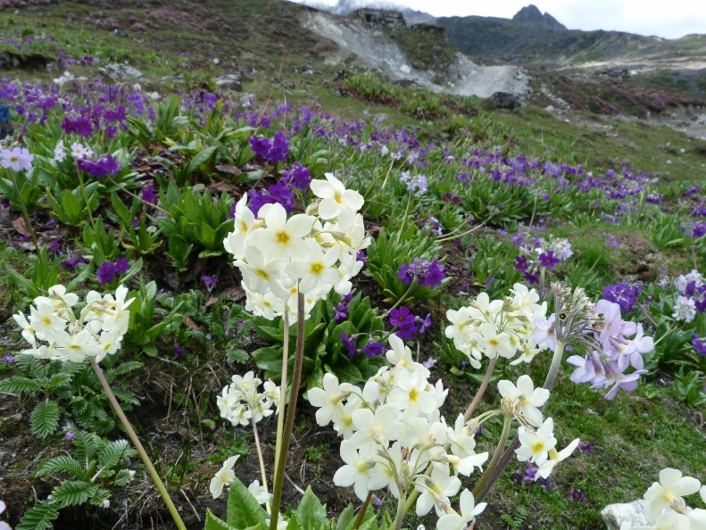
Thingnam Girija
Best flora picture on completion of 15 years
In June 2013 we (Tabish and I) were returning from Bumla Pass, in Tawang area, and were at altitude of 4000-4500 m, and we came across this captivating sight. The story emerged much later after Tabish thoroughly analyzed the pictures taken by us. Primula strumosa is a beautiful primrose with pale yellow flowers, with a golden eye at the center. Primula calderiana is a tall primrose with dark purple flowers with a golden eye. It was conjectured and later verified that the two species hybridize freely at altitudes where their distributions overlap. The result is natural hybrids of virtually every color flowers! We were fortunate to come across this phenomenon where we saw a large expanse with Primula strumosa and various hydrids with Primula calderiana with flowers of many different colors. I was awestruck by the beauty of the landscape, and the story turned out to be even more exciting. I thought of sharing this with you all.

Slide 20
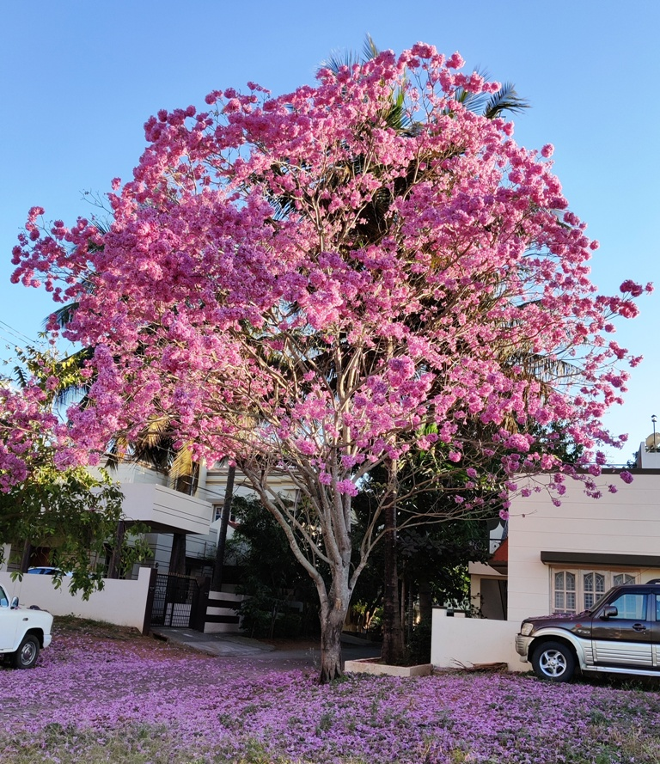
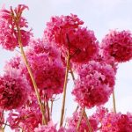
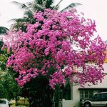
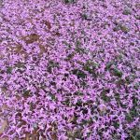
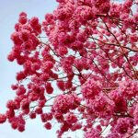
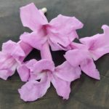
Dr. Mahadeswara Swamy
Best flora picture on completion of 15 years
I consider the photo (s) of Handroanthus impetiginosus as best (Ref: Swamy/New series/ID/65 – Handroanthus impetiginosus)
It is the most beautiful ornamental tree during winter in Mysore. This tree is very important to me because it is very close to my dwelling place, hardly a few yards from my residence located diagonally opposite on the street. It started flowering in the last 4 years. It produces bunches of beautiful pink blossoms in leafless condition. During the peak season, the tree packed with clusters of congested terminal inflorescences forming a crimson canopy is a treat to the eyes. With blossoms held on a linear plane, penetrating sunrays, during mornings, make the tree look magnificent. No doubt, It is the most gorgeous ornamental tree. The flowers attract bees and several birds (hummingbirds, black jacobin, black-throated mango, stripe-breasted starthroat etc). The photos were captured using mobile phone. Always I used to take photos using my Cannon camera. Since it is not working for the past 2 years (from the beginning of the covid season). I could not go to the repair shop and therefore forced to take photos using mobile phone. Surprisingly, the photos look good. Though I took the photographs during January I did not post. Now that the tree is in vegetative stage I thought I could present the two sides of the coin. Even when it is not in flowering it looks so beautiful with its rounded canopy. I can see this tree even from the windows of my house. This tree is seen all over the city. When in bloom it attracts passersby and many take photographs. I receive innumerable telephone calls to know about the tree. I also wrote an article on this tree.
Check the link for the article: https://starofmysore.com/pink-lapacho-winter-delight/
Needless to say that this tree is close to my heart. That is why I chose these photos for the best photograph contest.

Slide 21
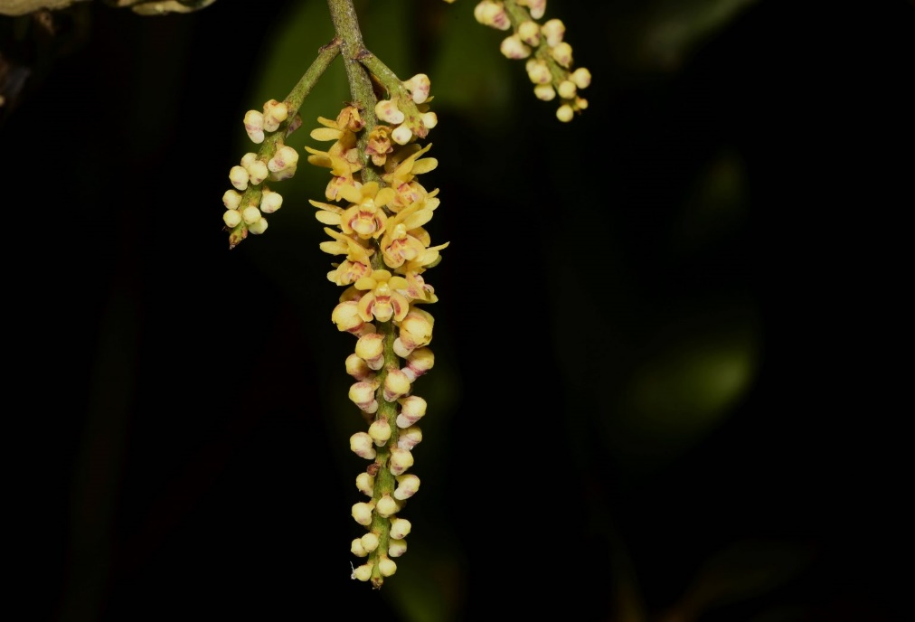
Dr. Giby Kuriakose
Best flora picture on completion of 15 years
Here attached is the best flora picture of mine. I have chosen this, not only because it is one of the best flora pictures of mine but also it is not yet on our site.
Will send you a full set of pictures soon.
Pomatocalpa spicata Breda
From Thattekkad, Ernakulam district, Kerala. Picture taken on 13-3-2022

Slide 22
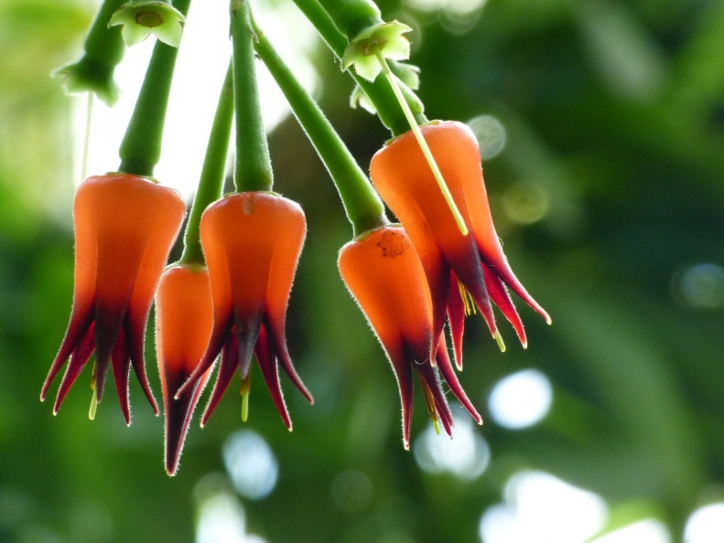
Aarti Khale
Best flora picture on completion of 15 years
Ceratostema silvicola : Neotropical Blueberries
My journey with Efloraofindia started on the 2nd of January, 2010.
For my Best Flora Photograph, I have chosen this image taken at the Conservatory of Atlanta Botanical Garden, in Atlanta.
Ceratostema silvicola is found in the temperate cloud forests of Ecuador in South America.
During my visit to Atlanta in October 2018, my close friend insisted that we must visit the Atlanta Botanical Garden, knowing my love for flowers and plants.
This was my first experience of visiting such a huge botanical garden and seeing a Conservatory.
All the plants and flowers were new to me.
I have never seen so many new ones in a single day.
It was and will always be a very unique one.

Slide 23
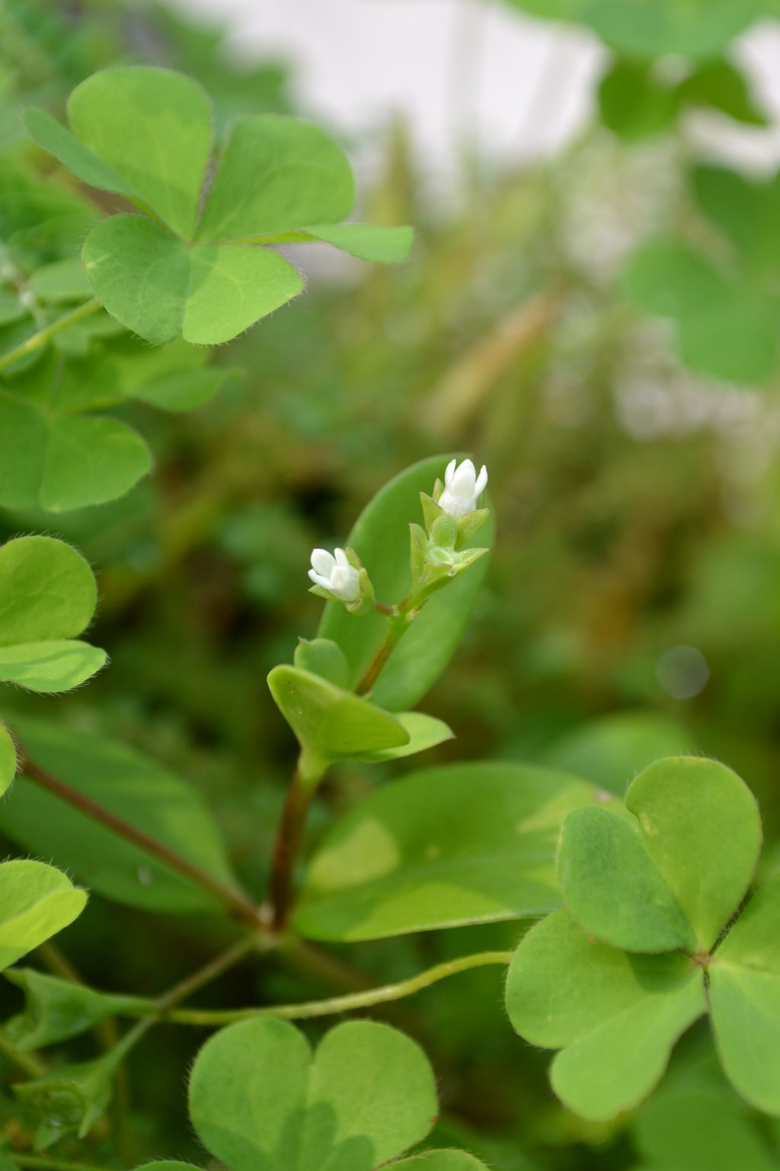
Sandhya Sasidharan
Best flora picture on completion of 15 years
I would like to share the picture and the story of a little plant that came to me unbidden. Years ago it had sprouted in a grow bag in which I used to grow vegetables on my terrace. I still wonder how those tiny seeds made its way into the bag. This was a plant I had never seen before. I was sure that it belonged to Rubiaceae. I sought the help of my botanist friend Dr. Kunhikannan. At first he said he couldn’t identify it and asked me to keep a herbarium specimen for him which I did. Later he came up with the identification. It was Oldenlandia attenuata (Hedyotis attenuata) which apparently has been identified from two districts in Kerala, one of which was Trivandrum where I was living. Another location of identification was Maharashtra. I tried the internet for more information but nothing much was available. It just says it is a native of India and perhaps Vietnam.
I was on the look out for the plant since then but I never found the plant in my neighbourhood. I came across it in other parts of the city only a couple of times, that too a tiny cluster clinging on to the recess of a wall. I had wanted to post it in eflora but somehow I didn’t ( I had photographed the plant in 2013). Looking at the eflora database now I can’t find this species.
So I thought I would share this plant with you friends hoping that we can get to know more about the plant from our experts. Celebrating the 15 wonderful years of eflora with the story of this tiny plant, with lovely tiny white flowers, nothing flamboyant or glamorous… but silently continuing its journey with the sheer power of survival.

Slide 24
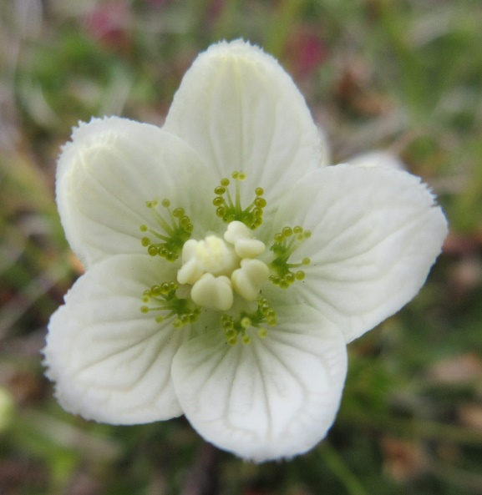
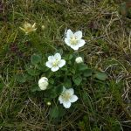
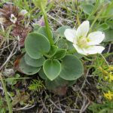
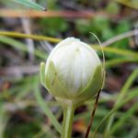
Sheila
Best flora picture on completion of 15 years
For many years I have seen pic of Parnassia in my wild flowers book.
I was so thrilled to find my first one besides the road on the West coast of Skye. Scotland.
It was growing in a bog.
I think the flowers are just exquisite.
This one was actually found on Iceland…again in a rush ..no time!
I have it labelled as Parnassia palustris.

Slide 25
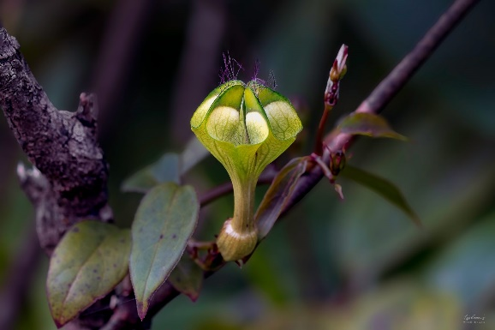
TSP Kumar
Best flora picture on completion of 15 years
I am extremely happy that efloraofindia is completing 15 years this June. I am ecstatic and proud that I have been associated with this forum since 2014 when I was a rookie photo enthusiast interested in photographing flowers that I came across during my field visits as a Forest Officer.I used to pester the experts @ efloraofindia relentlessly seeking the IDs. This forum, with a rich assortment of experts, satiated my inquisitiveness. I know the names of those that enriched this forum by heart. My pranams to each one of you that has made this forum what it is today.. a global authority on flora…….Kudos
This is my humble submission of a photo-story to commemorate the 15th anniversary of efloraofindia. The situation further kindled my passion to explore the floral wealth of Western Ghats. I love every moment of my field trips wherein I encountered spectacular orchids, curious Ceropegia, and a host of other breathtaking flora.
Subject: Ceropegia elegans Location: Mullaianagiri, Chikmagalur, Karnataka
THE STORY:
My tryst with the Queen …………… Ceropegia elegans
The genus Ceropegia has always been an enigma. The different floral shapes and colours have fascinated me. I had read that about 43 of the 53 species that are known to occur in India are threatened and have become rare and genetically depleted. I always searched for them, when on field duty, with no success whatsoever. They remained as elusive as quicksilver.
24-06-2014 was another day that I could not keep indoors. It was mid-monsoon. The call of the Giris, my favorite “beckoning hills,” was irresistible. The imposing cliffs, winding roads, mesmerizing mist, blinding rains and its orchid perfume always beckoned me. Unmindful of my nemesis, those cold, slithery, and bloodthirsty leeches, I set out with my team hoping to find some orchids. The day was fruitful as we could find quite a few orchids, terrestrial and epiphytic ones.
The climb was arduous and my nemesis, the leech, had its fair share of my blood. The sun was already behind the western hills and the light was falling rapidly. We hastened our descent hoping to get into the safety of my Bolero before it got too dark. Before getting into the vehicle, I stopped for a while to fill my lungs and to examine my shoes and socks, Bent a little, kick-dropped a couple of leeches and looked over my shoulders…! I thought that a pair of small, greenish, serpent-like eyes was watching me from among the thickets a few feet away. I stared for a while, eye-to-eye, and blinked first. Spellbound for a few seconds, I went closer. My heart missed a few beats as I realized that it was not a serpent, but an alien looking flower….! Yes. She was a Ceropegia….my Queen…! I had inadvertently stumbled upon the ‘Queen of Ceropegias’ that was later identified as Ceropegia elegans by that master explorer of Ceropegia, Mr. Sushant More.
She has been a lucky mascot for me because later on I could meet her mates as well during the year. Ceropegia juncea, Ceropegia biflora, Ceropegia candelabrum, Ceropegia spiralis and the King himself, Ceropegia gardneri…!
I have been recapitulating 24-06-2014 every now and then ever since. The images I took that day, in the falling light, are my treasure and occupy a prime place in my heart and archives as well.

Slide 26
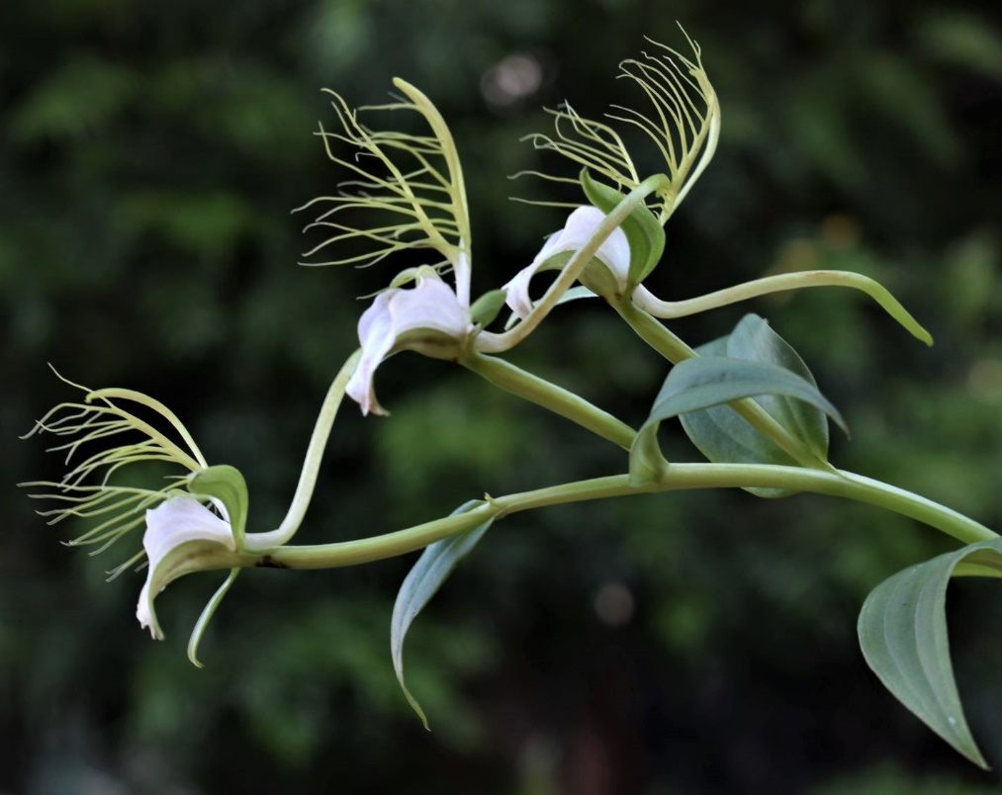
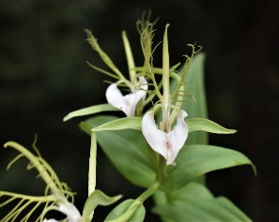
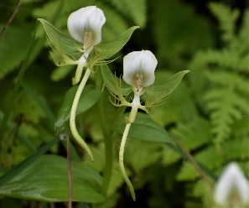
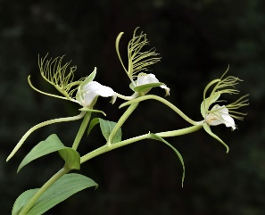
Dr. Anil Kumar Thakur
Best flora picture on completion of 15 years
We have to teach every course of Botany in the colleges. However, I love to teach taxonomy, physiology (my Ph.D. specialization), genetics, ecology and economic botany. I started preparing PPTs for class teaching in 2008 by taking images from the net. When preparing a PPT of the Orchidaceae family, I was fascinated by the peculiar beauty of the flowers of Habenaria intermedia. After noting the places from where it was previously recorded in FLORA SIMLENSIS and SHIMLA FLOWERS, I started visiting those places along with my non-botany friends. One day, on my way back home, I suddenly came across a single plant of Habenaria intermedia on a hill slope. To my dismay, only floral buds were there. So, I decided to come back after one week. On my next visit to that place, I was heartbroken as that plant was no longer there. It might have been plucked by someone. I never came across this species for the next two years.
One day, I was wandering in search of plants and our Computer Science teacher was accompanying me. Luckily, we came across a large patch of approximately 100 plants. I was spellbound on finding what I had been searching for for the last 3-4 years. I could not contain my excitement and spoke aloud to the plant, "Eureka, Eureka; I have finally traced you." Later on, I came across an ardent Nature Lover, Santosh Thakur, who works in the forest department of Himachal Pradesh. Together, we have explored extensively in the nearby areas. We have marked many places where this species flowers in the month of July. Similar to this, every click has its own story.

Slide 27
Thank you

