Slide 1
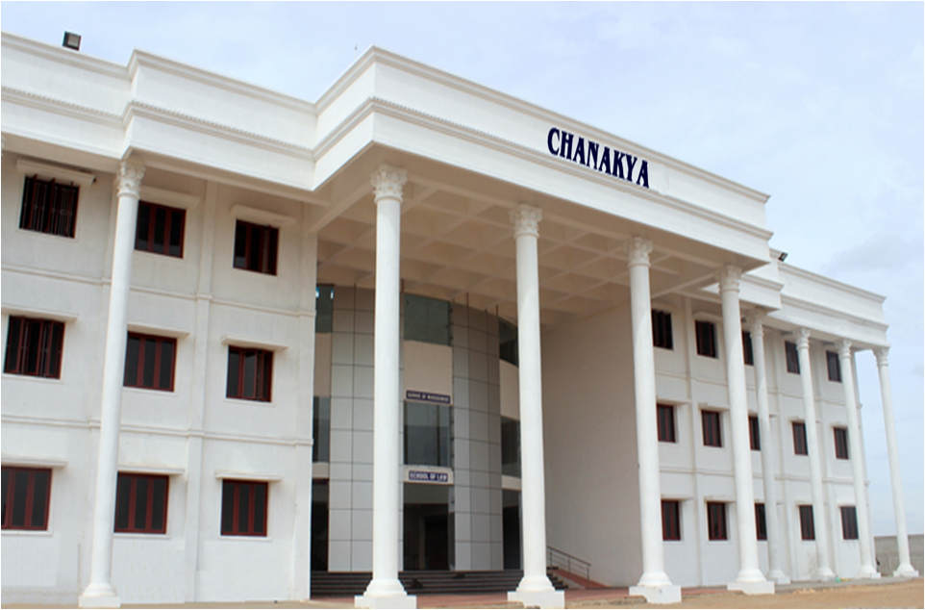
School of Management

Slide 2
About SASTRA - SOM- NIRF RANKING 2017
School of Management- SASTRA has secured 6TH rank in the State. Level , 18th rank among the private B-schools and 44th Rank in the National Level Management Institutes.
School of Management
SASTRA University

Slide 3
About SASTRA
Merit based & transparent admission process
Selection through SASTRA Aptitude Test (SAT), Group Discussion, Personal Interview. Weightage for CAT, MAT, TANCET scores
Affordable fee structure
No Donation / Capitation fee for any programme
Around 13,000 students from all over India are studying in various engineering, management & law programmes
Staff strength - 1200 including 700 teaching faculty
The campus is spread over 120 acres with the state-of-the-art infrastructure
Enjoys outstanding placement record with the support of 100+ regular recruiters visiting every year , both from IT, Manufacturing & Service sector
School of Management
SASTRA University

Slide 4
Mission Statement
“To work towards creating self- directed, ethical and confident generation of professional managers committed towards the corporate and social endeavours of tomorrow through a sustainable and collaborative environment teaching, learning and research.”
School of Management
SASTRA University

Slide 5
School of Management – Special Features
SASTRA re-accredited by NAAC, UGC, Govt. of India with the highest grade “A”
School of Management of SASTRA has been awarded 18th rank among private B-Schools and 44th rank among the overall category(including top 15 IIMs) in the National Institutional Ranking Framework(NIRF) – 2016 – 2017 by MHRD, Govt. of India.
Our MBA Programme is accredited by Tata Consultancy Services from 2013
School of Management stands 4th rank in faculty research publications in Tamil Nadu in Scopus indexed reputed international journals (2013 – 14)
School of Management won DEWANG MEHTA’s B-School Leadership Award in 2015 supported by Hindustan Unilever, Deloitte and World Education Congress
School of Management won DNA newspaper and Stars Of The Industry Group Best B-School with Innovative Marketing to the Target Segment Award in 2016 hosted by Asian Confederation Of Business
School of Management
SASTRA University

Slide 6
School of Management – Special Features
Class of 2018 is our proud 18th batch
20 out of 24 faculty in the school are Ph.D holders
Average Experience of Teaching faculty is at 24.5 years
Vibrant Industry – Academia interaction through regular Guest Lectures, Project works, Internships, Conferences , etc.
Dual specialization empowers students in placement
Banking ,insurance and capital market courses makes students ready to deploy in BSFI sector
Facility for students to gain additional Diploma in Banking & Finance from IIBF ( Indian Institute of Banking & Finance )
School of Management
SASTRA University

Slide 7
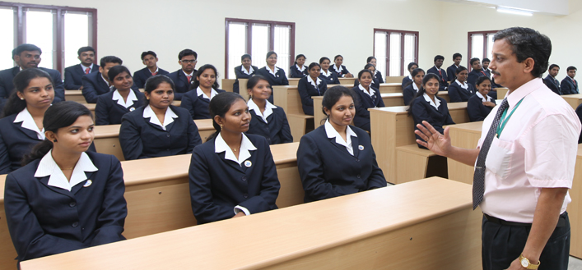
Excellence in Teaching Methodology
School of Management
SASTRA University

Slide 8
Excellence in Teaching Methodology
Special emphasis on building softskills including communication, managerial and leadership skills
Innovative teaching - learning & evaluation methods
Exposure to real time business scenario by way of case analysis and simulation games
School of Management
SASTRA University

Slide 9
Excellence in Teaching Methodology
Market Survey
Stock market analysis
Student Seminar Presentations
Preparation of business plan
Industry Watch
NPTEL
Corporate Internship
Case writing
Business Quizzes
Simulation games
Project work
Role Play
Mini projects
Debate & Paper presentations
Product Launching, Ad. Zap
Case study analysis in classroom
Summer and winter internships
School of Management
SASTRA University

Slide 10
Course Structure
School of Management
SASTRA University

Slide 11
Specialization Breakup - 2018
Specialization | Count
Finance & HR | 28
Banking & Marketing | 18
Finance & Marketing | 19
HR & Marketing | 40
Operations & Marketing | 14
Grand Total | 119
Marketing & HRM
Finance & HRM
Marketing & Production
Male
47
Female
70
Marketing & Finance
School of Management
SASTRA University

Slide 12
MBA - UG Profile- 2018
Total Student Strength → 119
Engineering
Arts & Science
Engineering
Arts & Science
School of Management
SASTRA University

Slide 13
MBA - UG Profile- 2018
Engineering | Count
Bio-Engineering | 1
CSE | 6
Civil Engineering | 1
CSE | 15
ECE | 8
EEE | 9
ECE | 6
ECE | 1
IT | 34
EIE | 2
Mechanical | 11
Grand Total | 64
Arts & Science | Count
B.A | 2
B.B.A | 5
B.Com | 30
B.Sc | 7
BCA | 11
Grand Total | 55
Engineering
Arts & Science
Engineering
Arts & Science
School of Management
SASTRA University

Slide 14
MBA - Split Up - 2018
Gender | Total
F | 73
M | 46
Grand Total | 119
Engineering
Arts & Science
Engineering
Arts & Science
School of Management
SASTRA University

Slide 15
List of Fulltime Faculty
Name | Qualification | Designation | Specialization
Dr. V. Badrinath | M.Com.,M.Phil,M.B.A ,P.G.D.P.M, DIL , Ph. D. | Dean | HRM
Dr. R. Renganathan | M.Sc, MBA ,MMM,M.Phil, PGBMM,DCPIC,FDD(IIM-A)Ph.D. | Professor | Marketing
Ca. S. Balachandran | M.Com., M.L., F.C.A. | Professor | Finance and Law
Dr.J.Sethuraman | MBA,CAIIB,PGDHRM,DBMIIB, Ph.D | Professor | Banking & Finance
Dr.P.Kanagasabathy | Ph.D | Professor | Finance & Economics
Dr. P.Vaijayahthi | MBA,D.LL,DPR,Ph.D | Professor | HRM & OB
Dr. C. Vijaya Banu | M.Com,M BA, DIM PGDMM,Ph. D.,Am –NIPM | Associate Professor | HRM & Marketing
Dr. V. Srinivasa Kumar | M.Com, M.Phil, Ph.D | Associate Professor | Accounting & Finance
Dr. S. Selvabaskar | B.Tech, MBA , Ph.D | Associate Professor | Marketing & HRM
Dr. S. T. Surulivel | MSc MBA M.Phil M.S (Em) MISTE Ph. D.(FIN) | Senior Assistant Professor | Finance & System
Dr. R. Amudha | M.Com M.Phil FICWA PGDFM B.Ed Ph. D. | Senior Assistant Professor | Finance & Marketing
School of Management
SASTRA University

Slide 16
List of Fulltime Faculty
Dr. R. Alamelu | M.Com, M.Phil, MBA,Ph.D | Assitant Professor | HRM & Systems
Dr. R. Srinivasan | M.A M.Phil M.B.A Ph. D. | Assitant Professor | Gandhian Thoughts & HRM
Mr K. A. Shreenivasan | MBA., M.Com.,(Ph.D) | Assitant Professor | Finance
Dr. V. Vijay Anand | M.Com.,M.Phil., M.B.A., M. Phil., MA., MS.,Ph.D (HR) | Assitant Professor | HRM, Marketing & ED
Dr N . R.Vembu | M.Com, M.Phil, MBA,Ph.D | Assitant Professor | Finance & Accounting
Mr S. Thiyagarajan | M. Tech. M C.A | Assitant Professor | Systems
Mr P. Vijayshankar | M.C.A., M.B.A., M. Phil.,(Ph. D.) | Assitant Professor | Computer Architecture
Dr C. Gangatharan | B.E , M.BA. Ph.D. | Assitant Professor | Marketing & Analytics
Dr K .Arun Kumar | B.Tech, MBA , Ph.d | Assitant Professor | Marketing & Analytics
Dr. V. Rengarajan | M.Com, M.Phil, MBA,Ph.D | Assitant Professor | Accounting & Finance
Dr K.Nigama | MBA,Ph.D | Assitant Professor | Accounting & Finance
Dr M.Velavan | M.com,,M.phil,MBA,Ph.D | Assitant Professor | Accounting & Finance
Dr R.Nalini | M.Com, M.Phil, MBA,Ph.D | Assitant Professor | Accounting & Finance
Dr R .Gayathri | M.A ,M.B.A Ph. D. | Assitant Professor | Economics
School of Management
SASTRA University

Slide 17
Adjunct Faculty
Dr. N. Kamakodi
Managing Director & CEO
City Union Bank Ltd. Kumbakonam
Dr.S.Vaidhyasubramaniam Ph.D., GMP (Harvard)
Indian Overseas Bank Chair Professor of Management &
Dean - Planning & Development
SASTRA University
School of Management
SASTRA University

Slide 18
Library and E - Journals
Number of books in the central library - 7,968
Number of books in the School Of management library -1,677
Number of e - journals - 38 journals + 10,850 online journals in all subjects
Dissertations - 17,00,000
School of Management
SASTRA University

Slide 19
A Partial List of our Proud Recruiters - MBA Programme
Average placement record is at 85 to 90% over last five years
Salary Range: 3 – 8 Lakhs per Annum

Slide 20
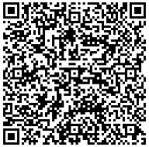
Contact us
More & detailed info available on request to
Dr. Badrinath,
Dean, School of Management
Director , Training & Placement
deanbadri@sastra.edu
placement@sastra.edu
Mobile: +91 94431 48947 Direct no: +91 4362 304223
If we both can decide, we can do it
Thank you!
School of Management
SASTRA University

