Slide 1
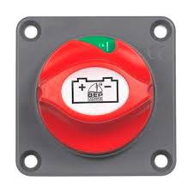
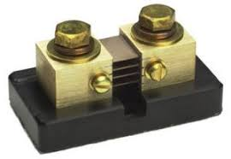
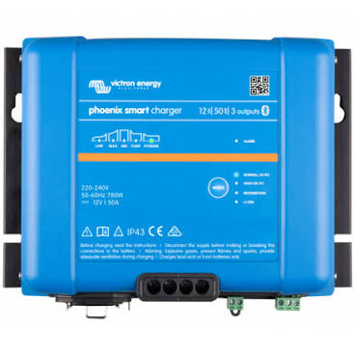
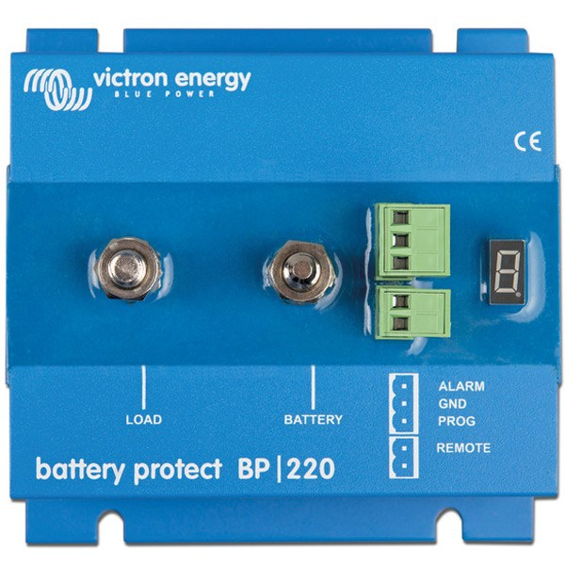
SBMS connection to chargers model 1:
EXTIo5+
EXTIo5-
EXTIo4-
Electrodacus SBMS0
EXTI04+
H
?
EXTI03 +
EXTI03 -
PVp /PVnç√
-
1 - 12
ADC1n/ADC1p
Ignition
0,6 W 1KV
LifePo4sSystem Elan 40 ‘Slowhand’ – May 2021
Winston 400 AH
LifePo4
+
Phoenix charger 12/50
H
LOAD

