Slide 1
Embedded supercomputing
For hobbyists
Prashant Sohani (08007017) <prashant.sohani@iitb.ac.in>
<psohani@nvidia.com>

Slide 2
What is computation?
A very broad description:
A mapping of abstract ideas into physical objects
Eg: Electrons/fields can represent numbers
A system of physical objects whose natural behaviour resembles abstract operations
Eg: A binary adder is purely driven by the laws of electrodynamics, and yet the result is similar to what we call ‘addition’
Why such a broad description?
Babbage’s Analytical Engine is also a computer!
And yet, plenty of assumptions:
linearity/causality of time,
invariance of physical laws (spatially, temporally local)

Slide 3
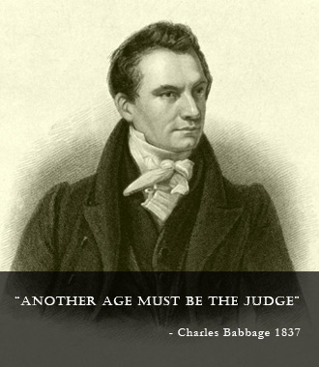
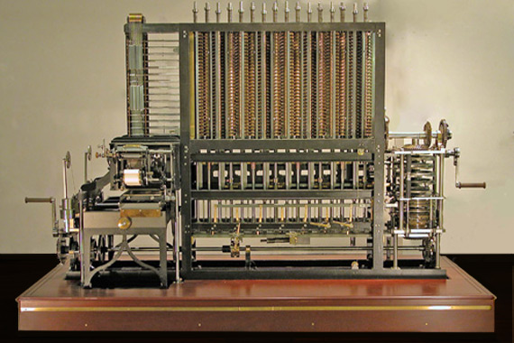
The past..
“Another age must be the judge”
The Babbage Engine
[ http://www.computerhistory.org/babbage/ ]
“[The Babbage Engine is] … the wonder of a future already passed.”
- Computer History Museum

Slide 4
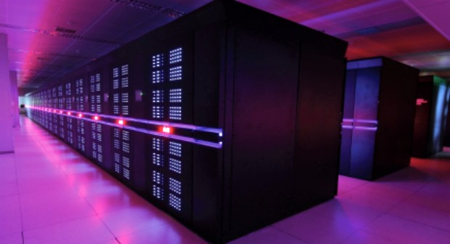
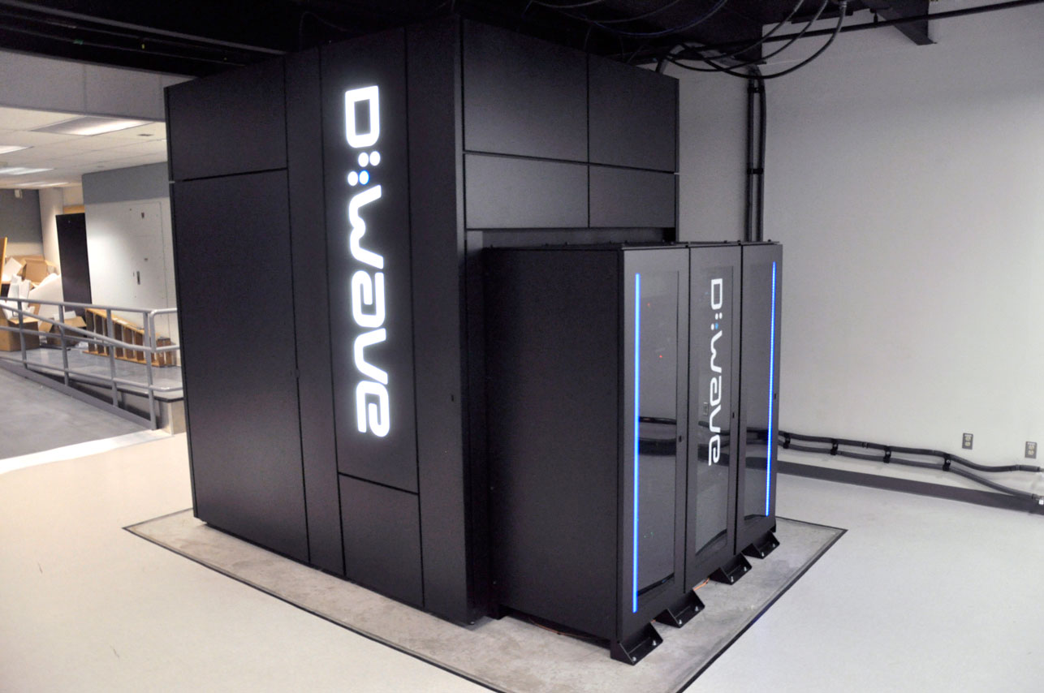
The present
Tianhe-2
[http://www.top500.org/featured/systems/tianhe-2/ ]
D-Wave Two
[http://www.nas.nasa.gov/quantum/quantumcomp.html ]

Slide 5
The future..
This slide inevitably left (almost) blank
“Parallel Quantum Computation” - Norman Margolus
MIT Laboratory For Computer Science, June 1989

Slide 6
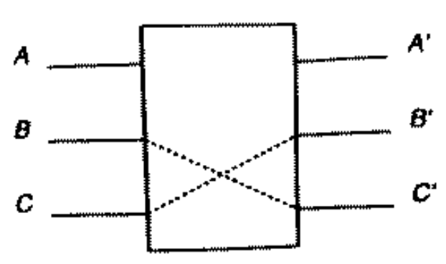
Side note: Fredkin gate
The top control input goes through unchanged (A’ = A), and the bottom inputs either go straight through also (if A = 1) or cross (if A = 0 then B’ = C and C’ = B)
Universal gate!
‘Reversible computation’
Thermodynamic implications:
Most energy-efficient at transforming information
“Parallel Quantum Computation” - Norman Margolus; MIT Laboratory For Computer Science, June 1989
http://en.wikipedia.org/wiki/Fredkin_gate

Slide 7
Important questions
What is the ‘nature’ of the ever-increasing computational power?
Where and how to use this power optimally?
Why should a hobbyist care?

Slide 8
Important questions (contd.)
Where and how to use this power?
Along (at least) 3 separate dimensions:
Why should a hobbyist care?
Casual: More computational power is good
Competitive: More computational power is good!
Algorithmic complexity
Per-peripheral complexity
Peripheral count

Slide 9
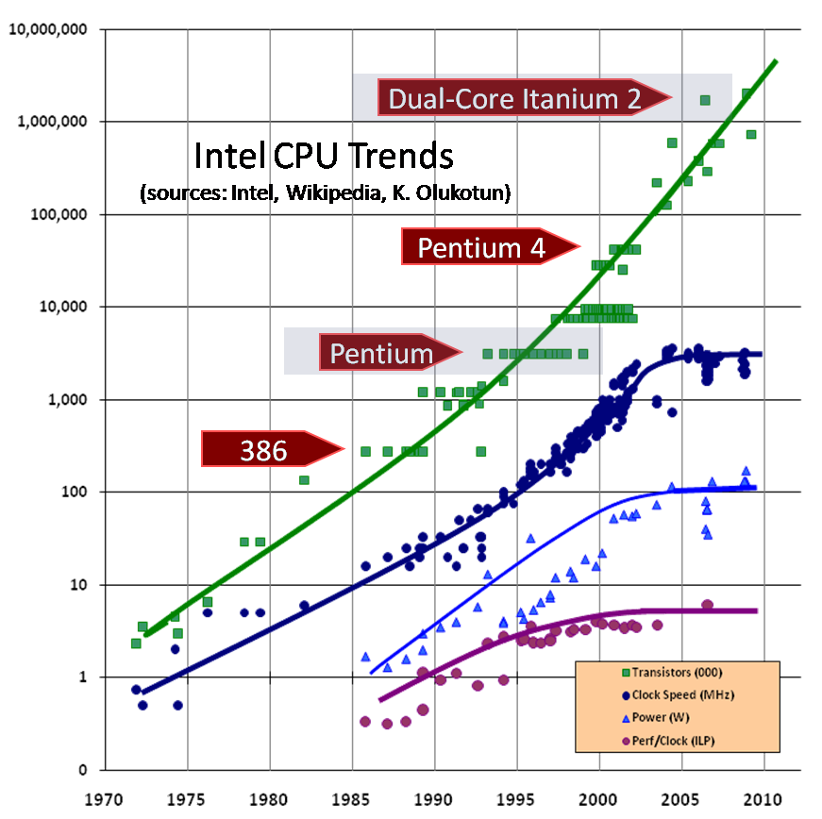
The Free Lunch Is Over:
A Fundamental Turn Toward Concurrency in Software
[ http://www.gotw.ca/publications/concurrency-ddj.htm ]

Slide 10
Single vs multi-threaded line-follower
Single-threaded:
“First read sensors, then do math, then drive motors”
Multi-threaded:
“Keep reading sensors”
“And also keep doing math”
“And also keep driving motors”
“And also keep flashing decorative LEDs”
“And also keep playing some background music”
…
“And also control the universe, while you’re at it!”

Slide 11
Why multi-threading?
May seem more complex to manage:
Need to synchronize; load-balance the threads,
Need to move data without ‘race conditions’, etc.
But has benefits too:
Flexible
Scalable to multi-core processors
Performant
Related operations grouped together => better optimization
Modular
A single slow/faulty thread need not halt the system:
“If the music stops, the line-follower doesn’t have to!”

Slide 12
Single-core single-threading
Single-threaded application:
Execute only one task at a time
Can use HW interrupts to ‘simulate’ more tasks:
Code executing
Incoming interrupt!
Execute interrupt routine
Resume code execution

Slide 13
Single-core ‘simulated’ multi-threading
Essentially a single-threaded application,
with timer-based context-switching:
On small platforms, you may use your own context-switcher, like above
‘Context’: Register values, program counter etc.
Protothreads: http://dunkels.com/adam/pt/
Thread 1 executing
Incoming timer interrupt!
Save thread 1 context; load thread 2 context
Schedule next timer interrupt
Start thread 2 execution

Slide 14
Hardware-based multi-threading
Implementation: beyond the scope of this session
Best left to OS-level thread scheduler, if available
[ http://playground.arduino.cc/Code/OsWrap ]
Other things not covered here:
Thread synchronization
Eg. AV playback
Wait for events/messages as a sync point
[ http://playground.arduino.cc/Code/OsWrap#MessageQ ]
Prevent race conditions on same data access
Obtain ‘locks’ before read/write to shared data [http://playground.arduino.cc/Code/OsWrap#Semaphores ]

Slide 15
Multi-threaded “Hello world!”
#include <iostream>
#include <string>
using namespace std;
int main(){
int pid;
string text[4]={“zero",“one",“two",“three"};
for (int i=0;i<4;i++){
pid=fork();
if (pid>0){
cout << "Thread " << text[i] << " says Hello World!" << endl;
exit(0);
}
}
return 0;
}

Slide 16
Multi-threaded “Hello world!”
#include <iostream>
#include <string>
using namespace std;
int main(){
int pid;
string text[4]={“zero",“one",“two",“three"};
for (int i=0;i<4;i++){
pid=fork();
if (pid>0){
cout << "Thread " << text[i] << " says Hello World!" << endl;
exit(0);
}
}
return 0;
}
i= 0 1 2 3 4

Slide 17
Multi-core CPUs
CPU cores: Ideal for a few, individual tasks
Heavy-duty, ultra-low latency processing
What if.. we need to perform the same task many times, on different data sets?
Theoretically, a CPU can operate on each data set, one at a time (or #cores at a time)
Each CPU core is heavy-duty, so #cores is limited
Time-to-finish: may be too much!

Slide 18
GPUs for parallel computing
3D graphics rendering:
Needs the same calculations for each vertex/pixel
Has to be done fast (More frames-per-second!)
More latency than CPUs, but more throughput also
GPUs initially had only 3D rendering functions; but now can do any parallel computing task:
“GPGPU”: General-Purpose computing on GPUs

Slide 19
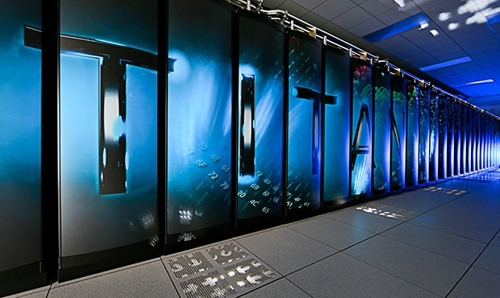
CPU vs GPU comparison
Different specializations, for different tasks
CPUs for Serial processing:
A few high-power cores, that can perform various tasks
Low-latency low-throughput
Typical: 4 / 16 / 32,000 cores!
GPUs for Parallel processing:
Many low-power cores, that can
all simultaneously perform the same task
High-latency high-throughput
Typical: 192 / 2048 / 46 million cores!

Slide 20
GPUs: Why should hobbyists care?
Most mobile devices have GPUs
Mobile GPUs: highest FLOPS/W on the planet.
[ Even more than supercomputers! ]
Due to focused design on power-efficiency
Same GPUs available on embedded platforms
Easy to program C/C++ with CUDA, OpenCL

Slide 21
CUDA “Hello World!”
#include "stdio.h“
__global__ void add(int *a, int *b, int *c){
c[threadIdx.x] = a[threadIdx.x] + b[threadIdx.x];
}
int main(){
int a={1,2,3,4};
int b={5,6,7,8};
int c[4];
int *dev_c;
cudaMalloc((void**)&dev_c, 4*sizeof(int));
add<<<1,1>>>(a,b,dev_c);
cudaMemcpy(&c, dev_c, 4*sizeof(int), cudaMemcpyDeviceToHost);
for(int i=0;i<4;i++){
printf("%d + %d is %d; Hello World!\n", a[i], b[i], c[i]);
}
cudaFree(dev_c);
return 0;
}

Slide 22
CUDA “Hello World!”
#include "stdio.h“
__global__ void add(int *a, int *b, int *c){
c[threadIdx.x] = a[threadIdx.x] + b[threadIdx.x];
}
int main(){
int a={1,2,3,4};
int b={5,6,7,8};
int c[4];
int *dev_c;
cudaMalloc((void**)&dev_c, 4*sizeof(int));
add<<<1,4>>>(a,b,dev_c);
cudaMemcpy(&c, dev_c, 4*sizeof(int), cudaMemcpyDeviceToHost);
for(int i=0;i<4;i++){
printf("%d + %d is %d; Hello World!\n", a[i], b[i], c[i]);
}
cudaFree(dev_c);
return 0;
}

Slide 23
FPGAs
Field-Programmable Gate Arrays:
‘LEGO’ kit to build your own processor
Used to contain only primitive logic blocks (AND-OR, Flip-flop arrays)..
Can be used to implement fixed-point arithmetic
..but modern FPGAs have higher-level blocks:
Floating Point Units (FPUs)
Signal processing blocks (DSPs)

Slide 24
FPGAs vs processors
Advantages:
Customizable:
Logic paths, ’macro-blocks’ can be greatly fine-tuned for specific algorithms
Parallel:
Each logic block can do some useful work in every clock cycle
Reconfigurable:
Can ‘reprogram’ the chip again and again
Disadvantages:
Need to use Hardware Description Language (VHDL)
Essentially, you are a microprocessor architect!
Could be harder to migrate from one architecture to another
Similar, low complexity solution: CPLDs

Slide 25
Examples of platforms: Multi-core CPU boards
Samsung Arndale board [ http://www.arndaleboard.org ]
Arndale Octa board
8 cores @ 1.8GHz/1.2GHz; big.LITTLE configuration
70 FP32 GFLOPS
$199
Adapteva Parallella Boards [ http://www.adapteva.com/ ]
Parallella 16 Micro-server
ARM Dual-core + Epiphany 16-core @ 1GHz
32 GFLOPS
$99

Slide 26
Examples of platforms: FPGA boards
Xilinx FPGA boards
Elbert V2 Spartan 3A board
~1500 logic cells
$39
Altera FPGA Boards
Cyclone Altera EP1C3T144 board
~3000 logic cells
$39

Slide 27
Examples of platforms: GPU boards
NVIDIA Jetson TK1 [https://developer.nvidia.com/jetson-tk1 ]
Quad CPU cores (+ 1 power-saver core)
192 GPU cores!
300 GFLOPS
$199

Slide 28
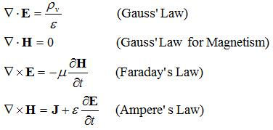
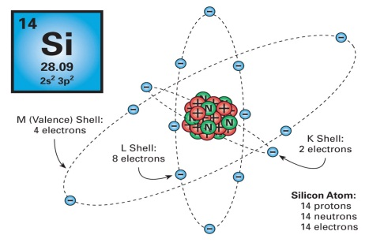
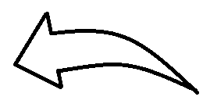
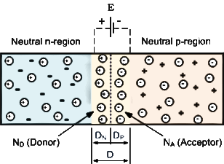
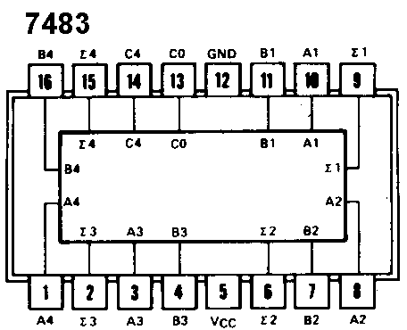
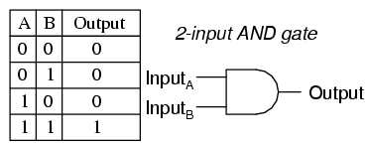
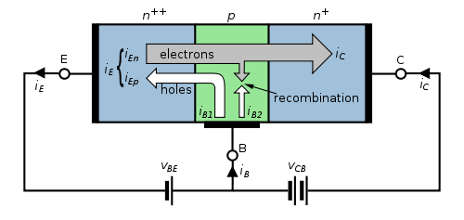
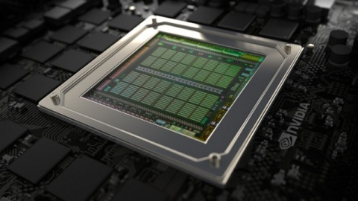
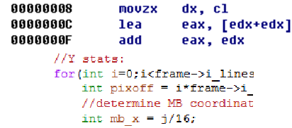
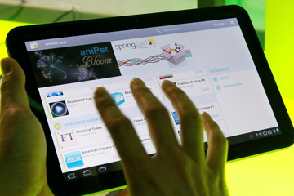
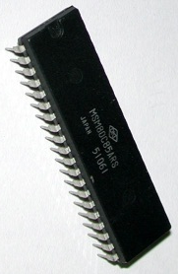
The hierarchical building blocks of a modern computing device
Maxwell’s equations | The silicon atom | P-N Junction
Digital circuits | Logic gates | Transistors
The microprocessor | Software code | User application

Slide 29
Applications
104 parallel computing project ideas:
http://www.adapteva.com/white-papers/104-parallel-computing-projects-for-next-summer/
Basically, anything a human can do

Slide 30
Robotics
Needs multithreading, to:
collect data from multiple sensors;
control multiple actuators
Suitable platforms:
Multi-core CPUs for control-centric devices
Robotic arms; Biped bots
FPGAs for a more dynamic complexity control:
If you need signal processing before control logic

Slide 31
Machine learning
Let machines ‘learn’, similar to how we learn
Usually follows ‘train → guess → correct’ loop
Supervised learning vs unsupervised learning
[Optional] Expected response
Eval
Training Data
Model
Guess
Feedback

Slide 32
Artificial Neural networks
A general model, similar to biological ones:
Hierarchical classification of data/signals
Various types: Convolutional/deep neural nets
Important Landmark:
ANN image recognition has surpassed human-level accuracy in February 2015!!
This is still narrow AI; cannot do ‘everything’

Slide 33
Model of an artificial neuron
Weighted sum of inputs → non-linear function
Popular non-linear function choices:
Piece-wise linear; step function, sigmoids etc.
$$x_{1}$$
$$x_{2}$$
…
$$x_{k}$$
$$w_{1}$$
$$w_{2}$$
…
$$w_{k}$$
$$f\left(\sum{w_{i}⋅x_{i}}\right)$$

Slide 34
Deep neural networks
Input
Output

Slide 35
Applications of ML:
Machine learning for..
Natural language processing
Speech recognition
Object/feature detection (Line follower on steroids!)
Weights training:
can be offline;
decoupled from weights usage
Suitable platforms for training:
More the parallelism; faster the training
GPU ‘farms’ are ideal; but even 1 GPU is better than none
For weights application:
Different platforms, depending upon model complexity

Slide 36
Computer vision
Example: Automated toll system
Requirements:
Image processing (OpenCV-like capabilities)
Encryption layer, for security reasons?
Suitable platforms:
High-end FPGAs (need DSP blocks)
Embedded GPU boards
Can use GPU-accelerated libraries

Slide 37
Putting it all together
Sensor inputs; image processing (OpenCV)
Navigation/collision avoidance (ML)
Actuators (Robotics)
=

Slide 38
Thank you!
Questions?

