Slide 1
CANDLE

Slide 2
TO UNITE THE WHOLE WORLD ONTO ONE PLATFORM OF TRADERS AND INVESTERS AND FINIANCIAL SERVICES

Slide 3
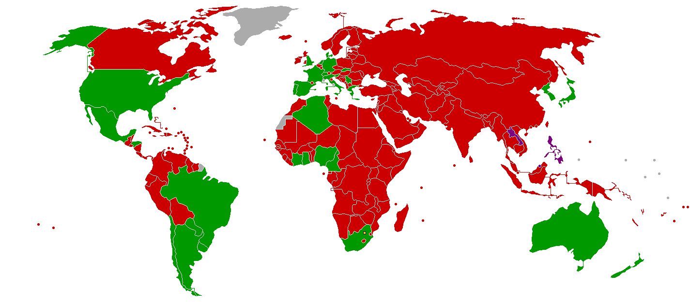

Slide 4
TIMEZONES WILL BE DISPLAYED TO THE RESPECTIVE IMPORTANT COUNTRY MARKETS
COUNTRY COLOUR CHANGES ACCORDING TO THE INDEX AND CURRENCY OF IMPORTANT MARKETS
IF ANY COUNTRY INDEX GAINS IT CHANGES TO GREEN
IF INDEX FALLS IT CHANGES TO RED

Slide 5
NEWS
All the news regarding the stocks,index, commodities will be gathered across the country and shown respective to the country
All the updates will be notified to the user and send recommendations

Slide 6
Communicate
People can login to communicate with other traders and share their view on certain stocks,index, commodities
People can follow another profile for updates
This can build a good platform for social networking for all traders and investers.

Slide 7
GROUPS
Certain profile can create a groups for communication with one another and also for teaching and learning
It can be built up as a community for investors and traders to discuss their view on stocks.
People can teach and share their knowledge with others

Slide 8
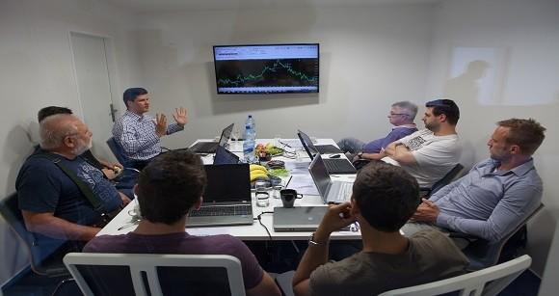

Slide 9
Broadcasts
News channels can broadcast their channel on their profiles
Investers can watch all types of news through their profile
Investers can also discuss their view on stockmarket

Slide 10
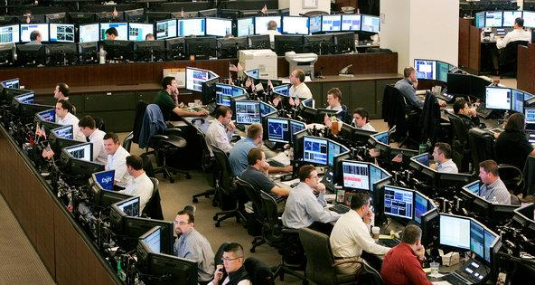

Slide 11
STOCKS
companys are given their own account so they can share their Quaterly earnings,updates they can communicate with the investers

Slide 12
SOCIAL NETWORKING
IT WILL BECOME A SOCIAL NETWORKING PLATFORM FOR INVESTERS, TRADERS, COMPANYS.
THIS WILL JOIN THE WHOLE WORLD IN ONE PLACE
PEOPLE CAN LEARN A LOT AND BE INFORMED

Slide 13
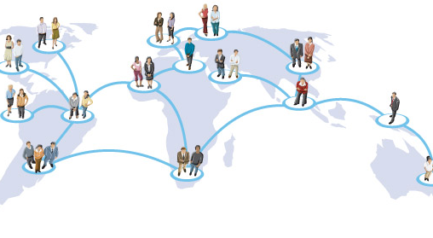

Slide 15


