Slide 1
A ‘Welcome Mail’ will be received by all existing VLE IRCTC Agents on their Registered Email ID (registered with us during Agent creation)
VLE to get 1 more email after the ‘Welcome Mail’ - which will contain the new user id (which will be the future agent ID for all correspondence) and the password.
VLE to click on the link https://www.operations.irctc.co.in/AgentInterface/loginHome.jsf( as received on first mail which is also a welcome mail) and to enter his User ID and Password and Captcha ( as on screen ).

Slide 2
It is Mandatory for all VLEs to register their Adhaar number through following link. VLE to enter Adhaar # and Click on ‘Generate OTP’.
VLEs will receive an OTP on their registered mobile #. VLE enters the OTP in the OTP field and click on Validate. Adhaar validation will be done successfully.

Slide 3
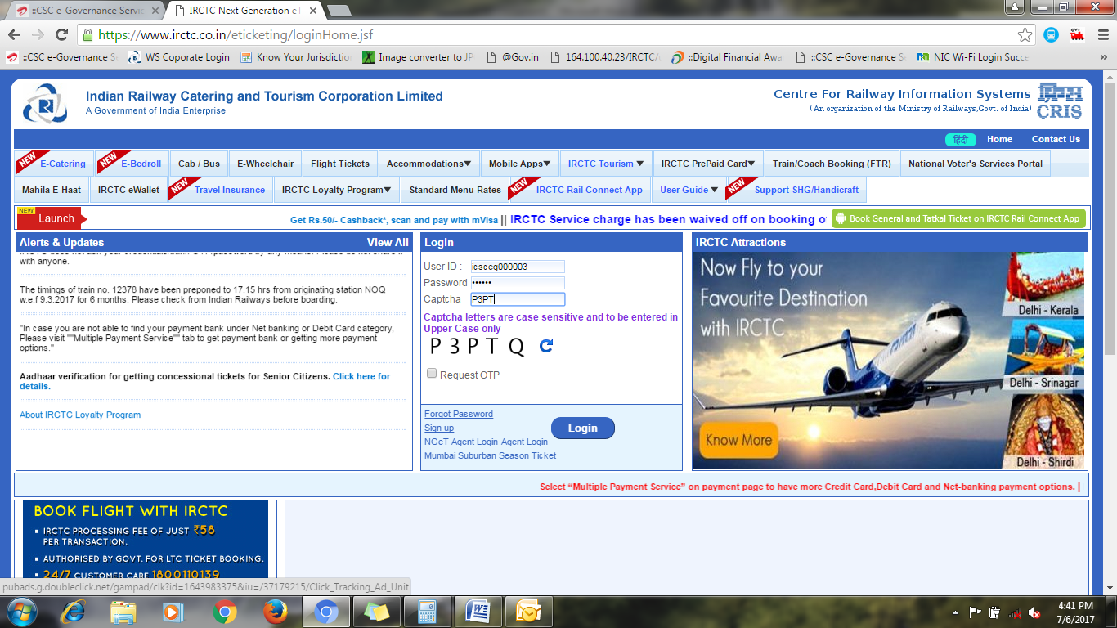
After successful Authentication of Adhaar VLE visit on www.irctc.co.in for Railway E-ticket booking. Enter your new User ID and Password as received from IRCTC in welcome mail.

Slide 4
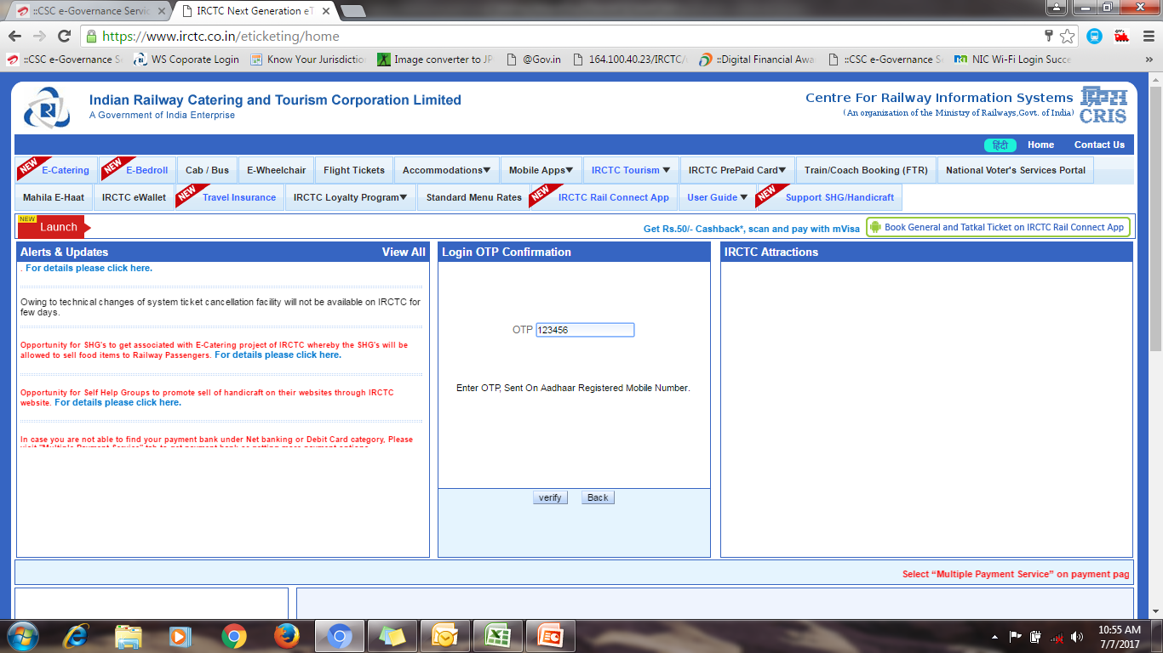
After Entering User ID and Password a new window will appear on your screen where VLE have to put received OTP on Adhaar registered mobile #. Then click on verify.
This is a continuous process for every login.

Slide 5
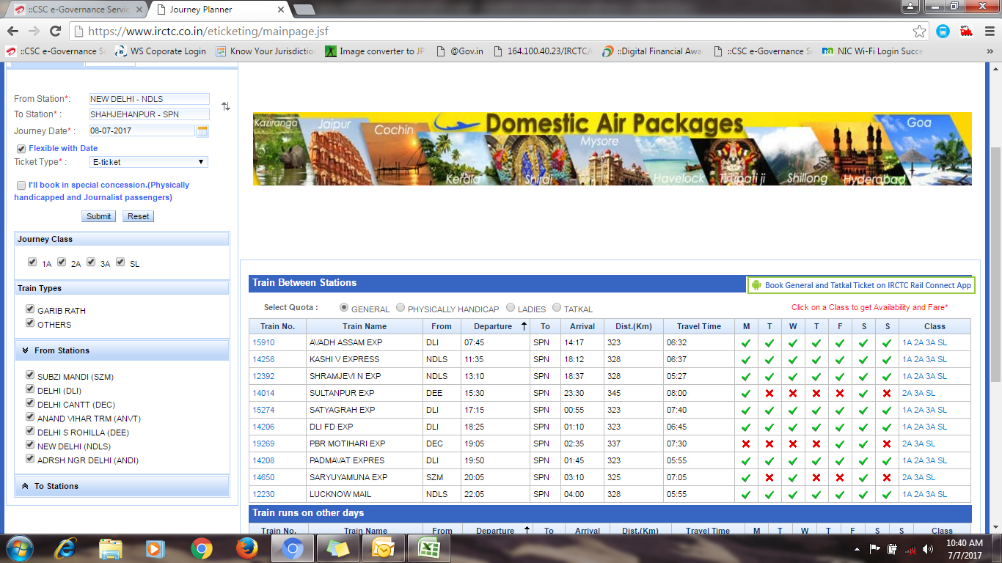
After successful authentication it will move on “Plan My Travel page” where VLE to enter required details for ticket booking.

Slide 6
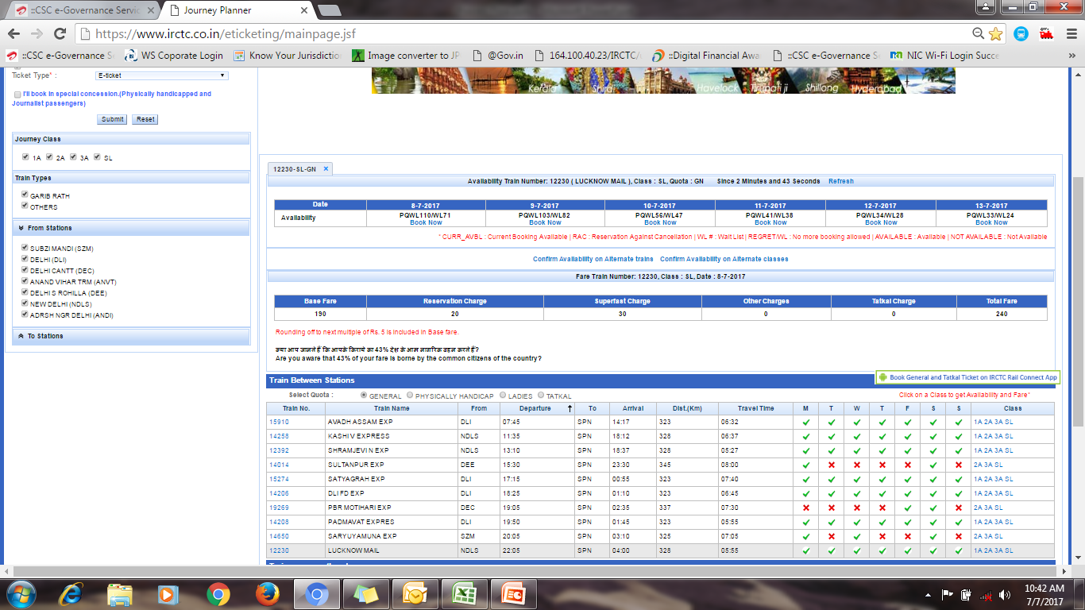
The train list will appear on your screen and select the train through which you want to travel with class then it will show the date wise availability then click on “Book Now” will move on next page.
Click on Book
Select Class

Slide 7
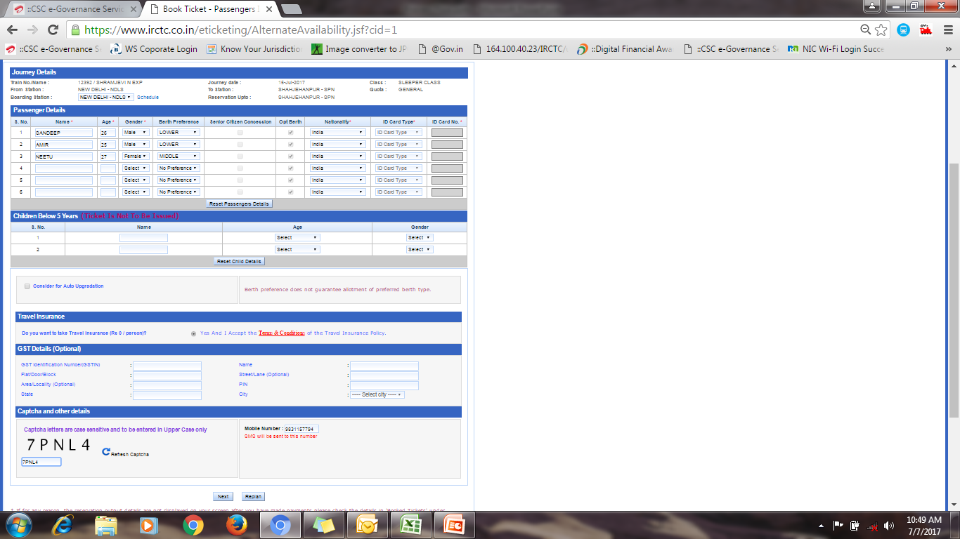
Here you have to fill the details of passenger, and can change the boarding point from the below option also and click on next button
You can change your boarding point from here
Fill the passenger details
Change the mobile number (if required )

Slide 8
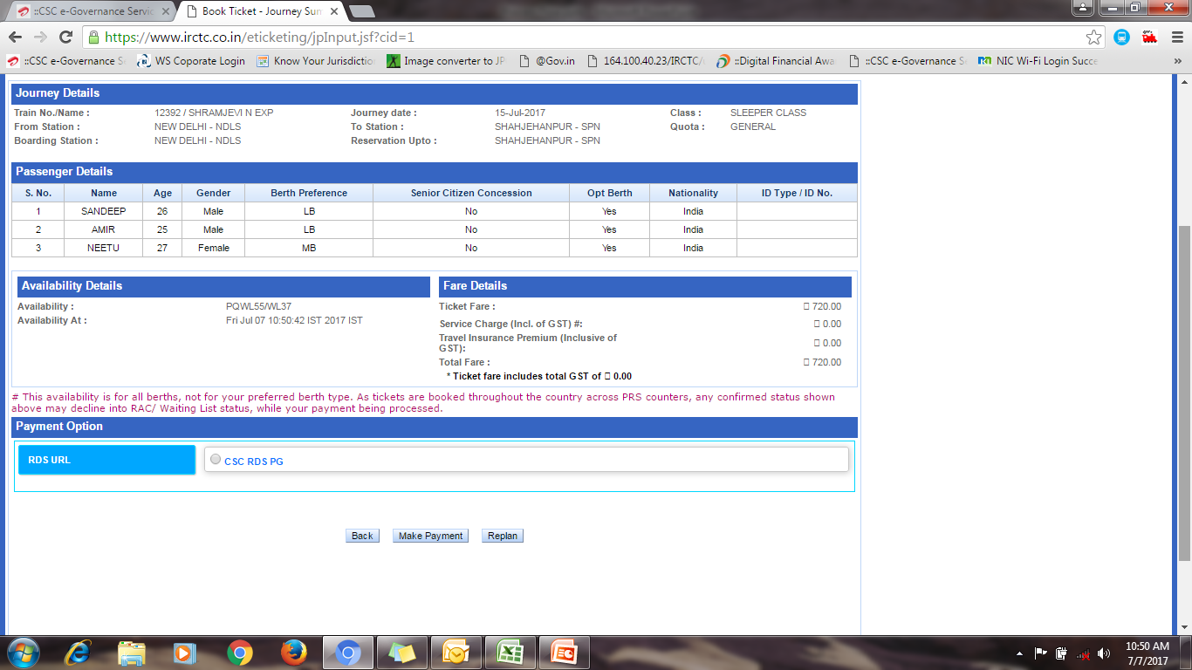
Here you can check your ticket amount, passenger details, and then you will get payment option.

Slide 9
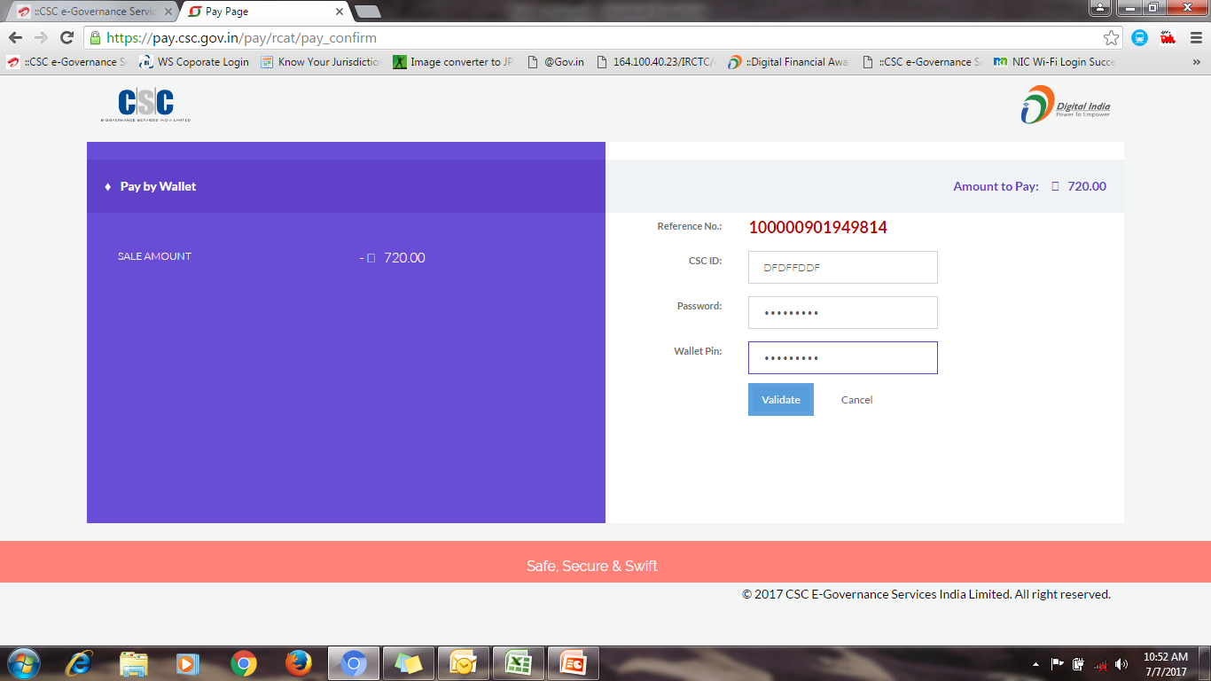
Here you have to enter your CSC ID, Password and Wallet Pin then validate.
Ticket Amount

Slide 10
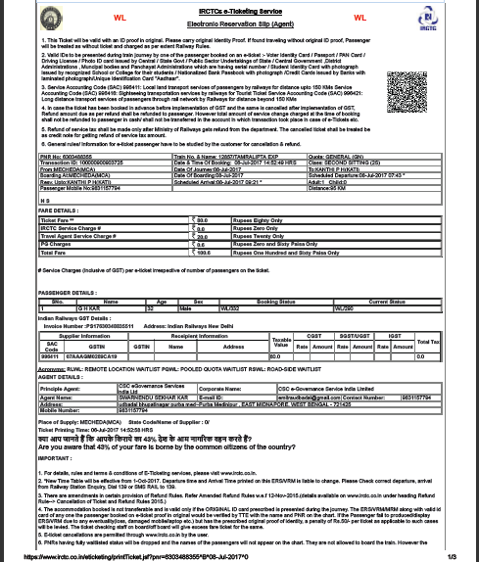
After successful validation the ticket will be Booked (ERS)

Slide 11
THANK YOU

