Slide 1
National Database of Unorganised Workers (NDUW) through CSCs

Slide 2
Who are Unorganised Workers?
There are 43.7 crore workers working in the unorganized sector in India.
Some examples of unorganised workers:
Small and Marginal Farmers
Agricultural laborers
Share croppers
Fishermen
Those engaged in animal husbandry
Beedi rolling
Labelling and packing
building and construction workers
leather workers
weavers
Carpenter
salt workers
workers in brick kilns and stone quarries
workers in saw mills
Midwives,
Domestic workers
Barbers
Vegetable and fruit vendors
News paper vendors
Rikshaw pullers
Auto drivers
Sericulture workers, Carpenters
Tannery workers
Common Services Centres
House Maids
Street Vendors
MNGRGA Workers
ASHA Workers
Milk Pouring Farmers
Migrant Workers

Slide 3
What is NDUW?
Ministry of Labour & Employment is creating national database of unorganised workers.
Registration of unorganised workers will be facilitate on the website.
Every UW will be issued identity card that will be a unique identification number.
Benefits to the unorganised worker
On the base of this database social security schemes will be implement by Ministries/Governments.
PM Suraksha Bhima Yojana
Registered workers under NDUW can take PM Suraksha Bhima Yojana.
Premium of Rs. 12 will be waived off for 1 year.

Slide 4
Why to do registration in NDUW ?
Unorganised workers will get the benefits of social security & welfare schemes.
This database will help government in policy & programs making for unorganized workers.
To track the movement of workers from informal sector to formal sector and vice-versa, their occupation, skill development etc.
Also, to track migrant labor workforce & to provide them more employment opportunities.

Slide 5
Eligibility Criteria
Each workers that fulfills the below criteria is eligible for registration under NDUW:
Age should be from16-59 years
Should not be an income tax payee
Should not be member of EPFO and ESIC
Must be working in unorganized workers categories

Slide 6
Who all cannot register in NDUW?
Anybody engaged in organised sector
Organised sector consist of workers in private or public sector that receive regular salaries, emoluments and other benefits including leaves and social security in the form of provident funds and gratuity.

Slide 7
Requirement for Registration
Mandatory
Mandatory e KYC using Aadhaar Number
OTP
Finger print
IRIS
Active Bank account
Active Mobile Number
Optional
Education Certificate
Income Certificate
Occupation Certificate
Skill Certificate

Slide 8
Role of CSCs
Support in registration of 43.7 crore of unorganised workers across country
Update requests of workers in the registered UAN
Advocacy of the NDUW at the local level
Register & handover UAN cards to the unorganised workers (A4 Paper)
Commission of Rs 20 (including taxes) per new registration which will be divided in ration of 80:20 between CSC VLE & CSC SPV
No amount to be charged from unorganized worker for registration.
Update Facility will be available through CSC where Rs 20 (inclusive of taxes) to be charged from beneficiary

Slide 9
Registration Process
VLE will visit the Digital Seva Portal.

Slide 10
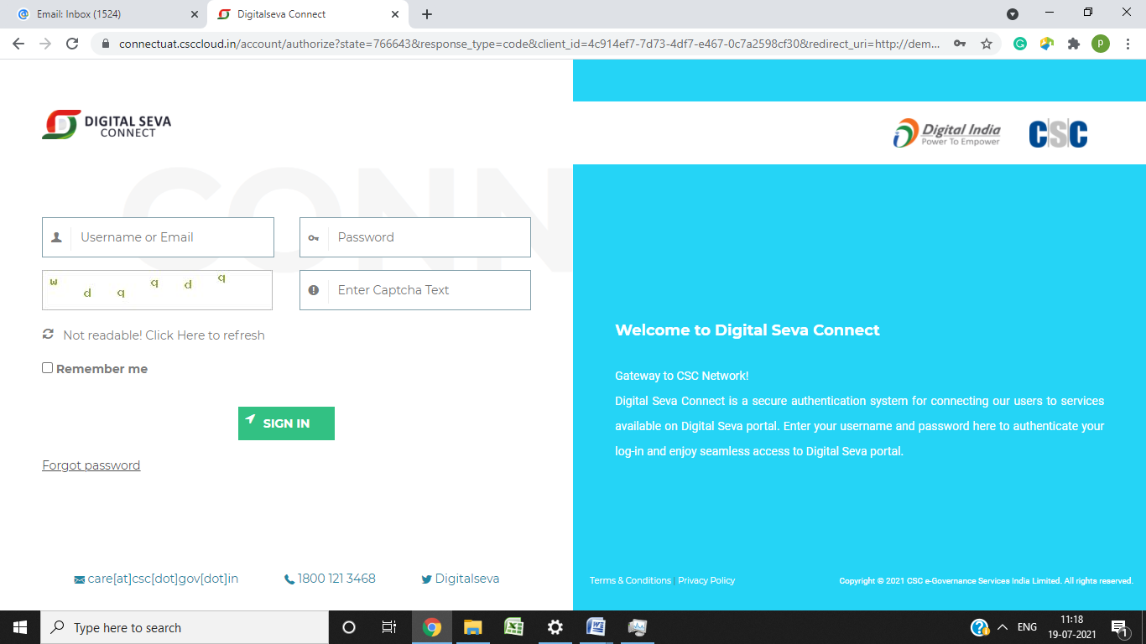
3. Login with credentials & search eShram.

Slide 11
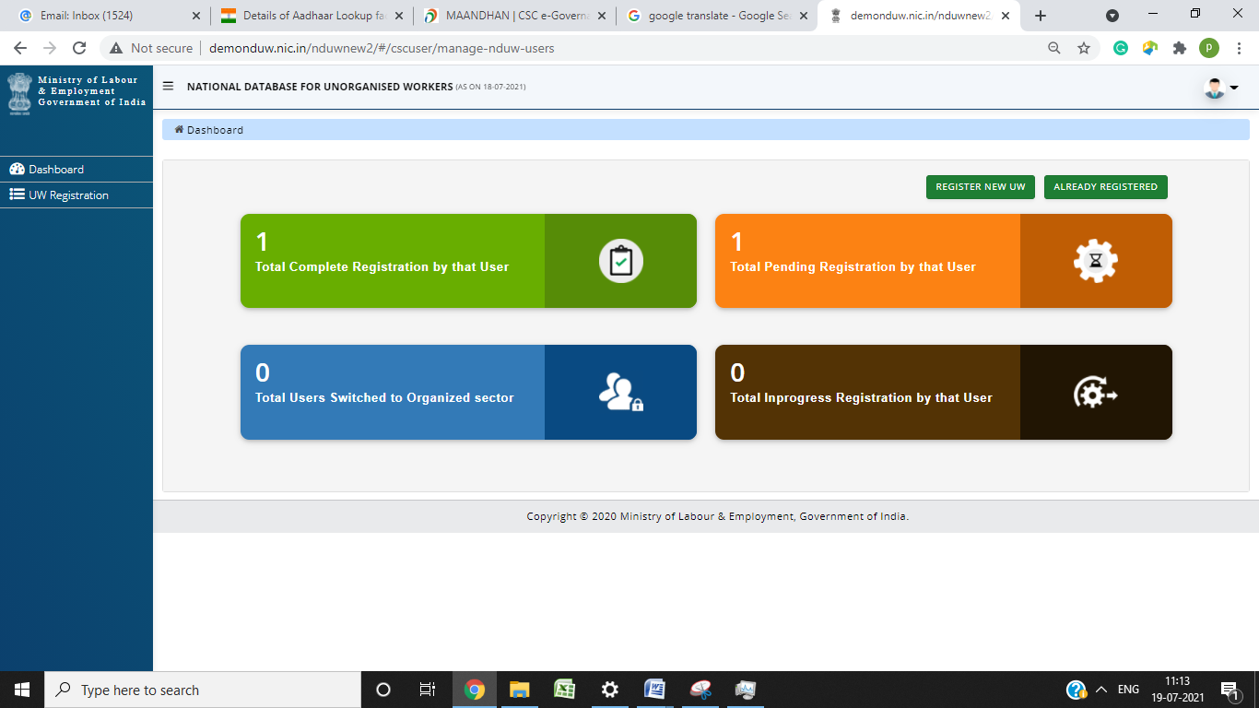
It will redirect to website. Click on REGISTER NEW UW.

Slide 12
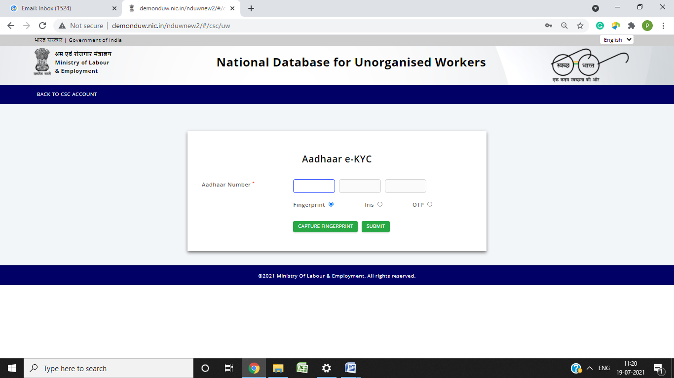
Enter beneficiary’s Aadhaar & validate him through biometric or OTP.

Slide 13
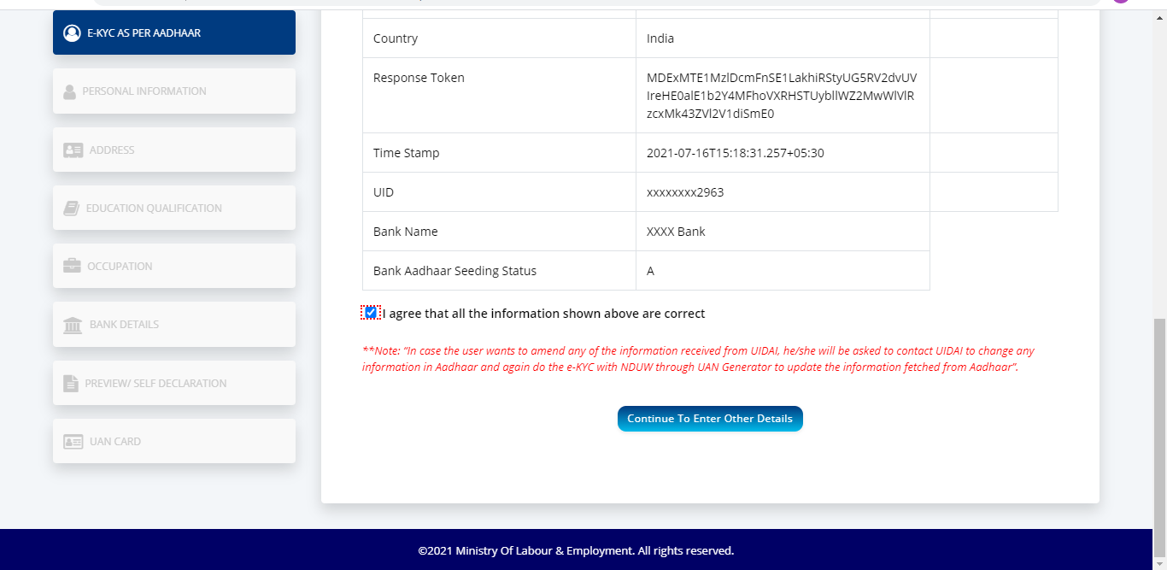
Review aadhaar fetched details, check declaration & continue.

Slide 14
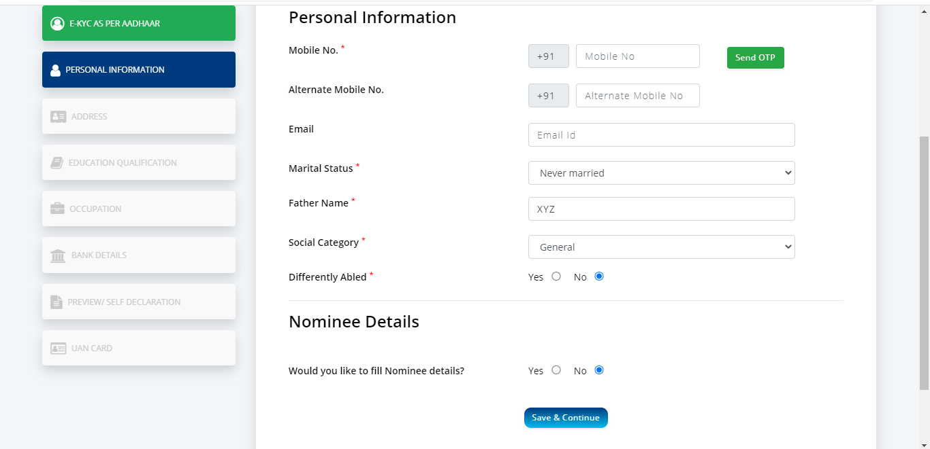
Enter Personal Information & continue.

Slide 15
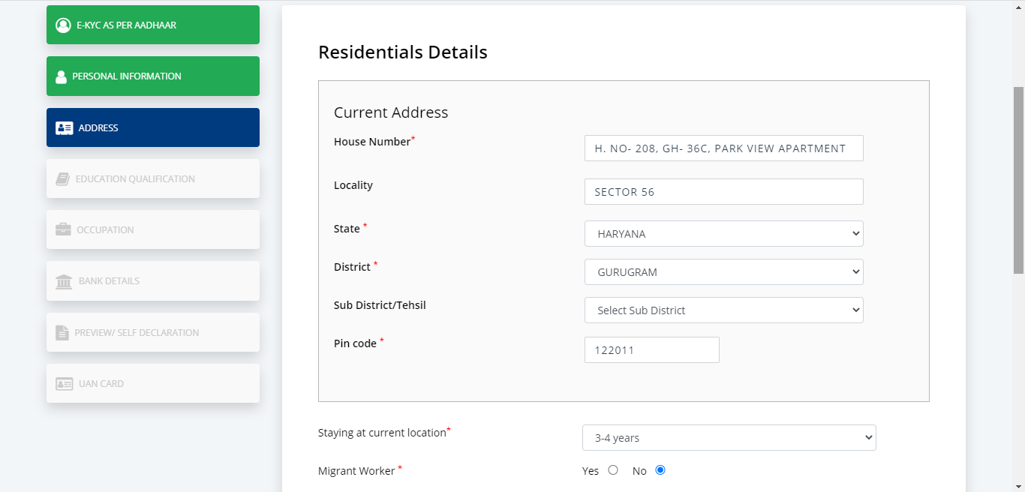
Enter Residential Information & continue.

Slide 16
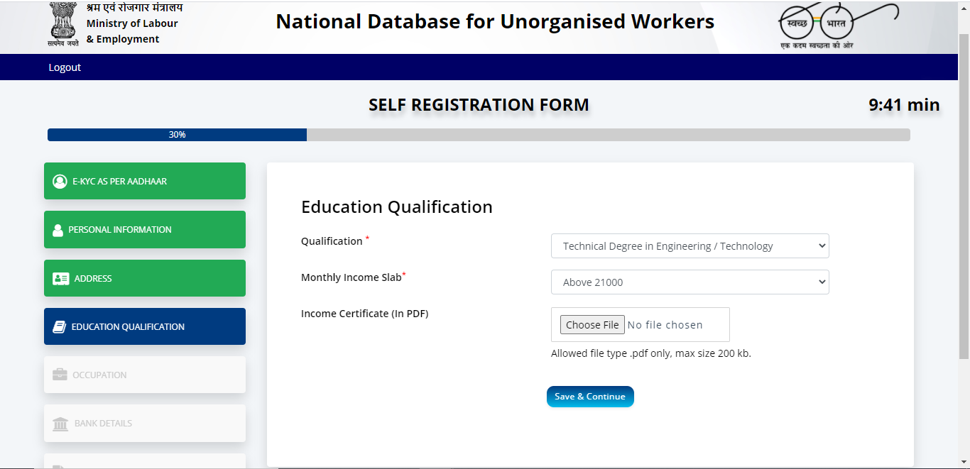
Enter Educational Qualification & continue.

Slide 17
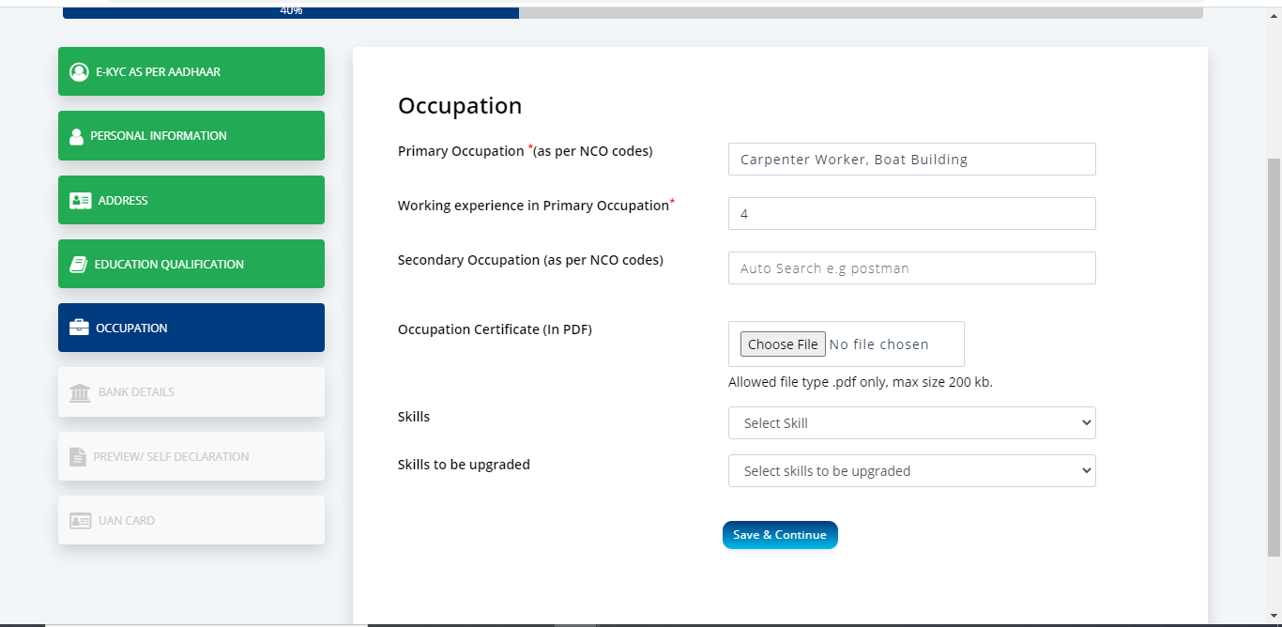
Enter Occupation details & continue.

Slide 18
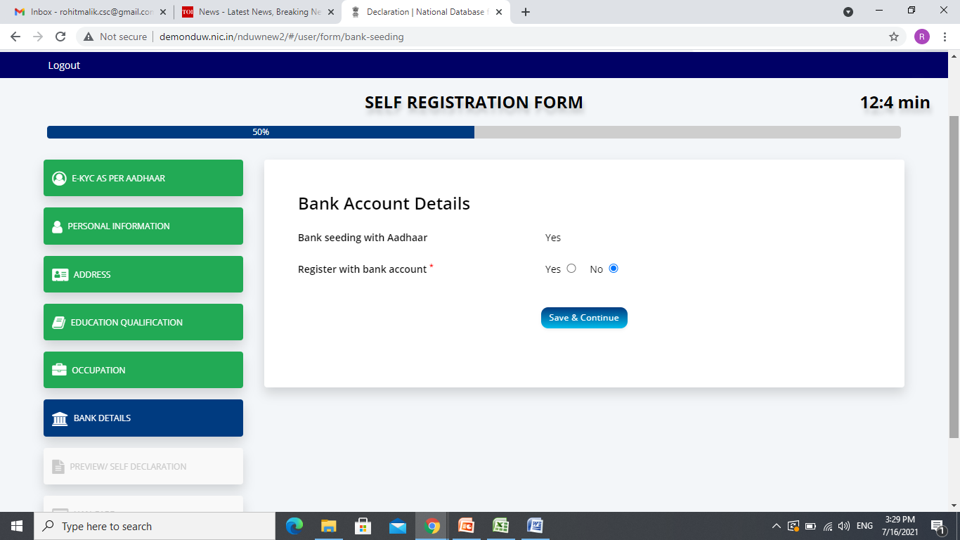
Enter details & continue.

Slide 19
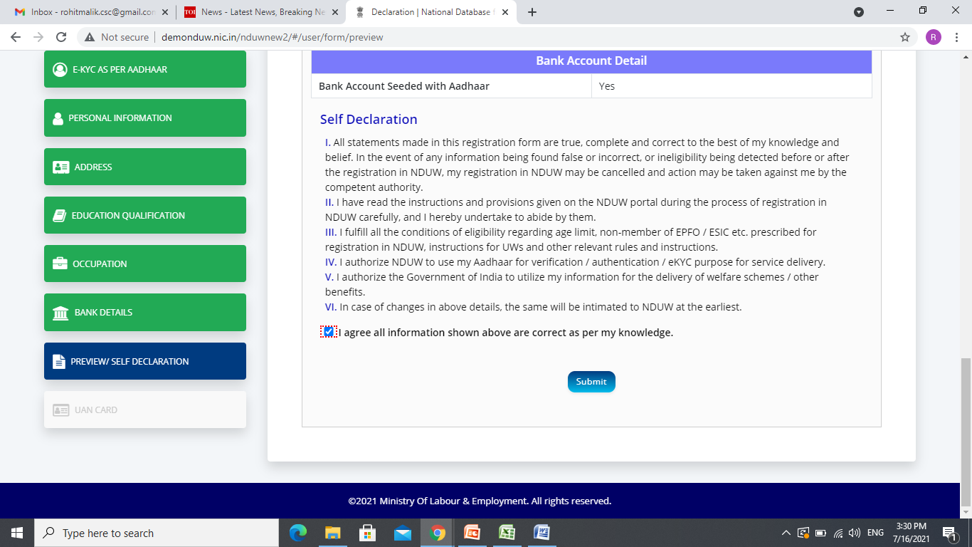
Preview & tick the self declaration.

Slide 20
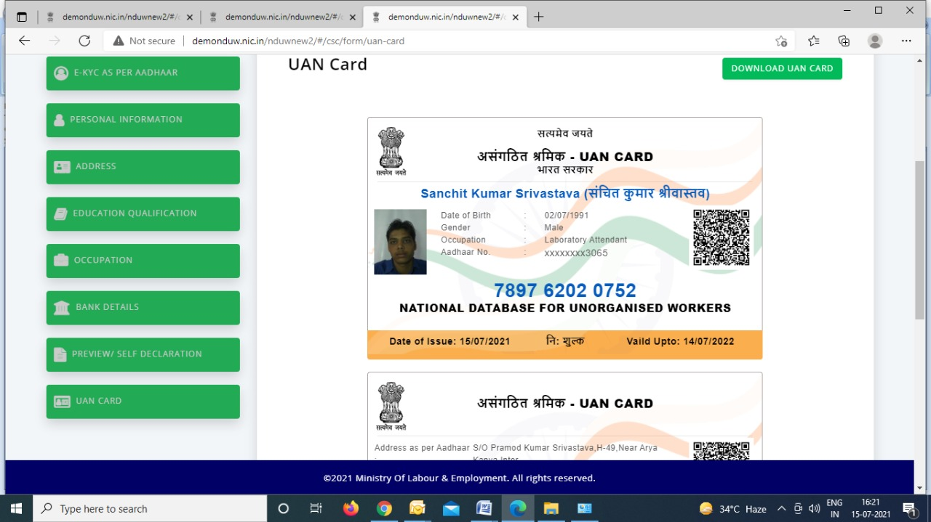
Download & handover UAN card to beneficiary.

Slide 21
GENERAL QUERIES
Is there any charge the worker has to pay for the new registration in NDUW?
No, the workers does not have to pay anything for new registration, however worker will pay any amount of Rs 20 incase of any updation.
Does the UAN card have some validity?
It is VALID for lifetime.
Does the worker have to renew the UAN card every year?
If the information changes or any other details is updated, the worker must
reprint the card again.
If the worker is not paying income tax but filing the returns. Is he eligible?
Yes, worker can get register in this case.
Is there any helpdesk we can contact to address our queries?
Yes, workers can call at XXXXX between 8 AM to 8 PM for any query on NDUW or register grievance online at (_____________)

