Slide 1
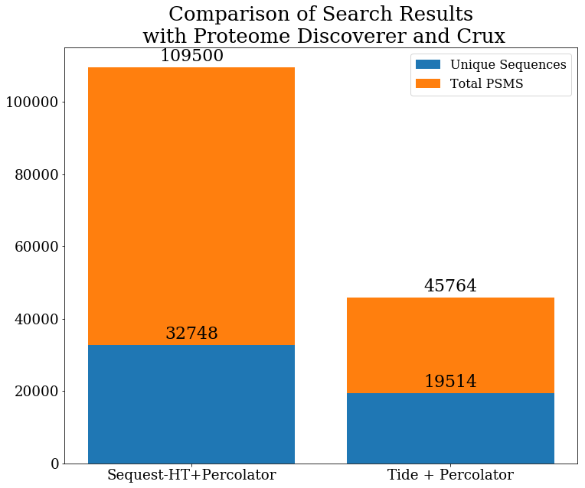
I’m interested in Tide performance benefits
DIA data with 1 Da isolation widths
Search results with Tide are much different than what I’m used to
Have tried changing various parameters like:
exact-p-value : 0 PSMs < q 0.01
Mz-bin-width : minimal effect
Peptide-centric : 0 PSMs

Slide 2
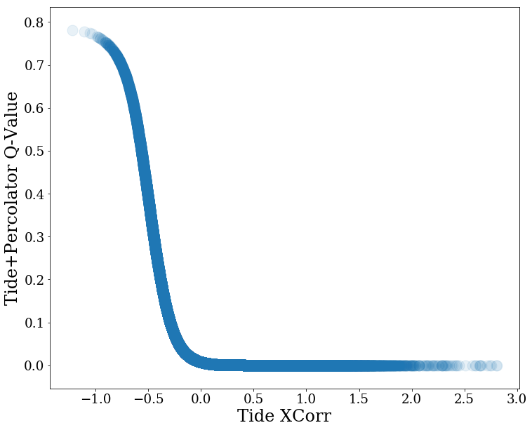
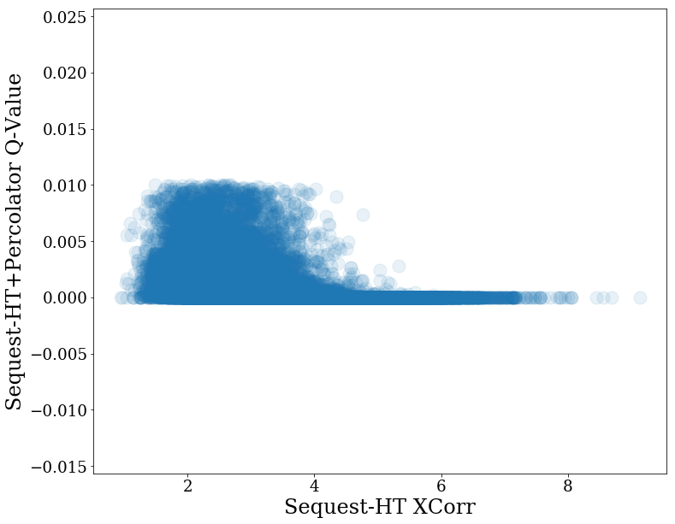
Q-Value and XCorr
Tide+Percolator separates PSMs mostly based on Q-Value
Sequest-HT + Percolator separates based on other factors as well as XCorr

Slide 3
Tide+Percolator SVM Weights
INFO: Split1 Split2 Split3 FeatureName
INFO: 1.5495 1.9191 1.6725 XCorr
INFO: -0.4122 -0.5457 -0.6260 PepLen
INFO: -0.4734 -0.6321 -0.5280 Charge1
INFO: 0.3537 0.4332 0.3128 Charge2
INFO: -0.0991 -0.0933 -0.0289 Charge3
INFO: 0.0000 0.0000 0.0000 enzN
INFO: 0.0000 0.0000 0.0000 enzC
INFO: -1.7301 -2.4355 -1.6154 enzInt
INFO: 0.5643 0.5807 0.1598 lnNumDSP
INFO: -0.0465 -0.0165 -0.0200 dM
INFO: 0.1825 0.2381 0.2314 absdM
INFO: -6.6336 -8.2748 -6.4508 m0
There are a different number of features used in the Crux version of Percolator than what Proteome Discoverer uses (next slide)

Slide 4
Sequest-HT+Percolator SVM Weights
Learned normalized SVM weights for the 3 cross-validation splits:
Split1 Split2 Split3 FeatureName
0.2051 0.1682 0.2194 XCorr
0.3211 0.2209 0.3727 Delta Cn From Second PSM
0.5588 0.4417 0.5467 Binomial Score
0.0000 0.0000 0.0000 Isolation Interference [%]
0.7569 0.6252 0.6216 MH+ [Da]
0.5711 0.4914 0.6386 Delta Mass [Da]
-0.3447 -0.3423 -0.3548 Delta Mass [ppm]
0.0009 0.0520 -0.0261 Absolute Delta Mass [Da]
-0.2575 -0.2304 -0.2518 Absolute Delta Mass [ppm]
0.0476 0.0092 -0.0969 Peptide Length
0.0625 0.0836 -1.3877 Is z=1
0.1598 0.2379 0.3877 Is z=2
-0.1767 -0.2604 -0.0125 Is z=3
0.0000 0.0000 0.0000 Is z=4
0.0000 0.0000 0.0000 Is z=5
0.0000 0.0000 0.0000 Is z>5
-1.7671 -1.2426 -1.8098 # Missed Cleavages
-0.1998 -0.1370 -0.8613 Log Peptides Matched
-0.4549 -0.5215 -0.8148 Log Total Intensity
0.0668 0.0168 0.0118 Fraction Matched Intensity [%]
-0.2566 -0.2403 -0.2987 Fragment Coverage Series A, B, C [%]
1.1001 0.8162 0.9986 Fragment Coverage Series X, Y, Z [%]
-0.5427 -0.3593 -0.4023 Log Matched Fragment Series Intensities A, B, C
1.1817 1.0725 1.4792 Log Matched Fragment Series Intensities X, Y, Z
0.2680 0.1943 0.2799 Longest Sequence Series A, B, C
0.8113 0.5587 0.8655 Longest Sequence Series X, Y, Z
0.1735 0.0509 0.1407 IQR Fragment Delta Mass [Da]
-0.3407 -0.1999 -0.3738 IQR Fragment Delta Mass [ppm]
1.1100 0.9338 1.1560 Mean Fragment Delta Mass [Da]
-1.0789 -0.9454 -1.1751 Mean Fragment Delta Mass [ppm]
-0.1797 -0.1425 -0.1351 Mean Absolute Fragment Delta Mass [Da]
-0.3556 -0.2504 -0.3313 Mean Absolute Fragment Delta Mass [ppm]
-7.2028 -5.7450 -7.3633 m0

Slide 5
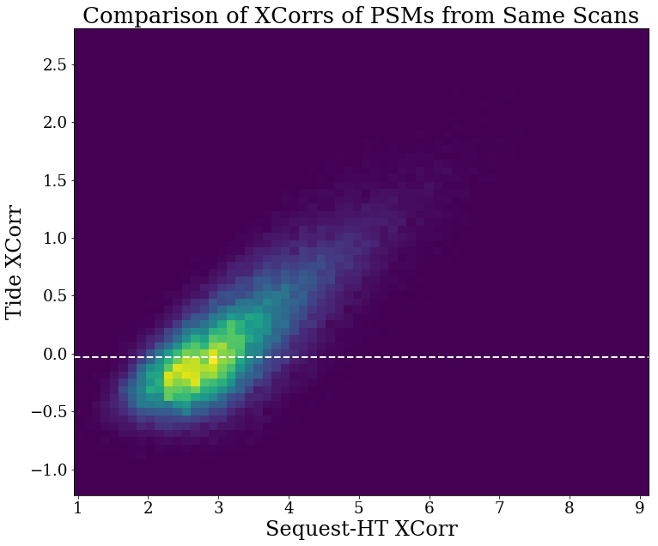
White line is q = 0.01 for Tide
PD PSMs file doesn’t have info for spectra with q-value > 0.01, so all of these are significant
Xcorr values for PSMs from the same spectra correlate but are much different in absolute value

Slide 6
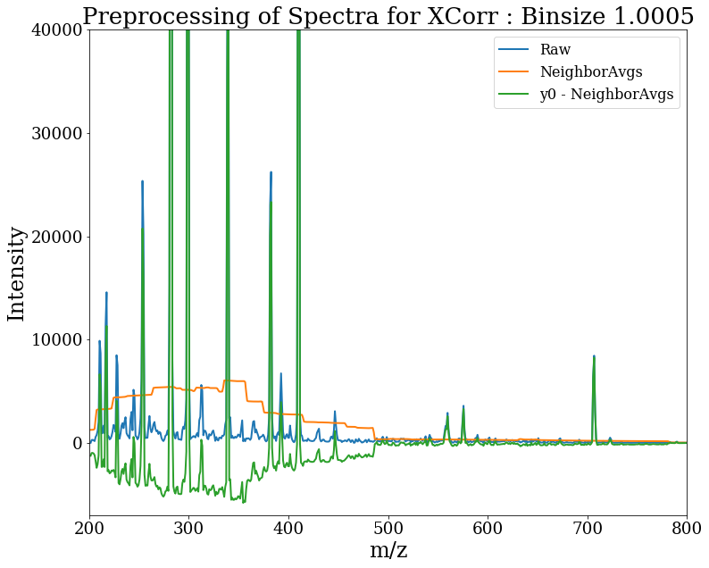
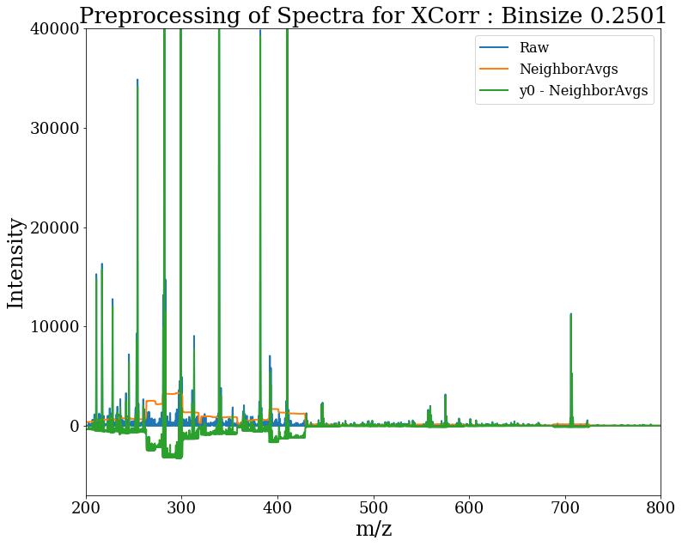
Negative Xcorrs can happen though
$$xcorr=x{∙y}^{′}=x∙\left(y_{0}−\sum_{τ=−75, τ≠0}^{75}{y_{τ}}/150\right)$$
$$x=theoretical spectrum$$
$$y_{0}=experimental spectrum at 0 shift$$
Eng. Journal of Proteome Research 2008, 7, 4598–4602
Preprocessing step subtracts average of neighboring bins
Smaller bins size reduces the effect
So far I’ve tried searching with 1.0 and 0.5 m/z bin sizes with little difference
Perhaps it doesn’t matter, but if bins were small like 0.02 for accurate mass spectra, then this effect is largely gone
This is the PSM with the most negative Xcorr
Tide+Percolator q = 0.78

Slide 7
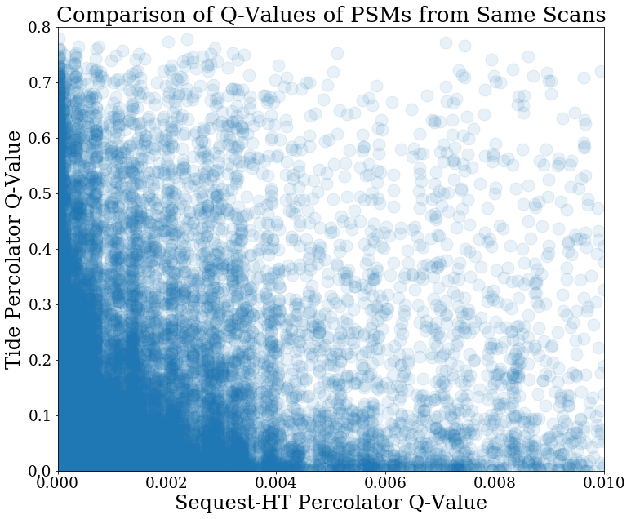
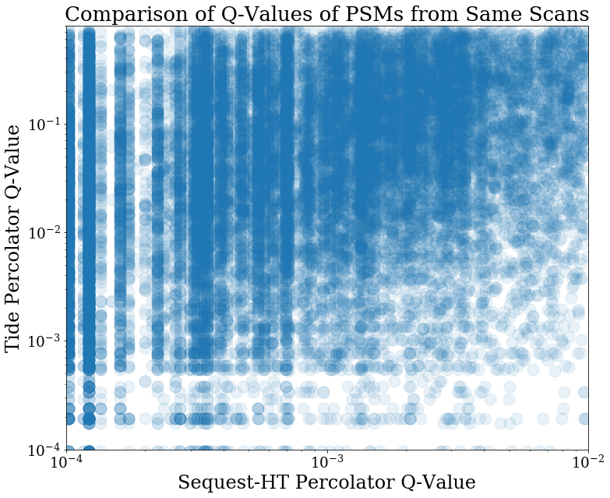
Little correlation between q-values of spectra from the same scan between search pipelines
Insights so far:
Xcorrs are different between PD and Crux for same spectra
Percolator features used are different
Q-values are different for same spectra

Slide 8
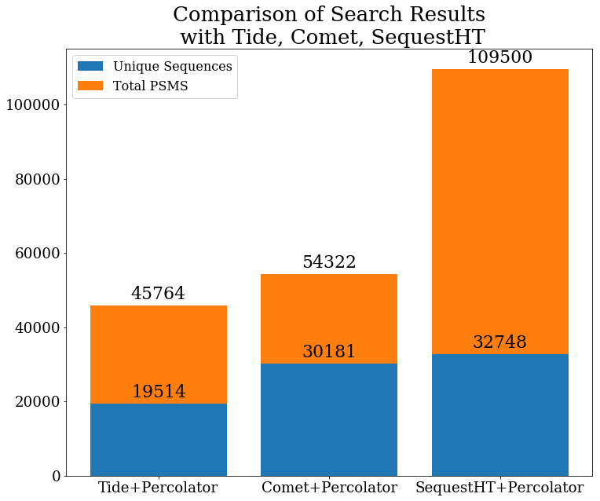
Comet Results
Much closer to SequestHT result than Tide
Sequest has a lot more PSMs, but most are redundant
Many repeats in this DIA set
Surprising that Tide and Comet didn’t have more as well

Slide 9
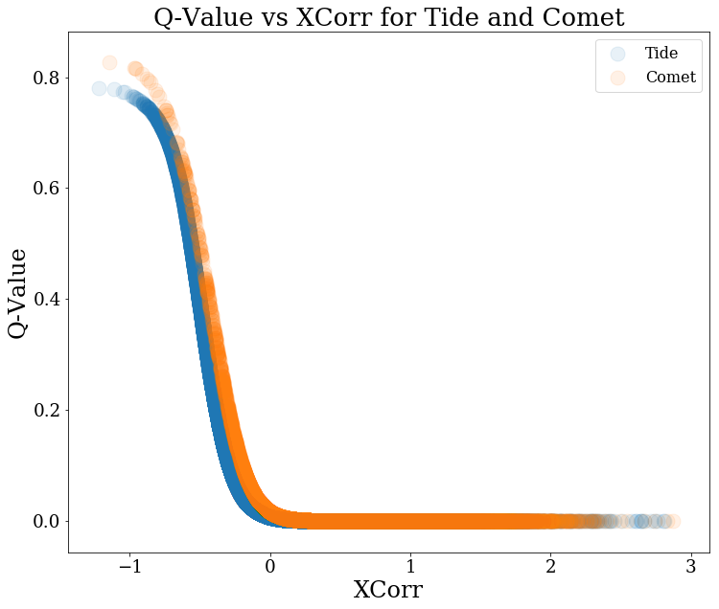
Q value versus XCorr
High correlation between q value and Xcorr for Tide and Comet results

Slide 10
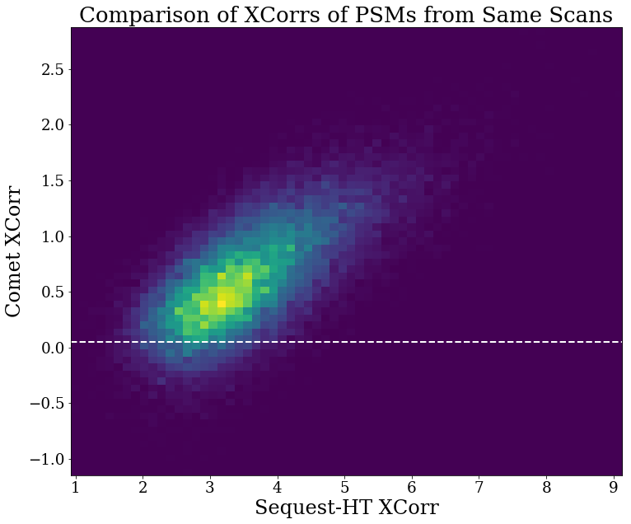
More of peptides that were significant for Sequest-HT are also significant for Comet (white line is q = 0.01)

Slide 11
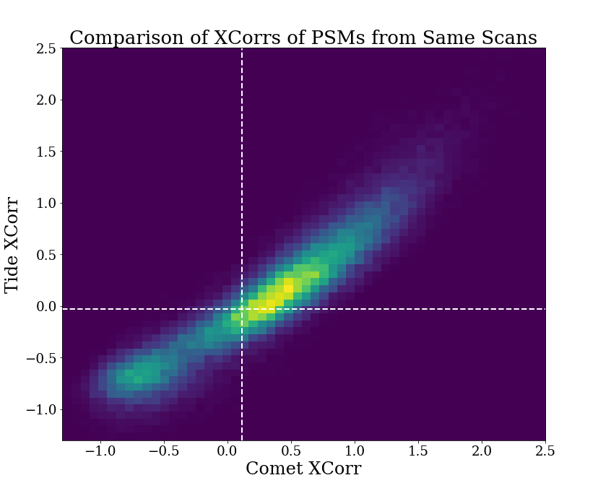
Tide Xcorr in general smaller than Comet Xcorr
Not clear that this would actually matter though

Slide 12
Tide+Percolator SVM Weights
Tide + Percolator
Comet + Percolator
INFO: Split1 Split2 Split3 FeatureName
INFO: 1.5495 1.9191 1.6725 XCorr
INFO: -0.4122 -0.5457 -0.6260 PepLen
INFO: -0.4734 -0.6321 -0.5280 Charge1
INFO: 0.3537 0.4332 0.3128 Charge2
INFO: -0.0991 -0.0933 -0.0289 Charge3
INFO: 0.0000 0.0000 0.0000 enzN
INFO: 0.0000 0.0000 0.0000 enzC
INFO: -1.7301 -2.4355 -1.6154 enzInt
INFO: 0.5643 0.5807 0.1598 lnNumDSP
INFO: -0.0465 -0.0165 -0.0200 dM
INFO: 0.1825 0.2381 0.2314 absdM
INFO: -6.6336 -8.2748 -6.4508 m0
INFO: Split1 Split2 Split3 FeatureName
INFO: 0.3317 0.295 0.34 lnrSp
INFO: 2.5754 2.4258 2.7366 deltCn
INFO: 0.7075 0.6433 0.7264 XCorr
INFO: 0.1466 0.116 0.1257 Sp
INFO: 0.4441 0.4493 0.5385 IonFrac
INFO: -0.2385 -0.1696 -0.1348 PepLen
INFO: 0.0000 0 0 Charge1
INFO: 0.0234 0.0263 0.0159 Charge2
INFO: -0.0234 -0.0263 -0.0159 Charge3
INFO: 0.6861 0.6225 0.8633 enzN
INFO: 0.0000 0 0 enzC
INFO: -0.1680 -0.1455 -0.1933 enzInt
INFO: 0.0461 0.0626 0.0791 lnNumSP
INFO: -0.0022 0.0295 0.0336 dM
INFO: -0.0174 -0.0275 -0.0492 absdM
INFO: -7.9597 -7.7346 -8.4786 m0

Slide 13
Conclusions
Some small differences between Comet and Tide Xcorrs
Tide in general shifted lower
Large Differences between Sequest and Comet/Tide Xcorrs
Sequest absolute Xcorrs are much larger
Percolator parameters used by default for crux pipeline with two search engines appear to be a little different
So perhaps I just have to figure out how to specify the features that Percolator uses

