Slide 1
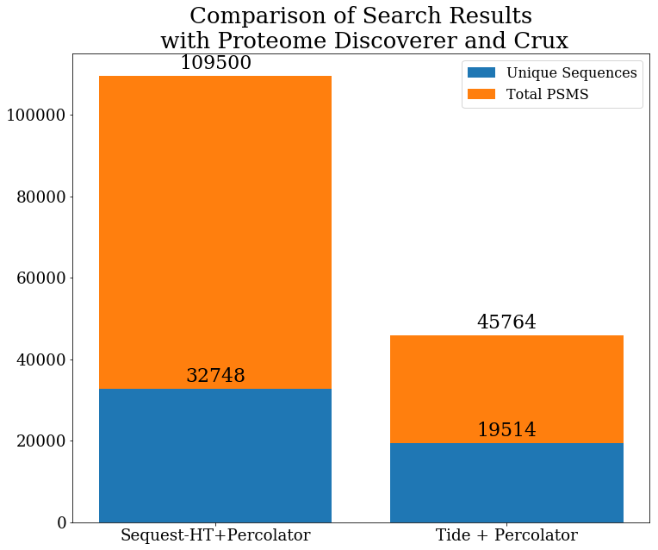
I’m interested in Tide performance benefits
DIA data with 1 Da isolation widths
Search results with Tide are much different than what I’m used to
Have tried changing various parameters like:
exact-p-value : 0 PSMs < q 0.01
Mz-bin-width : minimal effect
Peptide-centric : 0 PSMs

Slide 2
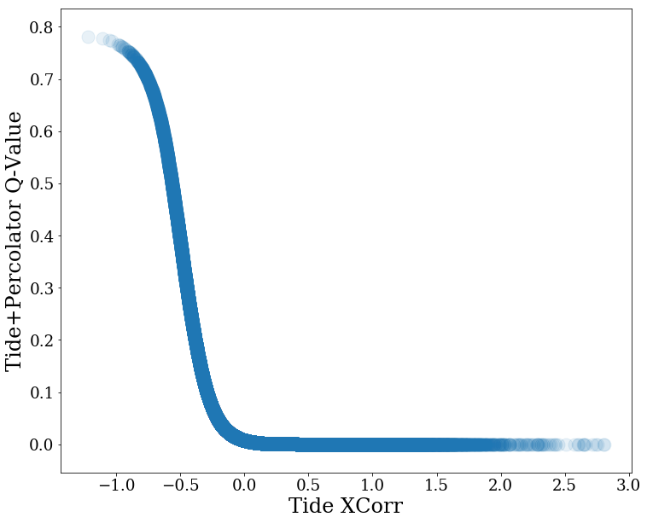
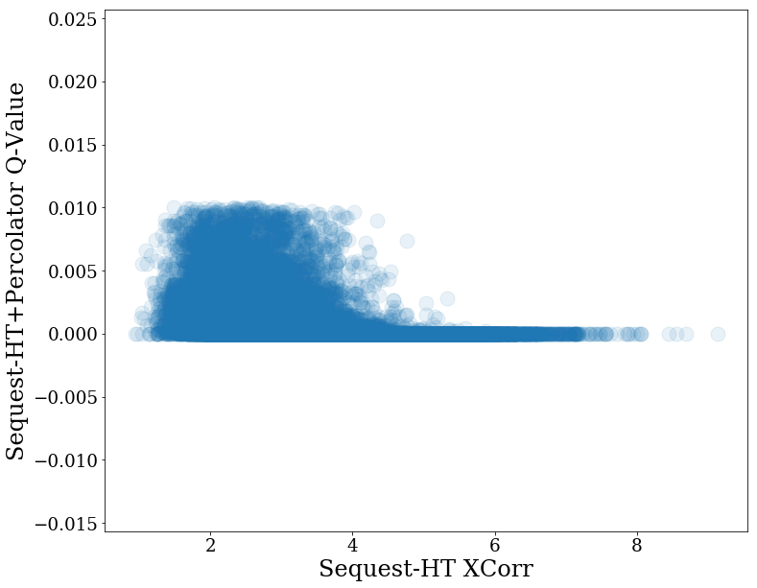
Q-Value and XCorr
Tide+Percolator separates PSMs mostly based on Q-Value
Sequest-HT + Percolator separates based on other factors as well as XCorr

Slide 3
Tide+Percolator SVM Weights
INFO: Split1 Split2 Split3 FeatureName
INFO: 1.5495 1.9191 1.6725 XCorr
INFO: -0.4122 -0.5457 -0.6260 PepLen
INFO: -0.4734 -0.6321 -0.5280 Charge1
INFO: 0.3537 0.4332 0.3128 Charge2
INFO: -0.0991 -0.0933 -0.0289 Charge3
INFO: 0.0000 0.0000 0.0000 enzN
INFO: 0.0000 0.0000 0.0000 enzC
INFO: -1.7301 -2.4355 -1.6154 enzInt
INFO: 0.5643 0.5807 0.1598 lnNumDSP
INFO: -0.0465 -0.0165 -0.0200 dM
INFO: 0.1825 0.2381 0.2314 absdM
INFO: -6.6336 -8.2748 -6.4508 m0
There are a different number of features used in the Crux version of Percolator than what Proteome Discoverer uses (next slide)

Slide 4
Sequest-HT+Percolator SVM Weights
Learned normalized SVM weights for the 3 cross-validation splits:
Split1 Split2 Split3 FeatureName
0.2051 0.1682 0.2194 XCorr
0.3211 0.2209 0.3727 Delta Cn From Second PSM
0.5588 0.4417 0.5467 Binomial Score
0.0000 0.0000 0.0000 Isolation Interference [%]
0.7569 0.6252 0.6216 MH+ [Da]
0.5711 0.4914 0.6386 Delta Mass [Da]
-0.3447 -0.3423 -0.3548 Delta Mass [ppm]
0.0009 0.0520 -0.0261 Absolute Delta Mass [Da]
-0.2575 -0.2304 -0.2518 Absolute Delta Mass [ppm]
0.0476 0.0092 -0.0969 Peptide Length
0.0625 0.0836 -1.3877 Is z=1
0.1598 0.2379 0.3877 Is z=2
-0.1767 -0.2604 -0.0125 Is z=3
0.0000 0.0000 0.0000 Is z=4
0.0000 0.0000 0.0000 Is z=5
0.0000 0.0000 0.0000 Is z>5
-1.7671 -1.2426 -1.8098 # Missed Cleavages
-0.1998 -0.1370 -0.8613 Log Peptides Matched
-0.4549 -0.5215 -0.8148 Log Total Intensity
0.0668 0.0168 0.0118 Fraction Matched Intensity [%]
-0.2566 -0.2403 -0.2987 Fragment Coverage Series A, B, C [%]
1.1001 0.8162 0.9986 Fragment Coverage Series X, Y, Z [%]
-0.5427 -0.3593 -0.4023 Log Matched Fragment Series Intensities A, B, C
1.1817 1.0725 1.4792 Log Matched Fragment Series Intensities X, Y, Z
0.2680 0.1943 0.2799 Longest Sequence Series A, B, C
0.8113 0.5587 0.8655 Longest Sequence Series X, Y, Z
0.1735 0.0509 0.1407 IQR Fragment Delta Mass [Da]
-0.3407 -0.1999 -0.3738 IQR Fragment Delta Mass [ppm]
1.1100 0.9338 1.1560 Mean Fragment Delta Mass [Da]
-1.0789 -0.9454 -1.1751 Mean Fragment Delta Mass [ppm]
-0.1797 -0.1425 -0.1351 Mean Absolute Fragment Delta Mass [Da]
-0.3556 -0.2504 -0.3313 Mean Absolute Fragment Delta Mass [ppm]
-7.2028 -5.7450 -7.3633 m0

Slide 5
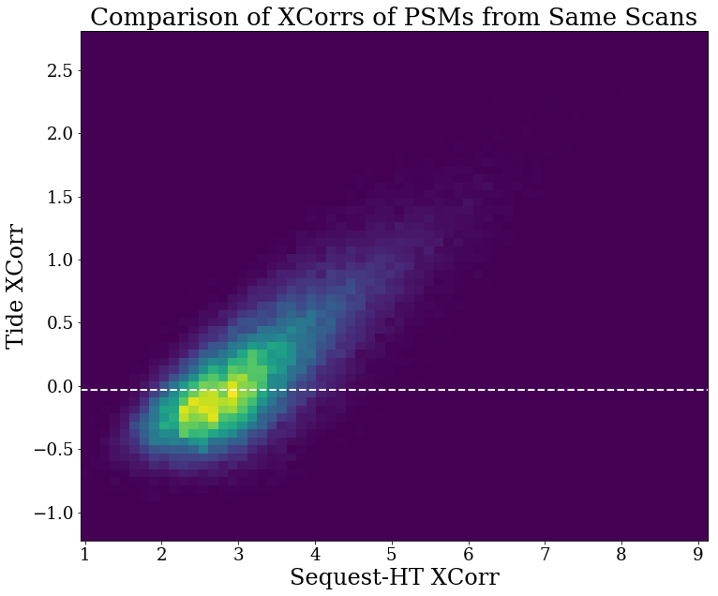
White line is q = 0.01 for Tide
PD PSMs file doesn’t have info for spectra with q-value > 0.01, so all of these are significant
Xcorr values for PSMs from the same spectra correlate but are much different in absolute value

Slide 6
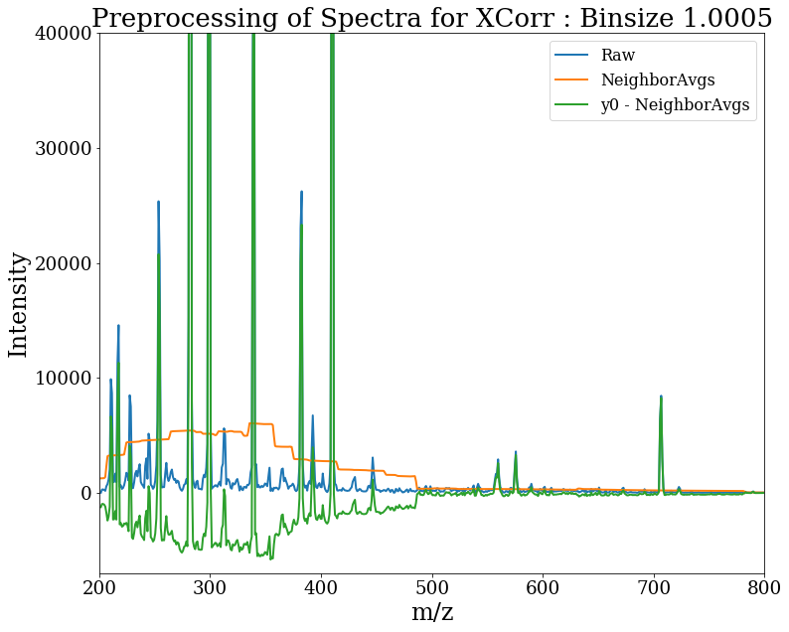
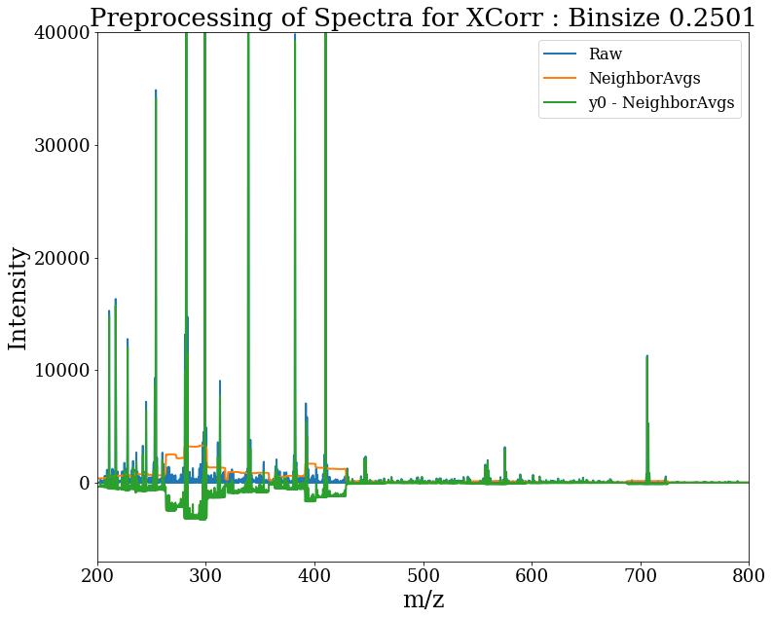
Negative Xcorrs can happen though
$$xcorr=x{∙y}^{′}=x∙\left(y_{0}−\sum_{τ=−75, τ≠0}^{75}{y_{τ}}/150\right)$$
$$x=theoretical spectrum$$
$$y_{0}=experimental spectrum at 0 shift$$
Eng. Journal of Proteome Research 2008, 7, 4598–4602
Preprocessing step subtracts average of neighboring bins
Smaller bins size reduces the effect
So far I’ve tried searching with 1.0 and 0.5 m/z bin sizes with little difference
Perhaps it doesn’t matter, but if bins were small like 0.02 for accurate mass spectra, then this effect is largely gone
This is the PSM with the most negative Xcorr
Tide+Percolator q = 0.78

Slide 7
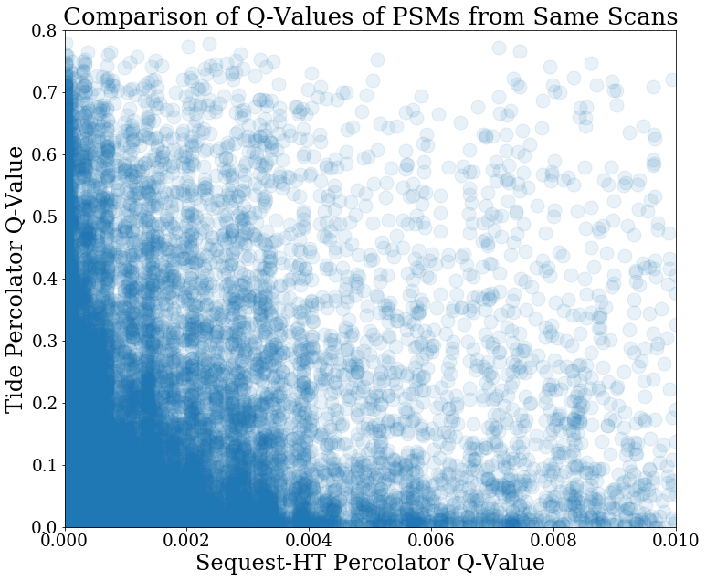
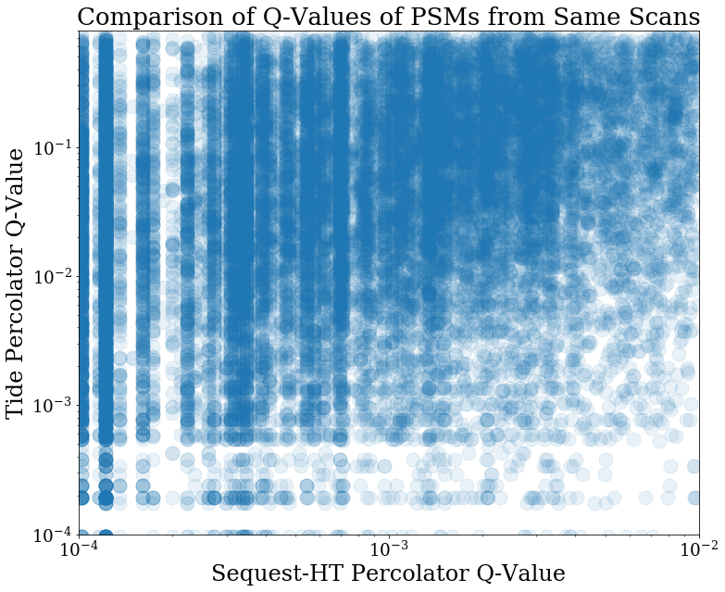
Little correlation between q-values of spectra from the same scan between search pipelines
Insights so far:
Xcorrs are different between PD and Crux for same spectra
Percolator features used are different
Q-values are different for same spectra

