Slide 1

Combined Flexible Workspace & Daycare
MGMT 295A: Entrepreneurship & Venture Initiation
Final Briefing
November 30, 2011
Adam Grayson, Tamra Johnson, Chris Langit, Richard Larson, Alex Medina

Slide 2
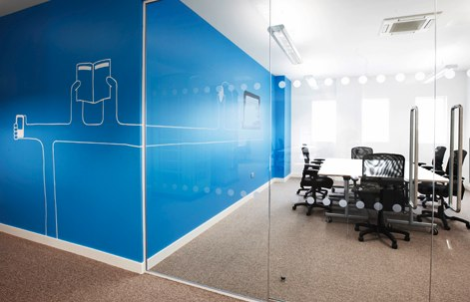
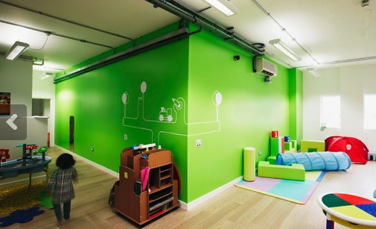
A Large Part of the Potential Labor Force is Untapped
Problem
Participation of women in the workforce drops off as they have children
Daycare & nanny solutions require set commitment, providing little flexibility
Concept
Flexible workspace with on-site daycare
Develop a community for professionally engaged parents
Initial location near 405/10
  Target membership to those living within 5 miles of location - Santa Monica, Brentwood, West Los Angeles, Culver City
Revenue through separate per-usage charge for workspace and daycare, with discounted rates for prepaid blocks
Later, expand model to other dense, central urban locations
Operational considerations included in the appendix

Slide 3

Parents Already in and Who Want to be in Flexible Work Solutions are the Target Customers
Mothers and fathers with young children who need a flexible workspace and childcare solution
  Freelancers
  Teleworkers
  Entrepreneurs
  Aspirational workers Want to work, but haven’t been able to balance childcare & professional engagement

Slide 4
Initial Targeted Market: Self-employed Moms
LA County
Pop: 9.8M
# Firms: 1047K
Initial Market Sizing
Focus on self-employed females in one geographic location
Target market would increase by including male/female co-owned self-employed, male caregivers, teleworkers, and those not yet working that could with this solution
Self-Employed
# Firms: 836K
Female Owner
# Firms: 282K
Santa Monica
Pop: 89.7K
Homes w/Kids <9: 8.4%
Venice, MdR Pop: 198K
Homes w/Kids <9: 11.1%
West LA, Palms
Pop: 153K
Homes w/Kids <9: 7.3%
Total Addressable Market
Just over 1150 self-employed women with younger children
Target Female Owned With Kids <9
SM: 215
V/MdR: 630
WLA: 323
Sources: 2010 US Census, 2007 Survey of Business Owners, City of LA Local Population & Housing Profile

Slide 5









Flexible Workspaces and Conventional Childcare Exist Independently in LA
Flexible workspace / working communities
Conventional daycares, nannies, on-call childcare
Shared workspace/daycare
London, UK
Decatur, GA

Slide 6
Mama Angel Is The Ideal Solution for Professional Parents
 | Typical Flexible Workspace | Typical Child Care Facility
Office Space
Office Equipment
Child Care Services
On-Demand Child Care
Flexible Pricing
Community Building
“I could not afford childcare for 3 kids… I would have
GREATLY benefited from an option like the one outlined above”
- Consultant and mother of 3

Slide 7
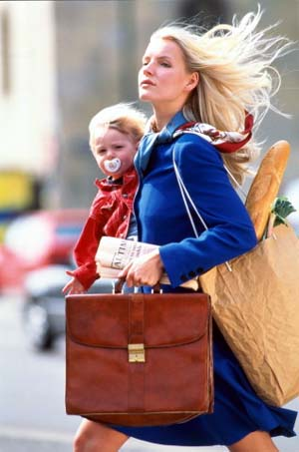
Sales & Marketing
Goals
Induce trial
Sign-up members
Facilitate word-of-mouth marketing
Three Marketing Approaches
Organization engagement
  Actively attend and participate in meetings of organizations for working/entrepreneurial mothers
  Provide special offers and promotions for members
  Event sponsorship
Social media engagement
  Identify and build relationships with bloggers/sites focusing on mothers/fathers in Los Angeles
Store engagement
  Promotional postcards at stores mom’s frequent in the area – Pump Station, Weego Baby, Janie & Jack
  Advertising Material Costs: 15,000 double sided, color Postcards - $371 (smartlevels.com)

Slide 8
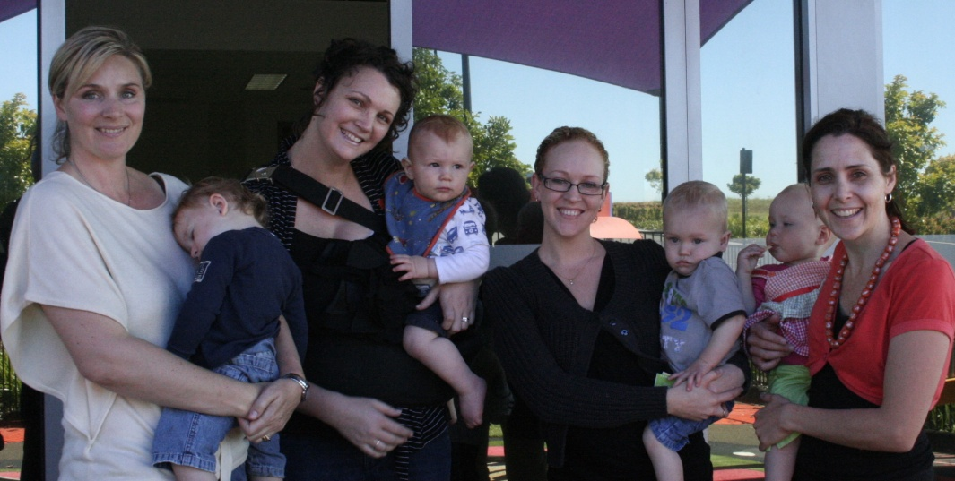
Competitive Advantage
Association effect – network and type of people who will be going there and using it
Provides professionals with a way to continue to stay engaged while raising their families
  Promote activities and events for organizations that support our target customer, e.g. Entrepreneur Women StartUp

Slide 9
Management is Experienced and Capable
Tamra Johnson, Founder and General Manager
  Background – BS Aero/Astro MIT, MS Management Science Stanford, MBA UCLA Anderson, 10 years experience in project management and system integration
  Qualifications – Founder 2000 member new hire network, Former Board Member MIT Alumni Association, Former President MIT Club Southern California
Aimee Grayson, Office/Daycare Manager
  Background – Degree in Early Childhood Education; Certified Pre-School Teacher
  Qualifications – Nanny Placement Manager, College Nannies & Tutors Los Angeles franchise
Lead Daycare Teacher – to be hired
  Desired background – Degree in Early Childhood Education
  Desired qualifications – Experience with a range of ages, staff supervision

Slide 10
Financial Projections
Based on 15% market penetration by month 9
Financial detail included in the appendix

Slide 11
Proposed Deal
4.2% of equity retained by founder
47.9% sold to investor for $229,873 investment; remaining 47.9% sold to founder at same price
Positive cash flows in month 5 – monthly dividends paid
Exit multiple pegged at 5x net income
Month 36 exit at $3.65m valuation - $1.17m post-tax to investor
IRR of 21% for both founder and investor

Slide 12
Backup

Slide 13
Operational Considerations
Four months for permitting and remodel of office space/daycare
Hours 8 am – 8 pm Monday-Friday, 9 am-3 pm Saturday
Management
  General Manager
  Office manager/receptionist
  Head daycare professional – key hire to build trust and confidence
Variability of Demand
  Adequate staff to care for twenty-five , 6 mo - 3 yr olds during prime hours
  Adjust staffing as customer behavior is understood

Slide 14
Financial Model Assumptions
Costs:
  Permits/Design/Remodeling/Furniture costs based on estimate from general contractor
  Utilities based upon $/ft² values from internet research
  Labor rates based on SME inputs
    Labor includes 1 General Manger, 1 Daycare Manager, 1 Office Manager, and 3 Daycare Professionals
  Other costs estimated based on personal experience, vetted by peers
Revenues:
  Office – Based on Competitor brochure and quotes
    Offering mirrors #of Customers/ ft²
  Daycare – Based on market analysis of various offerings

Slide 15
Additional Financial Detail
Both the Daycare and the Office are independently financially viable
Having both under one roof :
  Allows for access to a specific target customer profile
  Diversifies the risk of one side of the business working and the other requiring time to gain traction

Slide 16
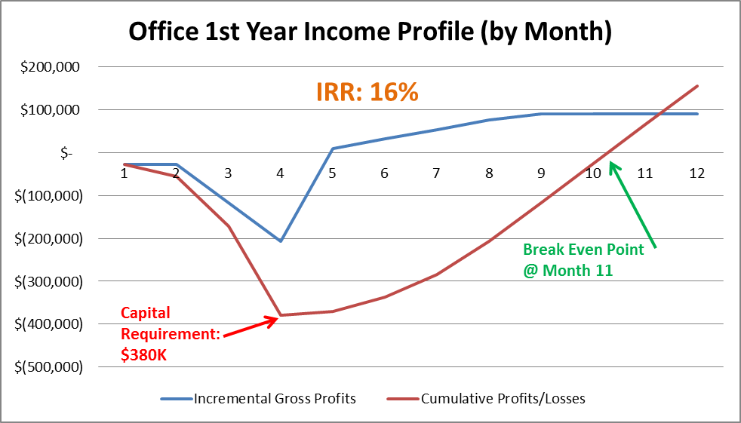
Office 1st Year Income

Slide 17
Office Financials

Slide 18
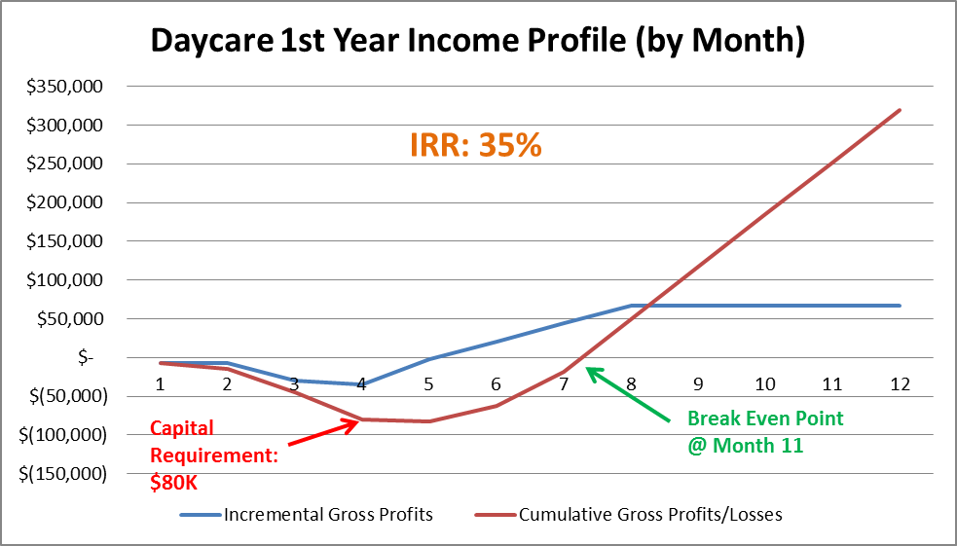
Daycare 1st Year Income

Slide 19
Daycare Financials

Slide 20
Combined Financials

Slide 21
Pricing Comparison to On-Call Nannies*
Typical placement fee: $30 - $50
Typical nanny wages: $14 - $16/hour
  Four hour minimum per day
Parents willing to pay $114 for 4 hours of
on-call childcare → Equates to $28.50/hour
* http://www.anihouseholdstaffing.com/on_call_nannies.html

Slide 22
Working Parents In Southern California
Were Questioned Via Email
* Sample size = 6

