Slide 1
Robotics Challenge 2015
Conceptual Design Review
University of Colorado at Boulder
Amber Bishop
Abby Johnson
Mack Tang
Luke Worley
13 February 2015

Slide 2
Mission Overview
Mission Statement:
The objective of this team is to design and build a robot costing less than $500 to autonomously and reliably navigate through a challenge course, while avoiding larger obstacles and traversing smaller obstacles in search of a beacon.
What is it?
The Robotics Challenge is hosted annually by the Colorado Space Grant Consortium (COSGC), and will take place on April 3rd of 2015 at the Great Sand Dunes National Park in the state of Colorado.

Slide 3
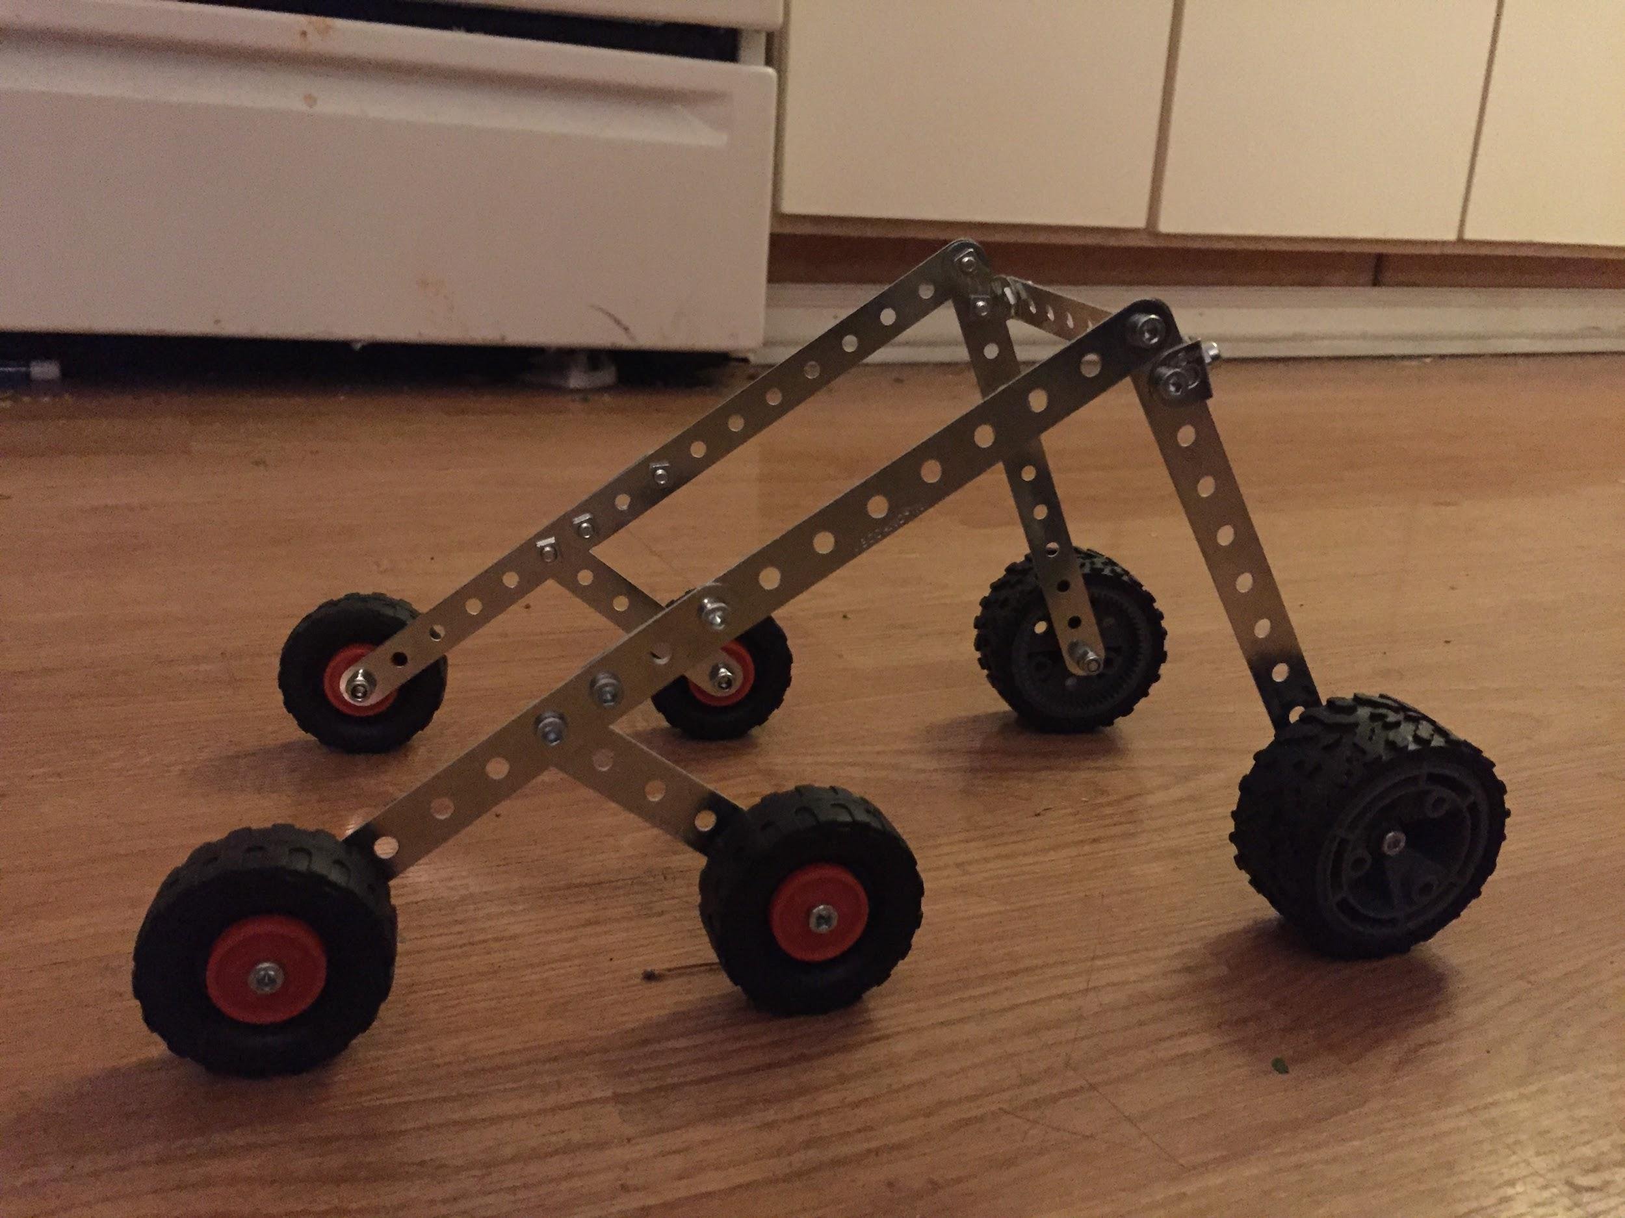
Design Overview
Arduino Uno
3-Axis Accelerometer
IR Sensor (x3)
Radio Transceiver
DC Motor (x6)
High Traction Wheels (x6)
Acrylic Structure
Lithium Polymer Batteries (x1)

Slide 4
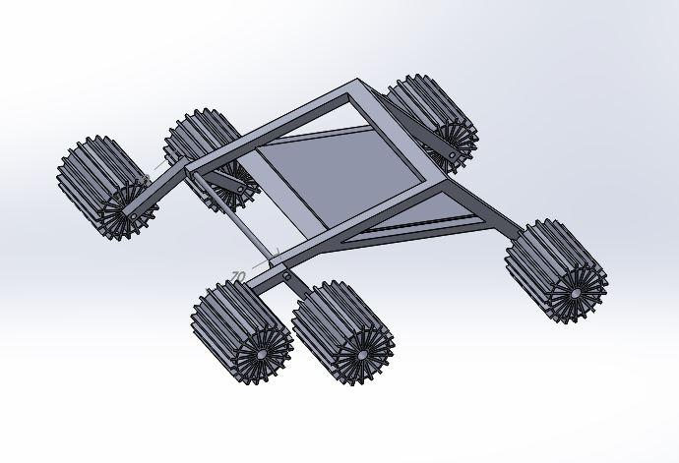
Design

Slide 5
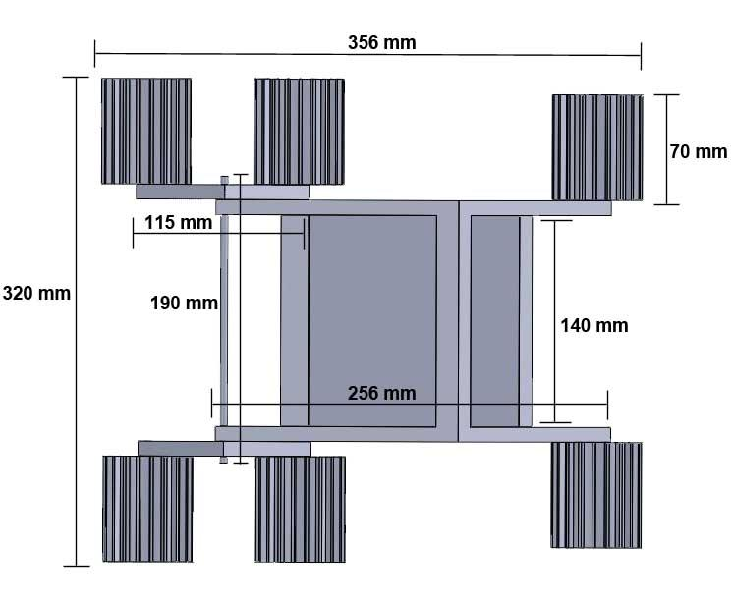
Design

Slide 6
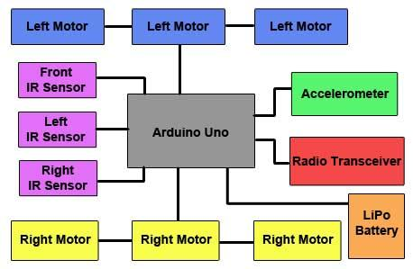
Functional Block Diagram

Slide 7
Management
Team Member | Roles
Abby Johnson | Structure/Software
Amber Bishop | Structure/Testing
Luke Worley | Software/Hardware
Mack Tang | Testing/Hardware

Slide 8
To Be Completed | Date
Conceptual Design Review | February 13, 2015
Preliminary Design Review | February 16, 2015
Structure Completed/Sensors Coded | February 24, 2015
Sensor and Structural Testing | February 24, 2015
Critical Design Review | February 25, 2015
Full integration | March 3, 2015
Testing Readiness Review | March 6, 2015
Fully Integrated robot testing | March 10 and March 12, 2015
Robot Delivery Review | March 16, 2015
Challenge at the Dunes | April 3-4, 2015

Slide 9
Requirements
Objective | Requirement | Reference
0.1 | The robot shall navigate autonomously to a beacon | Mission Statement
0.2 | The robot shall avoid large obstacles | Mission Statement
0.3 | The robot shall traverse smaller obstacles | Mission Statement
0.4 | The robot shall cost under $500 | Mission Statement
0.5 | The robot shall be safe and reliable | Mission Statement

Slide 10
Parts List & Budget
Component | Lead Time | Manufacturer | Distributer | Quantity | Mass (grams) | Cost
433 Mhz Rf Transceiver | 1 week | Parallax | Parallax | 1 |  | $39.98
3-Axis Accelerometer | 1 day | Sparkfun | Sparkfun | 1 | 1.7 | $9.95
IR Sensor | 1 day | Sparkfun | Sparkfun | 3 |  | $0
Wheel |  | N/A | N/A | 6 | N/A
Acrylic | ~1 - 3 days | Colorado Plastics | Colorado Plastics | N/A | 1.18 g/cm^3 | .01 $/cm^3
DC Motor | 1 day | Sparkfun | Sparkfun | 6 |  | $150
Arduino Uno | Acquired | Arduino | N/A | 1 | 23.1 | $0
Lithium Polymer Batteries | 1 day | Sparkfun | Sparkfun | 2 | 2.65 | $20

Slide 11
Testing: Structural Testing
Rigidity: Tested by driving the robot over certain obstacles including small to large rocks and other structures.
Navigation: Tested by setting up the beacon in a location that is relatively similar to what obstacles the sand dunes may provide.All sensors will be utilized in this test.
Traction: Tested by creating a sand pit to test the incline at which the robot can maneuver up.
Maneuverability: To test the robots mobility in the expected environment we plan to check how our design performs when moving over objects.
Wheel Functionality: The team will insure that the left wheels rotate at the same revolutions per minute and that the right wheels also move in sync.

Slide 12
Testing: Functional Testing
IR Sensor: The IR sensors will be tested by placing objects in front of the IR sensors at certain distances and the team will record at what distances the IR sensor recognizes the object in order to determine the sensor’s sensitivity. From these tests, the team will calibrate the IR sensor’s sensitivity.
3-Axis Accelerometer: The accelerometer will be tested by moving the accelerometer in multiple directions and viewing the output from the accelerometer to insure that the accelerometer is calibrated correctly and the code is correctly receiving and outputting the correct data.
Radio Transceiver: The radio transceiver will be tested by placing the transceiver at certain distances from the beacon to insure that the data received and outputted by the Arduino Uno is correct.
DC Motors: The motors will be tested by insuring that the motors output specific amounts of power to drive the robot for certain time intervals or distances. The motors will also be tested to insure the capability of turns for navigating around obstacles.

Slide 13
Challenges
Mechanical Failure
Electronic Disconnection
Tipping
Getting stuck on obstacles

