Slide 1
ProM/CC-PMS
A dating site for the climate action movement

Slide 2
What this presentation covers
The Concept: a dating site for the climate action movement
Building ProM: leveraging open infrastructures and processes – an Open Project
ProM Organizational Structure: how we run the project
ProM Workspaces: how we work day to day

Slide 3
The Platform Concept
A Dating Site for the Climate Action Movement

Slide 4
Introducing ProM/CC-PMS A Project Matching System
Coalition of the Willing and OpenKollab are developing a dating site/project matching system for the climate action movement.
This is ProM/CC-PMS (Climate Change Project Matching System).
ProM is an open culture initiative. This means:
1. We are building ProM the open source way.
2. We are designing ProM to promote open collaboration.
3. We invite you to join the build and design process.

Slide 5
Why does the world need ProM?
Many climate action projects have similar objectives. These projects would be better served if they were able to connect with one another. By connecting and converging on common goals, climate action projects could achieve the critical mass necessary to bring about massive social and systemic change.

Slide 6
What is ProM? Visibility and Convergence
The platform concept rests on two principles:
Project Visibility: we can make projects visible to each other in the same way as dating sites make people visible to each other
Convergence: we can identify information (called meta-data) about projects that can help projects identify others who might be working towards similar goals, or who might have common needs or resources. On this basis they can converge.

Slide 7
What Is meta-data and what meta-data do we need for the project?
Meta-data is information about a project that describes it in certain ways that make it possible to understand how the project can be connected with others. Here are examples of useful meta-data:
Organizational Mission: e.g.,… “We will reduce CO₂ emissions in Canada by 40% within 10 years!”
Specific Goals: “We will organize a conference on reducing CO2 emissions in Canada in September 2011!”
Needs: “We need… $10,000, a programmer, a graphic designer…”
Offers: ”We can offer a desk in our office and we can host websites…”

Slide 8
ProM project meta-data
By analysing projects, we will develop project meta-data analogous to the personal meta-data used by dating sites
PROJECT META-DATA
PERSONAL META-DATA
Mission
Goals
Leader
Team
Milestones
Age
Sex
Height
Interests
Hobbies
Note that Visible Personal Meta-Data is a recent phenomena. Why not Visible Project Meta-Data?

Slide 9
The ProM dating process From visibility to engagement
Make Project Visible via ProM Platform
Identify Potential Matches via ProM Platform
Start Dating!
Get Engaged!... collaborate

Slide 10
What is dating? Options for collaboration
Once projects have determined alignment, they are presented with options for dating. Each form of date involves a pre-established process with a different level of commitment. Possibilities include:
Coffee date: a “getting to know you” encounter
One night stand: alignment for a one-off project
Gooseberry: get involved in an existing date
Going steady: negotiate for ongoing engagement

Slide 11
What is engagement? Towards lasting convergence
All dates are variations on ‘engagement’. They involve a convergence process that tightens alignment and synergy.
ALIGNMENT
SYNERGY
Intentions
Language
Roles
Processes
Tools
Responsibilities

Slide 12
Serious dating Tools for engagement
Share Space
Explore Convergence
Skype Chat
Google Group
Shared Practices and Processes
Wiki
Ether
Pads
Aligning Intentions

Slide 13
ProM overview Tools and processes to connect projects
Technology platform or infrastructure
Open Community of Practice
Open Practices and Processes

Slide 14
Building ProM
Utilizing Open Infrastructures and Processes as the basis for Open Projects

Slide 15
Project organization and strategy
We are building ProM the open source way. Our centre of operations is http://cotw.cc/wiki/Project_Matching
We have divided the work into three "tracks":
Outreach
Meta-data
Technology.

Slide 16
ProM workstreams
ProM has three workstreams each with a particular mandate and set of interaction spaces enabled by certain tools
Outreach
MetaData
Technology
Mandate is to identify candidate groups for matching and to develop engagement strategy
Mandate is to identify the meta-data that can facilitate matching
Mandate is to both identify and test tools for internal use as well as support ProM platform development

Slide 17
ProM outreach workstream A layered approach
Outreach is integral to the development strategy for Prom. We have three main foci for our outreach efforts:
Community leaders: we want to convince climate action community leaders of the value of ProM for their activities and invite them to help us gather user stories and meta-data
Hackers and coders: we plan to pitch ProM-related projects at the June meet of Random Hacks of Kindness (RHoK)
Social media specialists: will present ProM as a work project-in-progress at the Contact Conference in NYC, October 2011

Slide 18
ProM meta data workstream
Mandate: Identify meta-data that can be applied to projects that can serve to facilitate the matches.
Approach: the group is pursuing three parallel tracks
Analyzing User Stories: the group is collecting use cases which will the form the basis for User Types
Research of Existing Meta-Data Sources: dating sites, algorithms etc.
Convergence Project: analyzing the ProM working group in order to identify what underlying patterns brought us together and what meta-data can be abstracted from this

Slide 19
ProM technology workstream
Mandate: To identify and develop the ProM platform as well as to support the entire group in the identification and testing of tools.
Approach: The group will work closely with other open source developers, such as those working on WagN, to explore relationships that are reciprocally beneficial.

Slide 20
ProM Organizational Structure
Structuring an Open Project

Slide 21
ProM: an open project
ProM is on open project. We abide by the following principles:
Visibility: We strive to make visible all aspects of the project.
Documentation: We document protocols and achievements and share them on http://cotw.cc
Open Collaboration : We clearly define and develop project management processes that are designed to manage the engagement and involvement of many people. Here are the Meeting Tools and Practices We try to leverage the principles of collective intelligence and crowdsourcing.
Open Infrastructure: We use open source tools when possible. The tools used to manage ProM are:
Community wiki: http://cotw.cc/wiki/Project_Matching
Etherpad: CC-PMS etherpad index
Skype: cc-pms
BetterMeans: https://secure.bettermeans.com/projects/163
Permeable Boundaries: We recognize that the boundaries of participation in the group cannot be clearly defined in open environments.
Decentralization: We recognize that managing a project that is highly inclusive can only be effective if decision making power is distributed widely.
Fluidity/Flexibility/Emergence: We recognize that in virtue of our interest in involving many people, different motivations and goals will converge within this project. This means that it is possible that this project seeds other projects, sub-groups etc. We need to be responsive to whatever arises

Slide 22
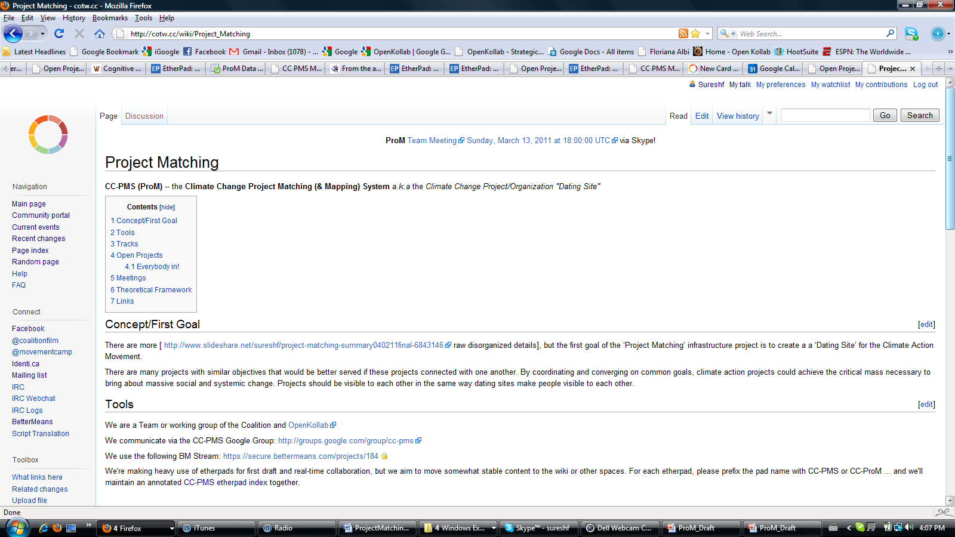
The main ProM wiki page

Slide 23
ProM tools
TOOL | FUNCTION
Google Group | Centralize communication for all interested parties
Wiki | Central repository for all information. Evolves organically...
Etherpad | Documentation both for real time meetings as well as ongoing discussion
Skype Chat and VOIP | Main area of ongoing conversations. Also used to coordinate conference calls
BetterMeans | Being evaluated for task management and governance processes

Slide 24
ProM Workspaces
Where all the deep stuff happens!

Slide 25
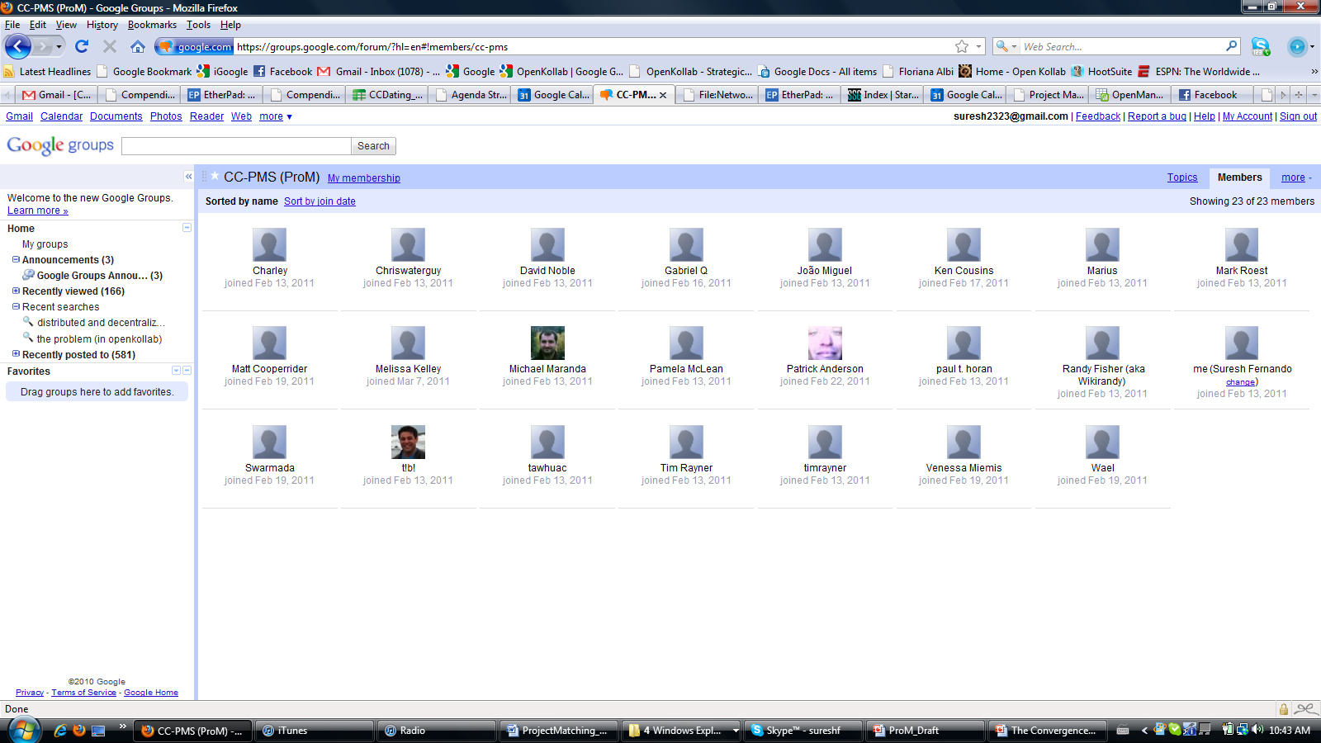
Google Group

Slide 26
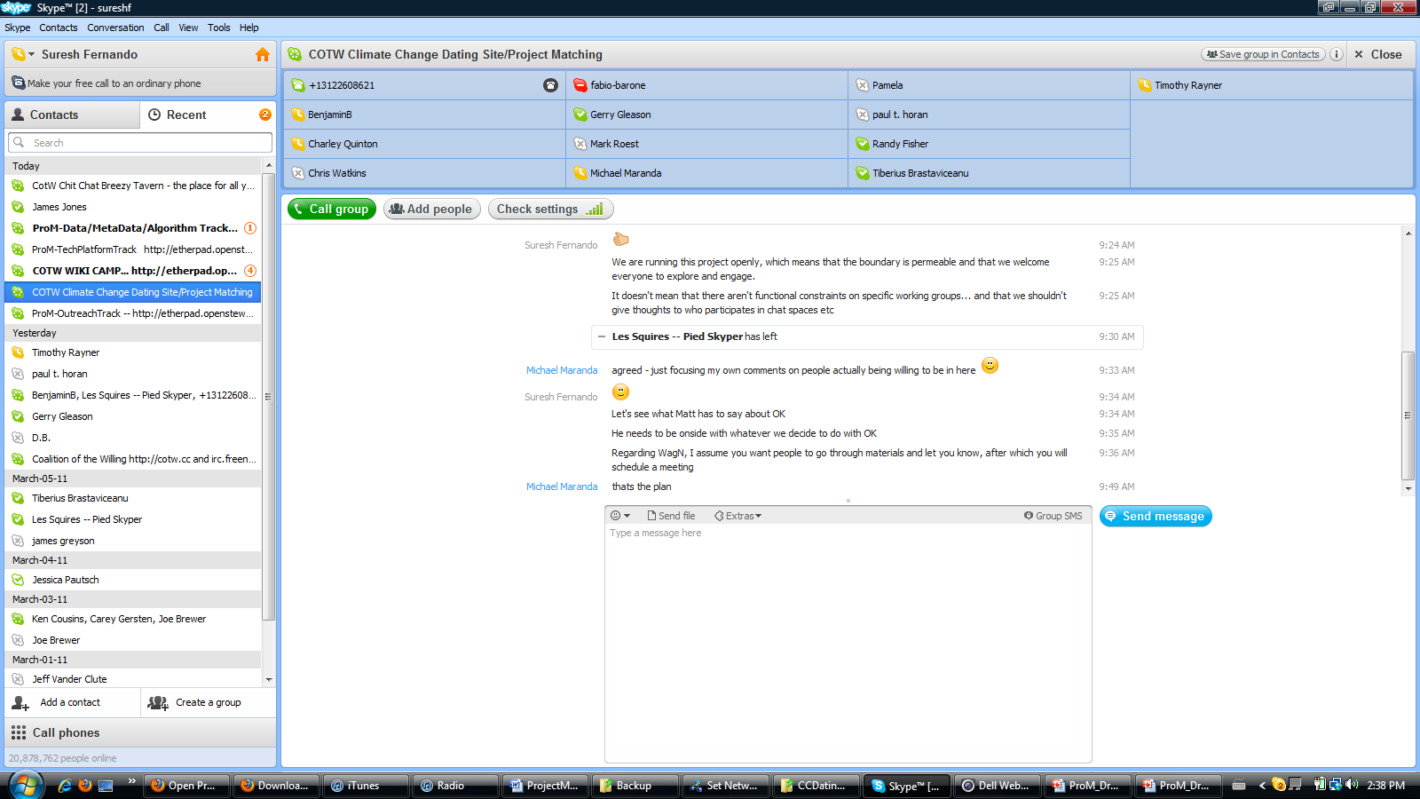
The Primary Chat Space Skype Chat Space

Slide 27
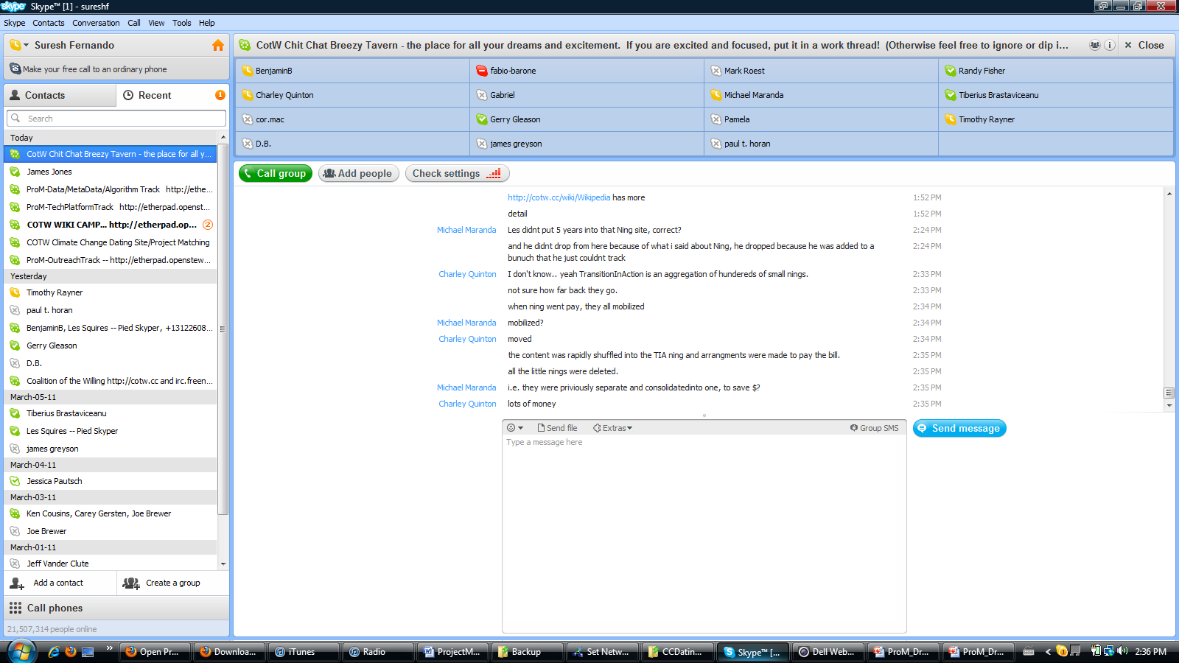
The Tavern... Skype Chat Space

Slide 28
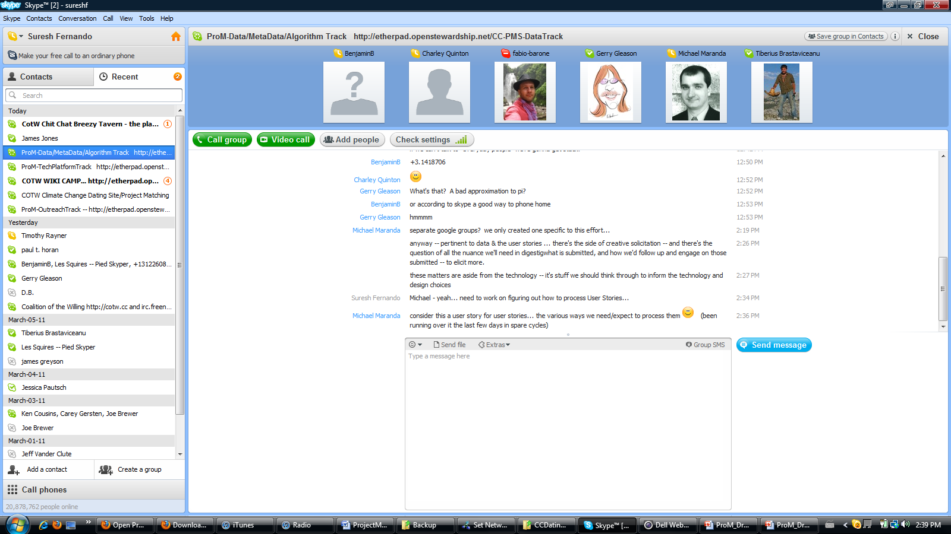
The Meta-Data Group Skype Chat Space

Slide 29
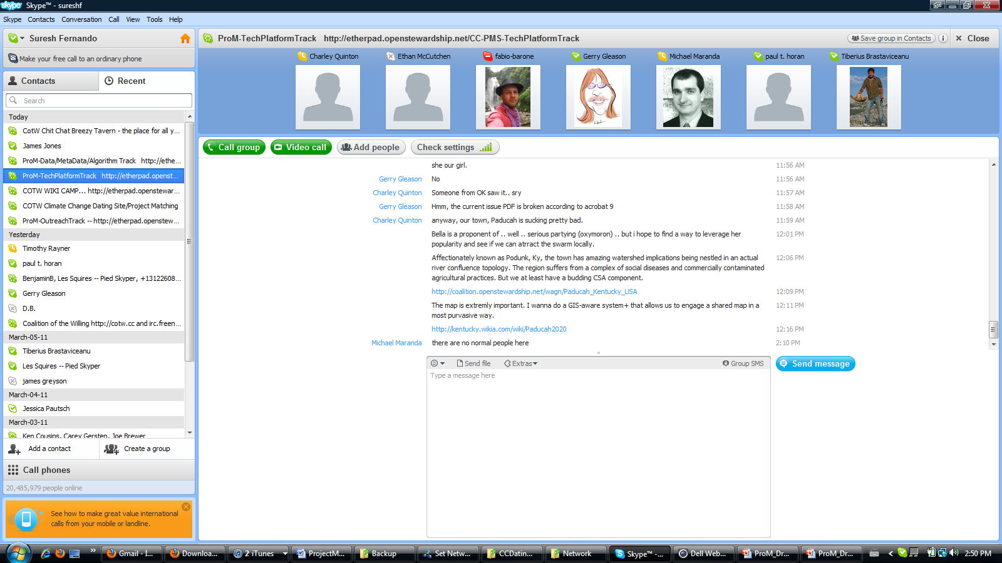
The Technology Group Skype Chat Space

Slide 30
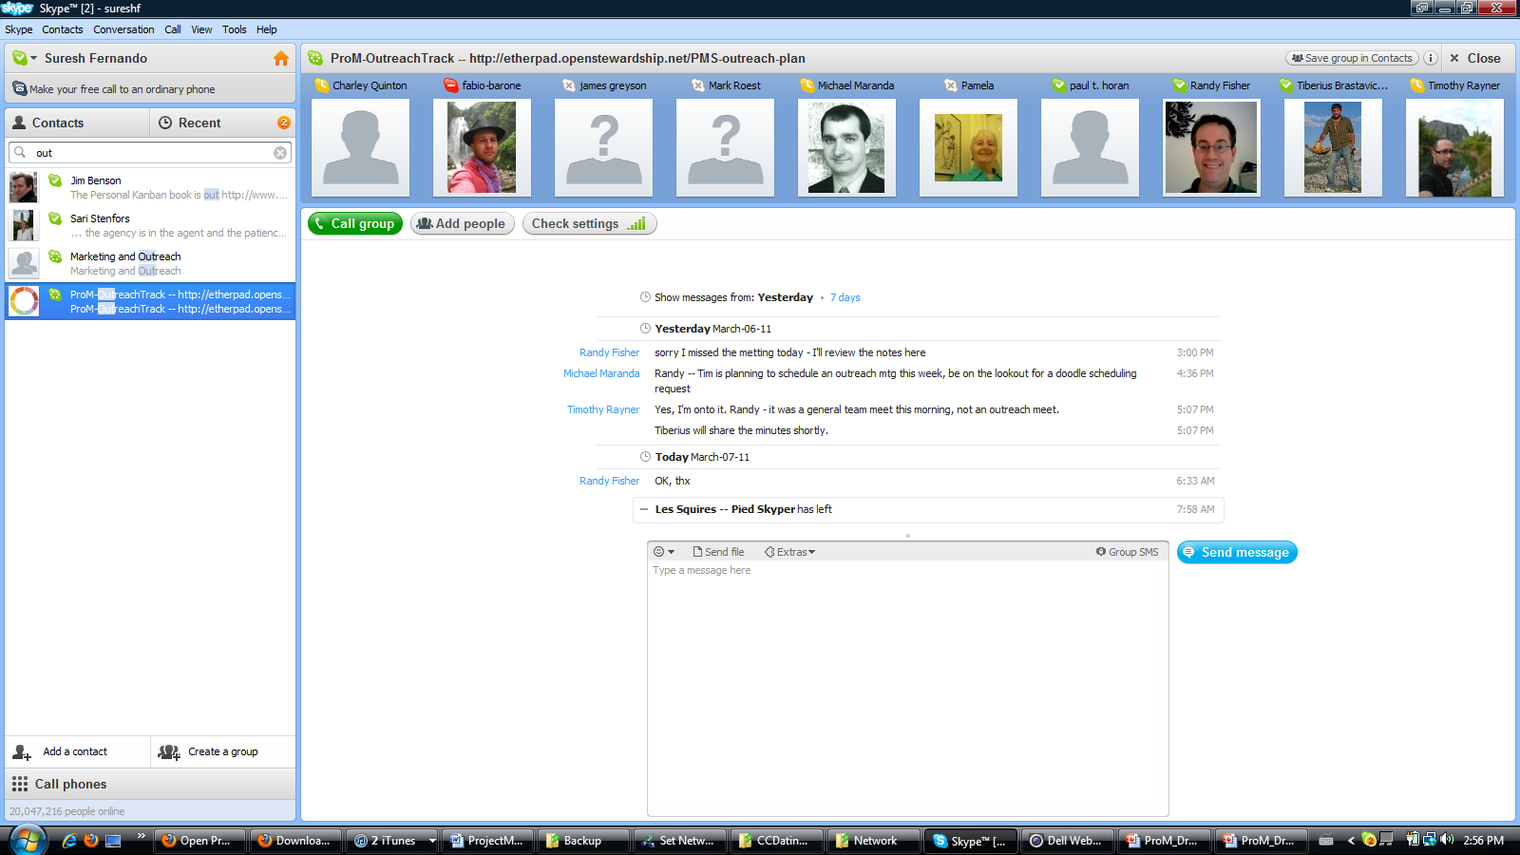
The Outreach Group Skype Chat Space

Slide 31
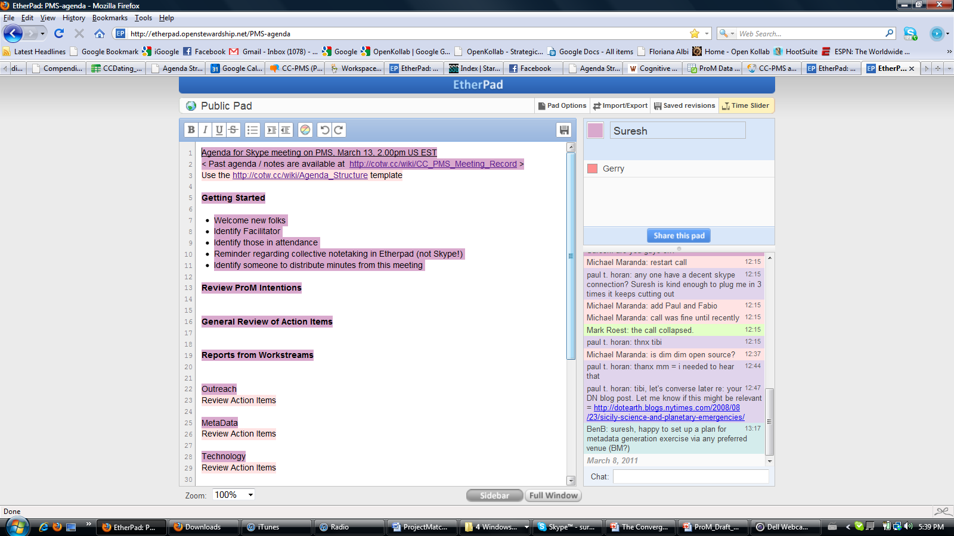
Collaborative Agenda Etherpad

Slide 32
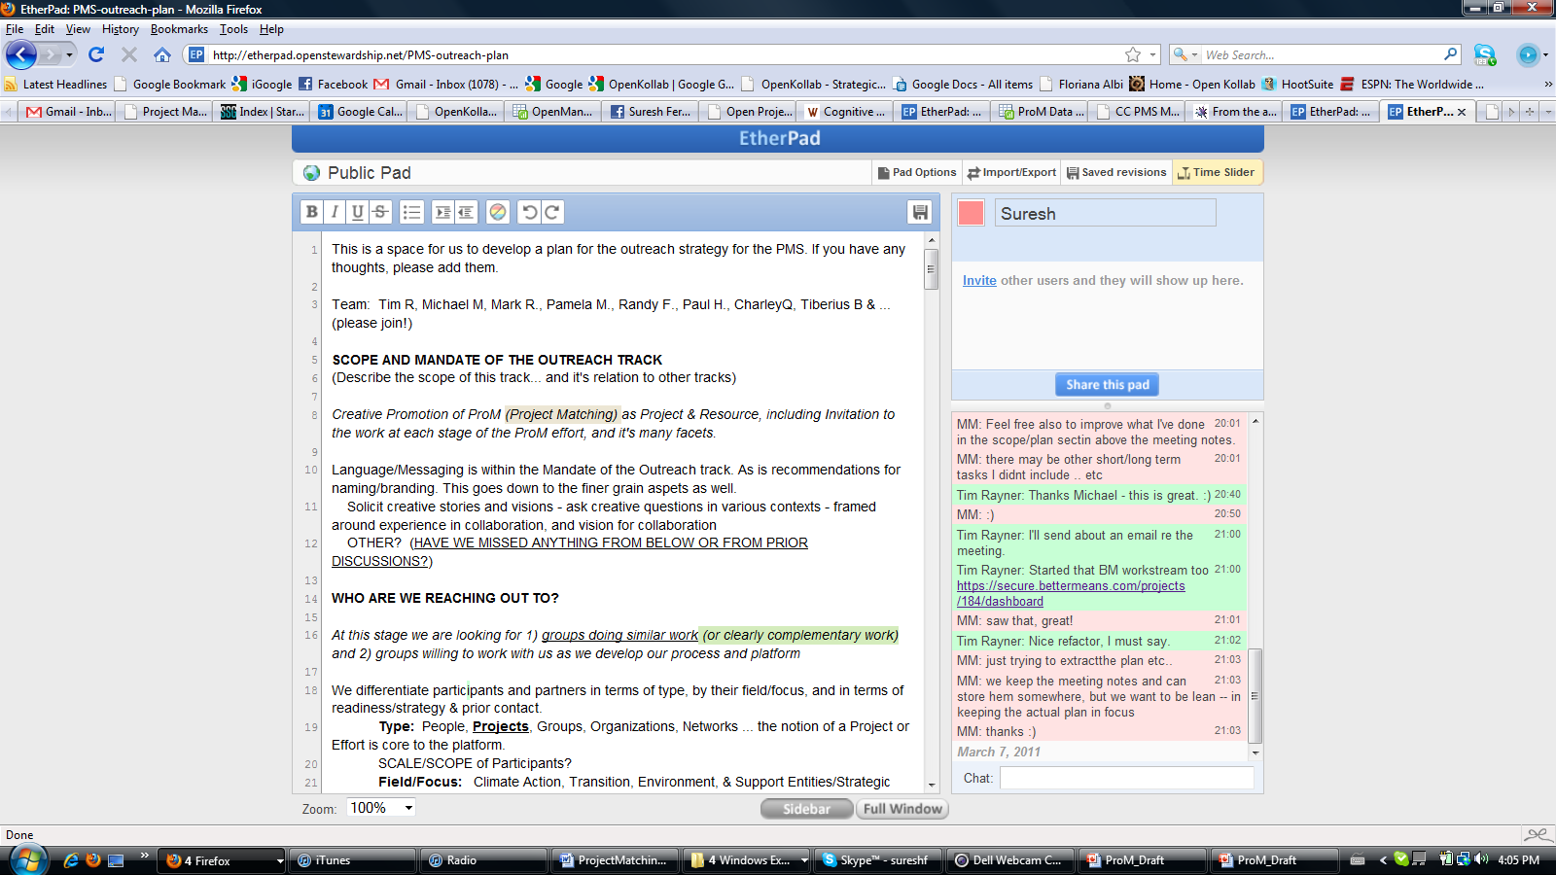
Outreach Group: scope and mandate Etherpad

Slide 33
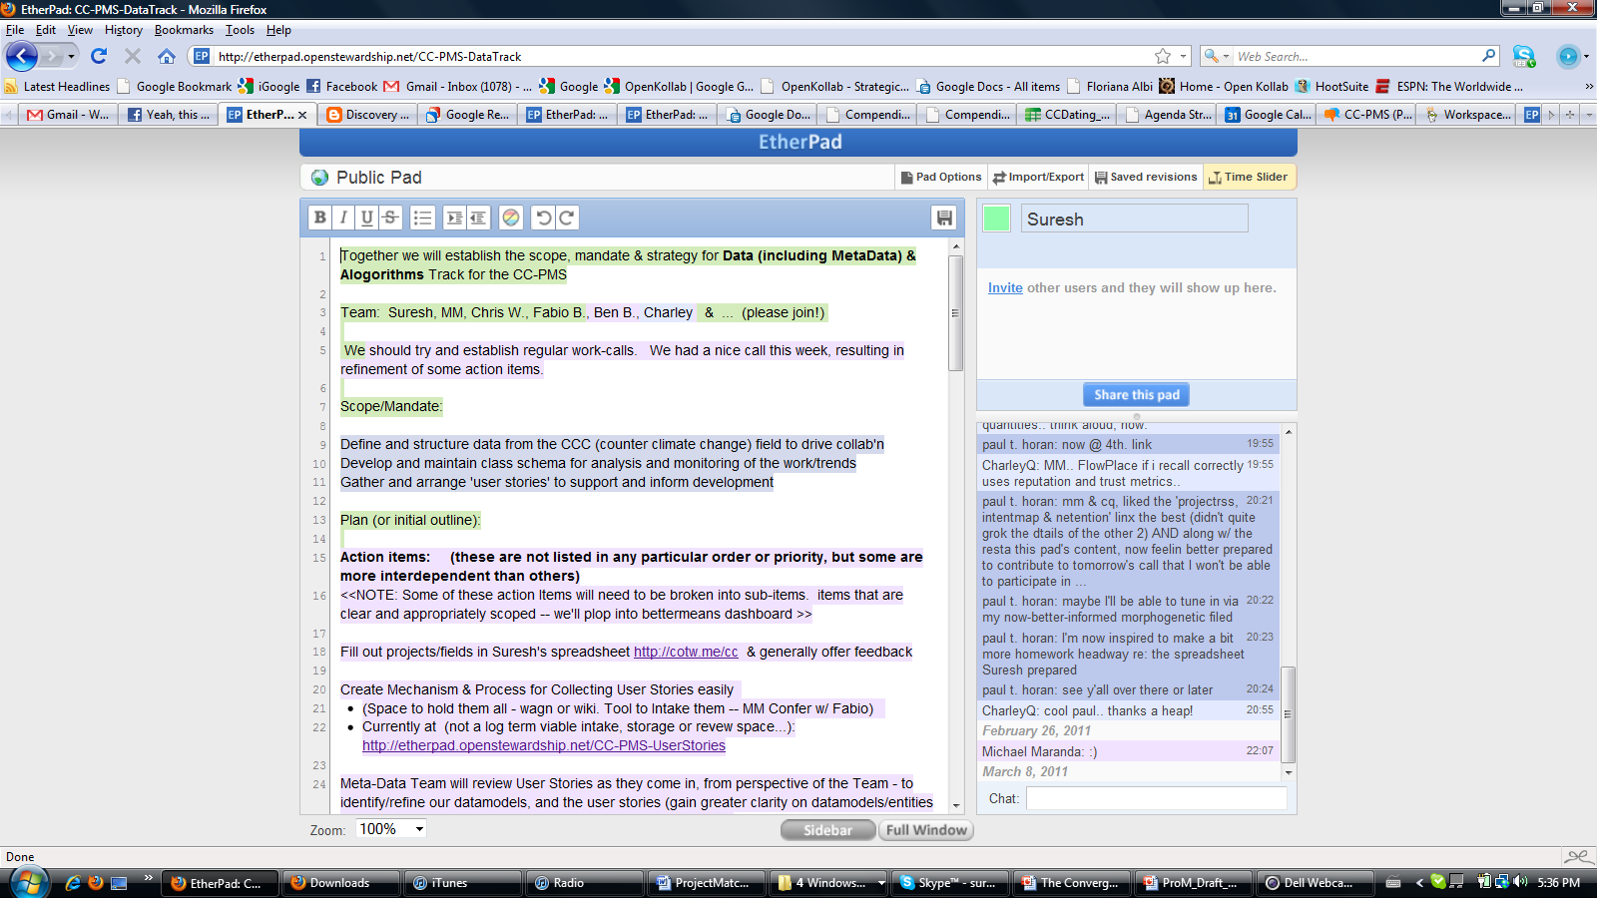
Metadata: Algorithms Etherpad

Slide 34
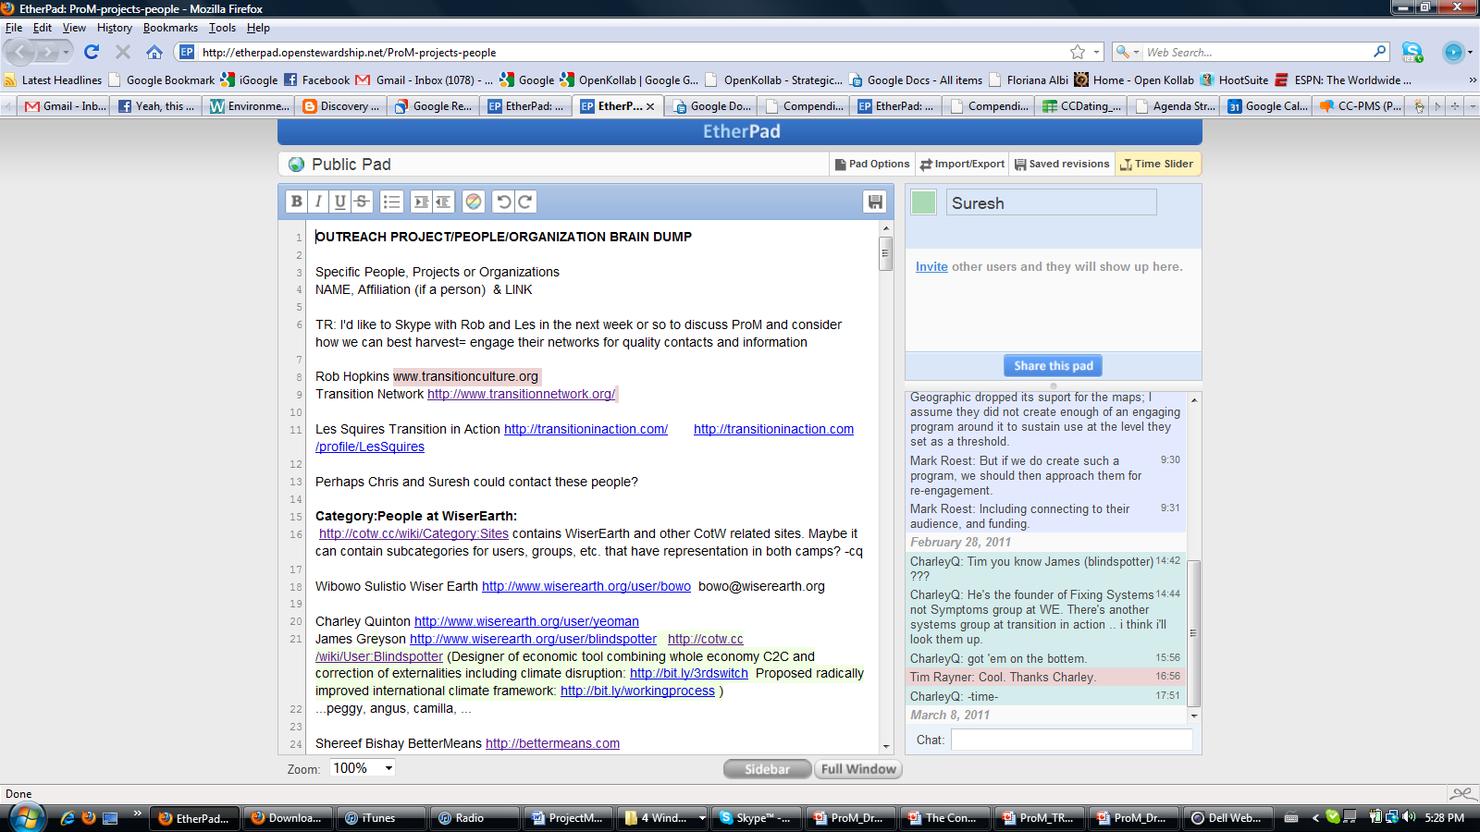
Outreach Group: projects and people Etherpad

Slide 35
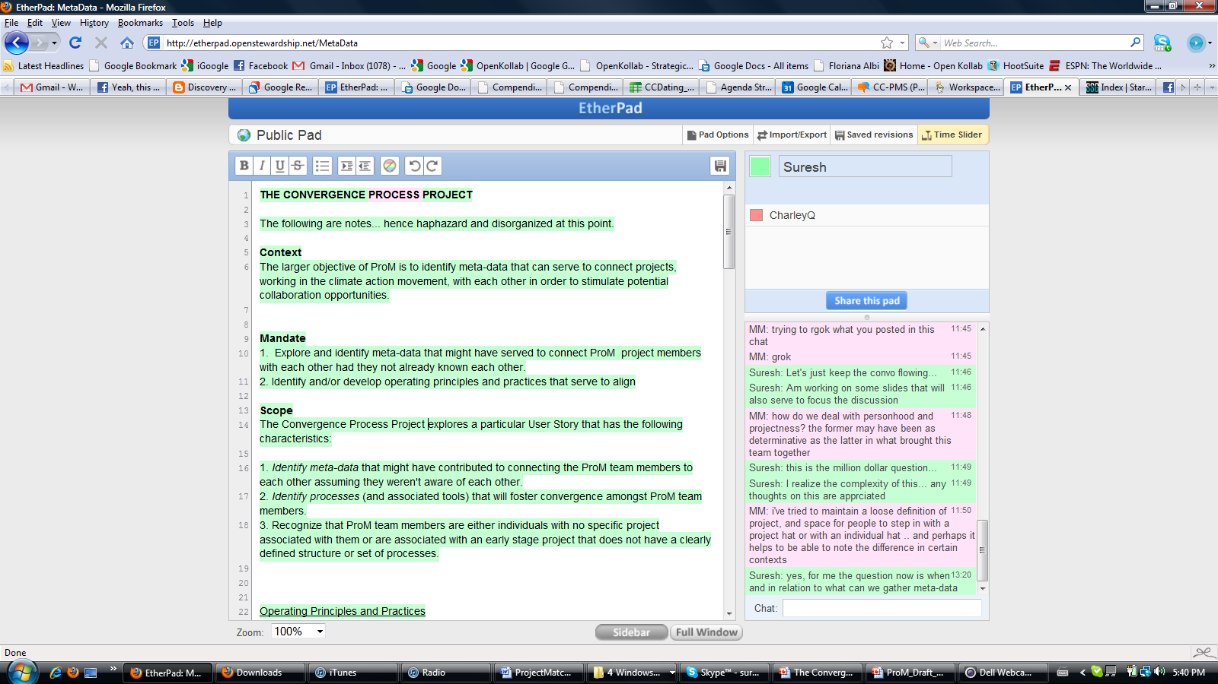
Metadata: Convergence Process Project Etherpad

Slide 36
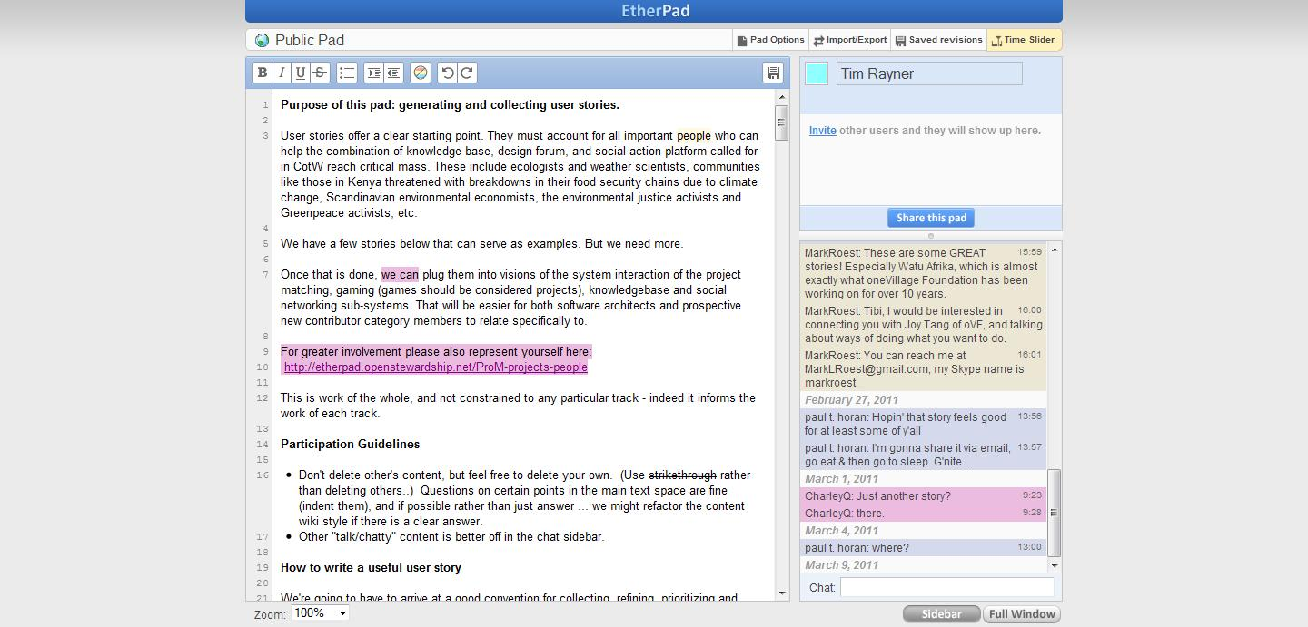
Metadata: User Stories Etherpad

Slide 37
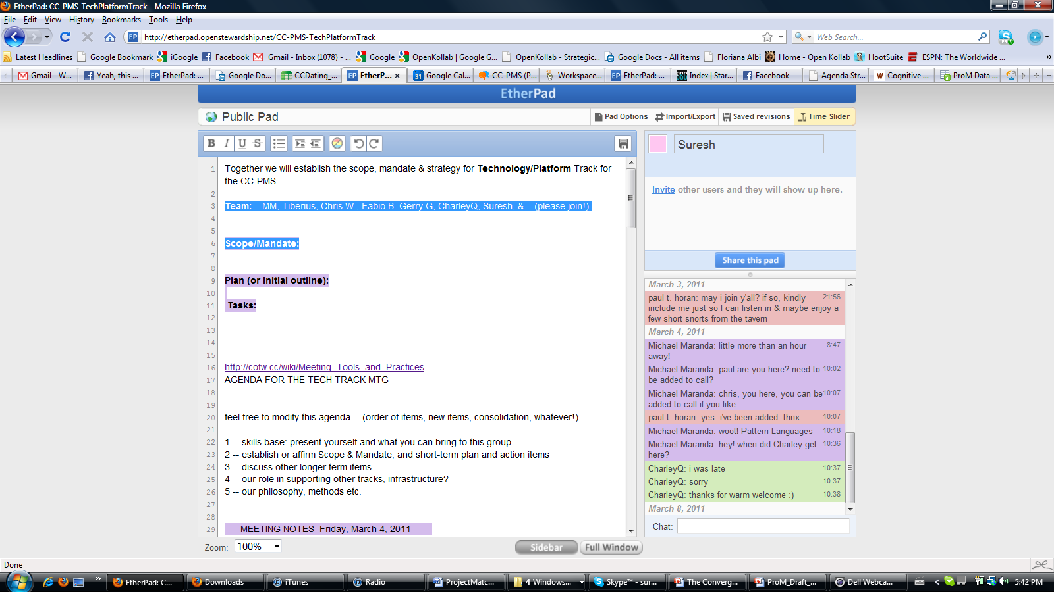
Technology Etherpad

Slide 38
ProM team
Name | Workgroup(s) | email | Notes
Tim Rayner | Outreach | tim@timrayner.net

Slide 39
ProM team
Name | Workgroup(s) | email | Notes

Slide 40
ProM team
Name | Workgroup(s) | email | Notes

