Slide 1
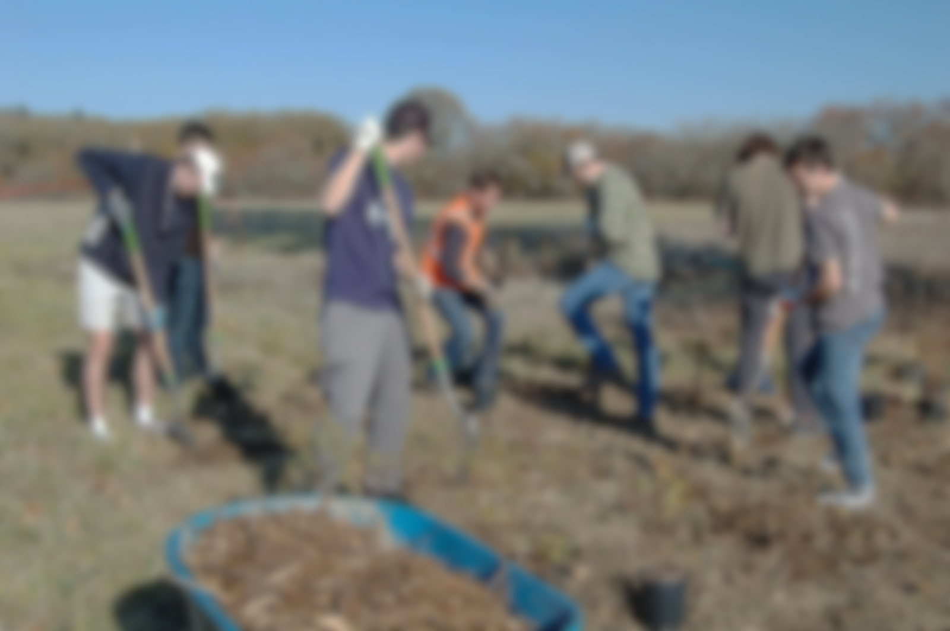
Water Action Team
Tangible Action
Collaboration
Engaged Youth

Slide 2
VISION
Water conservation efforts decrease the amount of water city residents use, and
our creeks are clean and clear.

Slide 3
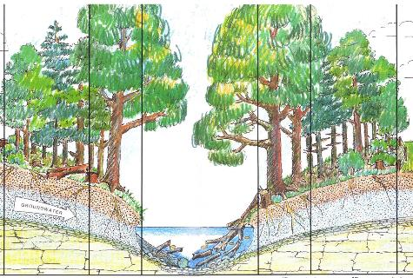
2020 Tangible Action
Ridge-to-River Creek Flow
Creek Buffers
Wetlands
Cultural Relevance

Slide 4
2020 Project Sites
SCHOOLS
Cheldelin Middle Corvallis Waldorf
Crescent Valley High
Corvallis High
Jaguar Elementary
PUBLIC
Dr. MLK, Jr. Park
Mill Race
Orleans Natural Area
Sequoia Creek
Starker Arts Park
Village Green Park
Bald Hill Natural Area

Slide 5
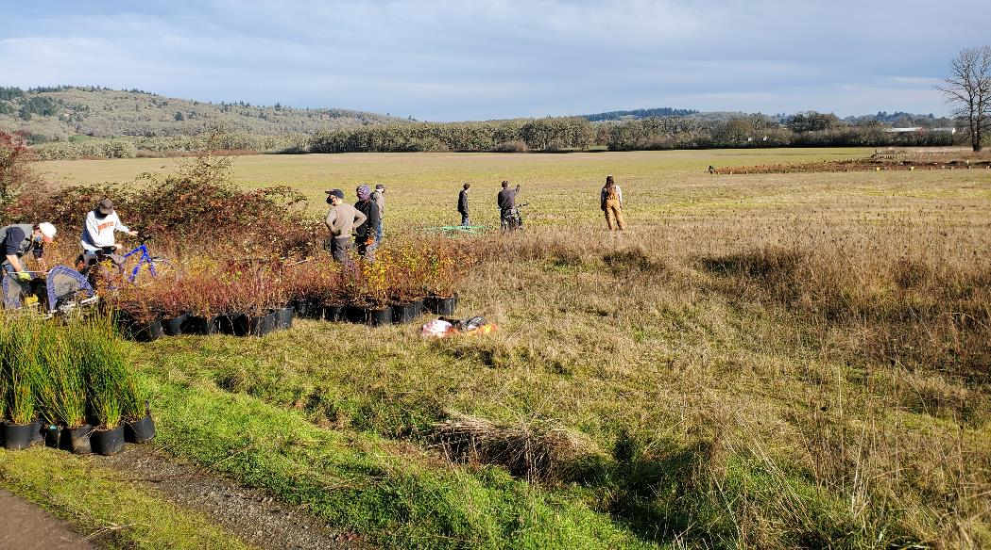
Planted 30 Species
>1,600 Plants

Slide 6
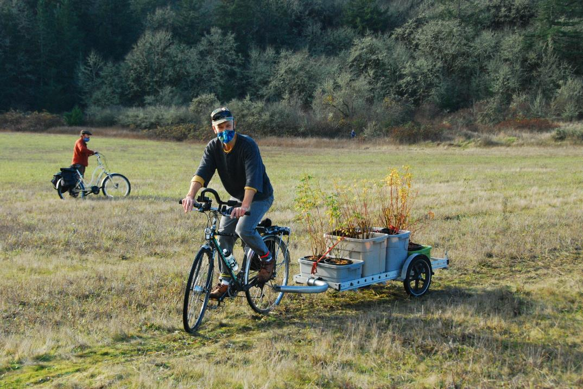
Creative Delivery

Slide 7
We Collaborate
Benton Soil and Water Conservation District
City of Corvallis
Parks and Recreation Department
Public Works Department
Corvallis Odd Fellows Lodge
Corvallis School District
Corvallis Waldorf School
Jobs Addition Neighborhood Association
Marys Peak Group Sierra Club
Marys River Watershed Council
Natural Areas Action Team
Oregon State University
Republic Services

Slide 8
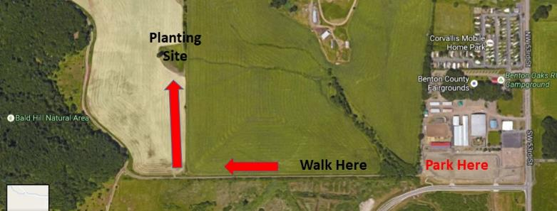
North Dunawi Creek
Regeneration Site
7,000 Plants
♾ Leaf Mulch
100s of logs
1 Underground Pipe
2 Undersized Culverts
1 Beaver Family

Slide 9
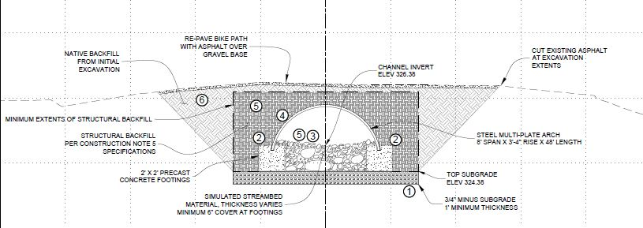
North Dunawi Creek Regeneration Site
Culvert Replacement Design

Slide 10
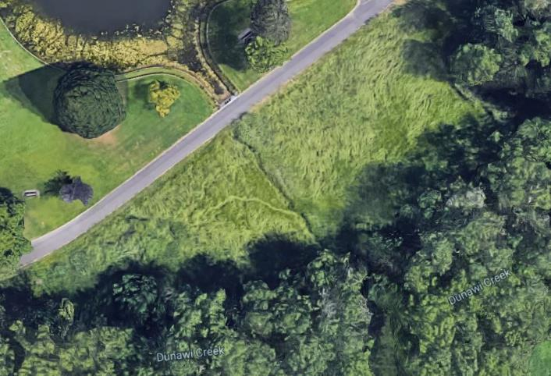
South Dunawi Creek Filtering Wetland
Duck Pond
Old Drainage Channel
South Fork Dunawi Creek

Slide 11
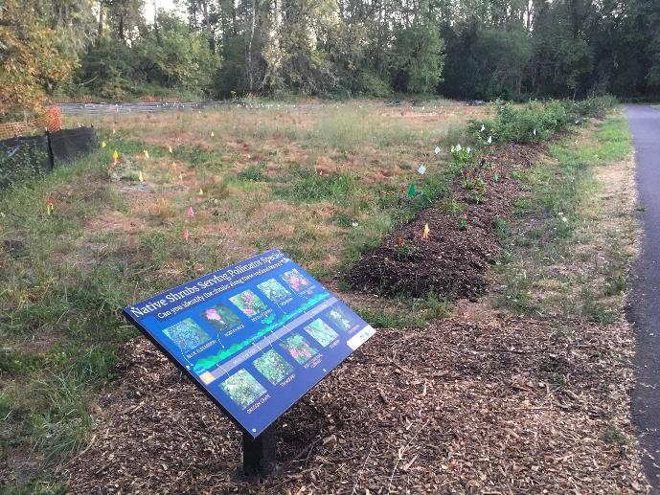
South Dunawi Creek Filtering Wetland
100 Shrubs
♾ Mulch
6 Displays
July 22nd

Slide 12
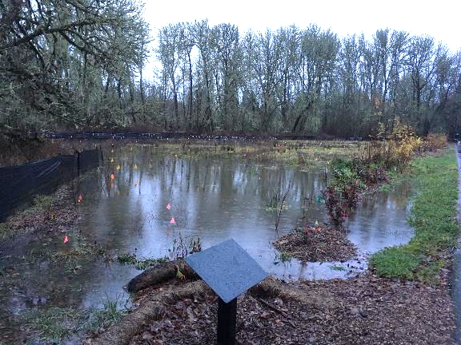
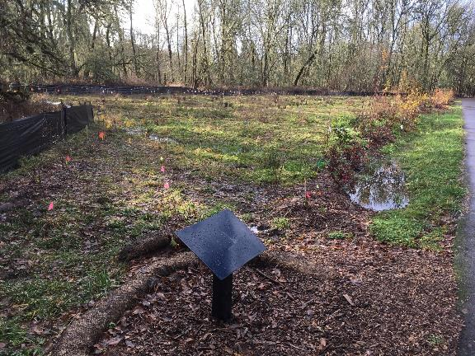
South Dunawi Creek Filtering Wetland
Dec. 21st
Dec. 20th

Slide 13
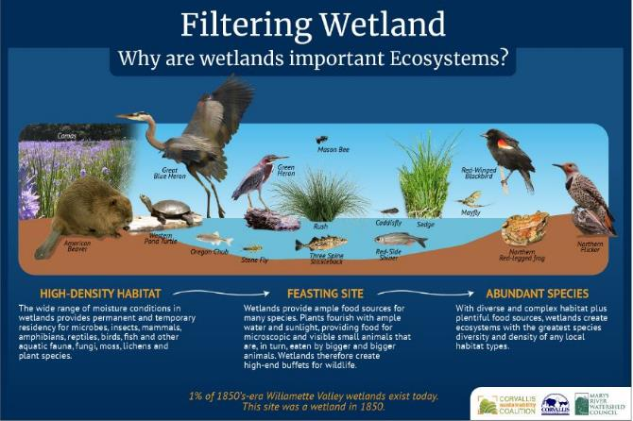
South Dunawi Creek Filtering Wetland

Slide 14
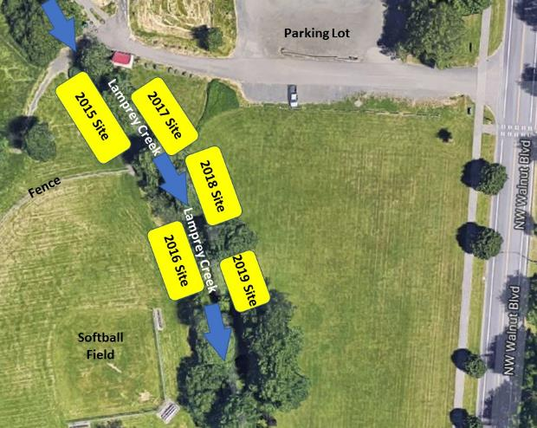
Lamprey Creek
Dr. MLK, Jr. Park Site
Upgraded Sites
Added 43 Shrubs
Refreshed Mulch
Removed Fencing

Slide 15
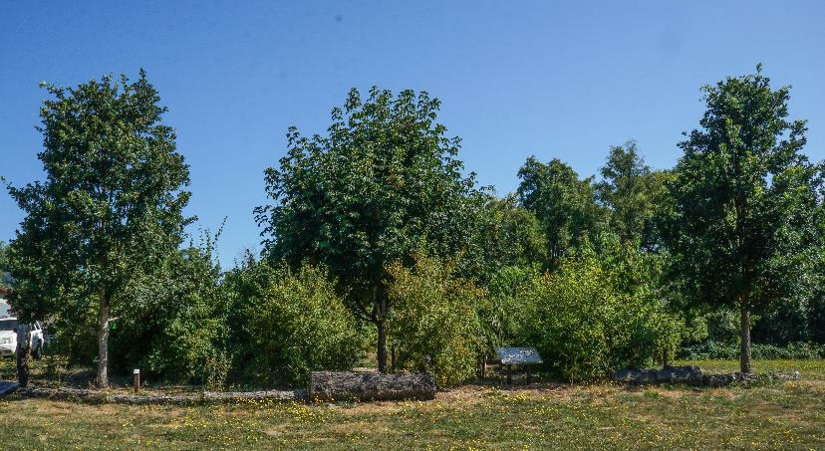
Shrubs
Mulch
PowerPoint

Slide 16
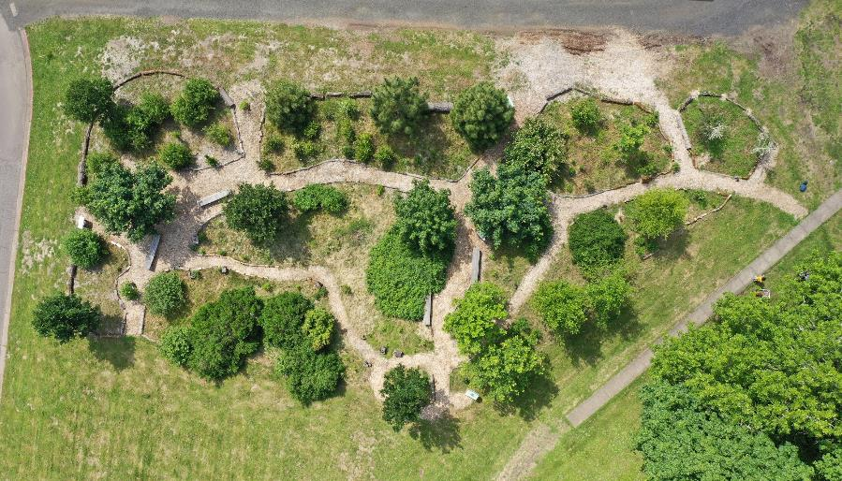
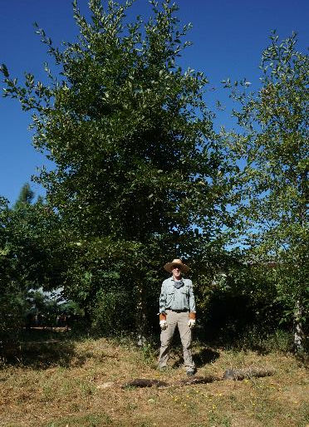
Crescent Valley High
Native Arboretum
Oregon White Oak Planted 2010
Jackson Creek

Slide 17
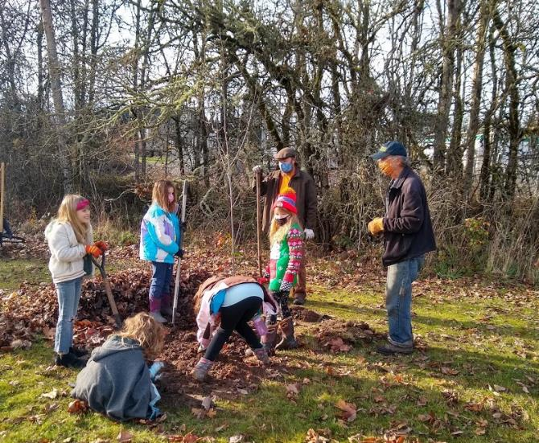
Team – Engaged Youth
52
Active Members
1,900 Hours
1 Meeting

Slide 18
Join the
Water Action Team
Weekly Updates
Corvallis Waterways
Outdoor Activities
Immediate Results

Slide 19
Join the
Water Action Team
Contact: Dave Eckert deckert@willamettewatershed.com
(541) 230-1237
Native Planters
Oak Creek Hydro-Explorers
Mill Race Greenway Plotters

