Slide 1
CoderDojo Athenry
Minecraft ModderDojo
Athenry
Code and notes by Michael Madden, 2014

Slide 2
Today's ModderDojo Challenge: Prepare to Earn A New Belt!

Slide 3
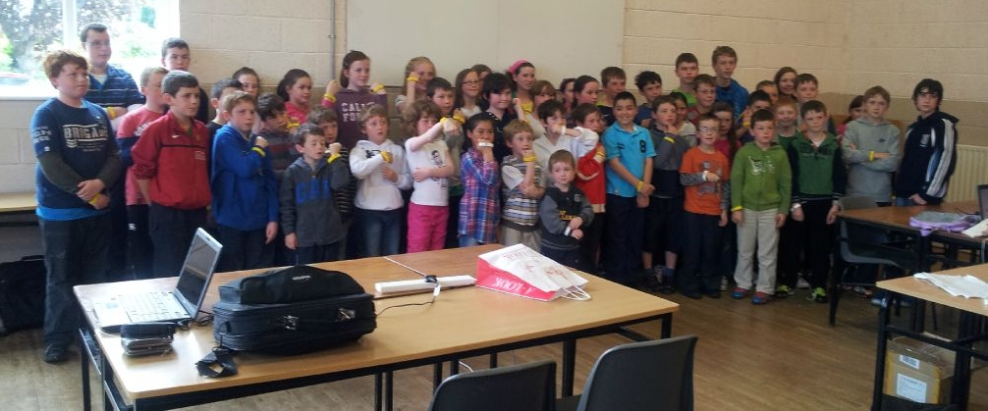
Belts!
Notes:
30 June 2012. 55 belts: 45 yellow + 10 white.

Slide 4
Can Earn White, Yellow or Green
White: Commitment & Basic Skill
Attend at least 5 sessions
+ Know how to get started with Modding
Sign in each week!

Slide 5
Can Earn White, Yellow or Green
Yellow Belt: Competent Minecraft Modder
Qualify for a White Belt
Write and explain a Mod in Java or JavaScript
Must work without crashing
Must do something
Must be your own design
Must be all your own work!

Slide 6
Can Earn White, Yellow or Green
Green Belt: Publish a High Quality Mod
Create mod in either Java or JavaScript, package it up, and post it on the web
JavaScript: must have variables, loops and decisions; structure must have multiple features
Java: recipes and 3 or more items and/or blocks, that should all work together to do something

Slide 7
Procedure for Earning Belts
A mentor will chat with you
Show us your code: old or new
Explain what you did and how you did it
Tell us which code is new and which is reused from other people's work

Slide 8
Applying for a Belt
Earning a Belt
Learn skills each week
Put skills into practice
Get recognition: belts awarded by mentors
Decide what belt level you want to go for
Attend the full session on the Belt Awards Day
Be prepared

Slide 9
Fairness
Nobody has a right to a belt: it must be earned
We will help you get there
The whole Dojo - mentors, parents, all members
We will give you feedback for next time if you did not make it
We will be clear about what is required to get to the next belt level

Slide 10
Belts & Levels
We are following agreed CoderDojo standards
White belts for commitment & basic skills
Yellow belts for competence in a specific coding discipline
Higher belts for higher level skills in a specific discipline
You have to earn a lower belt before moving to a higher one
When you start a new coding discipline, have to go back to start in applying for a belt

Slide 11
What if I Don't Get a Belt?
If you can't participate, or it doesn't go well for you, don't worry!
We will have another belt awarding session in the coming months

Slide 12
Ask Your Questions!

