Slide 1
CoderDojo Athenry
"Above all, be cool"
Every week:
Sign in at the door
If you are new:
Fill in Registration Form
Ask a Mentor how to get started
Make sure you are on the Athenry Parents/Kids Google Group: email coderdojoathenry@gmail.com

Slide 2
CoderDojo Athenry
Beginners
Athenry
Code and notes by Martha Fahy & Michael Madden

Slide 3
Today's Ninja Challenge: Prepare to Earn Your First Belt!

Slide 4
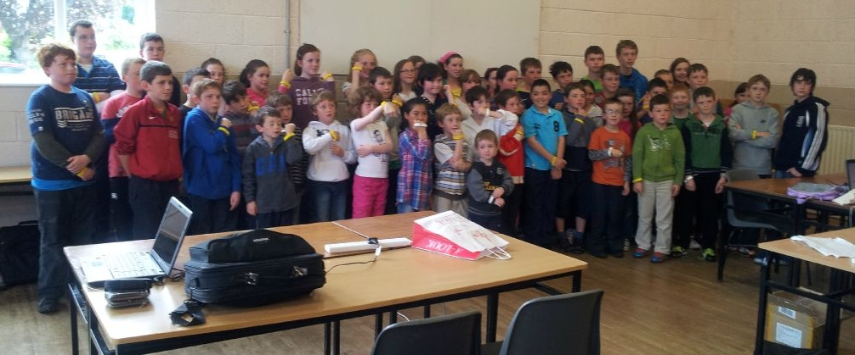
Belts!
Notes:
30 June 2012. 55 belts: 45 yellow + 10 white.

Slide 5
Two to Earn: White or Yellow
White: Commitment & Basic Skill
Attend at least 5 sessions
+ Know how to get started with Scratch
Sign in each week!

Slide 6
Two to Earn: White or Yellow
Yellow Scratch Belt: Competent Scratch Coder
Qualify for a White Belt
Write and explain a Scratch Program with:
Forever/Repeat If blocks Variables Animation/Sound Sprite controlled by mouse or keyboard
Must be all your own work!

Slide 7
Procedure for Yellow Belt
A couple of mentors will have a chat with you
Ask you to show us your code (new or old)
See if you know most of these Scratch ideas: Loop Blocks (Forever/Repeat) If Blocks Variables Animation, Sound & Changing Backgrounds Make a Sprite Move Make a Sprite Say Something Use Broadcasts

Slide 8
Sample Questions for Yellow Belt
Which block you would use to make the sprite speak?
How would you change the way your sprite looks?
How would you make a sprite move?
Can you show where you have used a loop block?
Can you show where you have used animation or sound?
Can you show us where you have used an IF block?
What blocks would you use to check if your sprite hit something?
How do you share a program online?
Show where you have used a variable or how would you create a new variable?
Show where you have used a broadcast or how would you create a new broadcast?

Slide 9
Yellow Scratch Belt: Program Ideas
Squash Game
Control a bat to hit a ball
Ball bounces off wall on the other side
Game over when you miss 5 times
ABC Game
Sprites with A/B/C fall from random start point
Press A/B/C key to stop them
Keep score of how many you stop

Slide 10
Fairness
Nobody has a right to a belt: it must be earned
We will help you get there
The whole Dojo - mentors, parents, all members
We will give you feedback for next time if you did not make it
We will be clear about what is required to get to the next belt level

Slide 11
Belts & Levels
We are following agreed CoderDojo standards
White belts for commitment & basic skills
Yellow belts for competence in a specific coding discipline
Higher belts for higher level skills in a specific discipline
You have to earn a lower belt before moving to a higher one
When you start a new coding discipline, have to go back to start in applying for a belt

Slide 12
What if I Don't Get a Belt?
If you can't participate, or it doesn't go well for you, don't worry!
We will have another belt awarding session in the coming months

Slide 13
Ask Your Questions!

