Slide 1
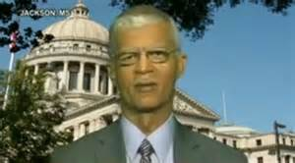
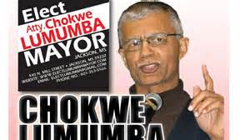
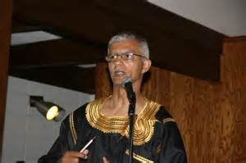
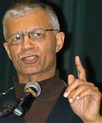
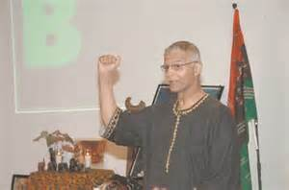
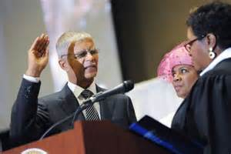
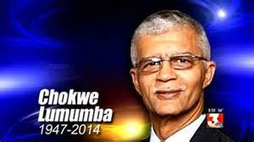
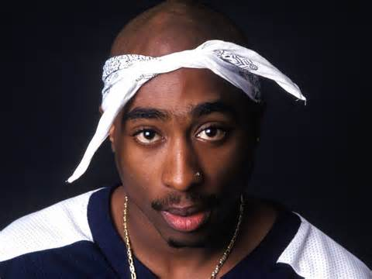
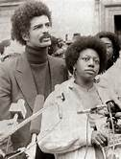
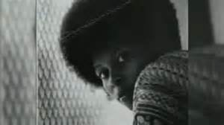
DC Area Memorial Tribute
in Honor of the Life & Legacy of
The Honorable
Chokwe Lumumba
Chokwe Lumumba …
Mayor
City Councilman
People’s Lawyer
Freedom Fighter
Organizer
Family man
Chairman
Minister of Justice
Vice President
Visionary
When: Sat. April 12, 2014
4:00-6:00 pm
Where: UDC David A. Clarke School of Law
4340 Connecticut Ave NW (Cn & Yuma)
Moot Court Room, 5th floor
Sponsored by:
National Conference of Black Lawyers, National Black United Front, National Lawyers Guild UDC Student Chapter,
Jericho Movement, Legacy Empowerment - info - 888-245-4789 f

