Slide 1
Product Concept
Image MultiViewer
December 2012

Slide 2
overview
This product allows various image sources to be merged into a single multiplexed channel.
Maximum four image-channels can be integrated.
Five different output patterns of 1,2,3 and 4-up.
The integrated output channel supports various types of signals.
A still picture in the multiplexed channel can be captured and stored on a USB memory.

Slide 3
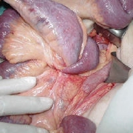
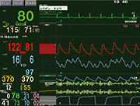
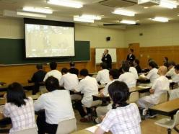
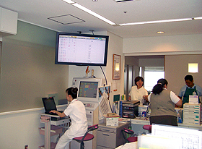
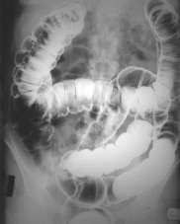
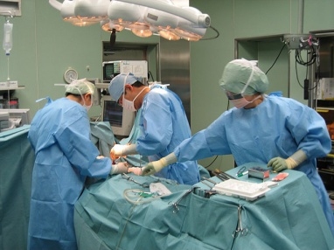
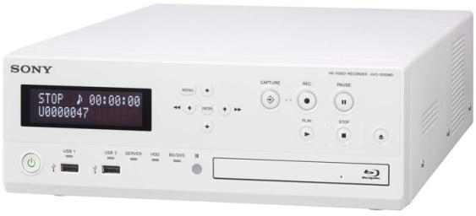
Use cases
Educational use
Information sharing
Conference room / Lecture hall
Nurse station /
Medical staff room
Recording surgery
Image data including some
clinical information

Slide 4
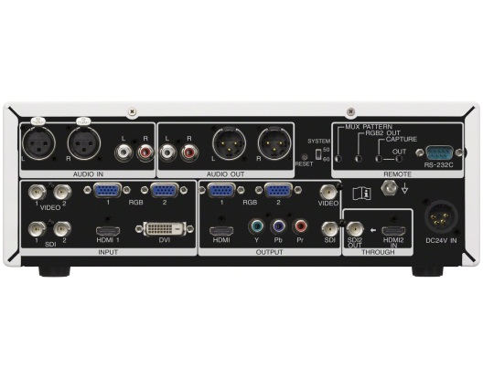
Rear Panel
Choose 2 from each

