Slide 1
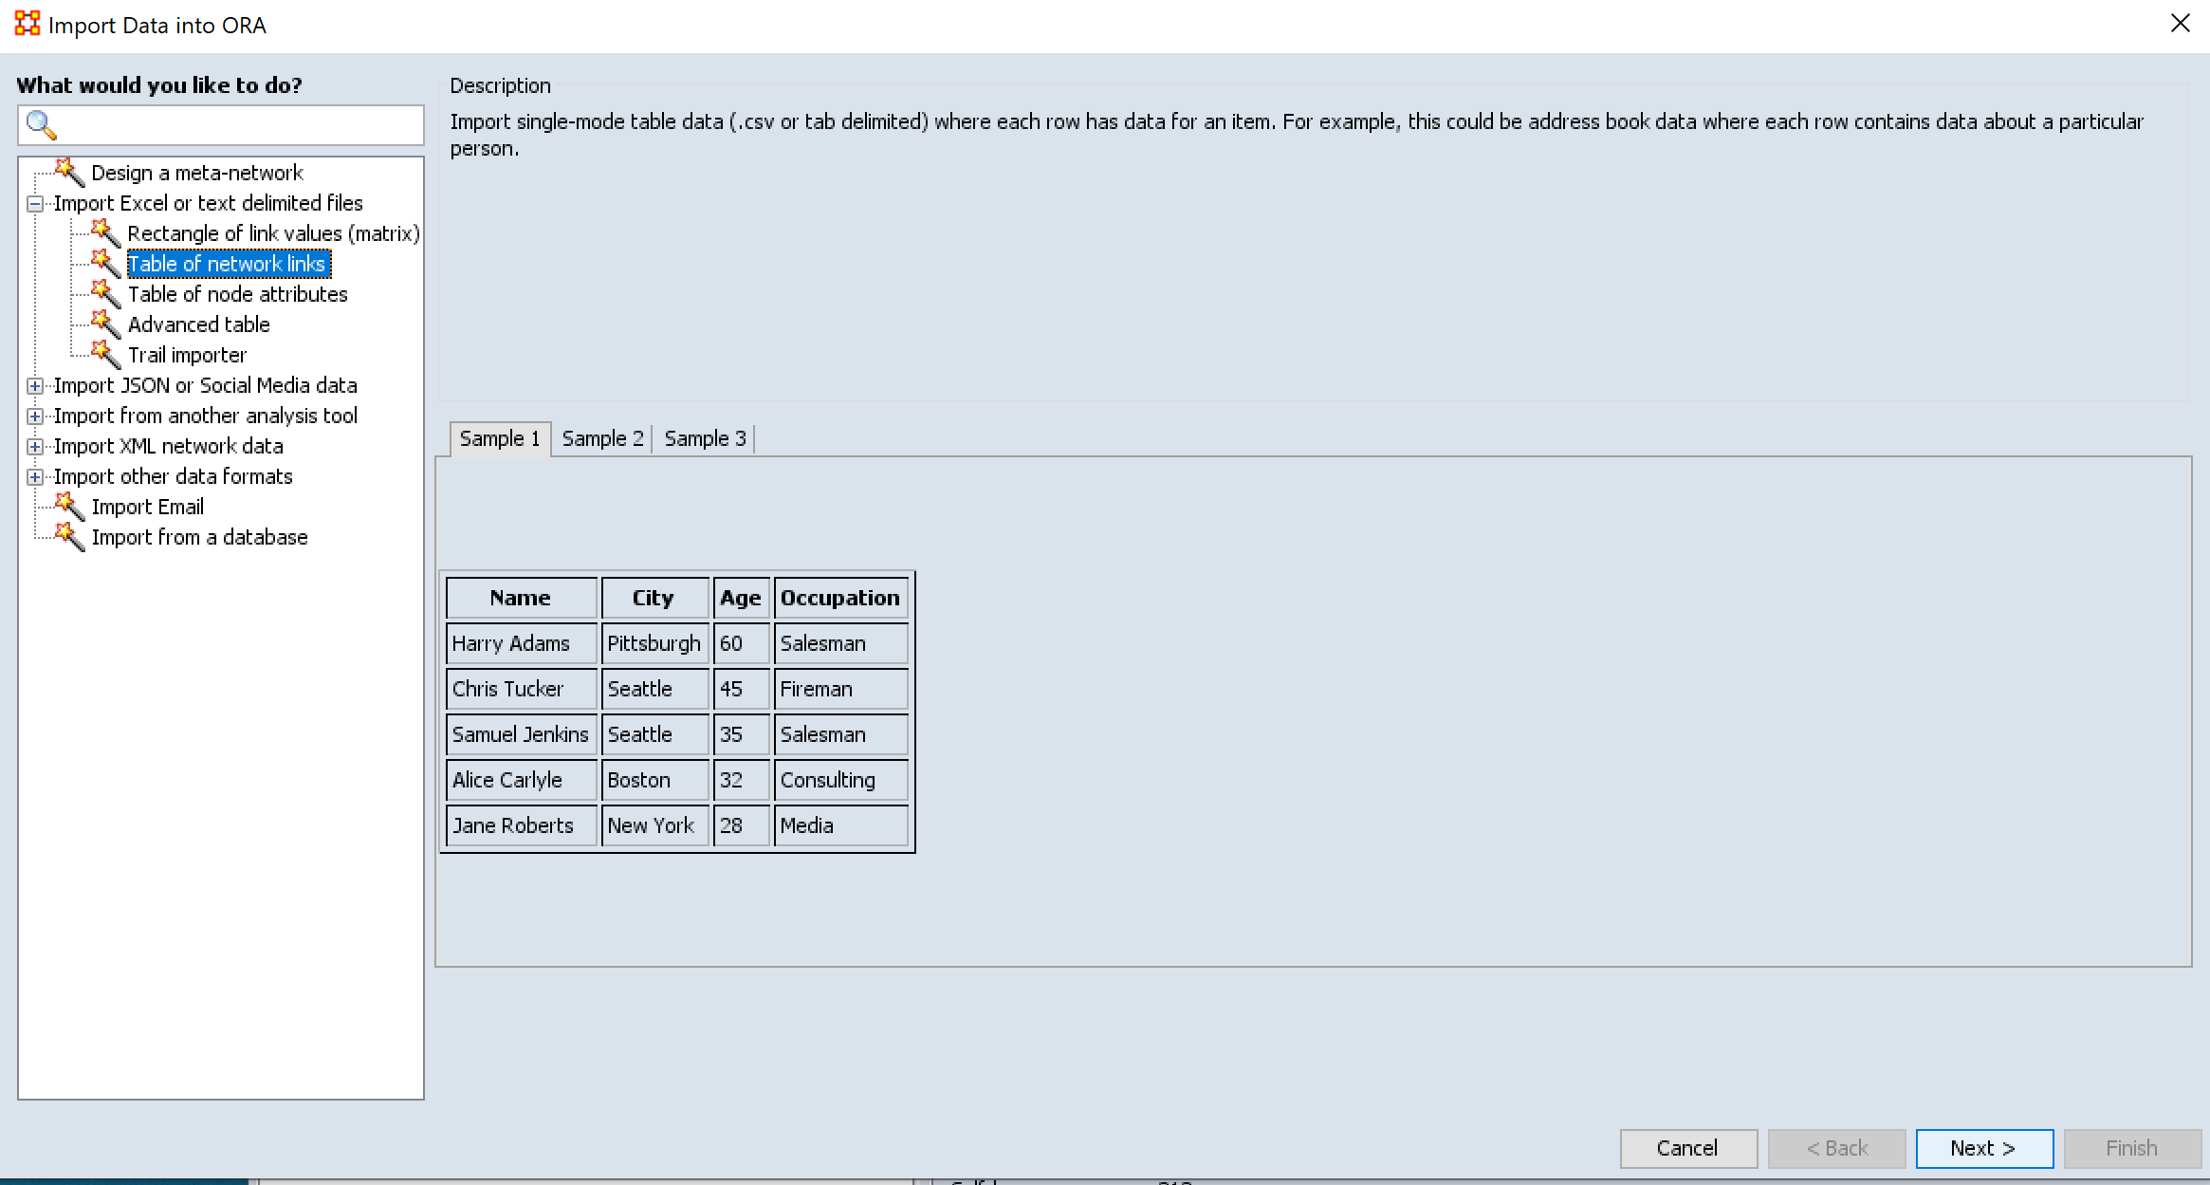

Slide 2
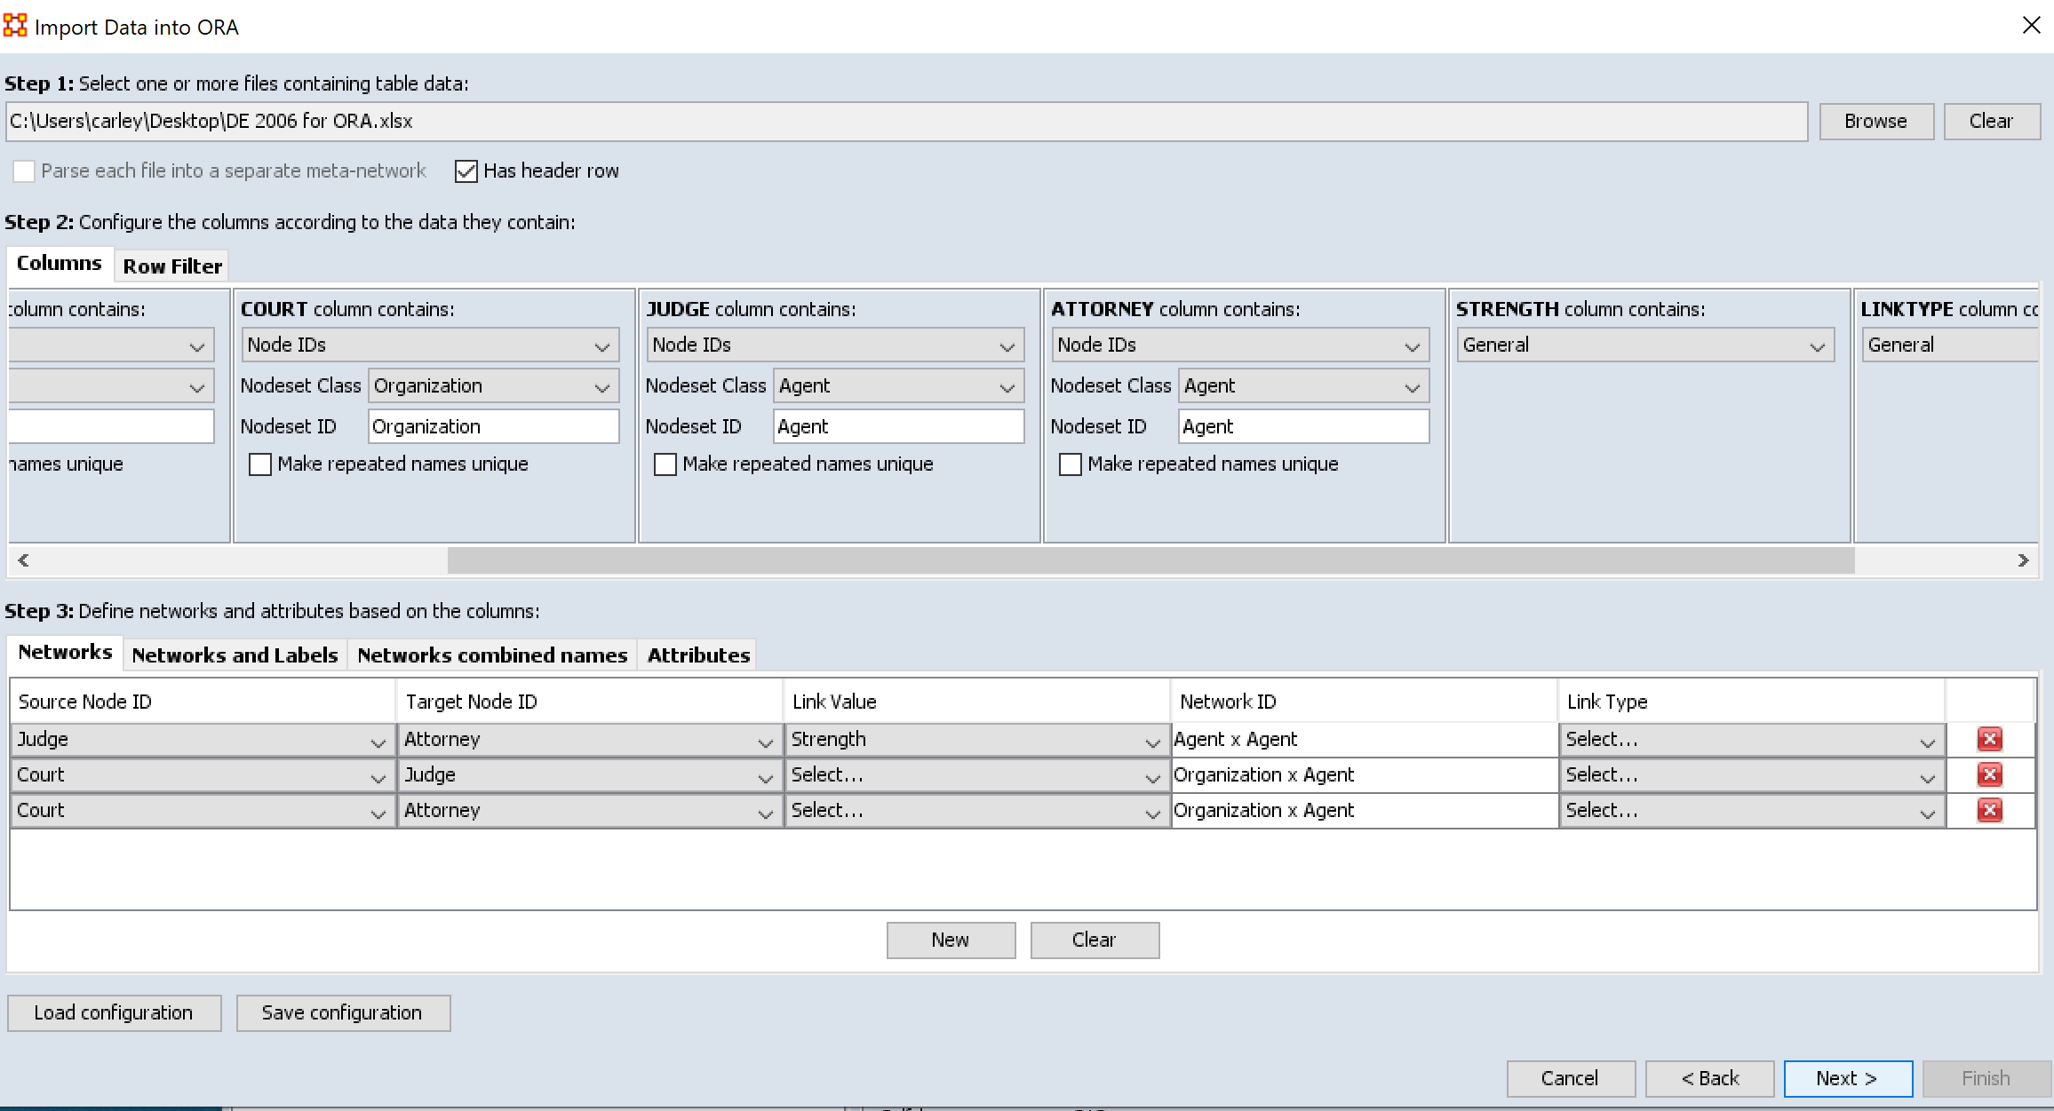
Keep saying new to add each network, note if you do not list a strength it will assume it is 1
When all networks are listed click next

Slide 3
