Slide 1
Imaging AI in Practice
(IAIP) Demonstration
A demonstration of new technologies and standards
at RSNA 2023

Slide 2
Why are we here today?
Review previous RSNA IAIP results
Introduce plans for RSNA IAIP 2023
Start a conversation and collaborative planning process
Continue to drive:
Standards development
Implementation of new technologies
CC
Notes:
-Please hold Q&A until the end - at least 15 minutes for Q&A and interactive discussion

Slide 3
Going strong since 2020
2020: Produced 3+1 Videos
16 vendors, 25 products
Nearly 14k Views
2021 Demo: Live, in-person
22 vendors, 34 products
~ 60 demo runs, hundreds of attendees at RSNA 2021
2022: In-person + Recorded Videos (coming soon)
19 vendors, 30 products
~60 demo runs, even more attendees
Media + VIP tours
MH

Slide 4
IAIP 2022 Vendors
MH

Slide 5
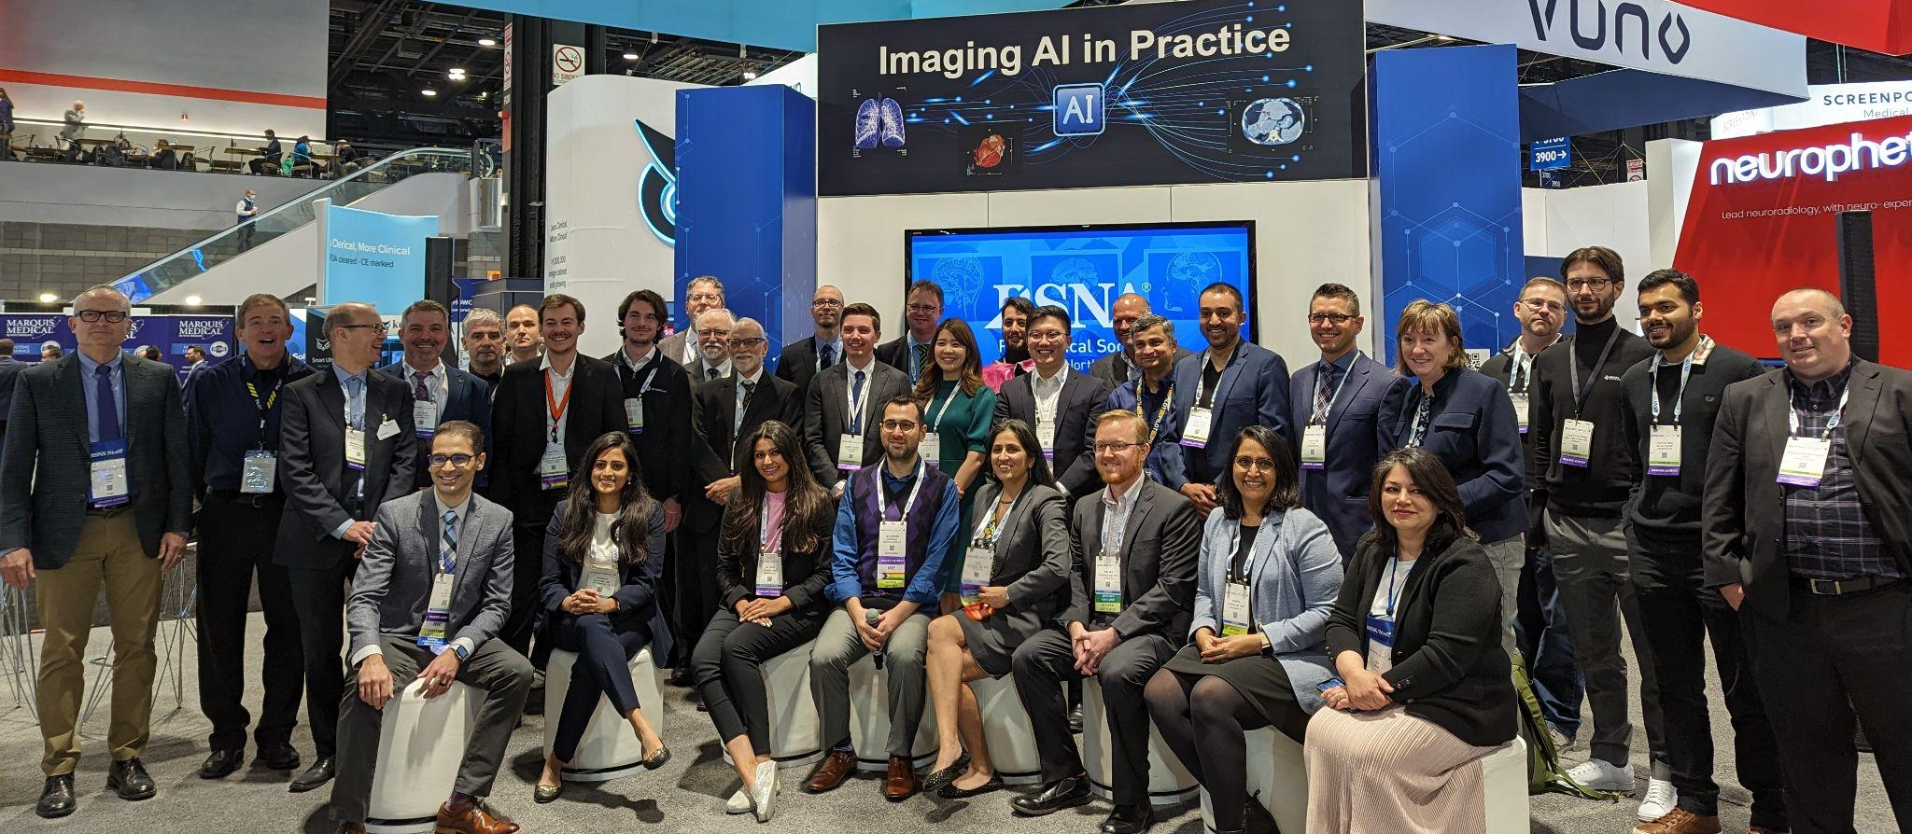
IAIP 2022 Crew

Slide 6
If you are new here…
Why?
Convene industry peers with a shared goal, encourage industry-radiology collaboration
Make interoperability visible and promote the use of standards
Drive awareness and adoption of emerging technologies
Provide a glimpse of the Future of Radiology
How?
We tell a story, taking into account the patient’s clinical journey and the data’s journey through IT systems
Vendors are divided into teams; each team tells a realistic clinical story
Stories involve multiple exams along a timeline based on a clinical scenario
MH

Slide 7
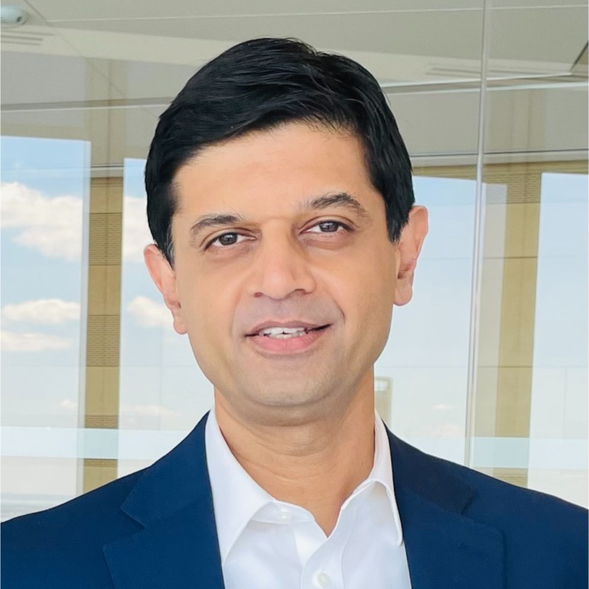
Impact per the radiologists...
“The Imaging AI in Practice (IAIP) videos were a hit! They turned an abstract concept of AI in radiology workflow into something that the any person could grasp. I think Radiologists and Industry leaders alike found these videos educational and enlightening.”
Krishna Juluru, MD
White House Presidential Innovation Fellow Advisor, RADx Tech, National Institute of Biomedical Imaging and Bioengineering
Associate Editor for Informatics, RSNA Radiographics
KA/KM

Slide 8
Participant feedback
Positive experience overall
Excellent feedback from Clinical Champions
Lots of work
Likely to repeat participation
Raise the bar!
CC

Slide 9
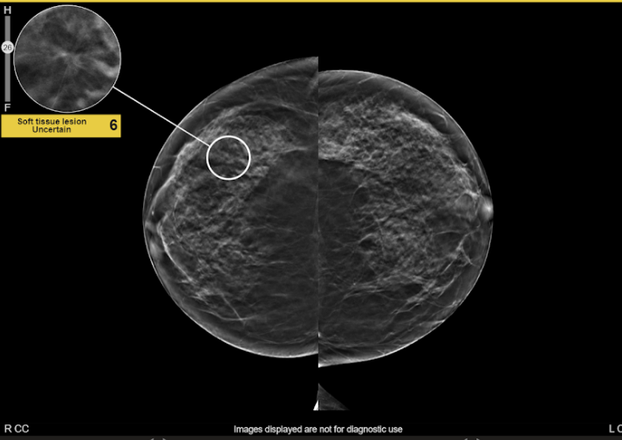
Clinical scenarios
2022 Scenarios:
Prostate Cancer
Mammo to Vehicular Trauma
Stroke Triage w/ incidental findings
Hope to raise the bar in 2023 with new body parts, scan types, modalities, etc.
Systems don’t have to be released for sale nor FDA/CE cleared
MH
Notes:
Build on what we did last year
Reminder: systems don’t have to be released for sale, nor FDA or CE cleared

Slide 10
High level schedule RSNA IAIP 2023
Feb 21 Expression of Interest Kickoff call
Mar 14 Expression of Interest due
Apr 12 Initial team formation announcement
Apr 26 Product Registration form + Signed contract and payment due
May 3 Solidify team formation
May-Aug Product partners work together/ bi-weekly team meetings
Sept 14-15 E2E Testing round 1: In-person at RSNA HQ in Chicago
Oct 10-12 E2E Testing round 2: Virtual via Zoom
October Clean up issues from test sessions/ship systems
Nov 25 Set up and test at McCormick Place
Nov 26-30 RSNA Annual Meeting, McCormick Place, Chicago
MH

Slide 11
Project Management of IAIP 2023
Plan:
3 teams based on product registrations and capabilities
Clinical Champions + clinical scenario right off the bat
Adding new standards and higher conformance expectations for existing ones
Two rounds of testing, first in-person & second virtual
Product partners will work together - Slack + Email
Encourage cloud-first hosting
Out of scope:
RSNA will not provide IT or security support
RSNA will not provide intra-team scheduling
MH
Notes:
New potential standards: IMR, AIR+, FHIRcast, SOLE
Maturing the demo might mean slightly smaller demo

Slide 12
Potential Systems Include
EHR
Radiology Information System (RIS)
Modality
AI Orchestrators
AI Imaging algorithms (detection, classification, etc.)
PACS/VNA
Radiology Reporting System
NLP or other quality (non-imaging) AI algorithms
Consumer Access Portal or App
Other
MH
Notes:
Reminder this is NOT a standalone demo. This demo REQUIRES work to integrate with teammates and demonstrate working workflows.

Slide 13
Potential Interoperability Standards Include
DICOM
DIMSE/DICOMweb
DICOM SR, Segmentation, etc.
IHE
AI Results AIR+
AI Workflow for Imaging (AIW-I)
Interactive Multimedia Reporting (IMR)
SOLE
Scheduled Workflow (SWF.b)
HL7
FHIR v4
FHIRcast STU3
CDS hooks
SMART on FHIR
CDA
HL7 v2
MH

Slide 14
Potential Semantic Standards Include
RSNA Radiology Report Templates
RSNA Common Data Elements (CDEs)
Radiology Lexicon (RadLex)
LOINC
ICD-10
SNOMED
MH

Slide 15
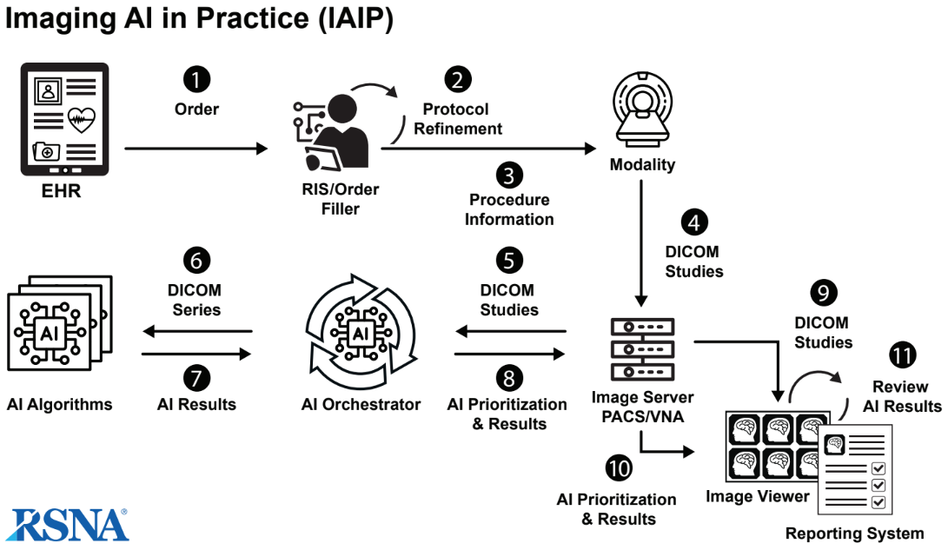
Potential Architectures Include
MH
Notes:
NOT mandating this architecture

Slide 16
Logistics and Requirements for Participation
Expression of Interest form
Agree to roles assigned by demo organizers: sign contract and payment
Fees:
$6,500 per company, includes one product/system
$3,500 for each subsequent product/system
Commit technical resources: Integration Demo = Time + Effort
Now through RSNA 2023
Participate in all teleconferences + virtual testing with teammates
Be present for end-to-end testing September 14-15 at RSNA HQ
Show set up before RSNA opens
MH
Notes:
-roles assigned may be an iterative process, but still assigned by demo organizers

Slide 17
Next step:
Complete Expression of Interest Form (by March 14)
https://forms.gle/ZbNSCNcXNvuprryZ7
CC

Slide 18
Questions and Discussion
CC

