Slide 1
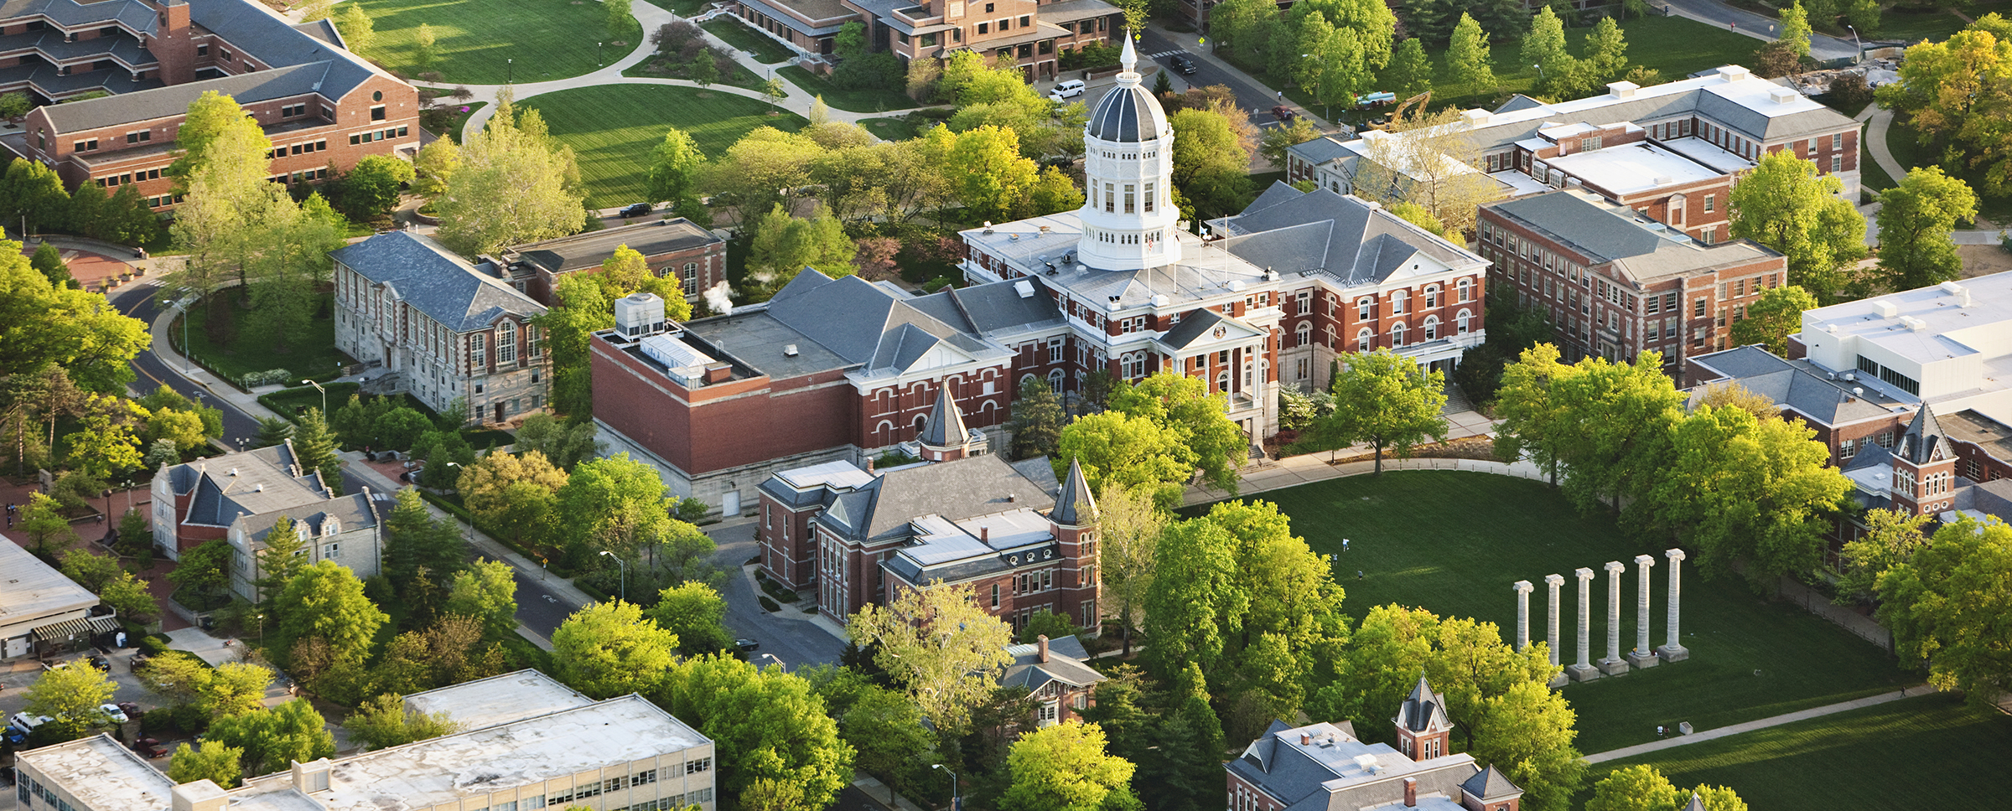
University of Missouri—School Psychology
Tenure-track Faculty Position in School Psychology
Open Rank
School Psychology at the University of Missouri (Job ID 38274)
https://education.missouri.edu/educational-school-counseling-psychology/degrees-programs/school-psychology/
The University of Missouri (MU) School Psychology program is searching for an individual to fill a tenure-track faculty position who shares the College’s commitment to quality research, excellent teaching, exceptional service to students and the profession, and to continuous quality improvement in an environment of civility and respect.
The APA-accredited school psychology training program emphasizes a scientist practitioner model of training with a focus on prevention and training the next generation of leaders in the field. We offer both the Ed.S. and Ph.D. terminal degree options. Our doctoral student population is highly diverse with 58% identifying as racial ethnic minority or international individuals. The program is affiliated with the Missouri Prevention Science Institute, the National Center for Rural School Mental Health, the Boone County Schools Mental Health Coalition, and the Family Access Center of Excellence. The successful candidate will join a vibrant team of six core faculty.
The successful candidate will have a strong research agenda with a clear academic, behavioral, or mental health focus that compliments the existing research agendas of the current faculty and that aligns with our strategic priorities to increase research and educational capacity within the program.
Salary: Competitive and commensurate with experiences and qualifications.
Appointment: Tenure-track, 9-month appointment beginning September 1, 2022
Closing Date: Review of applications will begin November 1, 2021, and continue until the position is filled.
To Apply: Apply on-line at https://hrs.missouri.edu/find-a-job/academic (Job ID 38274): Upload (a) a letter of application in which candidates describe in detail their qualifications for the position, (b) evidence of scholarly quality and productivity, (c) evidence of teaching effectiveness (course syllabi, student evaluations, chair/advisor/peer reviews) (d) evidence of experiences in generating external funding, (e) diversity statement that describes experience with and commitment to diversity (250 words), and (f) names and contact information for three reference in the Attachments section of the application. Your CV must be uploaded in the Resume/CV and Cover Letter section.
Please contact Dr. Wendy Reinke, Search Committee Chair, at ReinkeW@missouri.edu for questions about the position.
The University of Missouri is an equal opportunity/access/affirmative action/pro-disabled and veteran employer. https://missouri.edu/statements/eeo-aa.php

