Slide 1
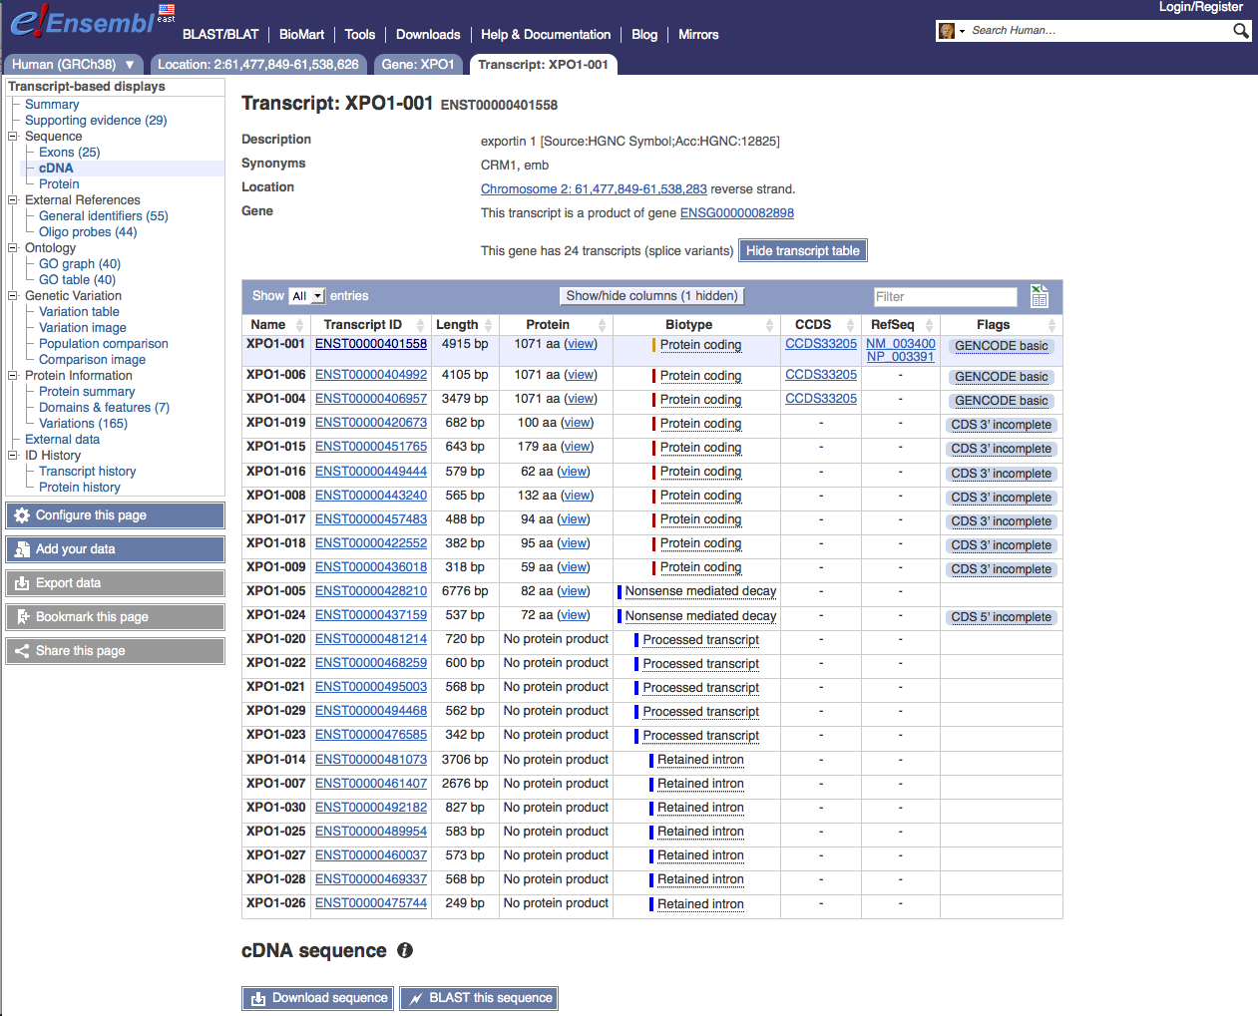
The transcript we were interrogating

Slide 2
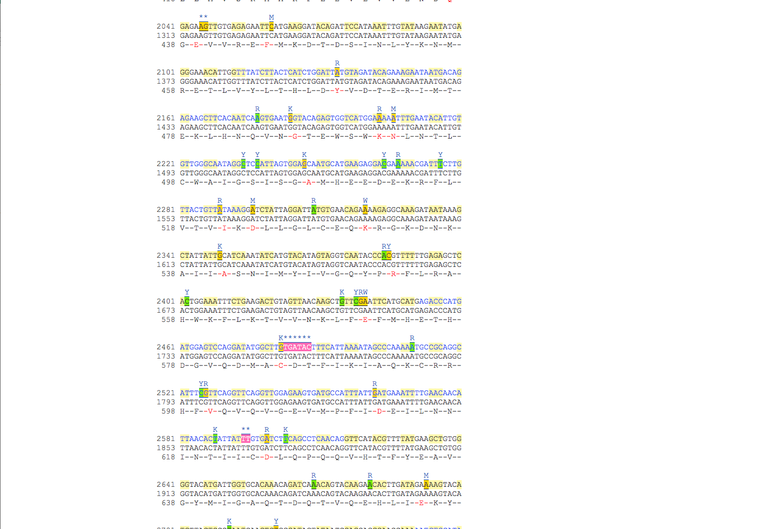
c.1711G>A p.E571K is at codon GAA

Slide 3
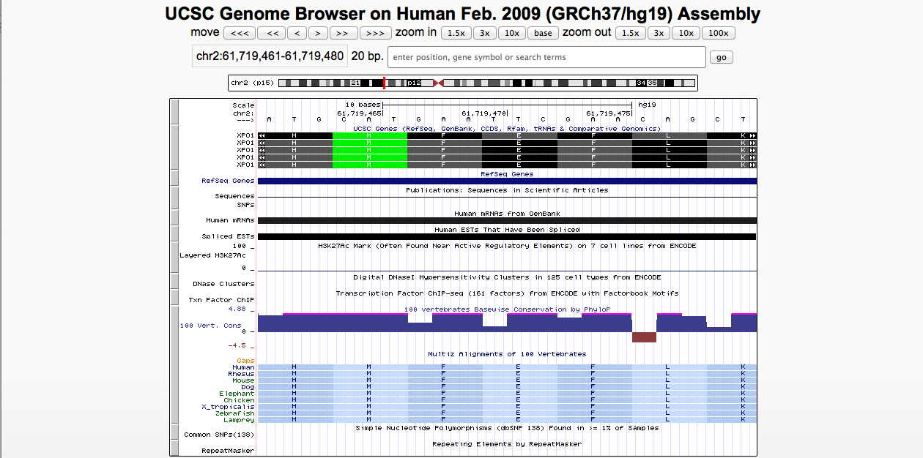
Discrepancy in the alignment of amino acids. Here GAA codes for phenylalanine rather than glutamic acid, but in fact GAA should code for glutamic acid.

