Slide 1
Good afternoon
Where guiding history comes alive!
Notes:
Giff to annotate to show us coming alive… this is one of our key objectives, to get our collection out there.

Slide 2
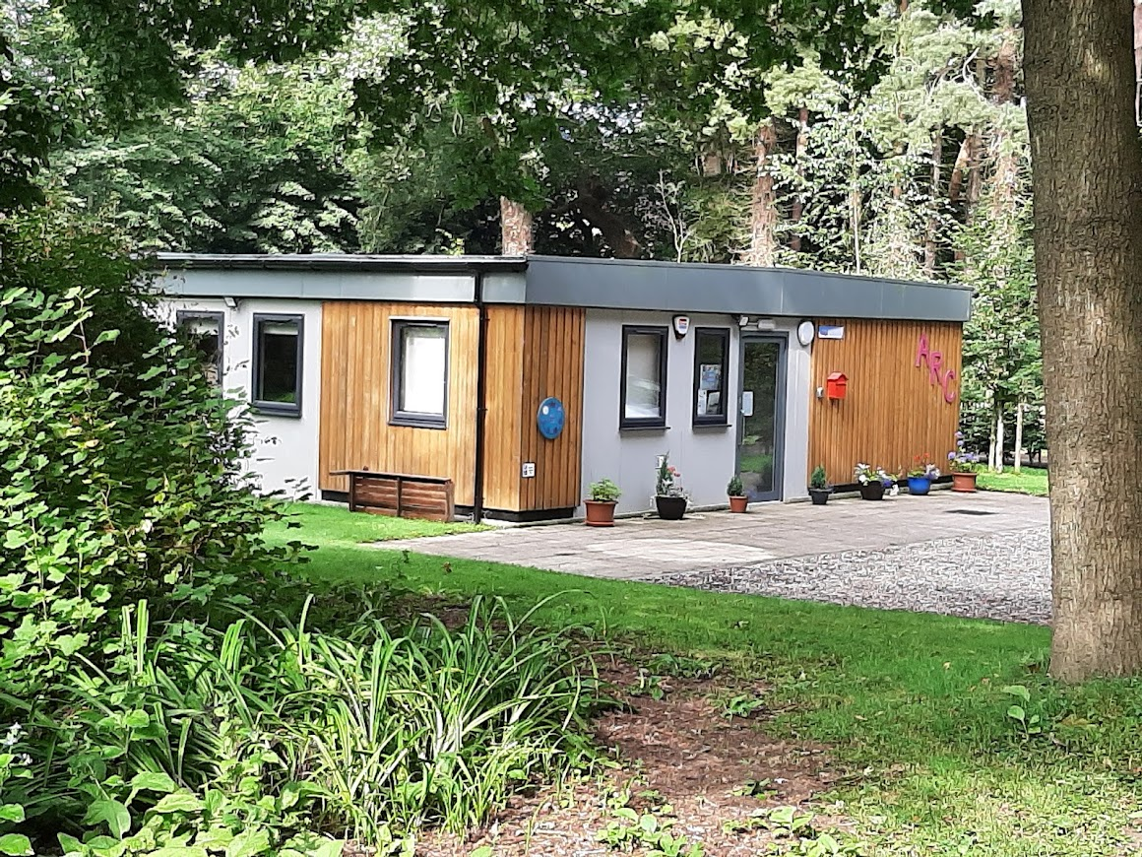
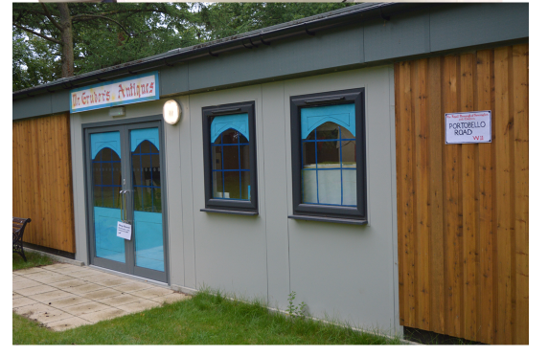
Notes:
This is us… 6 years old this week. Adapted to visiting Brownie unit! In Coltishall

Slide 3
The Community Archives: Skills, Support & Sustainability Project –
Our achievements and learning
Girlguiding Norfolk has been delighted to have been part of this project and being on the Board has been a good learning opportunity for Helen too.
Notes:
We had the opportunity to be trained and go to sessions virtually; not the same as hands-on, absolutely, but the offer was still there. This was of big benefit to our young volunteers in particular. Those who had just arrived at uni, hadn’t made friends yet. Gave them a purpose, met as a small group every week – five – and achieved virtual and digital projects for us. Gained experience. Were there when we opened for part-business again. More people received training than would have otherwise. Regular Monday volunteers, students and Girlguiding Anglia group via Zoom…

Slide 4
That all the resources
are still available is
excellent, thank you.

Slide 5
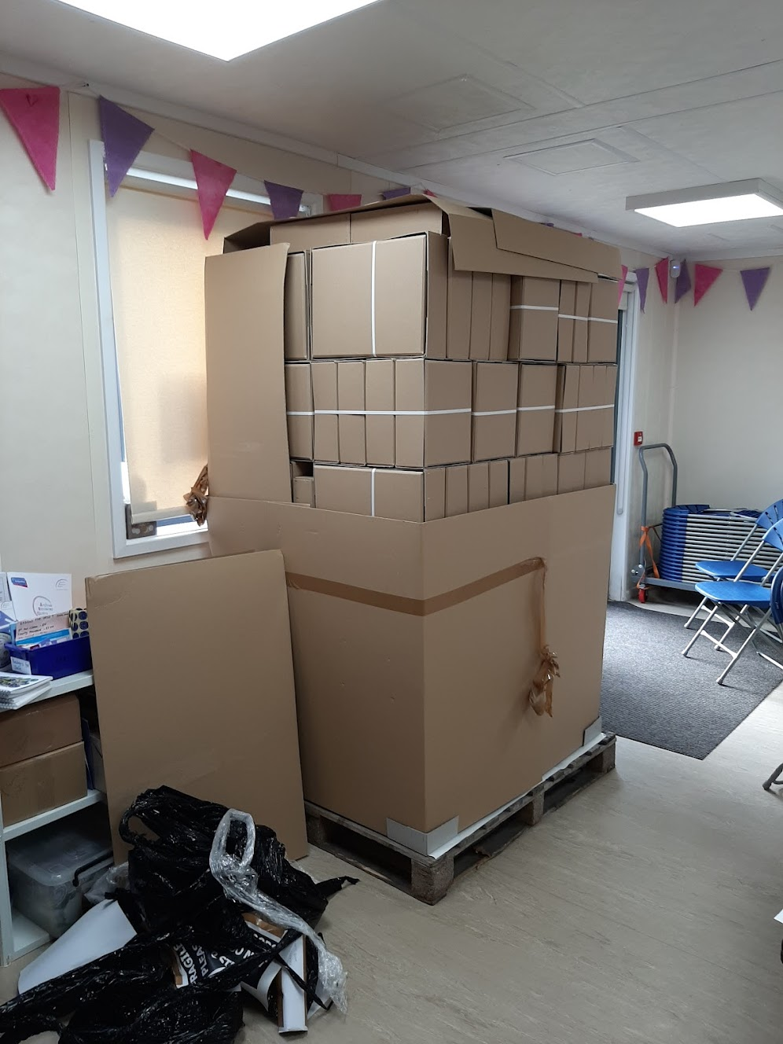
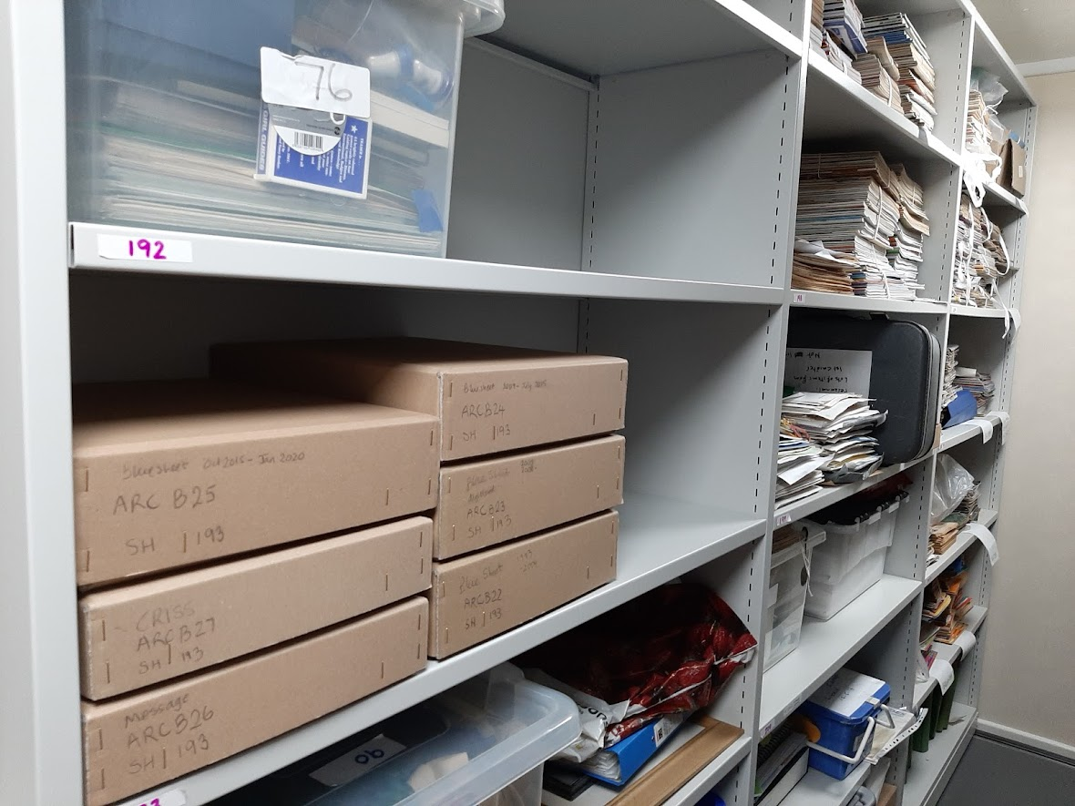
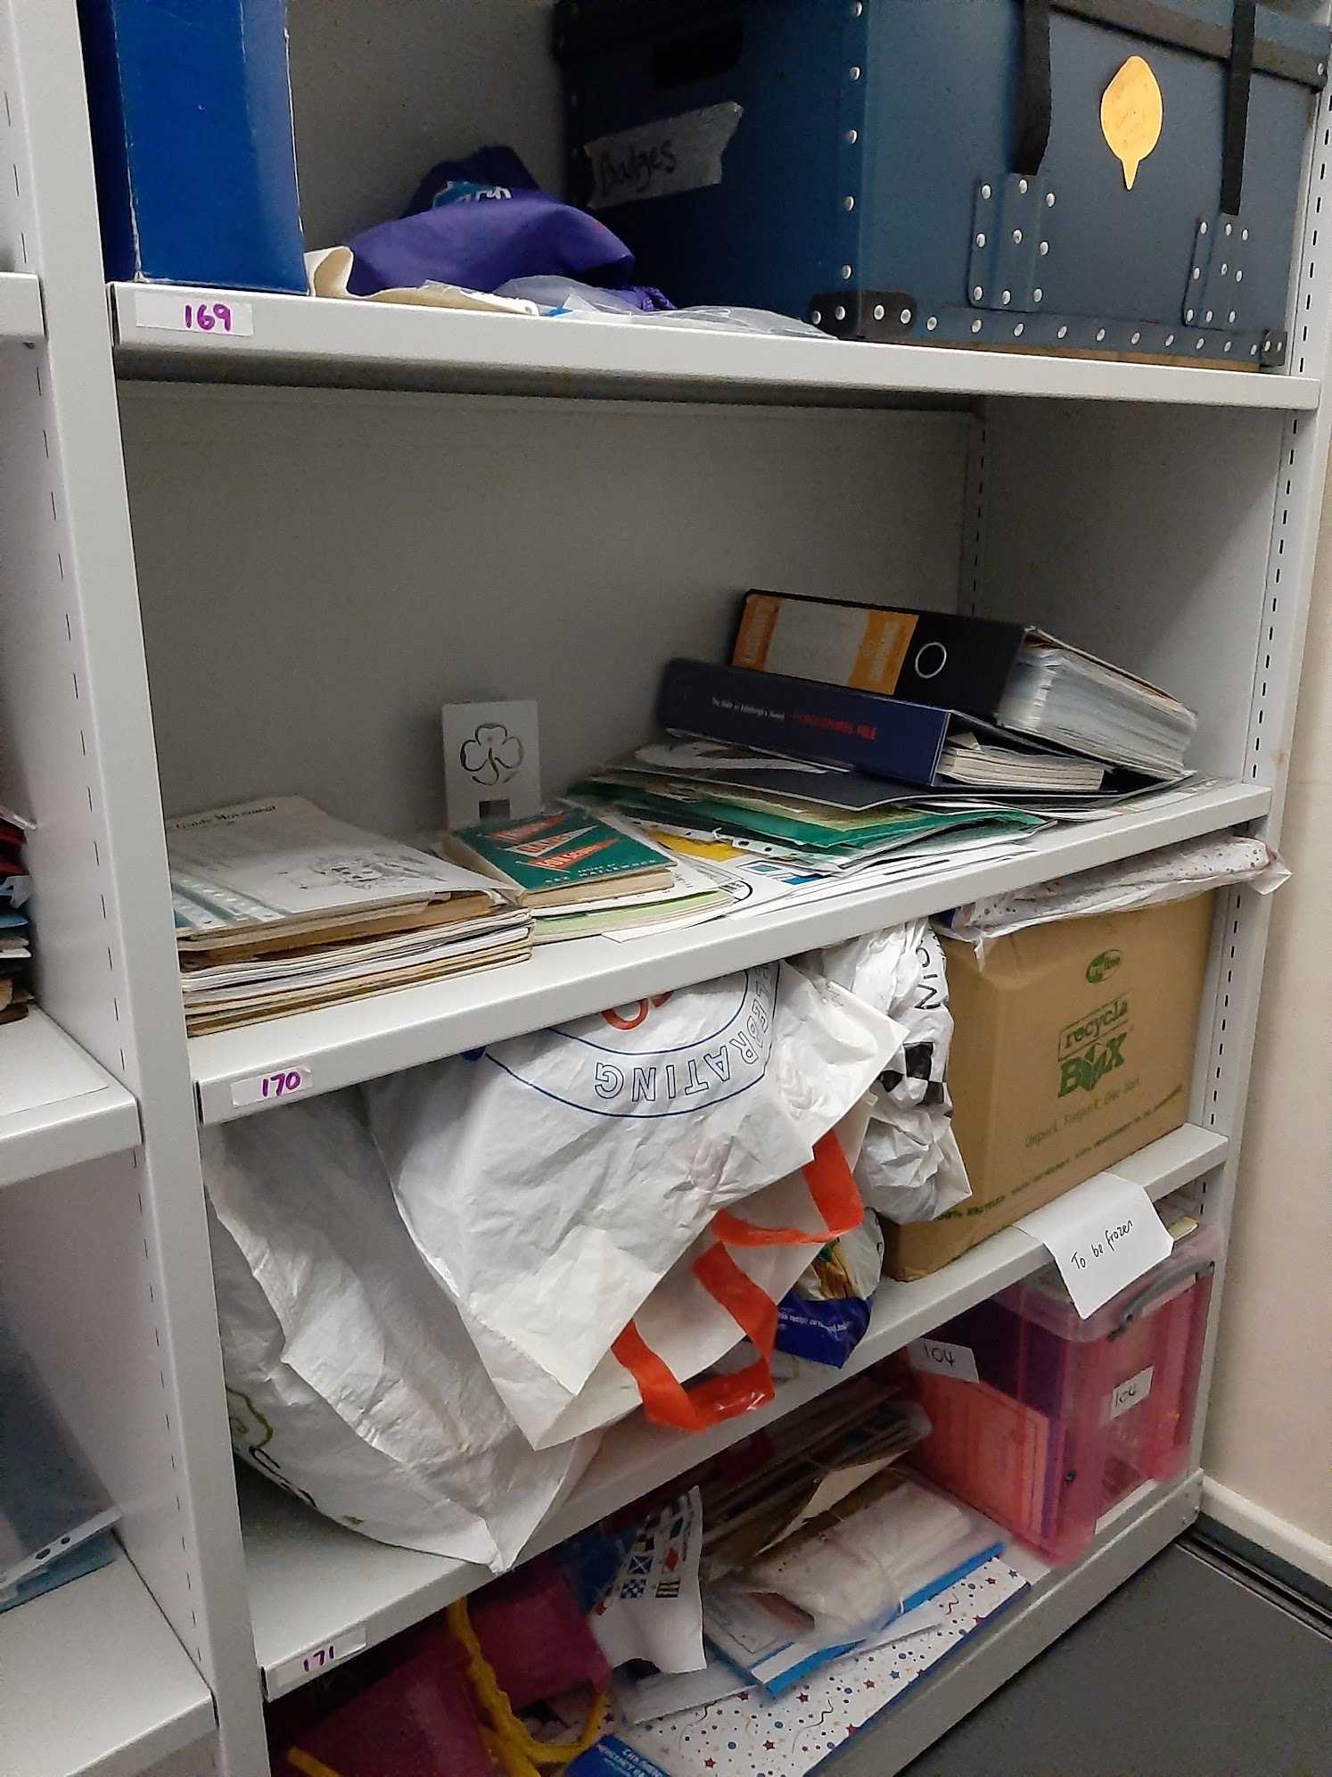
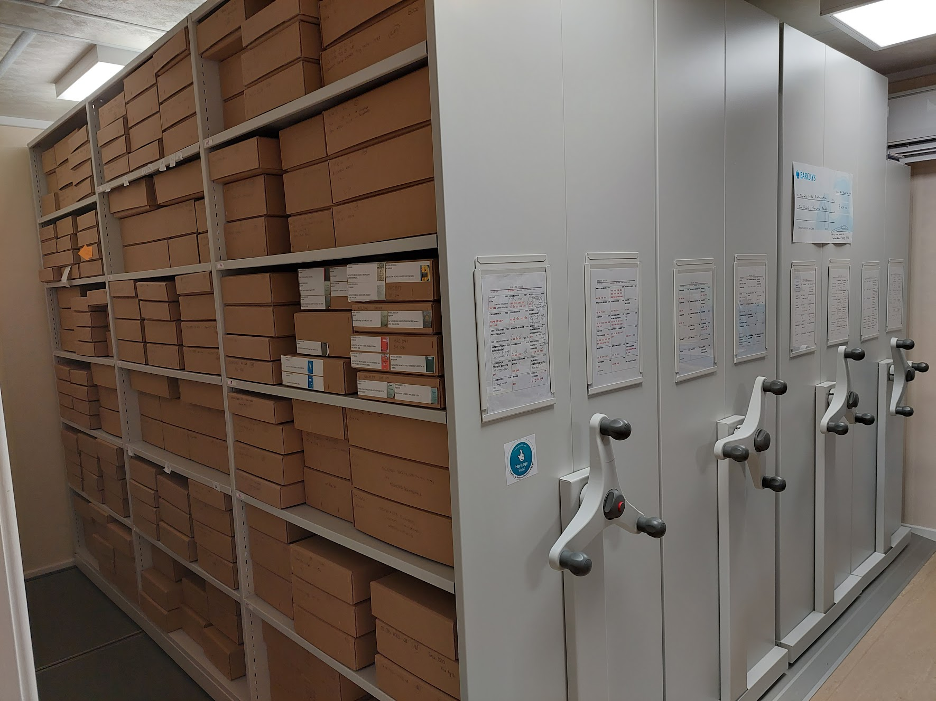
Before
After
Notes:
Stuff from Big Box into boxes in a room… in last two years have moved from being on shelves, to in some boxes, then into pallets full of boxes…. Labelling and entering everything on Modes are next steps.
One lesson – everything takes longer than you hope/expect! Takes time to do properly. Had to adjust order of doing things to get NLH funding spent on time, due to pandemic restrictions. Achieved ok though

Slide 6
Lockdown was / could be turned into something really positive and an opportunity to be creative.
Notes:
We had the opportunity to be trained and go to sessions virtually; not the same as hands-on, absolutely, but the offer was still there. This was of big benefit to our young volunteers in particular. Those who had just arrived at uni, hadn’t made friends yet. Gave them a purpose, met as a small group every week – five – and achieved virtual and digital projects for us. Gained experience. Were there when we opened for part-business again. More people received training than would have otherwise. Regular Monday volunteers, students and Girlguiding Anglia group via Zoom…

Slide 7
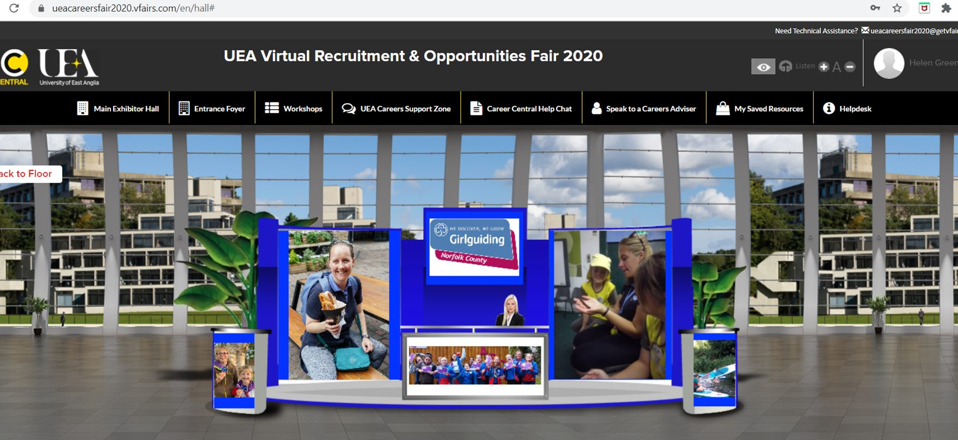
Notes:
Found these girls through volunteer fair

Slide 8
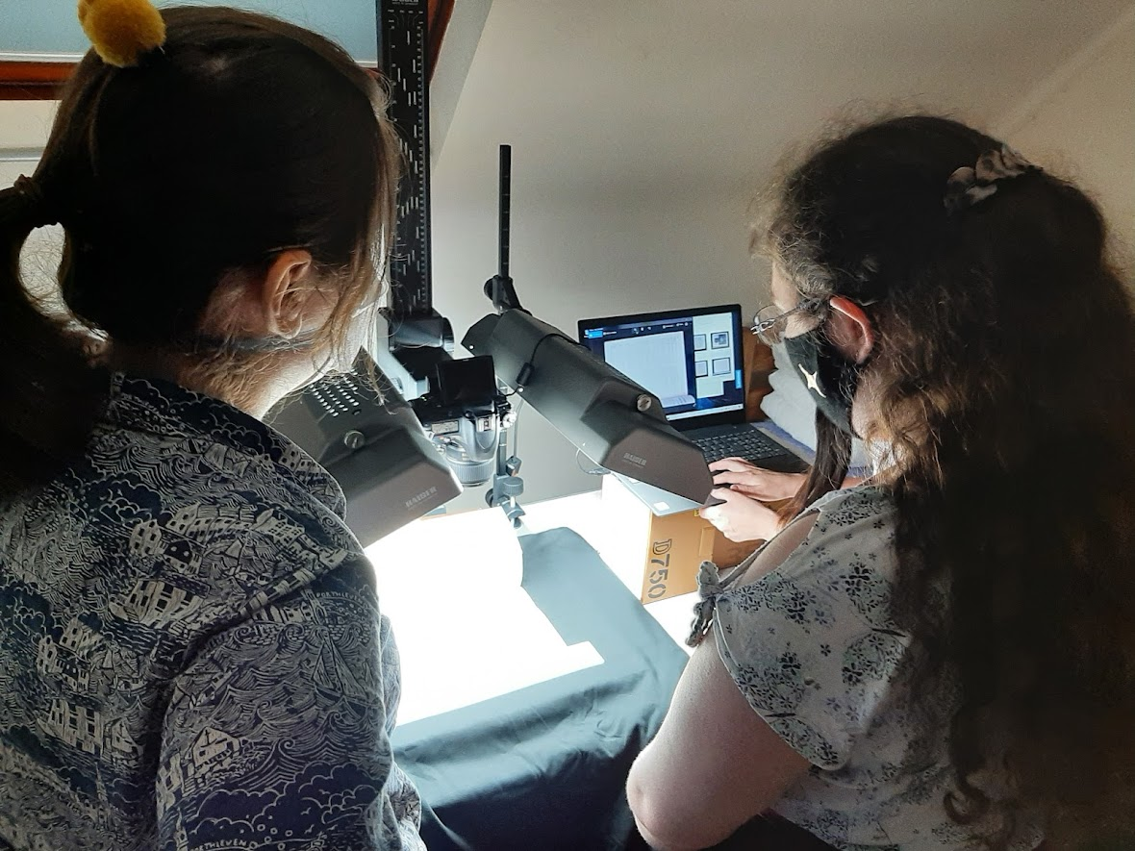
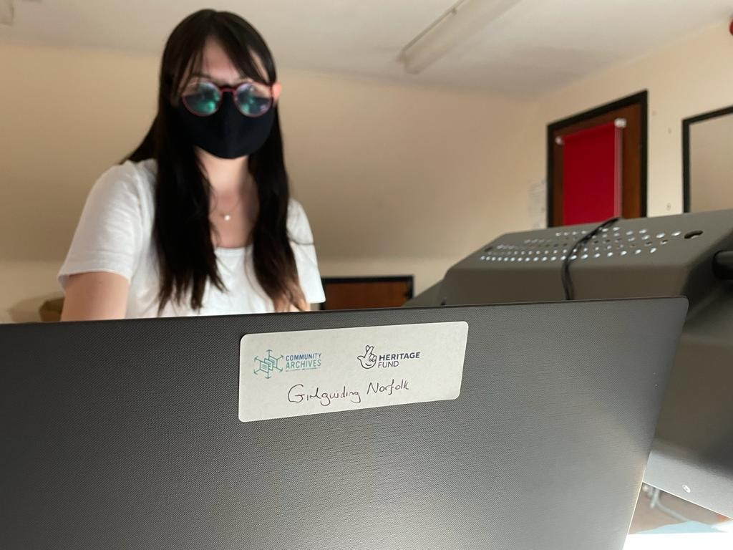
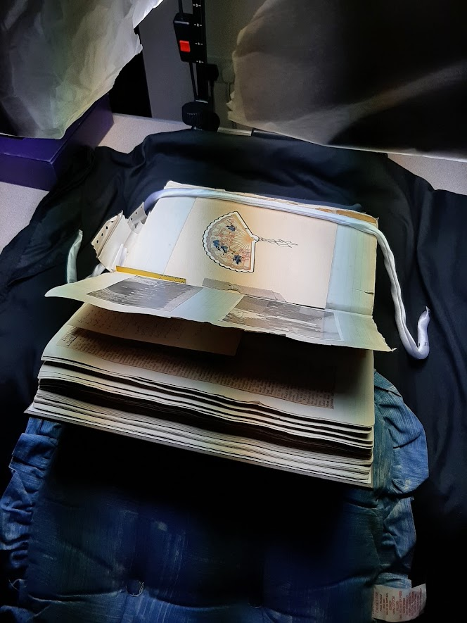
Notes:
Took place in CAS3 training. Learnt about teamwork, having a pilot run and checking as you go.

Slide 9
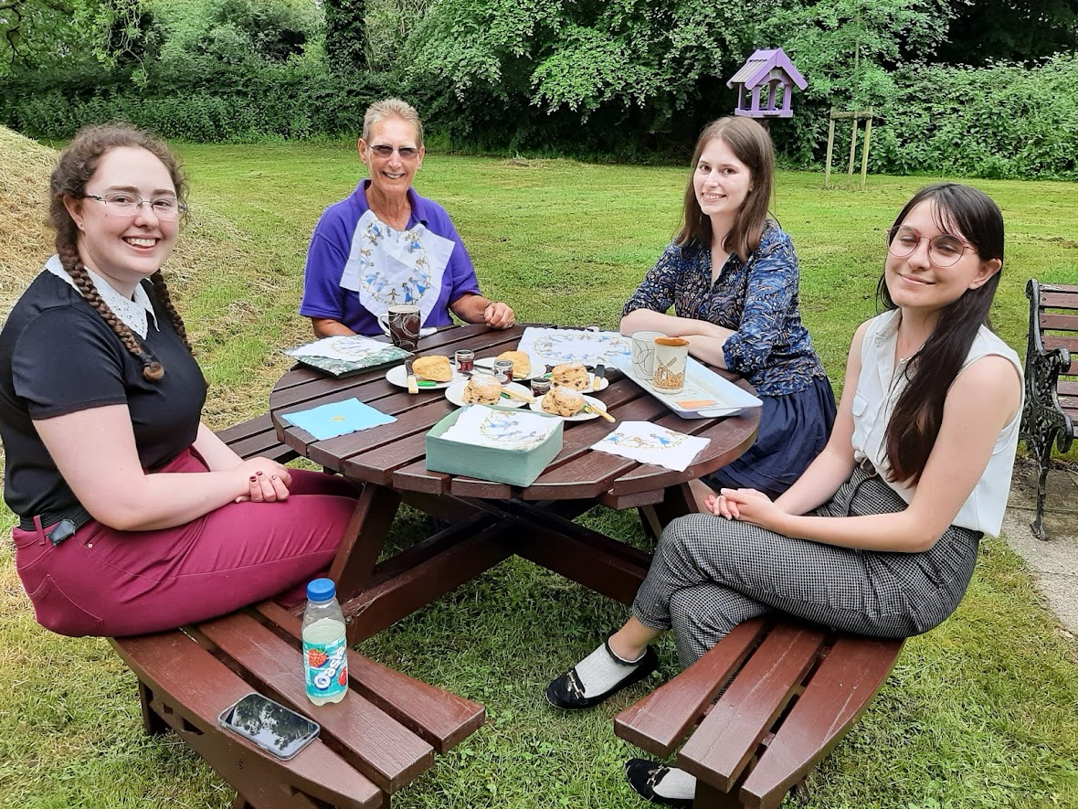
Notes:
We had interns for three weeks and they supported digitising. They helped to created the process, recorded it carefully…
We gave hands-on opportunity, experiences – two of these young people have jobs in the sector, other doing her masters at UCL.
Well-deserved cream tea!

Slide 10
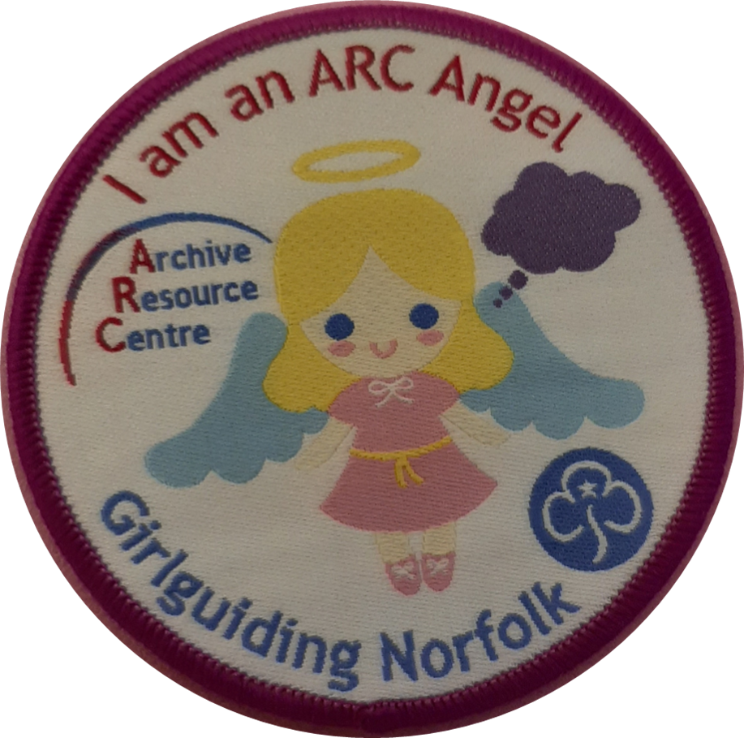
Notes:
Our group of ARC Angels grew in size!

Slide 11
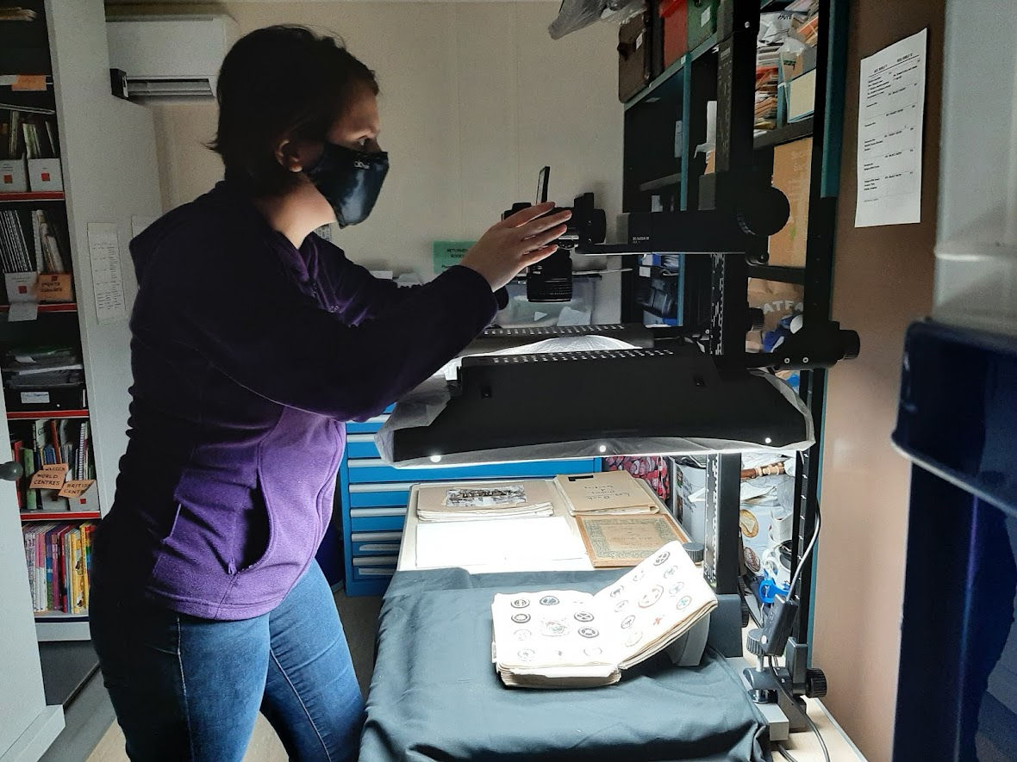
Notes:
We realised it is something young people enjoy doing…. They are happy to do it, adds a skill to cv…. Our older volunteers not so keen!
Have advertised for some more volunteers through Leicester uni website but no response as yet.
It is possible to persuade people they can reach far out places in Norfolk on public transport! We have to be flexible! We offer to pay travel expenses for volunteers; UEA work placement module students were able to get funding from UEA for travel.

Slide 12
Making our collection accessible… key to what we are doing. Have done it during lockdown and since via accessing via Google drive.
geocaching
QR code trail for mosaics
Notes:
Another way to get our collection out there…

Slide 13
Accessing primary sources
From one of our
Sandringham Logbooks
which were both
digitised during the project.
To use in displays, and for papers which are becoming fragile. Also as sources for activities we organise.

Slide 14
Interviewing project
Share My Story (SMS)
Has been a challenge previously… but tried out a pilot, trained people based on CAS3 training, found a theme people were happy to talk about, sorted the paperwork, offered a badge and it worked!
Downside – recording possibly not up to ‘excellent’ standard, but we do have something. It is on Zoom, plus we also have videos.
Notes:
We had the opportunity to be trained and go to sessions virtually; not the same as hands-on, absolutely, but the offer was still there. This was of big benefit to our young volunteers in particular. Those who had just arrived at uni, hadn’t made friends yet. Gave them a purpose, met as a small group every week – five – and achieved virtual and digital projects for us. Gained experience. Were there when we opened for part-business again. More people received training than would have otherwise. Regular Monday volunteers, students and Girlguiding Anglia group via Zoom…

Slide 15
Moving on…. What would be the next project…. The opportunities are out there.
We need to continue to be proactive, and it is easier now as so much is online.
Went to National Archives session – thank you for introducing us to them and to other agencies! They talked about Testbed funding
We are gaining in confidence in applying for funding, learning the buzz words!
Notes:
We had the opportunity to be trained and go to sessions virtually; not the same as hands-on, absolutely, but the offer was still there. This was of big benefit to our young volunteers in particular. Those who had just arrived at uni, hadn’t made friends yet. Gave them a purpose, met as a small group every week – five – and achieved virtual and digital projects for us. Gained experience. Were there when we opened for part-business again. More people received training than would have otherwise. Regular Monday volunteers, students and Girlguiding Anglia group via Zoom…

Slide 16
Fab opportunity!
Did you know Princess Elizabeth was a Girl Guide?
Girl Guide, Ranger and Patron
Notes:
Timing was perfect…

Slide 17
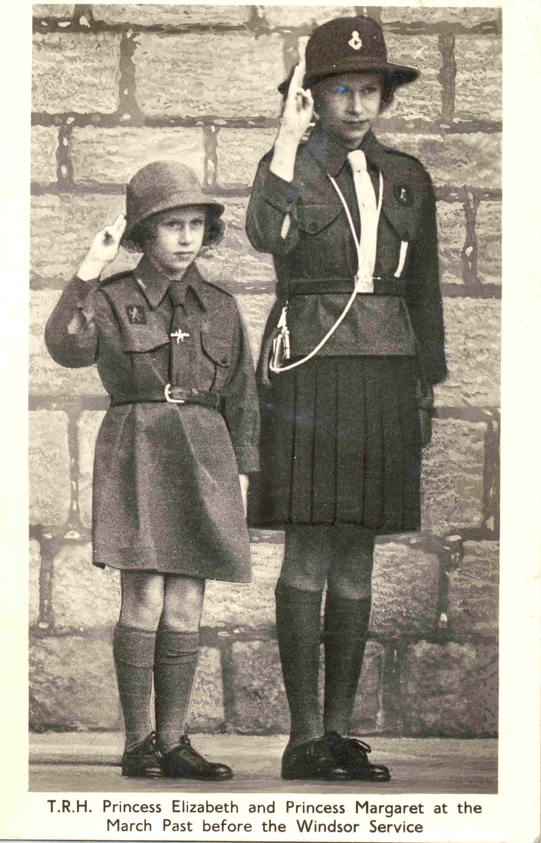
Notes:
We have learnt a lot about copyright too

Slide 18
Applied to The National Archives Testbed Fund – Themed Round -
The Queen’s Platinum Jubilee
Notes:
The Archive Testbed funding scheme provides grants of up to £5,000 (and up to £10,000 in specified rounds) for archives who would like to test, explore, or evolve a new idea that has the potential to lead to positive change or improvement to the way we keep, preserve, promote and enable access to archives. The purpose of the fund is to encourage services to trial new approaches, provide them with room to experiment even if the initiative might ultimately fail, and enable the results and learning outcomes of our support to be shared with the wider archive sector.

Slide 19
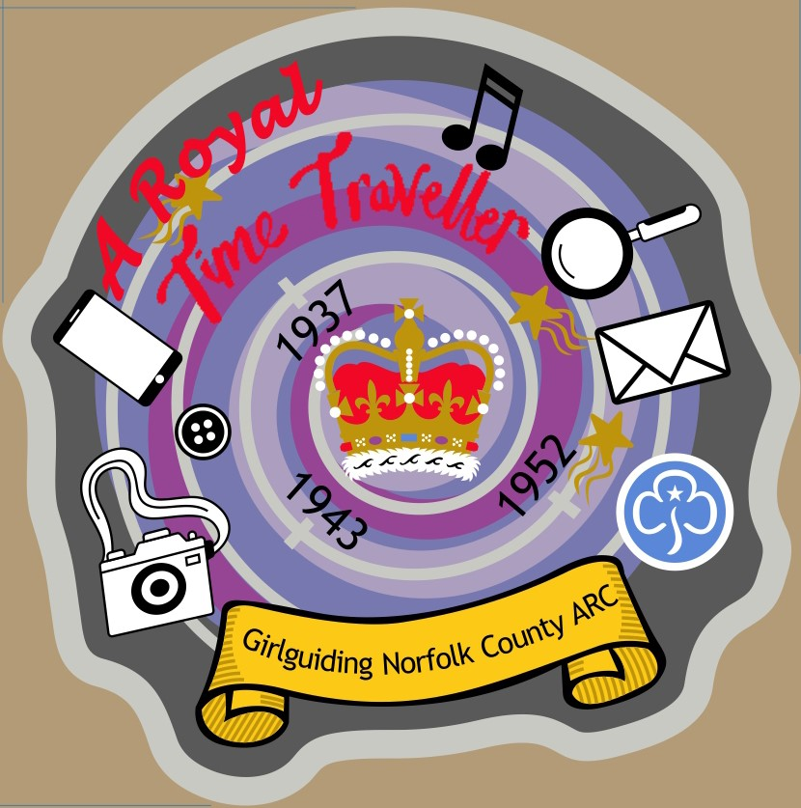
Royal time travelling display
including display, and accompanying album, badge, activities, and quizzes to make interactive.
Notes:
The Archive Testbed funding scheme provides grants of up to £5,000 (and up to £10,000 in specified rounds) for archives who would like to test, explore, or evolve a new idea that has the potential to lead to positive change or improvement to the way we keep, preserve, promote and enable access to archives. The purpose of the fund is to encourage services to trial new approaches, provide them with room to experiment even if the initiative might ultimately fail, and enable the results and learning outcomes of our support to be shared with the wider archive sector.
Refer to come of these things we have here…

Slide 20
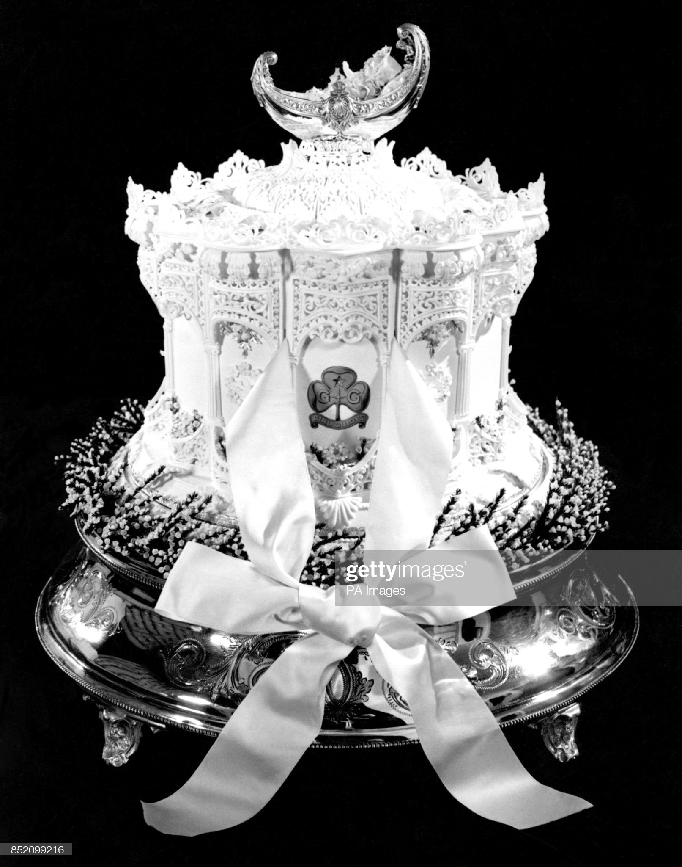
Notes:
Get Sandringham logbook out there…. Girl Guides of Australia sent ingredients for the cake… (still on rationing in this country). Guide badge on the top cake layer which looked like a crown.
Therefore was also Prince Charles’s christening cake

Slide 21
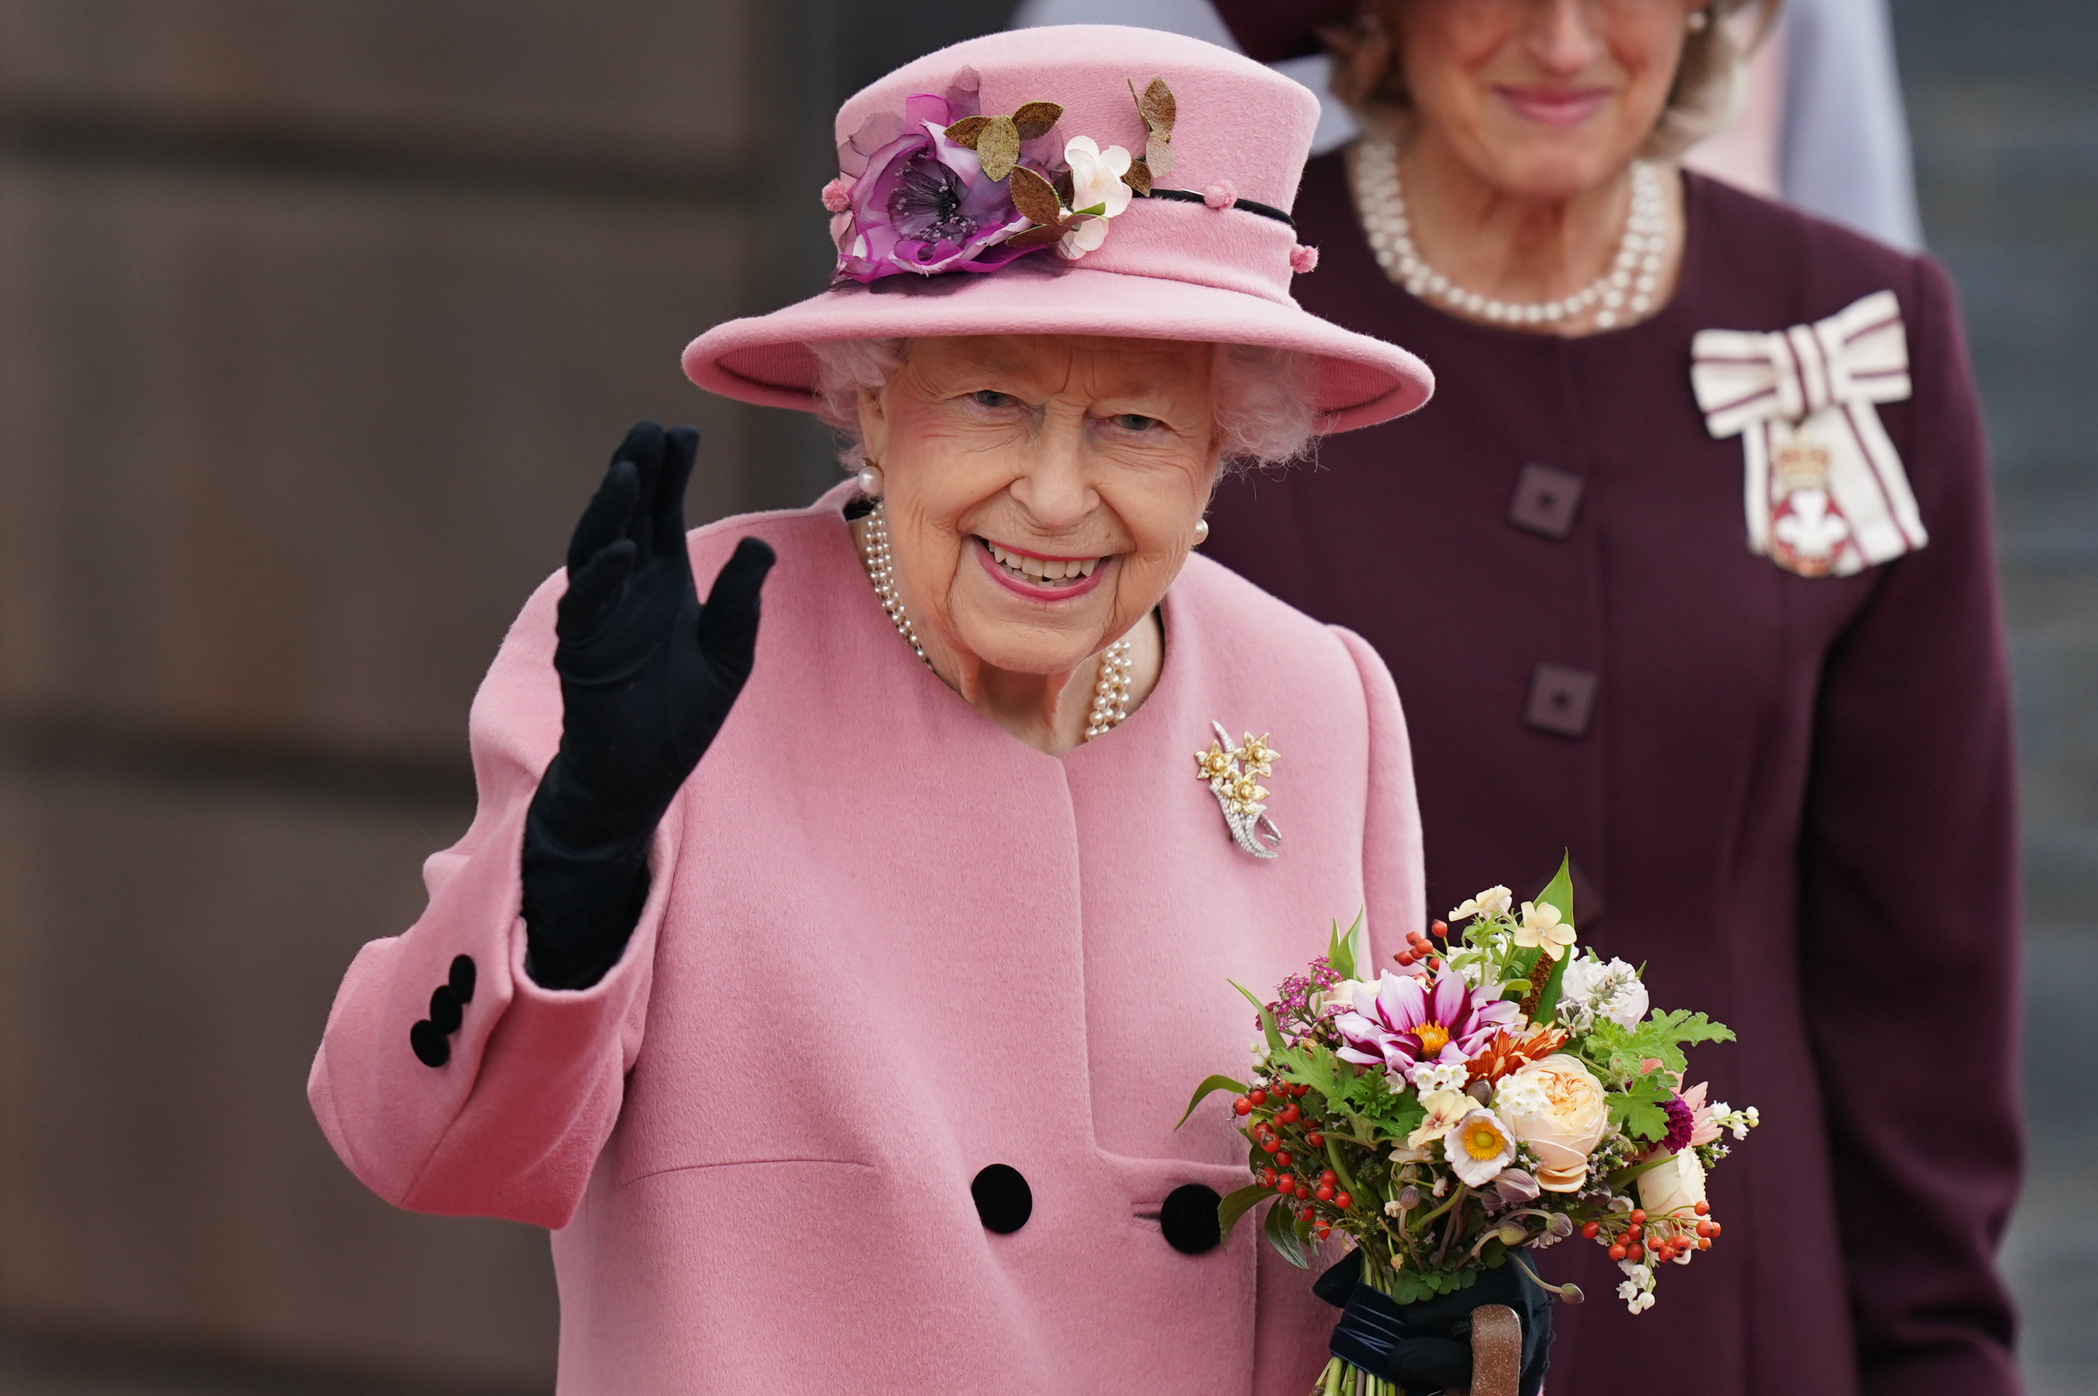
Notes:
So proud to be associated with the Queen, and what an amazing excuse! We have so enjoyed it….. From postbox toppers to lighting fires, all in honour of Her Majesty… once a guide, always a guide.
What a brilliant family to belong too…. And we appreciate that belonging to a larger organisation has helped us get to where we are. Aiming to achieve Museum Accrediation, and also Archive Accrediation.

Slide 23
Thank you very much to

Slide 24
Come and see us….
Community Archives project team will be running an
‘Archives Surgery’ afternoon at the
Girlguiding Norfolk Archive Resource Centre at Coltishall,
from 12:00 to 17:00 on 22nd June 2022.
And any other times or check our royal display dates… or Mondays or by arrangement.
Notes:
Contact details next slide.

