Slide 1
Structured Product CDM Modelling – AGENDA
Purpose :
deliver proposals to ISDA Architecture Committee (“ARC”), how to represent Structured Products in CDM
Methodological Deliverables x 5 :
definition of a Structured Product, as compared to an Exotic Product
framework “how to assess” whether to refactor or to create CDM objects, as compared to modelling with current CDM objects
method “how to model” the features of Structured Products, notably the payout formula, thus resolving the question “how to represent algebric characters in CDM ?” – preliminary requirements for that purpose, before we decide :
provide typology of the possible methods for clarification purposes (e.g. are CDM Product Objects sufficient and/or do we need CDM Functions to be involved and/or is there any other alternate approaches we should also contemplate ?)
provide a ‘pros/cons’ analysis for each type of method
scope of concrete Structured Products in terms of roadmap priorities e.g. Autocallable first (single/basket, cash/physicall) ?
method “how to challenge” our Final Deliverable proposals : to collect termsheets (from what source ?)
Final Deliverables x “N” :
concrete list of “N” proposals, each a set of CDM objects to refactor or to create
EXAMPLES (most probably on roadmap) : Observable, Knock, capFloor, payoutBasis, performancePayout, optionPayout, earlyTerm

Slide 2
Structured Product – Deliverables
Methodological Deliverables n°1
definition of a Structured Product, as compared to an Exotic Product
“Exotic Product” means “an OTC Trade with at least 1 feature which is not an ISDA Standard feature”
where “ISDA Standard” means : “described in an applicable ISDA documentation to which a Trade Confirmation may refer to, so that such description shall have a legally binding effect”
“Structured Product (in CDM)” means : “an OTC Trade with a set of features which synthetic representation (in CDM) includes at least 1 option payout feature and at least 1 non-option payout feature”
where “synthetic representation (in CDM) ” means : “the most granular representation of a Trade i.e. when broken down into individual ISDA Standard payouts (in CDM) e.g. optionPayout, interestRatePayout, fixedPricePayout or performancePayout”
example (EqS whith capped amount) : Performance leg x 1 (long iniPrice @100) + Call leg x 1(short @strike > iniPrice)
by comparison with “synthetic”, an “explicit representation (in CDM)” means : “the representation of the Trade which original ISDA Standard payout (in CDM) has been extended, to include at least 1 option payout feature as an explicit attribute”
example : a cap barrier @strike is required as an explicit attribute of the performancePayout leg i.e. an option feature (the cap) would exist as a refactored object inside performancePayout for the purpose of having an explicit CDM representation
Accordingly, modelling Structured Products in CDM means answering to the question :
what are the “option features” we need to refactor and to add as explicit objects to the individual ISDA Standard payouts ?
EXAMPLES (most probably on roadmap) : Observable, Knock, capFloor, payoutBasis, performancePayout, optionPayout, earlyTermination

Slide 3
Structured Product – Deliverables
=> I’m not sure about this one, maybe this would cause “administrative work” i.e. documenting each gap analysis might be too long for little usage ?… direct refactoring of object vs termsheet challenging might be preferable, more efficient, so we would skpit thisone and directly move to n°4 and n°5 about what product we want to model first and how to source and collect termsheets ?
Methodological Deliverables n°2
framework “how to assess” whether to refactor or to create CDM objects, as compared to modelling with current CDM objects
The method would consist in applying these 4 steps (with an xls. template, in order to document results in systematic way)
First, we describe the core economic features for the kind of Structured Products we want to represent
then we assess whether a synthetic representation is possible for each feature with the current CDM as it is
we perform a “gap analysis” by comparing such “synthetic CDM representation as it is” vs “our expectations”, by asking :
is it feasible to represent in synthetic manner, or “not” ?
if not : what is needed so that is becomes “feasible” ?
if feasible : is it fully satisfactory as such, with regards to sound business standards ? in terms of :
habits of Traders when booking such Structured Product in non-CDM Legacy systems ?
product booking controls by Market Risk officers ?
and post-trade processing by Operations officers (booking control, matching, cash, events, etc.) ?
then we decide and document our rationale whether final needs we have assessed are to refine &/or to create CDM objects
either for synthetic representation only
or for an explicit representation as well – which has more impact on the model, because this will always imply creation of new objects, or at least existing objects to be attached as new attributes of some objects in performancePayout

Slide 4
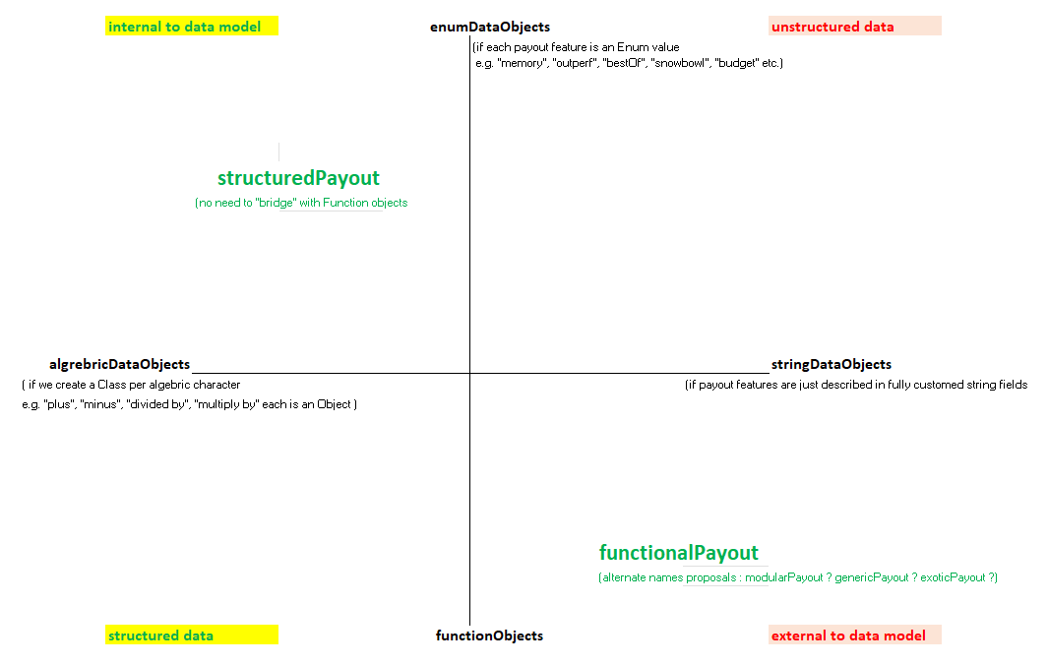
Structured Product – Deliverables
Methodological Deliverables n°3
method “how to model” the features of Structured Products, cf payout formula - “how to represent algebric characters in CDM ?”
axis of the typology are defined with
4 cardinal directions,
each an “extreme solution” i.e. asymptotic theoretical solution
Proposal for the Working Group
is to retain 2 modelling methods:
1st as the Core Work
with deliverables calendar, etc.
structuredPayout
2nd as an Extra Work
if opportunistic ideas/momentum, etc.
functionalPayout

Slide 5
Structured Product – Roadmap Priorities = Products + related CDM objects refactoring
Methodological Deliverables n°4
Scope of concrete Structured Products in terms of roadmap priorities e.g. Autocallable first (single/basket, cash/physicall) ?
“Autocallable” : what does that mean, actually ?
per se = the word refers to a Knock-Out feature at Trade level which means ther is an “existence condition” that would automatically early terminating the whole trade position if the related trigger conditions are met
practically for OTC trades = a family of Structured Products
with these 4 core features : Autocallable + Knock-In Put + Coupon + Financing
plus optionally, modular features e.g. most popular below (non-exhaustive list) :
Autocallable : KO triggerLevel may be unique or multiple
Put KI trigger may be EUR-Style or US-Style and with LockIn effect or not
Coupon : may be “guaranteed” or “conditional” (i.e. with KI conditions) and/or with “memory” conditions, etc.
Underliers and settlementType features may also be considered as well : single/basket (worstOf), cash/physical, etc.
Proposal in terms of Roadmap is 1st Product to deliver :
singleStock, cashSettled, straight Coupon (basic… either guaranteed or with knockCondition, but with no “memory”)
Methodological Deliverables n°5
method “how to challenge” our proposals in terms of Final Deliverables with regards to concrete Structured Products ?
Any project contributor with an access to potential source ?
What about SIX-Exchange where termsheets may be accessed for free ?
Other ideas ?
Copyright © 2022 by International Swaps and Derivatives Association, Inc.

Slide 6
Deliverables
Refactoring of :
coreWork : Observable, Knock, capFloor, Multiplier, performancePayout, earlyTermination
extraWork : optionPayout (if we create the bridge), functionalPayout (is that necessary ?)

Slide 7
Structured Products – coreWork Problem Statement is modelling the Payout Amount
Discussion about this Problem Statement will lead us to the set of objects we propose to refactor as part of the coreWork for the group
Further specifying terms involved in Payout Amount definition leads to problem statement :
Payout Amount = Payout Quantity (PQ) x Payout Formula (PF)
per se = either payable cash amount or deliverable assets (depending on settlementType and perUnitEnum involved)
example n°1 (cash amount) = number of options (PQ) x optionPayout (PF, say Call = max [0; K-S])
example n°2 (cash amount) = nominal amount (PQ) x performancePayout (PF, say priceReturn = currentPrice/previousPrice – 1)
Payout Quantity
per se = a quantitative value with units, which business purpose is to represent the size of P&L exposure of the Trade
practically for OTC trades = depending on the product e.g. usual practice : number of units for optionPayout, nominal amount for swaps with performancePayout (though an OTC representation of a trade is natively agnostic to units)
CDM representation = OK, there is a proper “payoutQuantity” object in CDM, attached to each Payout leg
Payout Formula
per se = mathematical function = description how to aggregate inputs (1..*), in order to return it as an output (1..1)
practically for OTC trades = such mathematical function which description terms are defined in OTC Trade terms
CDM representation = either OK (“xxxPayout” exists) or KO (no “payoutFormula” exists hence Problem Statement)
WHEN the related formula is designated by a CDM class object with a kind of name such as “xxxPayout” e.g. “optionPayout”, “interestRatePayout”, “performancePayout” meaning implicitly “as per Legacy ISDA Documentation”
ELSE “problem statement”
because no “payoutFormula” object exists for modelling any “xxxPayout” beyond current ISDA documentation scope
Copyright © 2022 by International Swaps and Derivatives Association, Inc.

Slide 8
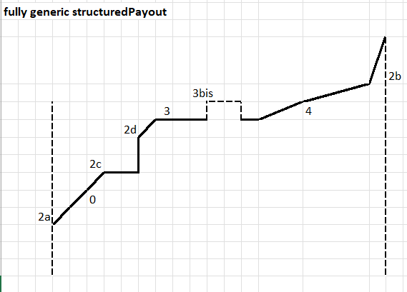
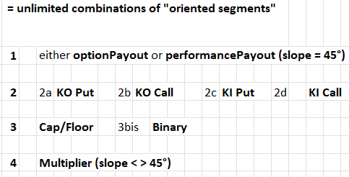
Structured Product – “structuredReturn” is the modelling of a generic “broken-line” payout
Broken-Line Payout
Horizontal axis : Observable value
i.e. any quantitative data, gross or calculated, on Observed Date/Time
Vertical axis : Payout Amount value
i.e. per 1 unit of the Payout Quantity x Payout Formula (Observable)
resulting Graph = “oriented segments” in series = “broken-line”
Functional components
When synthetic representation is used for booking
Then modelling is any kinds of options strategy/combination :
= optionPayout (1..*)
Else explicit representation is used for booking
Then core modelling
= structuredPayout (1..1)
= performancePayout (1..*) + basicStructuredTerms (1..1)
= performancePayout (1..*) + knock (0..*) + capFloor (0..*) + multiplier (0..*)
And extended modelling
= core modeling + structuredReturn (0..1)
Copyright © 2022 by International Swaps and Derivatives Association, Inc.

Slide 9
Structured Product – benefits of the “bridge” between “structuredReturn” and “optionPayout”
Background : compare options which payout exposure is defined in Quantity Units vs, Nominal Amount
WHEN exposure = Quantity Units (perUnit <> currency) e.g. number of options
THEN options payout amount = Quantity x max (0 ; StrikeDifferential)
where StrikeDifferential is an amount of money (perUnit = currency) made of strikePrice vs. observablePrice
and either StrikeDifferential = Strike – Observable, then the optionType is a Put
else = Observable – Strike, then the optionType is a Call
WHEN exposure = Nominal Amount (perUnit = currency)
THEN options payout amount = Nominal Amount x max (0 ; performanceReturn)
where performanceReturn is a rate in % (perUnit <> currency) made of strikeReturn vs. observableReturn
and either performanceReturn = Strike – Return, then it is “bearish” thus would equal to a Put if associated with a floor@0
else = Return – Strike, then it is “bullish” thus would equal to a Call if associated with a floor@0
How to apply the “bridge” for standard cases i.e. when Strike = 100% observablePrice
Put = Quantity x Strike / Strike x [max (0 ; Strike – Observable)
= Quantity x Strike x [max (0 ; Strike/Strike – Observable/Strike)
= Nominal Amount x [max (0 ; 100% – Return)
Call = Quantity x Strike / Strike x [max (0 ; Observable – Strike) ; here performanceReturn = priceReturn as per ISDA Standard
= Quantity x Strike x [max (0 ; Observable/Strike – Strike/Strike)
= Nominal Amount x [max (0 ; Return – 100%)
info : here “Return – 100%” is actually the vanilla case referred to as “priceReturn” as per ISDA standard documentation
Copyright © 2022 by International Swaps and Derivatives Association, Inc.

Slide 10
drafts, appendix, etc.

Slide 11
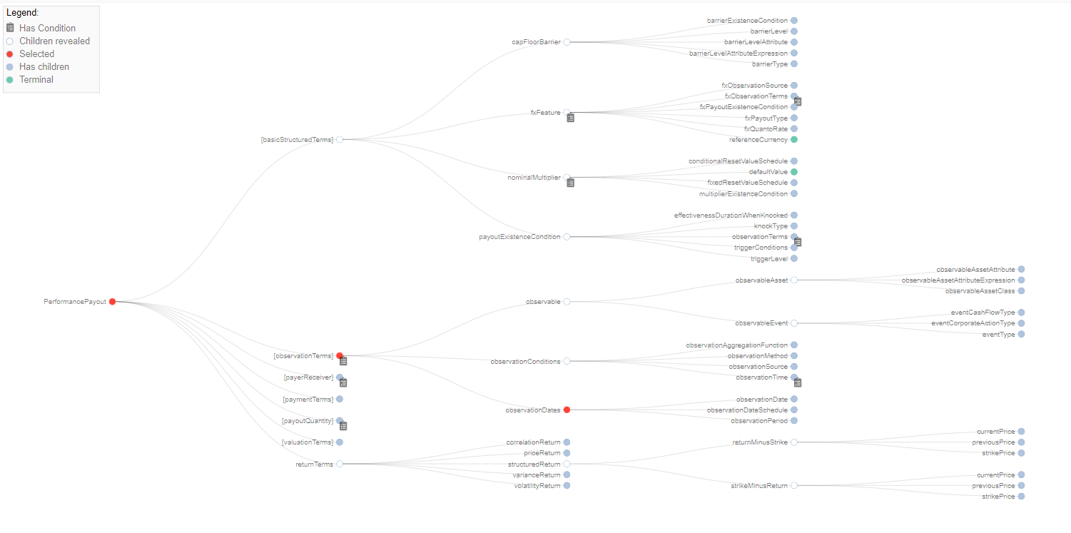
Structured Product – ROADMAP in terms of Object Refactoring Sets
Core Work
core modelling
= structuredPayout (1..1)
= performancePayout (1..*)
+ knock (0..*) + capFloor (0..*) + multiplier (0..*)
extended modelling
= core modeling + structuredReturn (0..1)
1st Refactoring Set :
Observation Terms
Knock
Product Familly coverage (examples)
= …. To draft/JB
2nd Refactoring Set :
structuredReturn (new object but re-using 1st Refactoring Set)
Product Familly coverage (examples)
= …. To draft/JB
3rd Set is Creation &/or “heavy refactoring”
New objects in Trade templates
New objects in Event templates
Need to have “bridges” between Data and Functional models
Smart Contract topic at stake (legal impact ?)
Extra Work
= functionalPayout (1..*)
Copyright © 2022 by International Swaps and Derivatives Association, Inc.

Slide 12
Structured Product – CDM modelling interpretation assumptions
Hereunder the interpretation rules we assume are acknowledged by any CDM implementor or CDM end-user
“Waterfall Logic” : values at upper level apply by default to lower levels, unless otherwise specified at lower level
Rule :
GIVEN a root path with an Object (hereafter “upperLevelObject”) which may also exist in child paths attached to this root path thus being a repeated Object at lower level than root path level (hereafter “lowerLevelObject”)
WHEN such repeatable Object is absent at lower level, THEN values of upperLevelObject apply
ELSE (such repeatable Object exists at lower level), THEN values of lowerLevelObject apply
Example :
GIVEN root path “economicTerms”
IF economicTerms -> businessDaysAdjustment exists, say with “MODFOLLOWING” value
WHEN economicTerms -> payout -> interestRatePayout -> calculationPeriodDates -> businessDaysAdjustment
THEN such “MODFOLLOWING” value shall apply to economicTerms -> payout -> interestRatePayout -> calculationPeriodDates
UNLESS calculationPeriodDates -> businessDaysAdjustment also exists, which would overwrite it, say with “PRECEDING” value
“Long” Payout Party
per se = the receiverParty who makes profit when calculating the Payout Amount results in a positive number
practically = the Party who would receive a quantity of either payable cash amount or deliverable assets, depending on the product settlementType
Payout Amount = Payout Quantity x Payout Formula
Further details on next slide

Slide 13
Structured Product – features modelling documentation : “how to book [CORRIDOR]”
Problem statement : I want to book this “Corridor” feature
Feature summary :
per se = depending whether an observed value stays (or not) within the range defined by up and down barriers, a particular value is considered as an input (or ignored) with regards to payout calculations
practically for OTC trades =
GIVEN an Observable value e.g. underlier price, being observed daily on a continuous time basis, during the whole trade life period from a startDate (e.g. tradeDate) to an endDate (e.g. valuationDate)
WHEN this value does not exceed neither a capBarrier nor a floorBarrier
THEN this value is taken into account in my payout calculation e.g. say it is the daily closing price that is required as part of the sum of daily log returns that my varianceReturn is referring to
ELSE such value does not exit e.g. would be as if daily log return would equal to 0 as part of the daily sum calculation
Feature modelling :
barrierTypeEnum=FLOOR
barrierLevel=0
barrierExistenceCondition->[…]->triggerLevel =
barrierExistenceCondition->[…]->obervationPeriod = startDate + endDate
example n°1 (cash amount) = number of options (PQ) x optionPayout (PF, say Call = max [0; K-S])
Copyright © 2022 by International Swaps and Derivatives Association, Inc.

