Slide 1
Modelling the impact of climate change on food systems through integrated assessments
Hugo Valin
Ecosystems Services and Management Program, IIASA
valin@iiasa.ac.at

Slide 2
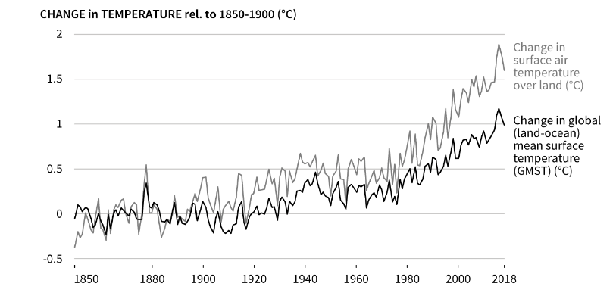
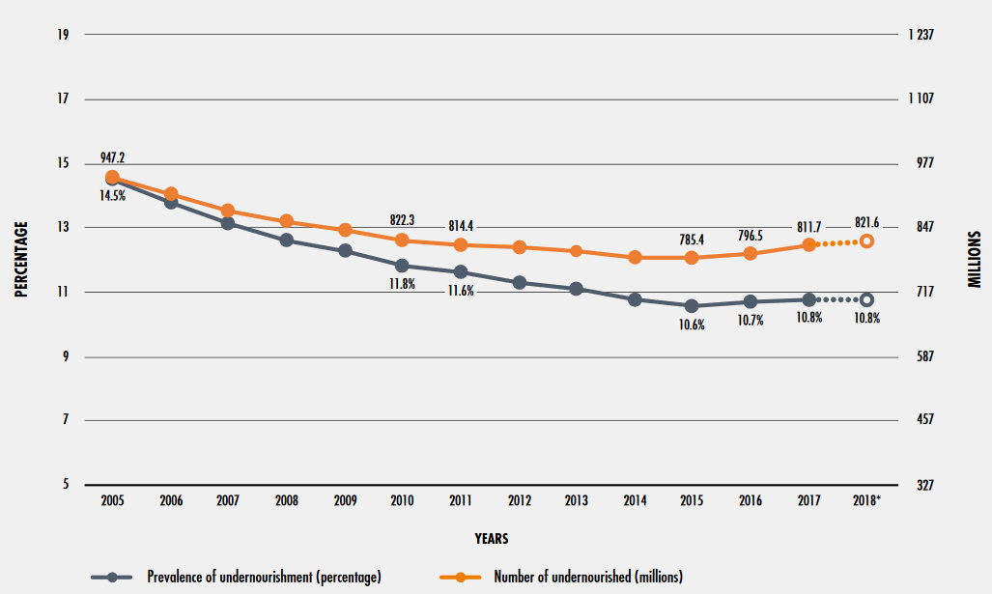
Background
But climate forcing effect is strengthening
Food production growth still outpaces current global population increase…
3 000 Mt cereals
4.1 t/ha
10.2 bn
Source: IPCC, Special report on land, 2019
And affects agriculture productivity…
…in a context of increasing food insecurity
7.8 bn
Estimated impact of climate change on wheat yield (1989-2009)
3.1 bn
Source: FAOSTAT, 2020
Source: Moore and Lobell, PNAS, 2015
Source: FAO, State of Food security and Nutrition, 2019

Slide 3
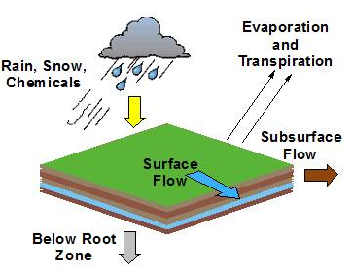
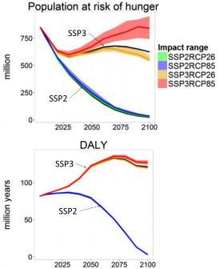
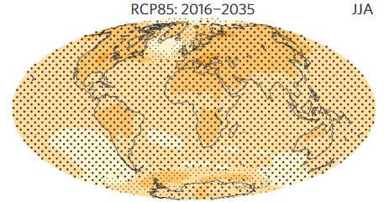
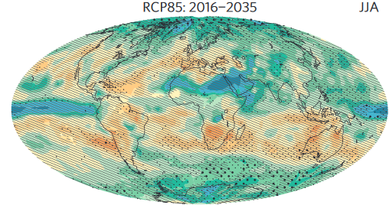
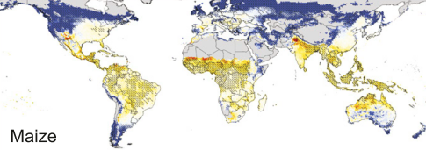
Climate change impact modeling chain for the food system (AgMIP, ISIMIP)
Perturbation
Climate
Biophysical
Economic
Human impacts
Representative concentration pathways
RCPs
General circulation models
Global gridded crop models
GGCMs
∆ Yield ∆ Ferti.
∆ Irrig
Market
equilibrium models
∆ Food
∆ Price
∆ Income
Human impact models
∆ RF
∆ T
∆ Pr
Mortality
Hunger
Health
Poverty …
+
Global land database
Socio-economic pathways (SSPs) (population, GDP, technology)
Source: www.iiasa.ac.at
Source: van Vuuren et al., 2011
Source: Knutti and Sedláček, 2013
Source: Rosenzweig et al., 2014
Source: Valin et al., 2014
Source: Hasegawa et al., 2016

Slide 4
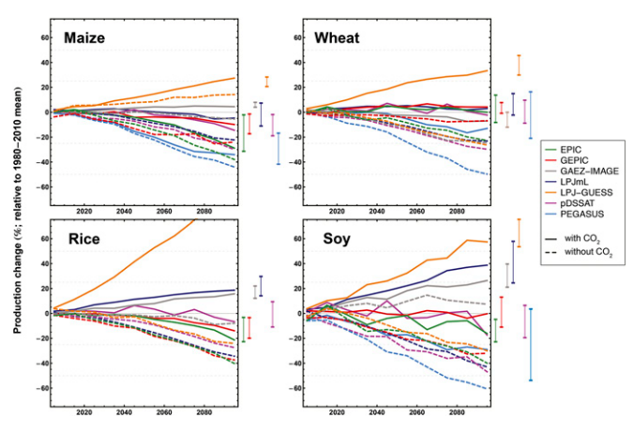
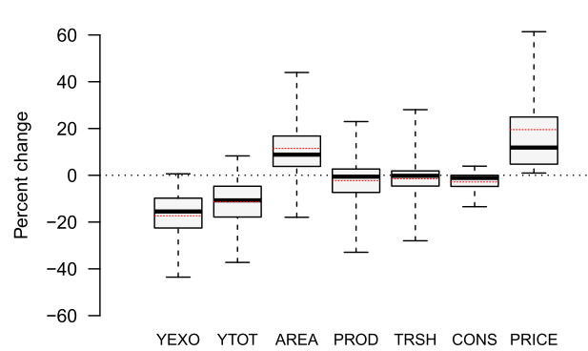
Propagation of shock and uncertainties along the modeling chain
Multiple mechanisms buffer the climate impact uncertainties (GCM, GGCM, CO₂ response) from farm to global level
In crop models: shifting of planting dates, adjustments of inputs
In economic models: through market responses
Crop models yield response for RCP8.5
Economic models response for for RCP8.5 without CO₂ effects
Yield response
Area and reallocation response
Trade and consumption response
Source: Rosenzweig et al., 2014
Source: Nelson et al., 2014

Slide 5
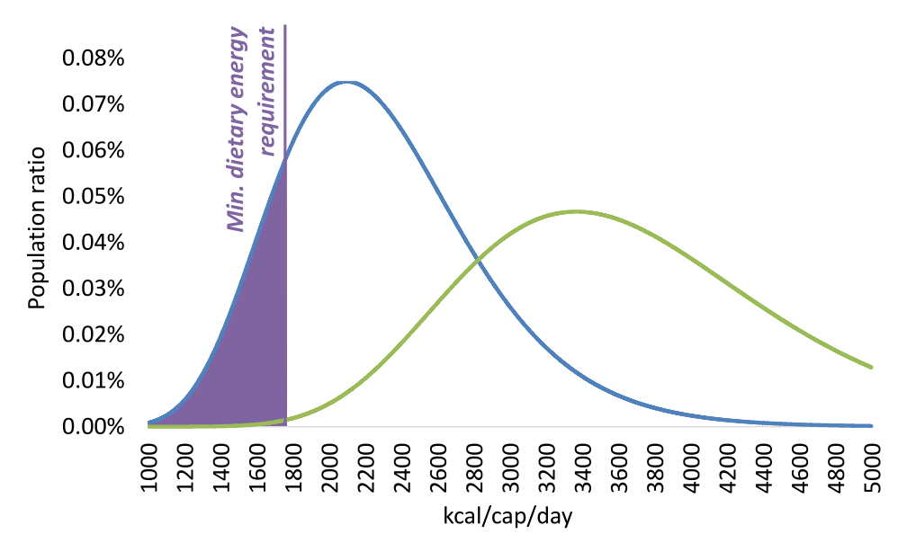
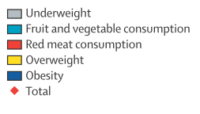
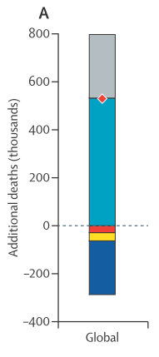
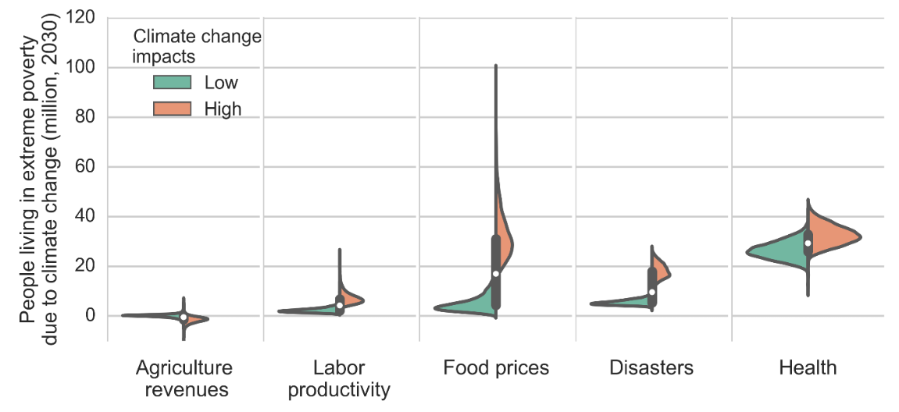
Approaches to food security and health impacts
FAO approach to prevalence of undernourishment
(change in total calories availability)
Mortality risk modelling
(change in total calories and consumption of specific products)
For RCP6.0 with CO₂: 2-56 million at risk of hunger by 2050
Source: Hasegawa et al., 2018
529 000 climate-related deaths globally in 2050 for RCP8.5 without CO₂
Source: Springmann et al., 2016
Source: Hasegawa et al., 2015
Household level modelling
(change in agricultural income and food prices)
Agriculture with high climate impact: 15-75 million at risk of extreme poverty by 2030
Source: Scarborough et al., 2014
Source: Springmann et al., 2016
Source: Hallegatte and Rozenberg, 2017

Slide 6
Current limitations and future research
Integration approach works but many uncertainties to be resolved at all levels of the modelling chain ► model comparison (MIPs) to be pursued and improved
Economic models so far focused on slow-onset average effects ► representation of extreme events impact to be added
Interdependencies across sectors and impacts channels needs to be better considered ► Cross sectoral impacts on water, livestock, fisheries, labor productivity, infrastructure…
Costs and limits to adaptation ► Economic and institutional barriers to better understand to represent adaptation capacity

